Slide 1
C/C++ Program Design
Lab 3 Common Commands
于仕琪，王大兴，廖琪梅

Slide 2
Commands in Linux
Linux is a family of open-source Unix operating systems based on the Linux Kernel.
There are some popular distributions
such as Ubuntu, Fedora, Debian, openSUSE, and Red Hat.
A Linux command is a program or utility that runs on the Command Line Interface – a console that interacts with the system via texts and processes.
Linux command’s general syntax looks like:
CommandName [option(s)] [parameter(s)]
CommandName is the rule that you want to perform.
Option or flag modifies a command’s operation. To invoke it, use hyphens (-) or double hyphens (--).
Parameter or argument specifies any necessary information for the command.

Slide 3
Common commands in Linux
Linux directory and file commands:
Command | Meaning
pwd | Print the name of current/working directory.
cd <directory name> | Change the current directory.
ls | List of content of a directory.
mkdir <directory name> | Make a new directory under any directory.
rmdir <directory name> | Remove directories without files.
cat <file name> | Display content of the file.
rm <file name> | Remove a file.
cp <source> <dest> | Copy a file or files to another
mv<source><dest> | Move a file or files to another directory
https://www.javatpoint.com/linux-commands

Slide 4

pwd command
Use the pwd command to display the current working directory you are in.
Start Ubuntu, you will see:
$ or # is the prompt, you can type command now.
The current directory

Slide 5
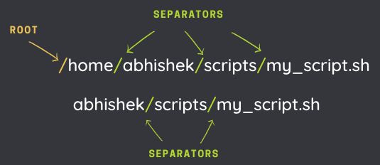
Absolute path and relative path
A path is how you refer to files and directories. It gives the location of a file or directory in the Linux directory structure. It is composed of a name and slash syntax.
If the path starts with slash "/", the first slash denotes root. The rest of the slashes in the path are just separators.
The absolute path always starts from the root directory (/).
A relative path starts from the current directory.
Two special relative paths:
. ( single dot) denotes the current directory in the path.
.. (two dots) denotes the parent directory, i.e., one level above.

Slide 6
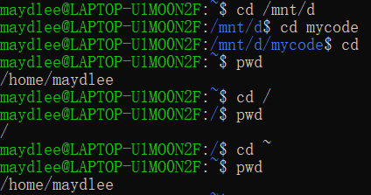
cd command
To navigate through the Linux files and directories, use the cd command.
change the directory to the root directory of d drive
change the directory to the home directory
change the directory to the root directory
change the directory to the home directory
Here are some shortcuts to help you navigate:
cd ~[username] goes to another user’s home directory.
cd .. moves one directory up.
cd - moves to your previous directory.
cd without an option will take you to the home folder.

Slide 7
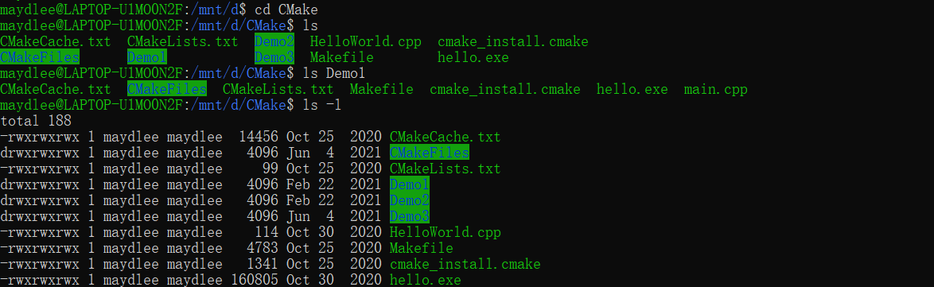
ls command
The ls command lists files and directories within a system. Running it without a flag or parameter will show the current working directory’s content.
List subdirectory and files in the current directory
List subdirectory and files in the Demo1 directory
List detail information of subdirectory and files in the current directory
Here are some options you can use with the ls command:
ls -R lists all the files in the subdirectories.
ls -a shows hidden files in addition to the visible ones.
ls -l (or ll) shows detail information of subdirectory and files

Slide 8
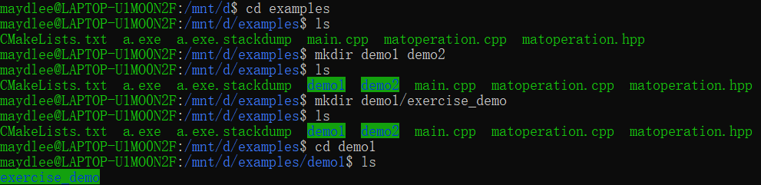
mkdir command
Use the mkdir command to create one or multiple directories at once.
Create two subdirectories in the current directory
Create a subdirectory inside the demo1 directory

Slide 9
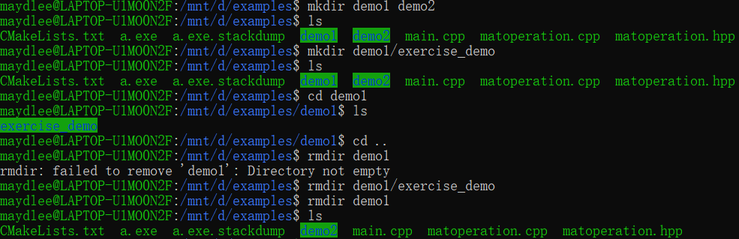
rmdir command
Use the rmdir command to permanently delete an empty directory.
Delete demo1 in the current directory
First delete the directory in demo1,
then delete demo1

Slide 10
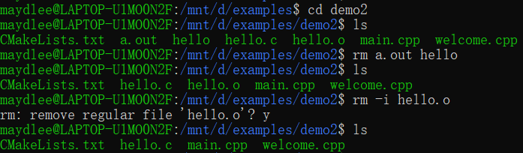

rm command
The rm command is used to delete files within a directory. Make sure that the user performing this command has write permissions.
Delete two files without confirmation
Delete a file with confirmation
Delete all the files in demo2
Here are some acceptable options you can add:
-i prompts system confirmation before deleting a file.
-f allows the system to remove without a confirmation.
-r deletes files and directories recursively.

Slide 11
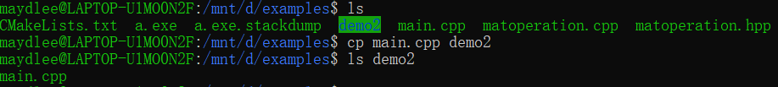
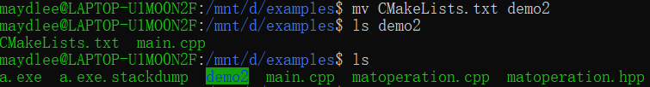
cp command and mv command
The cp command is used to copy a file or directory.
Copy a file into demo2
The mv command is used to move a file or a directory form one location to another location.
Move a file into demo2
The CMakeLists.txt is not in the examples directory because it is moved into demo2.
Use mv command to rename a file

Slide 12
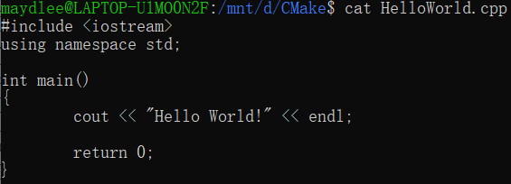
cat command
Concatenate, or cat, is one of the most frequently used Linux commands. It lists, combines, and writes file content to the standard output. To run the cat command, type cat followed by the file name and its extension.
Here are other ways to use the cat command:
cat > filename.txt creates a new file.
cat filename1.txt filename2.txt > filename3.txt merges filename1.txt and filename2.txt and stores the output in filename3.txt.
tac filename.txt displays content in reverse order.

Slide 13
Some other commands
cat/tail/head
less/more
nano/vim
file
where
echo

Slide 14

Shortcut keys
Up and down arrow keys can list the commands you typed.
Tab key can complete the command. For a long command, you can type first few letters and press Tab key to complete the command or list alternate commands.
Type the first few letters of a command,
and then press Tab key. If there is completion,
press Tab key again, it will list the alternate
commands.
clear is a standard Unix computer operating system command that is used to clear the terminal screen.

Slide 15
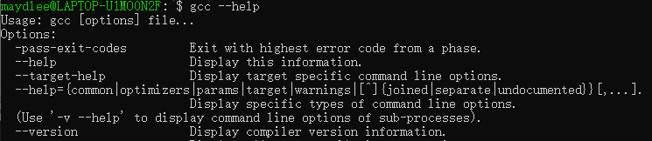
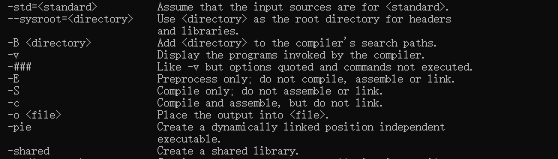
gcc & g++
gcc and g++ are GNU C or C++ compilers respectively, which issued for preprocessing,
compilation, assembly and linking of source code to generate an executable file.
Type command gcc or g++ --help, you can get the common options of the gcc or g++. g++ accepts
mostly the same options as gcc.

Slide 16
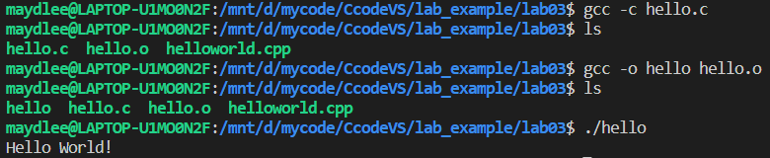
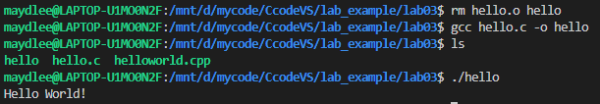
gcc & g++
-c Compile or assemble the source files, but do not link. The ultimate output is in the form of an object file
for each source file. The object file name for a source file is made by replacing the suffix .c with .o.
-o <file> Place output in file file. This applies regardless to whatever sort of output is being produced,
whether it be an executable file, an object file, an assembler file or preprocessed C code.
If -o is not specified, the default is to put an executable file in a.out.
gcc source_file.c -o program_name or gcc source_file.o -o program_name
compile
link
#include <stdio.h>
int main()
{
printf("Hello World!\n");
return 0;
}
run
compile and
link
run

Slide 17

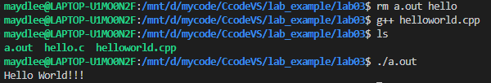
gcc & g++
With one step to generate an executable target file:
gcc file_name or g++ file_name
This command is used to compile and create an executable file a.out (default target name).
#include <iostream>
using namespace std;
int main()
{
cout << "Hello World!!!" << endl;
return 0;
}

Slide 18
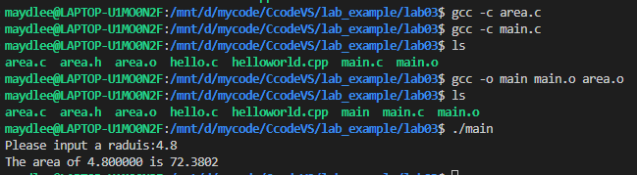

gcc & g++
compile multiple files
You can compile the files one by one and then link them to an executable file.
Another choice is using one step to list all the .c(or .cpp) files after gcc(or g++) command and create an executable file named a.out.
//area.h
#define PI 3.1415
double compute_area(double r);
//main.c
#include <stdio.h>
#include "area.h"
int main()
{
double r,area;
printf("Please input a raduis:");
scanf("%lf", &r);
area = compute_area(r);
printf("The area of %lf is %.4lf\n", r, area);
return 0;
}
//area.c
#include "area.h"
double compute_area(double r)
{
return PI * r * r;
}

Slide 19
1. Demonstrate two Linux commends which are introduced previously and randomly selected by the SA for creating a directory, changing to another directory, listing the subdirectories and files in a certain directory, removing files, copying and moving files.
Exercises

Slide 20
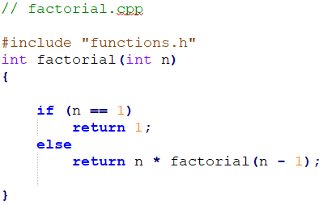
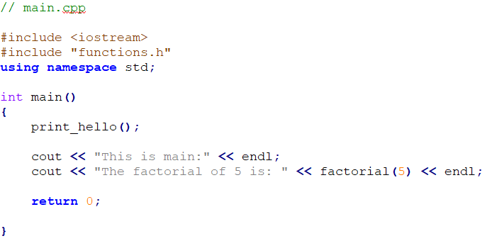
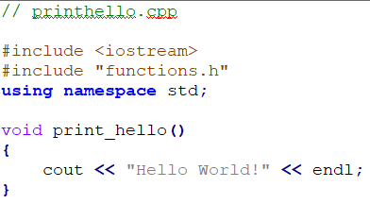

Exercises
2. Compile the 3 source files one by one using "g++ -c”, then link the generated object files together to generate an execute file.
Demonstrate to a SA to pass the test.

Slide 21
Exercises
3. Run the following source code and explain the result.
You need to explain the reason to a SA to pass the test.
#include <iostream>
using namespace std;
int main()
{
for(size_t n = 2; n >= 0; n--)
cout << "n = " << n << " ";
return 0;
}

Slide 22
Exercises
4. Run the following source code and explain the result.
You need to explain the reason to a SA to pass the test.
#include <iostream>
using namespace std;
int main()
{
int n = 5;
int sum;
while(n >0){
sum += n;
cout << "n = " << n << " ";
cout << "sum = " << sum << " ";
}
return 0;
}

Slide 23
Exercises
5. Run the following source code and explain the result.
You need to explain the reason to a SA to pass the test.
#include <iostream>
using namespace std;
int main()
{
int n,fa;
do{
fa *= n;
n++;
}while(n <= 10);
cout << "fa = " << fa << endl;
return 0;
}

