Slide 1
C/C++ Program Design
Lab 4, Makefile
廖琪梅, 王大兴, 于仕琪

Slide 2
Makefile
What is a Makefile?
Makefile is a tool to simplify and organize compilation. Makefile is a set of commands with variable names and targets . You can compile your project(program) or only compile the update files in the project by using Makefile.

Slide 3
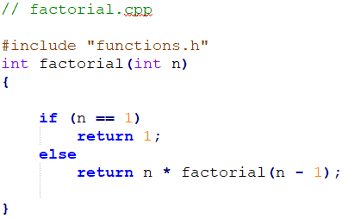
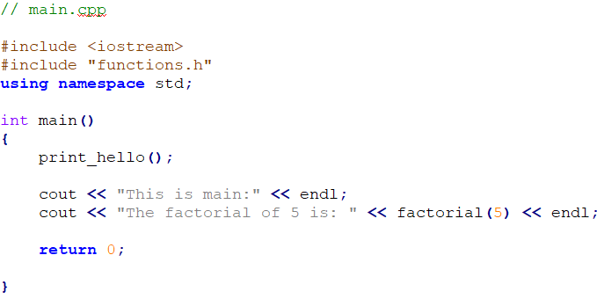
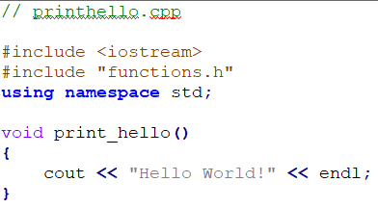

Suppose we have four source files as follows:
Normally, you can compile these files by the following
command:

Slide 4
How about if there are hundreds of files to compile? Do you think it is
comfortable to write g++ or gcc compilation command by mentioning all
these hundreds file names? Now you can choose makefile.
The name of makefile must be either makefile or Makefile without extension.
You can write makefile in any text editor. A rule of makefile including three
elements: targets, prerequisites and commands. There are many rules in the
makefile.

Slide 5
A makefile consists of a set of rules. A rule including three elements: target,
prerequisites and commands.
targets : prerequisites
<TAB> command
The target is an object file, which is generated by a program.
Typically, there is only one per rule.
The prerequisites are file names, separated by spaces, as input to create the target.
The commands are a series of steps that make carries out.
These need to start with a tab character, not spaces.

Slide 6
comments begin with #
prerequisites
target
Put the
makefile
together
with your
programs.
commands
g++ is compiler name, -o is linker flag and hello is binary file name.

Slide 7
Type the command make in VScode
If you don’t install make in VScode, install it first according to the instruction.
Run the commands in the makefile automatically.
Run your program
output

Slide 8
Defining Macros/Variables in the makefile
To improve the efficiency of the makefile, we use variables.
variables
Write target, prerequisite and commands by variables using ‘$()’

Slide 9
If only one source file is modified, we need not compile all the files. So, let’s
modify the makefile.
If main.cpp is modified, it is compiled
by make.
targets

Slide 10
All the .cpp files are compiled to the .o files, so we can modify the makefile like this:
$@: Object Files
$^: all the prerequisites files
$<: the first prerequisite file
This is a model rule, which indicates that all the .o objects depend on the .cpp files

Slide 11
Using phony target to clean up compiled results automatically
Because clean is a label not a target, the command make clean can execute the clean part. Only make command can not execute clean part.
Adding .PHONY to a target will prevent making from confusing the phony target with a file name.

Slide 12
Functions in makefile
Search all the .cpp files in the current directory, and return to SRC
wildcard: search file
for example:
SRC = $(wildcard ./*.cpp)
All .cpp files in the current directory

Slide 13
patsubst(pattern substitution): replace file
$(patsubst original pattern, target pattern, file list)
Replace all .cpp files with .o files
for example:
OBJ = $(patsubst %.cpp, %.o, $(SRC))
Replace all .cpp files with .o files

Slide 14
All .h files are in inc
All .cpp files are in src
-I means search file(s) in the specified folder i.e. inc folder
GNU Make Manual
http://www.gnu.org/software/make/manual/make.html

Slide 15
Keyboard input and terminal output of string
1. C: scanf & printf
%d ----int
%f ----float
%c -----char
%s -----string
Why only
Computer?
scanf uses whitespace—spaces, tabs, and newlines to separate a string.

Slide 16
2. C: gets & puts
There is a warning due to using gets().
You can use fgets() function instead.
Use gets to gain a sentence with a space. gets() stops reading input when it encounters a newline or end of file.

Slide 17
3. C++: cin & cout
The cin is to use whitespace-- spaces, tabs, and newlines to separate a string.

Slide 18
4. C++: cin.getline( ) & cin.get( )

Slide 19
4. C++: cin.getline( ) & cin.get( )
If the length of input string is greater than 20,
it can only store first 19 characters in str.

Slide 20
4. C++: cin.getline( ) & cin.get( )
getline() and get() both read an entire
input line—that is, up until a newline
character. However, getline() discard
the newline character, whereas get()
leave it in the input queue.
Program runs
without entering
another string

Slide 22
C++ string using string data type
getline() function takes the input
stream as the first parameter which
is cin and str as the location of the
line to be stored.

Slide 23
Exercise 1
#include <iostream>
#include <string.h>
using namespace std;
int main()
{
int cards[4]{};
int hands[4];
int price[] = {2.8,3.7,5,9};
char direction[4] {'L',82,'U',68};
char title[] = "ChartGPT is an awesome tool.";
cout << "sizeof(cards) = " << sizeof(cards) << ",sizeof of cards[0] = " << sizeof(cards[0]) << endl; cout << "sizeof(price) = " << sizeof(price) << ",sizeof of price[0] = " << sizeof(price[1]) << endl; cout << "sizeof(direction) = " << sizeof(direction) << ",length of direction = " << strlen(direction) << endl; cout << "sizeof(title) = " << sizeof(title) << ",length of title = " << strlen(title) << endl;
//Print the value and address of each element in cards and hands respectively.
…….
return 0;
}
First, complete the code, then run the program and explain the result to SA. If it has bugs, fix them.

Slide 24
Exercise 2
#include <stdio.h>
union data{
int n;
char ch;
short m;
};
int main()
{
union data a;
printf("%d, %d\n", sizeof(a), sizeof(union data) );
a.n = 0x40;
printf("%X, %c, %hX\n", a.n, a.ch, a.m);
a.ch = '9';
printf("%X, %c, %hX\n", a.n, a.ch, a.m);
a.m = 0x2059;
printf("%X, %c, %hX\n", a.n, a.ch, a.m);
a.n = 0x3E25AD54;
printf("%X, %c, %hX\n", a.n, a.ch, a.m);
return 0;
}
Run the program and explain the result to SA. You can write a program to check whether you system is little-endian or big-endian.

Slide 25
Exercise 3
Design a struct “DayInfo” which contains two enumeration types as its member. The first is an enum “Day” for (Sunday, Monday, ...), and the second is an enum “Weather” for (Sunny, Rainy, ...).
Define a boolean function “bool canTravel( DayInfo )” . It will return true if the day is at weekend and the weather is good.
Call function canTravel() in main().

Slide 26
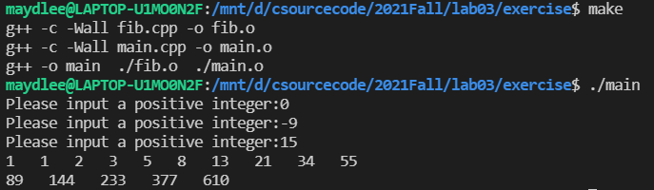
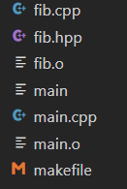
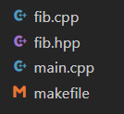
The Fibonacci numbers are : 1,1,2,3,5,8……. Please define a function in fib.cpp to compute the nth Fibonacci number. In main.cpp, prompts the user to input an integer n, then print Fibonacci numbers from 1 to n, 10 numbers per line. Write a makefile to manage the source files.
Exercise 4
Before clean:
After clean:

