Slide 1
C/C++ Program Design
Lab 6, static library
廖琪梅，王大兴

Slide 2
Static library and Dynamic library
Static Linking and Static Libraries (also known as an archive) is the result of the linker making copy of all used library functions to the executable file. Static Linking creates larger binary files, and need more space on disk and main memory. Examples of static libraries are, .a files in Linux and .lib files in Windows.
Dynamic linking and Dynamic Libraries Dynamic Linking doesn’t require the code to be copied, it is done by just placing name of the library in the binary file. The actual linking happens when the program is run, when both the binary file and the library are in memory. If multiple programs in the system link to the same dynamic link library, they all reference the library. Therefore, this library is shared by multiple programs and is called a "shared library" . Examples of Dynamic libraries are, .so in Linux and .dll in Windows.

Slide 3
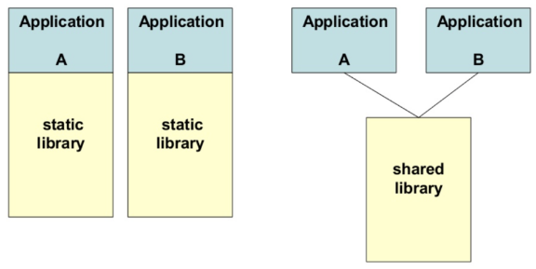
 | advantages | disadvantages
Static Library | 1. Make the executable has fewer dependencies, has been packaged into the executable file. 2. The link is completed in the compilation stage, and the code is loaded quickly during execution. | 1. Make the executable file larger. 2. Being a library dependent on another library will result in redundant copies because it must be packaged with the target file. 3. Upgrade is not convenient and easy. The entire executable needs to be replaced and recompiled.
Dynamic Library | 1.Dynamic library can achieve resource sharing between processes, there can be only one library file. 2. The upgrade procedure is simple, do not need to recompile. | 1. Loading during runtime will slow down the execution speed of code. 2. Add program dependencies that must be accompanied by an executable file.

Slide 4
Building a static library
Suppose we have written the following code:
// mymath.cpp
#include <iostream>
#include "mymath.h"
float arraySum(const float *array, size_t size)
{
if(array == NULL)
{
std::cerr << "NULL pointer!" << std::endl;
return 0.0f;
}
float sum = 0.0f;
for(size_t i = 0; i < size; i++)
sum += array[i];
return sum;
}
// mymath.h
#ifndef __MY_MATH_H__
#define __MY_MATH_H__
float arraySum(const float *array, size_t size);
#endif

Slide 5
// main.cpp
#include <iostream>
#include "mymath.h"
int main()
{
float arr1[8]{1.f, 2.f, 3.f, 4.f, 5.f, 6.f, 7.f, 8.f};
float * arr2 = NULL;
float sum1 = arraySum(arr1, 8);
float sum2 = arraySum(arr2, 8);
std::cout << "The result1 is " << sum1 << std::endl;
std::cout << "The result2 is " << sum2 << std::endl;
return 0;
}

Slide 6
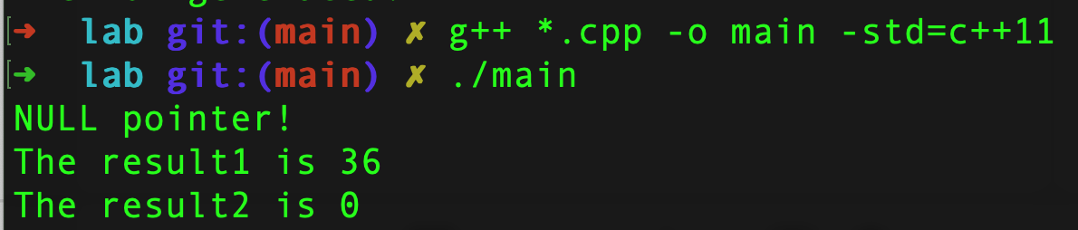
Building a static library
In previous class we do the following:
This will compile the “main.cpp” and “mymath.cpp” into “main”
And then run “main”

Slide 7
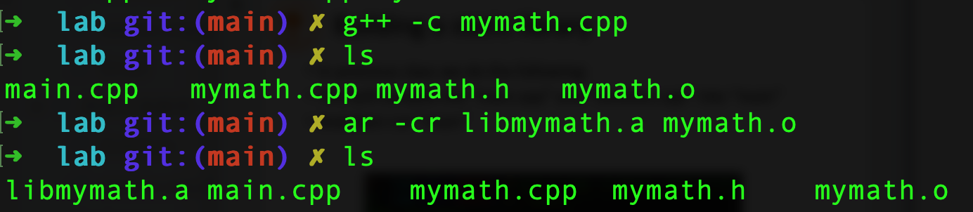
Building a static library
A static library is created by .o file.
Remember to use “ar” command with arguments “-cr” when building it.
Now we should see “libmymath.a” in the current directory
The name of .a must be started with “lib” followed by the .cpp name in which a function is defined.
Compile the source file to the object file.
c: create a static libray.
r: add the object file to the static library.
ar is a linux command.

Slide 8
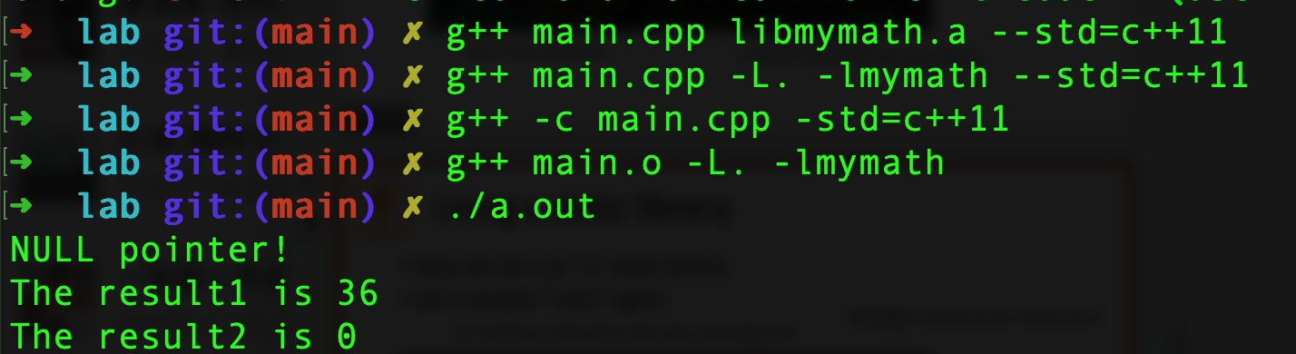
Using a static library
Now we can use “.a” static library.
Let’s compile “main” again:
“-lmymath” indicates to use “libmymath.a” or “libmymath.so”
“-L.” indicates to find a library file in the current directory.
The 3 methods
are equivalent.
-L: indicates the directory of libraries
-l: indicates the library name, the compiler can give the “lib” prefix to the library name and follows with .a as extension name.

Slide 9
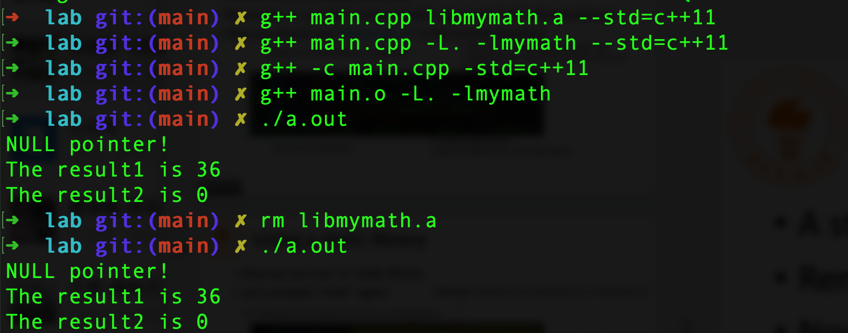
Using a static library
If the static library is removed, the program can run normally.
remove the static library file.
To create a static library from multiple object files:
ar –cr libtest.a test1.o test2.o

Slide 10
Exercise 1
#include <iostream>
using namespace std;
#define SIZE 5
int main()
{
int const *pa = new int[SIZE]{3,5,8,2,6};
int total = sum(pa,SIZE);
cout << "sum = " << total << endl;
return 0;
}
int sum(const int *pArray, int n)
{
int s = 0;
for(int i = 0; i < n; i++)
s += pArray[i];
return s;
}
Fix bugs of the program and run it correctly
without memory leak.
Note: In a function with pointer parameters, the pointers should be checked first. If there is no such statement, please add it.

Slide 11
Exercise 2
#include <iostream>
using namespace std;
int * create_array(int size)
{
int arr[size];
for(int i = 0; i < size; i++)
arr[i] = i * 10;
return arr;
}
int main()
{
int len = 16;
int *ptr = create_array(len);
for(int i = 0; i < len; i++)
cout << ptr[i] << " ";
return 0;
}
What compilation warnings occur when
you compile the program? Why?
What will happen if you ignore the warning
and run the program?
Fix bugs of the program and run it correctly
without memory leak.

Slide 12
Exercise 3
#include <iostream>
#define SIZE 5
void sum(const int *, const int *, int);
int main()
{
int a[SIZE] = {10,20,30,40,50};
int b[SIZE] = {1,2,3,4,5};
std::cout << "Before calling the function, the contents of a are:" << std::endl;
for(int i = 0; i < SIZE; i++)
std::cout << a[i] << " ";
// passing arrays to function
sum(a,b,SIZE);
std::cout << "\nAfter calling the function, the contents of a are:" << std::endl;
for(int i = 0; i < SIZE; i++)
std::cout << a[i] << " ";
std::cout << std::endl;
return 0;
}
void sum(const int *pa, const int *pb, int n)
{
for(int i = 0; i < n; i++)
{
*pa += *pb;
pa++;
pb++;
}
}
Can the program be run correctly?
How to fix the bugs?

Slide 13
Exercise 4
Define a function that swaps two values of integers. Write a test program to call the function and display the result.
You are required to compile the function into a static library “libswap.a”, and then compile and run your program with this static library.

