Slide 1
C/C++ Program Design
Lab 8, SIMD and OpenMP
于仕琪

Slide 2

Intel Intrinsics

Slide 3

SIMD@Intel
MMX: 1997, 8 registers, 64 bits,
SSE (Streaming SIMD Extensions): 1999, 128 bits
SSE2: 2000
SSE3: 2004
SSSE3: 2006
SSE4.1: 2006
SSE4.2
AVX (Advanced Vector Extensions): 2011, 256 bits
AVX2: 2013
AVX-512: 2016

Slide 4
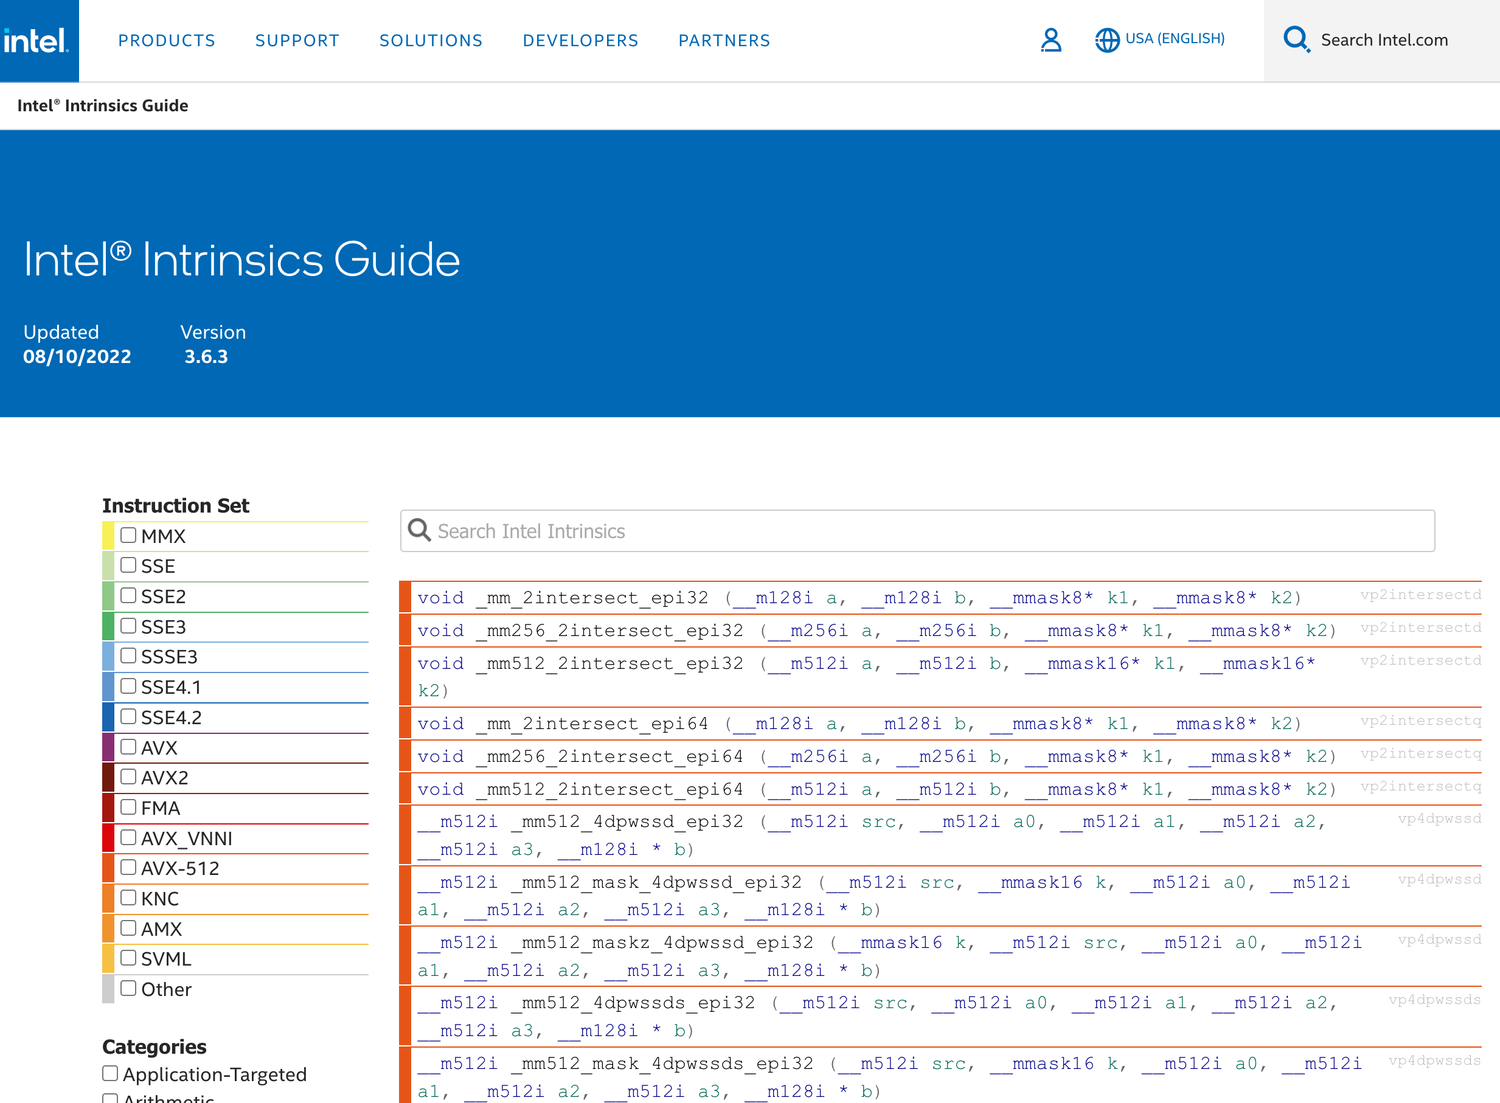
Intel® Intrinsics Guide
https://www.intel.com/content/www/us/en/docs/intrinsics-guide/index.html

Slide 5
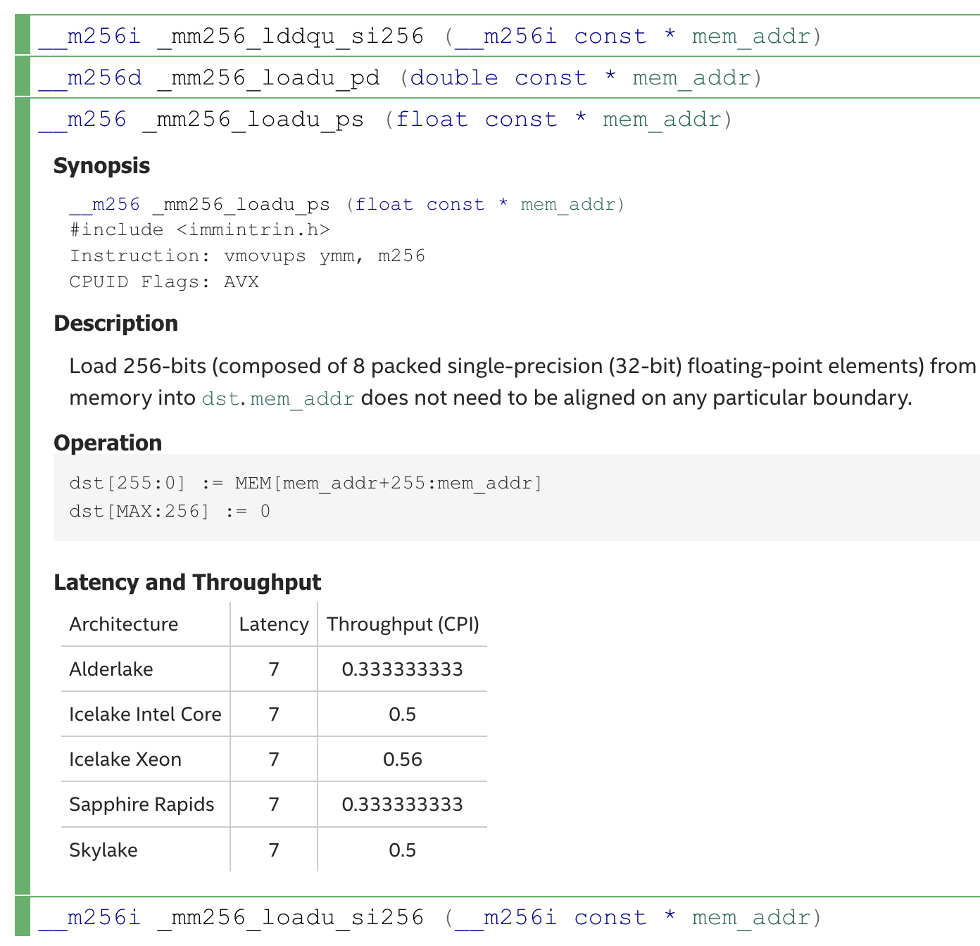
Load data from memory to registers
float * p = ...;
__m256 a;
a = _mm256_loadu_ps(p);

Slide 6
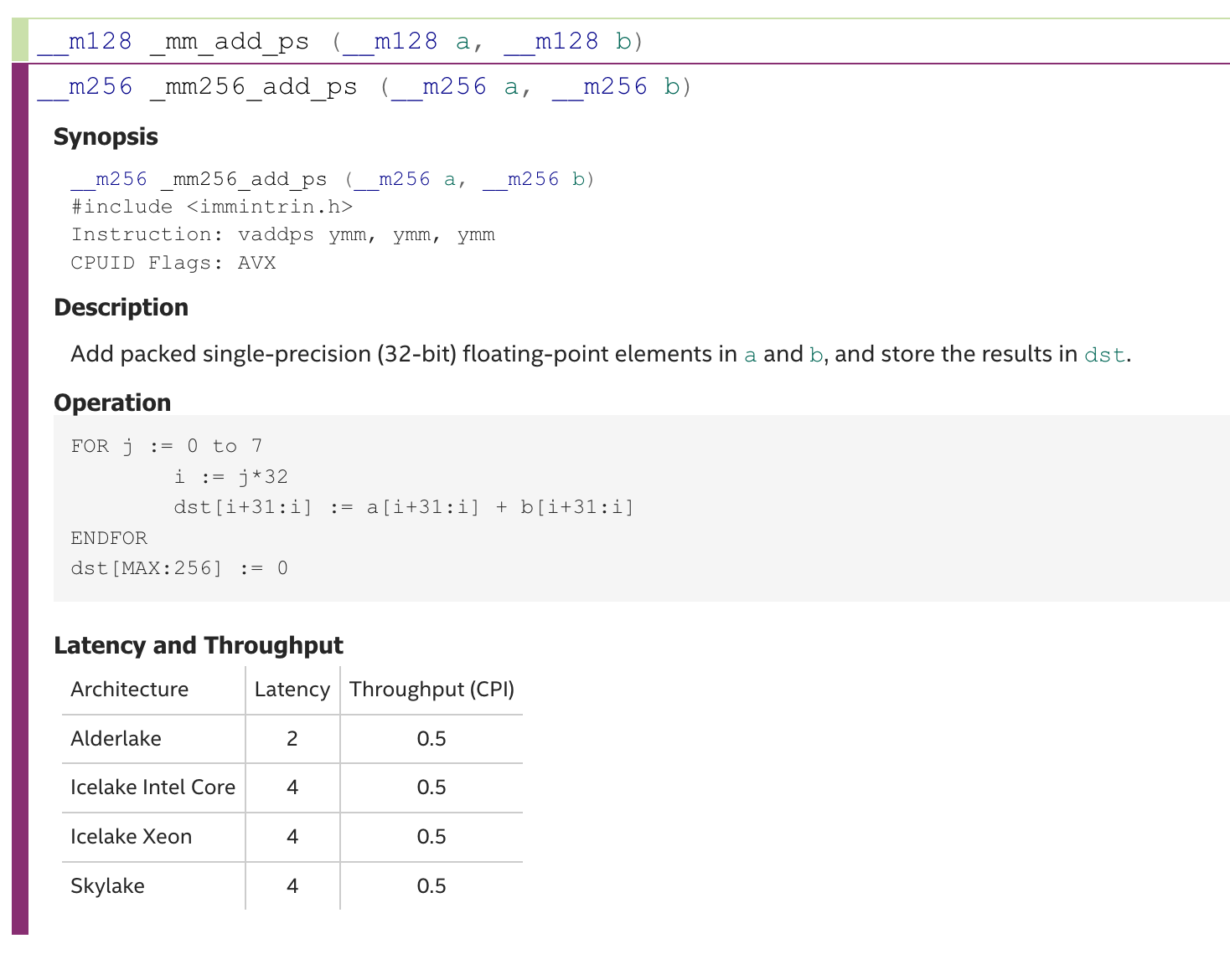
Add operation
__m256 a, b, c;
a = _mm256_loadu_ps(p1 + i);
b = _mm256_loadu_ps(p2 + i);
c = _mm256_add_ps(a, b);

Slide 7
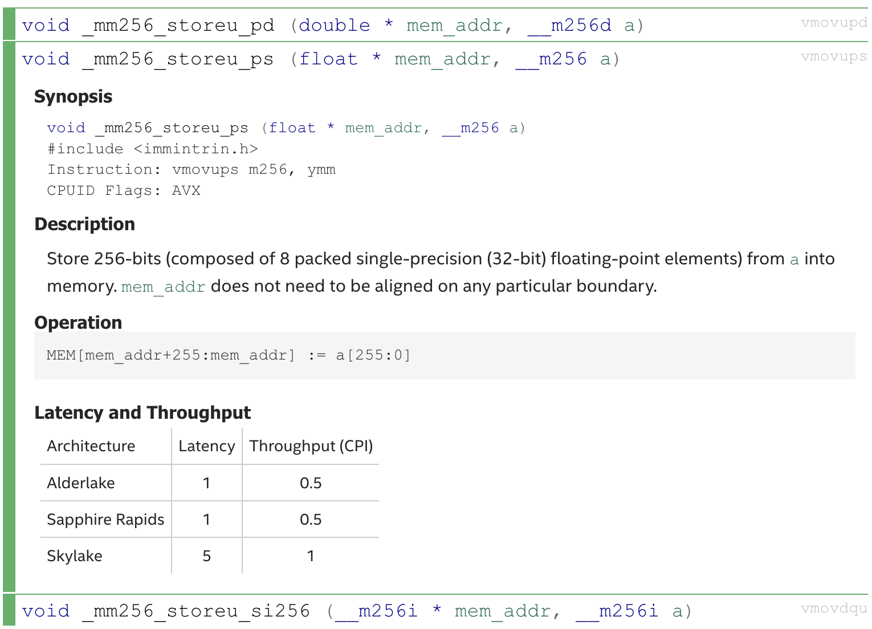
Store data from registers to memory
__m256 c;
float * p = ...;
_mm256_storeu_ps(p, c);

Slide 8

ARM Neon Intrinsics

Slide 9
SIMD@ARM
Neon: 64 bits and 128 bits
Helium (or MVE): More instructions
SVE (Scalable Vector Extension): 128 bits to 2048 bits
SVE2

Slide 10
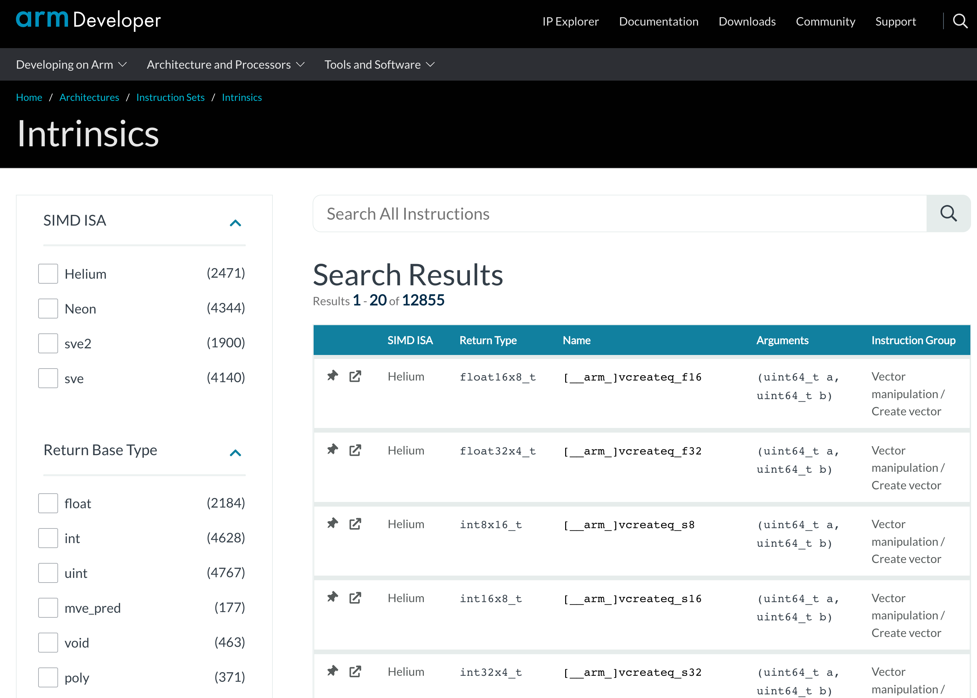
ARM Intrinsics
https://developer.arm.com/architectures/instruction-sets/intrinsics/

Slide 11
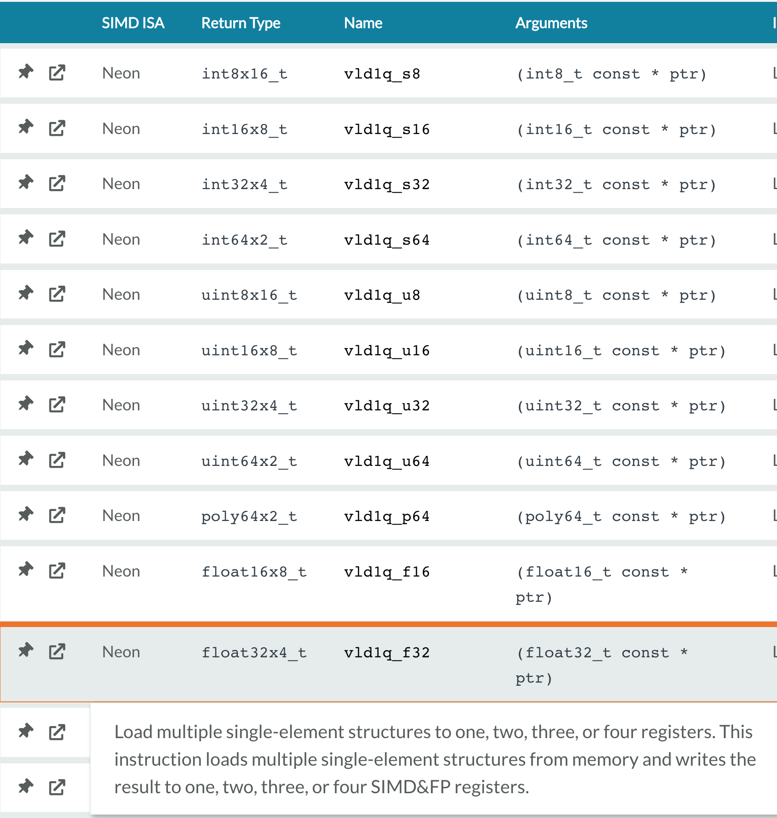
Load data from memory to registers

Slide 12
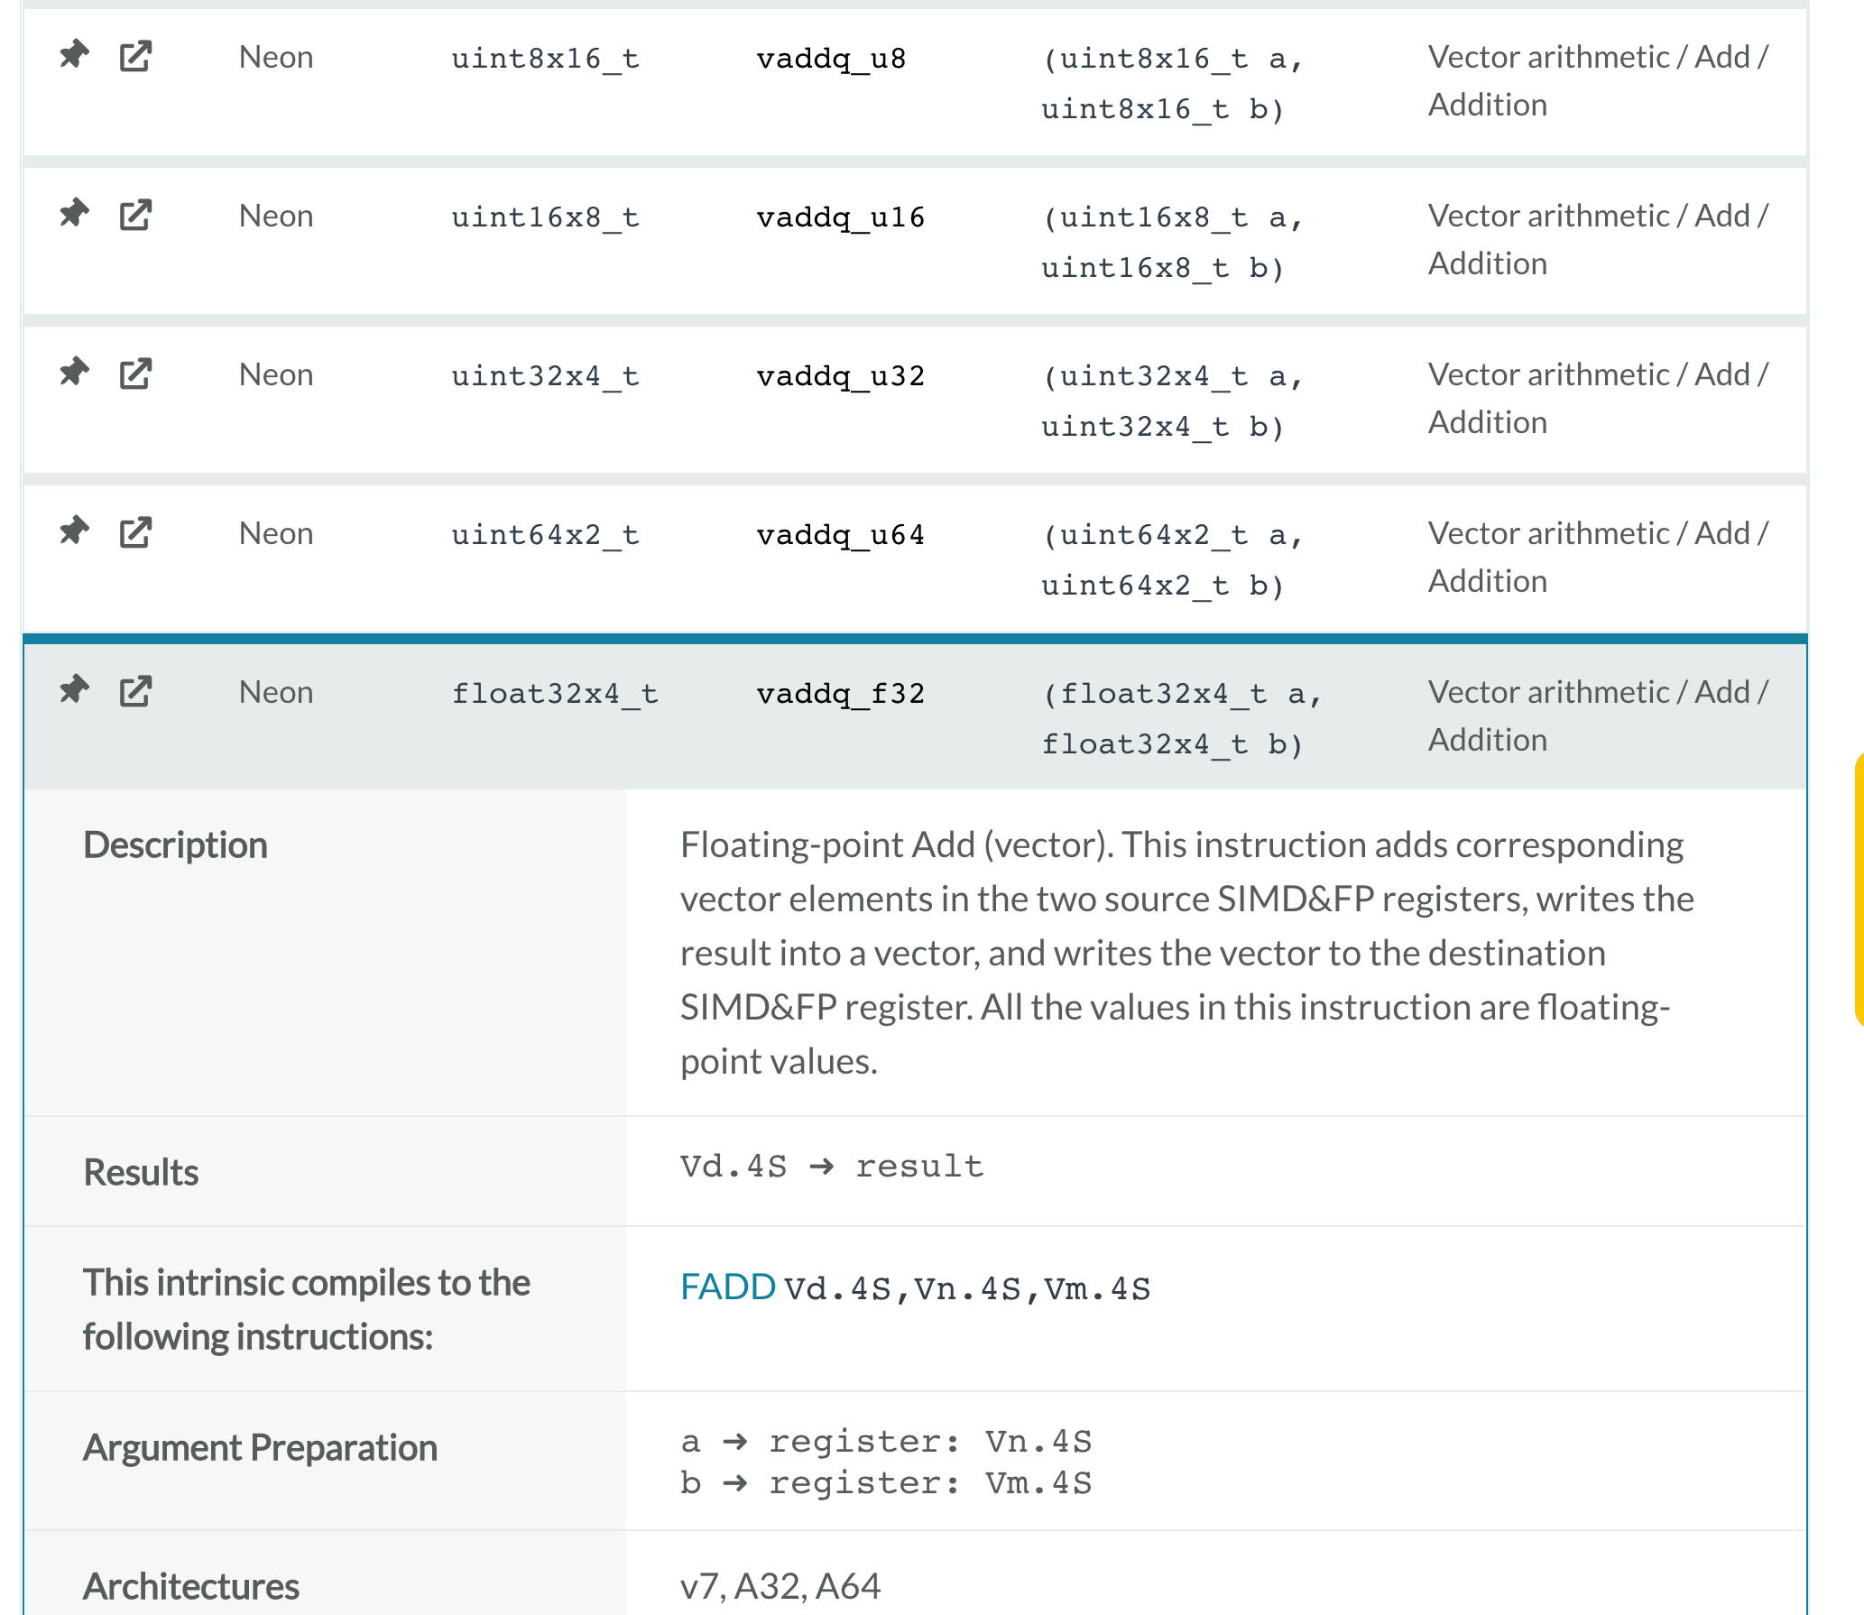
Add operation

Slide 13
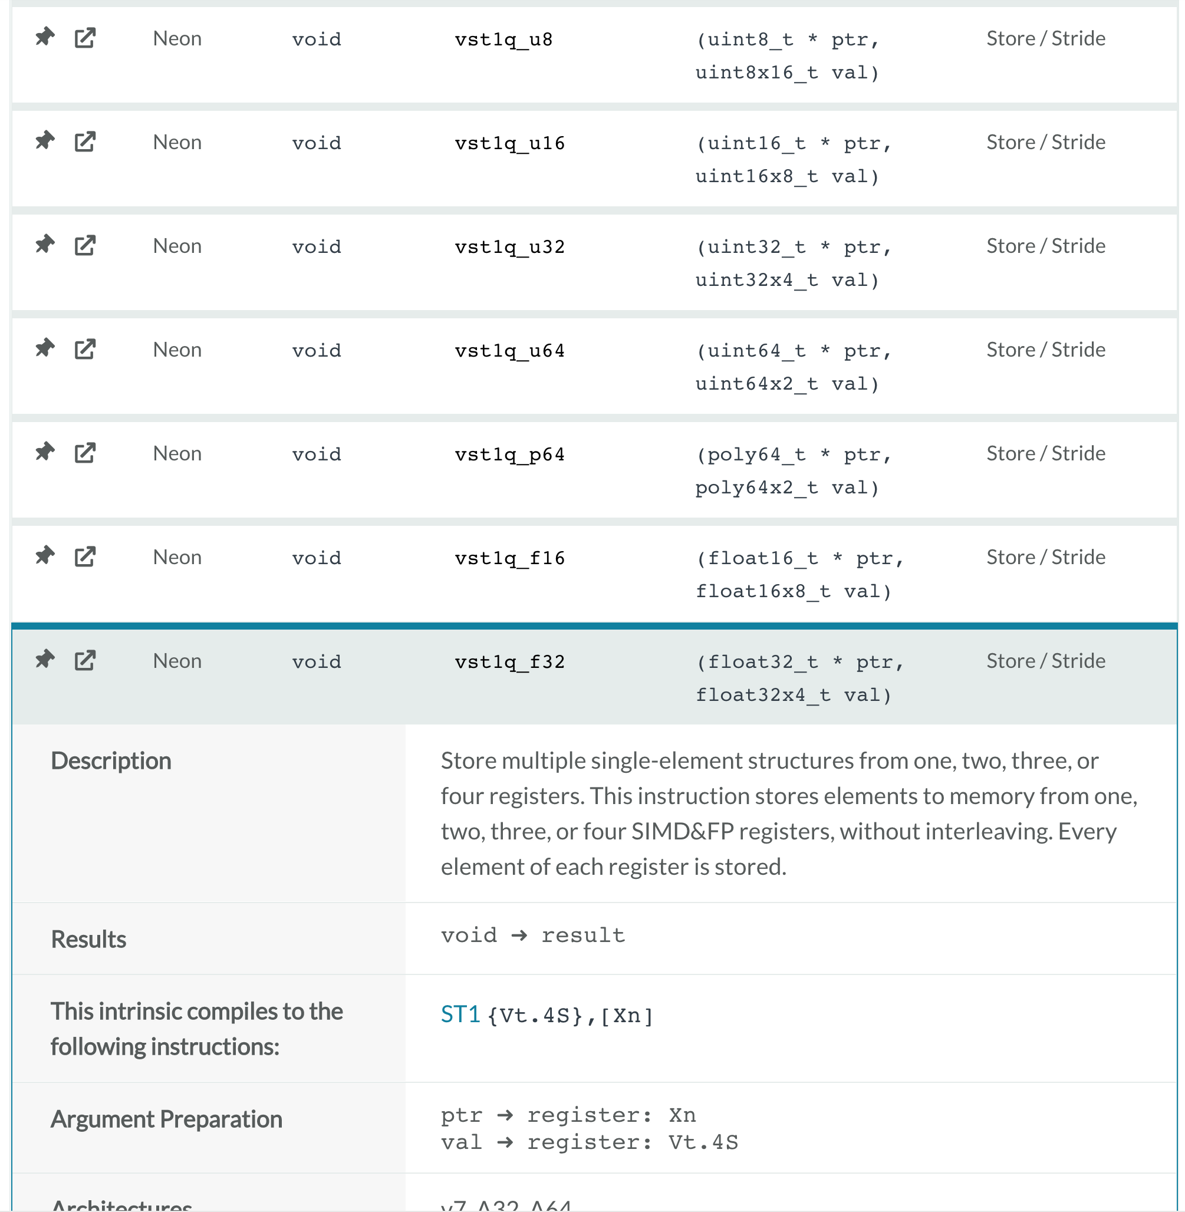
Store data from registers to memory

Slide 14
Exercise:
Write a program to add 2 float vectors whose size should be more than 1M. You can initialize the two vectors with values like 0.f, 1.f, 2.f, …
Use pure C source code and SIMD (AVX2 or NEON) separately, and compare their speeds
Use OpenMP to speed up the addition. Can you get the correct result?

