Slide 1
C/C++ Program Design
Lab 10, operator overloading and friend function
廖琪梅，王大兴

Slide 2
Operator overloading and friend function
Operator overloading
Friend function
Overloading << operator

Slide 3
Operator overloading
To overload an operator, use a special function form called an operator function.
return_type operator op(argument-list)
op is the symbol for the operator being overloaded
An operator function must either be a member of a class or have at least one parameter of class type.

Slide 4
member function, non-member function, friend function
Only non-member operator overloading function can implement type conversion on its left argument, so if a function need convert type on its left argument, define the function as non-member function; if the function must get the non-public members of the class, define it as a friend function of the class.
Other cases beyond the above, define the function as a member function.
The assignment (=)operators must be defined as member function. However, IO operators(<< and >>) must be non-member functions.

Slide 5
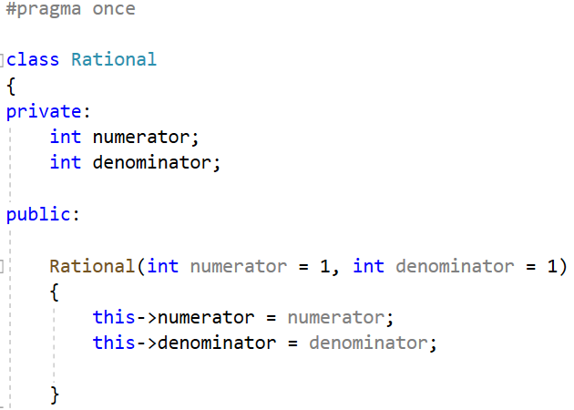

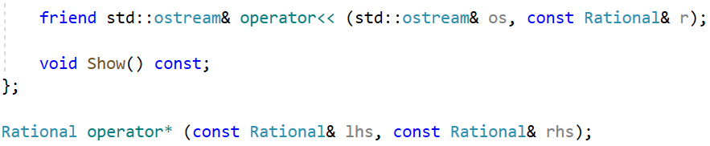
Constructor with default arguments
Define << operator function as a friend function who
can access the data members of the class.
Its declaration is inside the class and the definition is
outside the class.
Define * operator function as a normal function

Slide 6
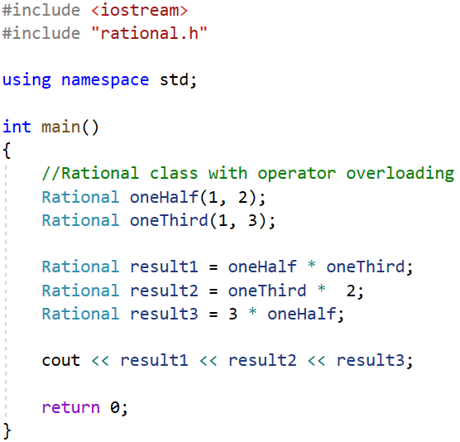
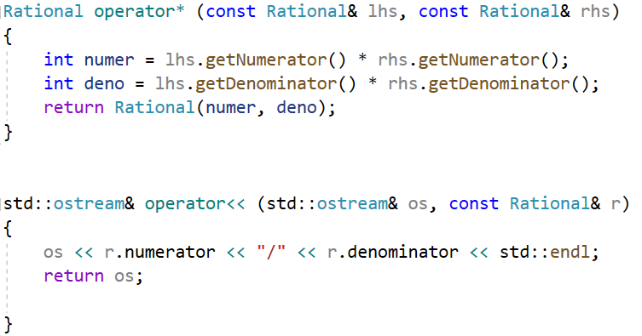

Note: In this example, the Rational class must have one argument constructor without explicit keyword. Otherwise, the int type can not be converted to the object type.

Slide 7

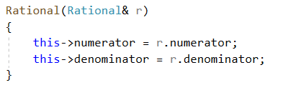
Member-wise initialization
If you use an existing object to initialize a new object, the compiler will invoke the copy constructor to implement the member-wise initialization. The data members of the class are copied in turn. This is called default member-wise initialization.
Invoke copy constructor implicitly
other.numerator = oneHalf.numerator;
other.denominator = oneHalf.denominator;
The copy constructor of Rational class
If you don’t provide the copy constructor, the compiler will provide a default one
and implement the member-wise initialization.
This copy constructor is the same as the default copy constructor.

Slide 8

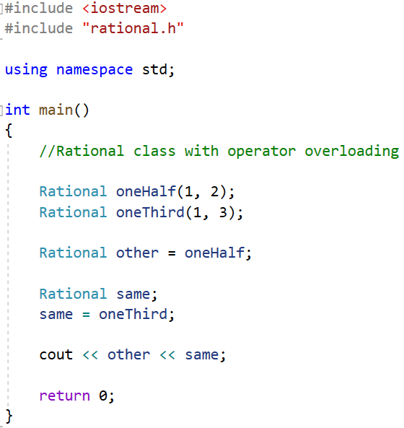

Objects assignment
If you use an equal sign to assign one object to another, this is called assign one object to another. In this case, the copy constructor is not invoked while the assignment operator works for the member-wise assignment.
Assignment statement
same.numerator = oneThird.numerator;
same.denominator = oneThird.denominator;
Invoking the copy constructor
Invoking the assignment operator

Slide 9
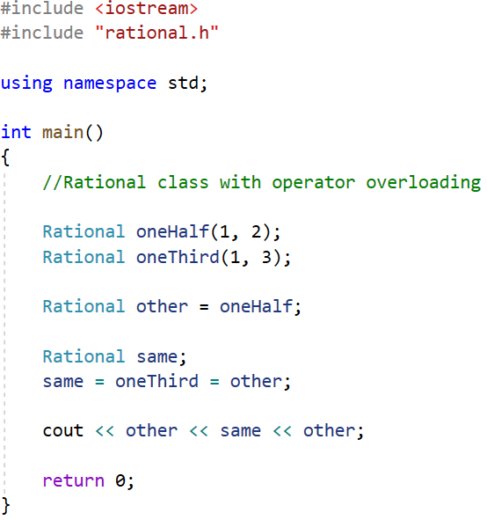
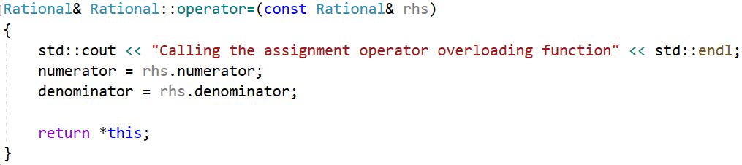
Objects assignment
You can overload the assignment operator which is the same as the default one. The assignment operator must be overloaded as a member function.
Chained assignment

Slide 10
Exercise:
Create a class called Complex for performing arithmetic with complex numbers. Write a program to test your class. Complex numbers have the form
realPart + imaginaryPart * i
Develop a complete class containing proper constructor functions as well as setter and getter functions. The class should also provide the following overloaded operator capabilities:
(1) Overload the addition operator (+) to add two Complex numbers.
(2) Overload the subtraction operator (-) to subtract two Complex numbers.
(3) Overload the assignment operator(=) to assign one Complex to another.
(4) Overload the multiplication operator (*) to multiply two Complex numbers.

Slide 11
Exercise:
(5)Overload the == and != operators to allow comparisons of Complex numbers.
(6) Modify the class to enable input and output of Complex numbers via overloaded >> and << operators, respectively.
Write a test program to test your Complex class.
What operator(s) must be overloaded as member function(s)? What operator(s) must be
overloaded as non-member function(s)? How about friend functions? Why? Give your
explanations to SA.

