Slide 1
C/C++ Program Design
Lab 12, class inheritance & polymorphism
廖琪梅，王大兴

Slide 2
Class inheritance
Class inheritance
Polymorphism (virtual function)
Inheritance and dynamic memory allocation

Slide 3
Class inheritance
Inheritance syntax:
class derived_class_name : access_mode base_class_name
{
// body of subclass
};
Subclass,Derived class, Child class
public, protected, private
Base class, Super class, Parent class
Public inheritance represents an is-a relationship, it means every derived-class object is an object of its base class.
If you do not provide a copy constructor or an assignment operator for the base class and the
derived class, the compiler will generate a copy constructor and assignment operator for both
of them respectively.

Slide 4
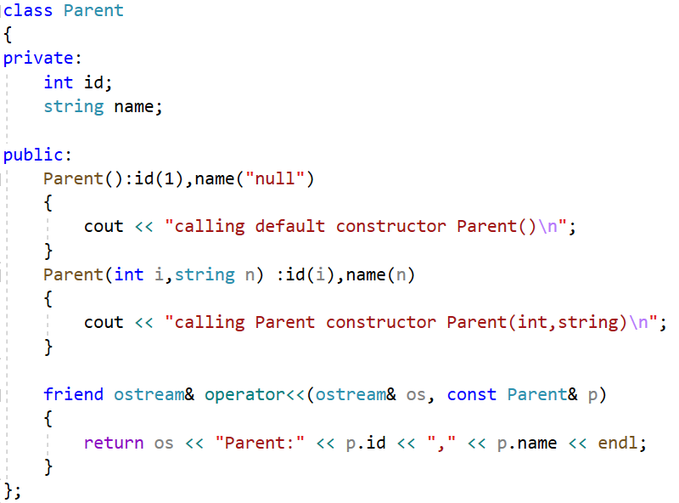
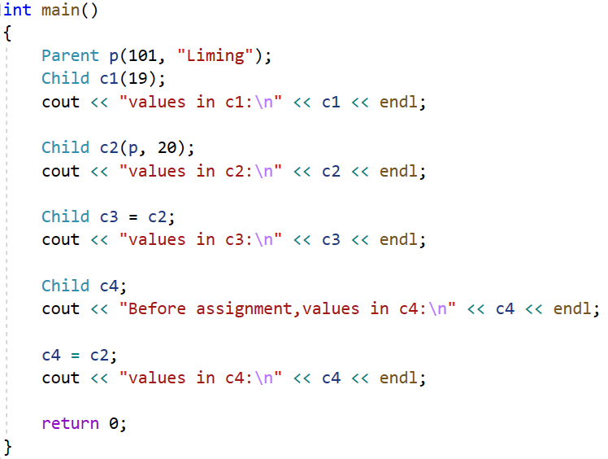
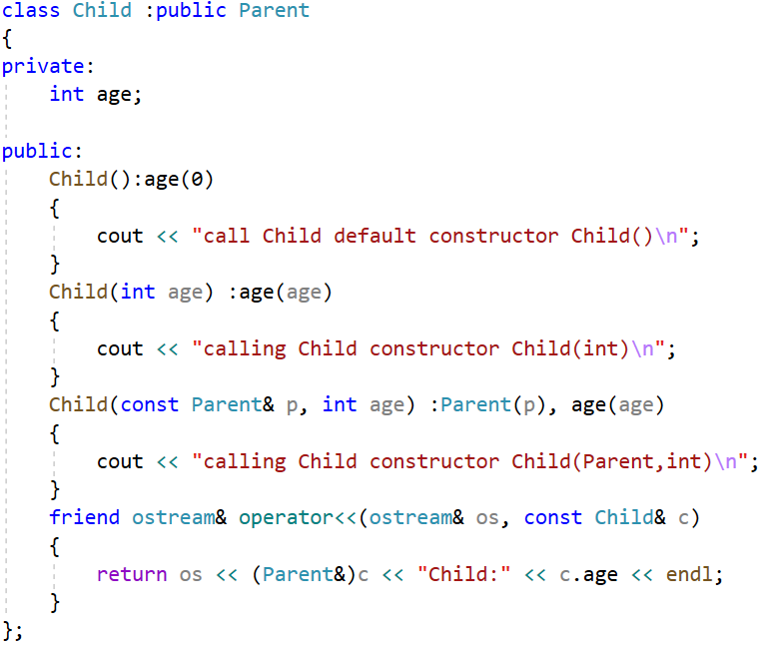
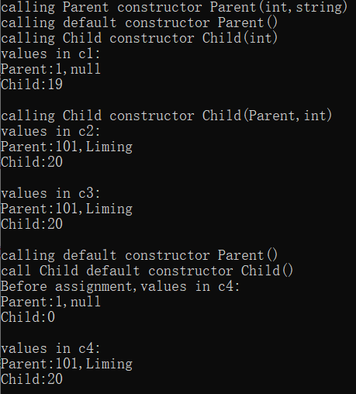
Call Child copy constructor
Call Child assignment operator
The derived class will call the default constructor of the base class
to initialize the data members.
Call Parent copy constructor

Slide 5
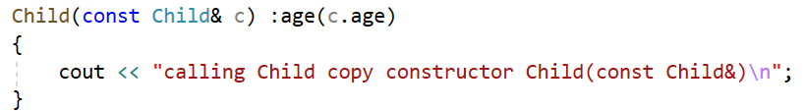
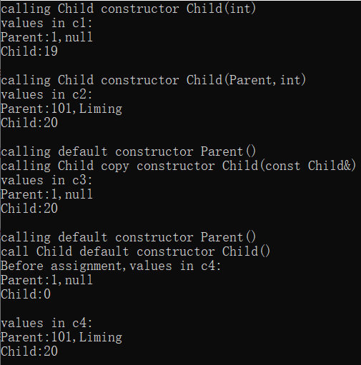
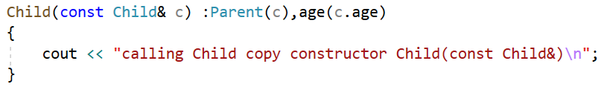

Define copy constructor of Child without initializing the base class component.
without initializing the base class component
Call Parent copy constructor by Child object.
initializing the base class component

Slide 6
Note:
When creating an object of a derived class, a program first calls the base-class constructor and then calls the derived-class constructor. The base-class constructor is responsible for initializing the inherited data member. The derived-class constructor is responsible for initializing any added data members. A derived-class constructor always calls a base-class constructor.
To destroy an derived class object, the program first calls the derived-class destructor and then calls the base-class destructor. That is, destroying an object occurs in the opposite order used to constructor an object.

Slide 7
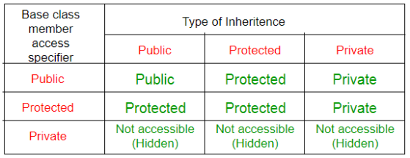
The table below shows the access specifier of the members of base class in the sub class when derived in public, protected and private modes:
In a base class definition, if a member declared as protected can be directly accessed by the derived classes but cannot be directly accessed by the general program.

Slide 8
Polymorphism
Polymorphism is one of the most important feature of object-oriented programming. Polymorphism works on object pointers and references using so-called dynamic binding at run-time. It does not work on regular objects, which uses static binding during the compile-time.
There are two key mechanisms for implementing polymorphic public inheritance:
1. Redefining base-class methods in a derived class
2. Using virtual methods

Slide 9
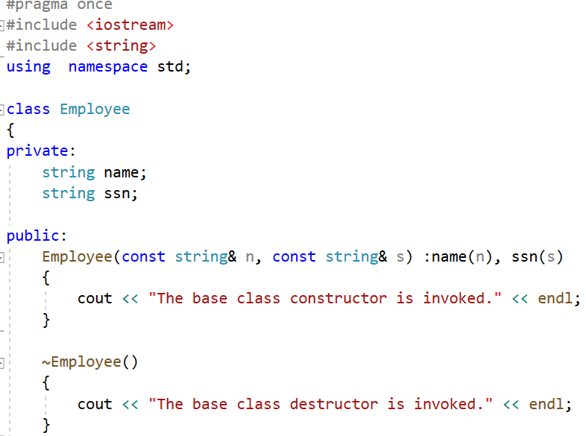
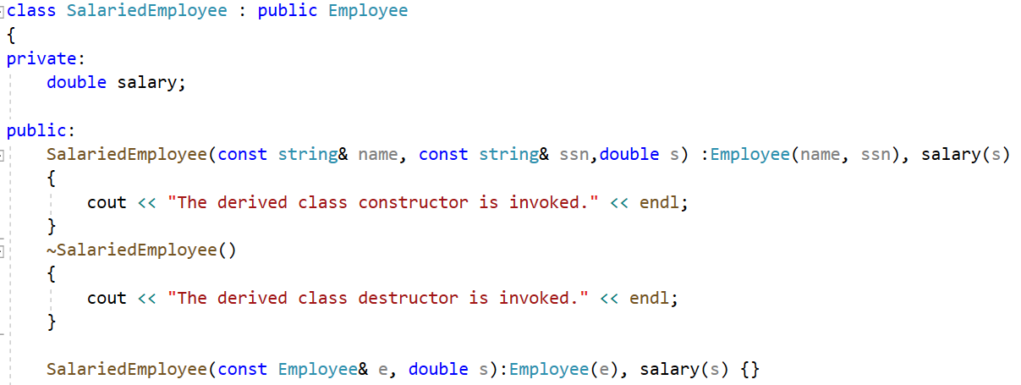
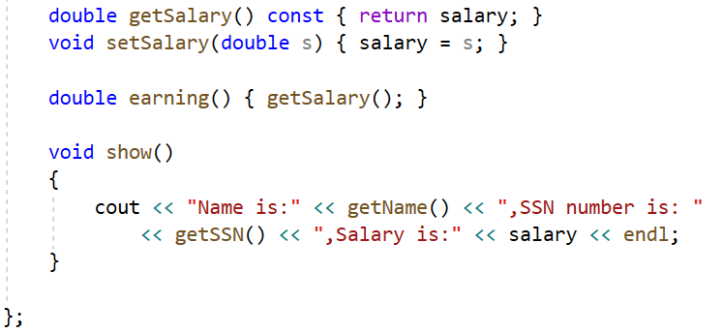
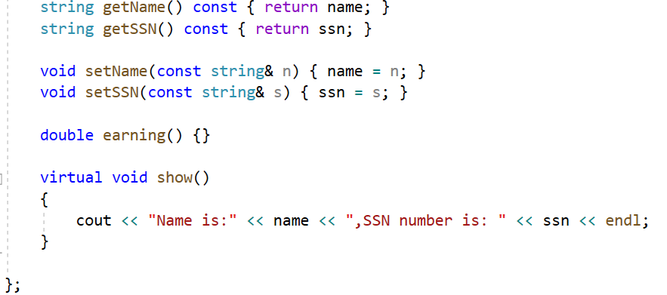
derived class
base class
If the access specifier is protected,
the derived class can access the data
override the function show() in SalariedEmployee
invoke base class method in derived class to get the name and snn
If you use the keyword virtual, the program choose a method based on the type of
object the reference or pointer refers to rather than based on the reference type or
pointer type.

Slide 10
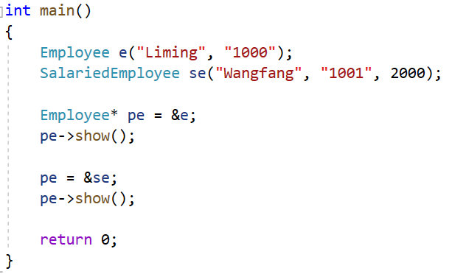
The pointer type of pe is Employee, it points to a different object respectively,
and invokes different objects’ show() functions. This is polymorphism.

Slide 11
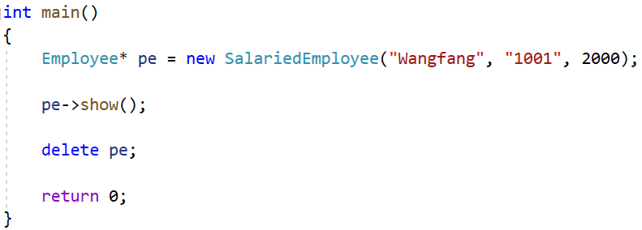

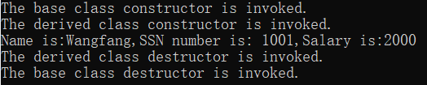
Destructors
If the destructors is not virtual, the delete statement invokes the ~Employee() destructor.
This frees memory pointed to by the Employee component of the SalariedEmployee object
not memory pointed to by SalariedEmployee component.
If the destructor is virtual, the same code invokes the ~SalariedEmployee() destructor, which frees memory pointed to by the SalariedEmployee component, and then calls the ~Employee() destructor to free memory pointed to by the Employee component.

Slide 12
Inheritance and Dynamic Memory Allocation
If a base class uses dynamic memory allocation and redefines assignment operator and a copy constructor, how does that affect the implementation of the derived class? The answer depends on the nature of the derived class.
If the derived class does not itself use dynamic memory allocation, you needn’t
take any special steps.
If the derived class does use new to allocate memory, you do have to define an explicit destructor, copy constructor, and assignment operator for the derived class.

Slide 13
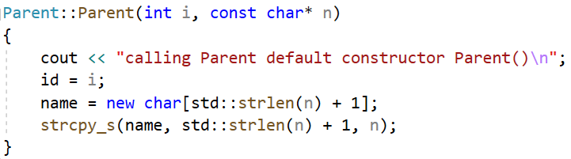
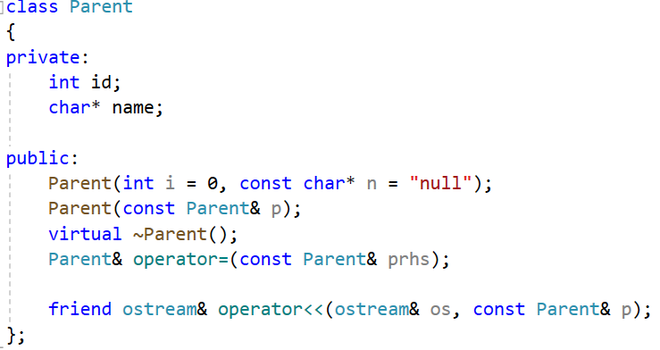
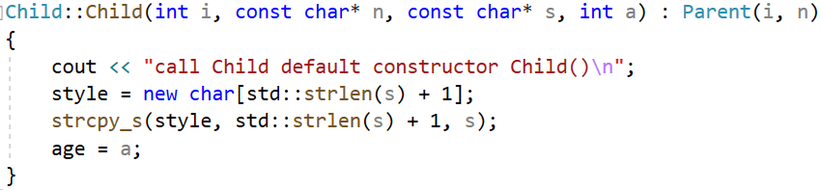
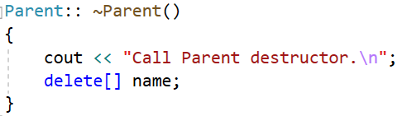
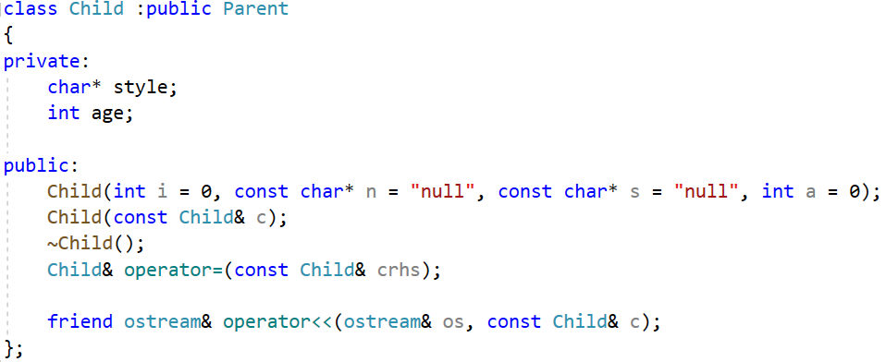
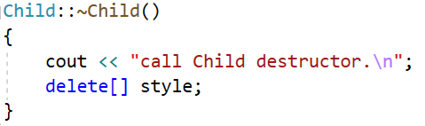
base class constructor
base class
derived class constructor
derived class
The data fields both in the base class
and the derived class hold pointers,
which indicate they would use dynamic
memory allocation.
A derived class destructor automatically calls the base-class destructor, so its own responsibility is to clean up after what the derived-class destructors do.

Slide 14
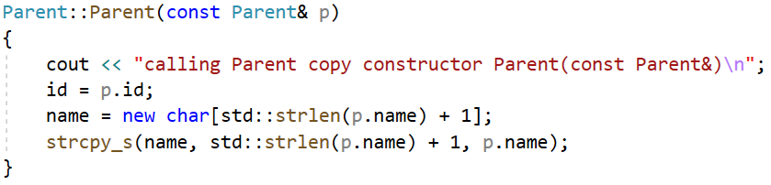
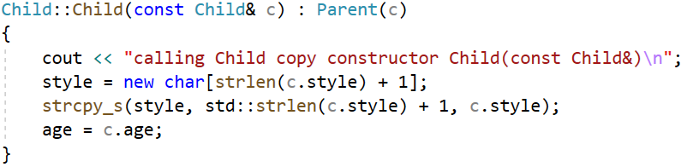
Consider copy constructor:
the base-class copy constructor
The derived class copy constructor can only accesses to its own
data, so it must invoke the base-class copy constructor to handle
the base-class share of the data.
The member initialization list passes a Child reference to a Parent constructor.
The Parent copy constructor has a Parent reference parameter, and a base class reference
can refer to a derived type. Thus, the Parent copy constructor uses the Parent portion of the
Child argument to constructor the Parent portion of the new object.

Slide 15
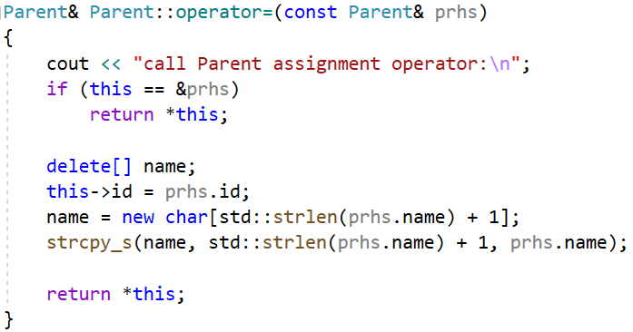
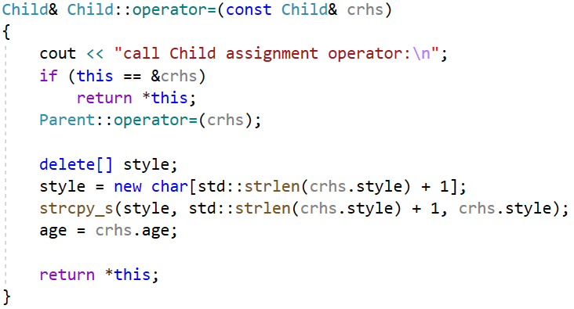
Consider assignment operators:
the Parent assignment operator
Because Child uses dynamic memory allocation,
it needs an explicit assignment operator. Being a
Child method, it only has direct access to its own
data.
An explicit assignment operator for a derived class also has to take care of assignment for the
inherited base class Parent object. You can accomplish this by explicitly calling the base class
assignment operator.

Slide 16
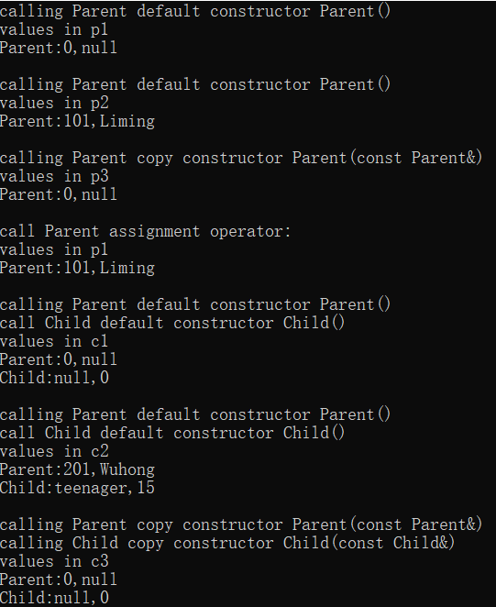
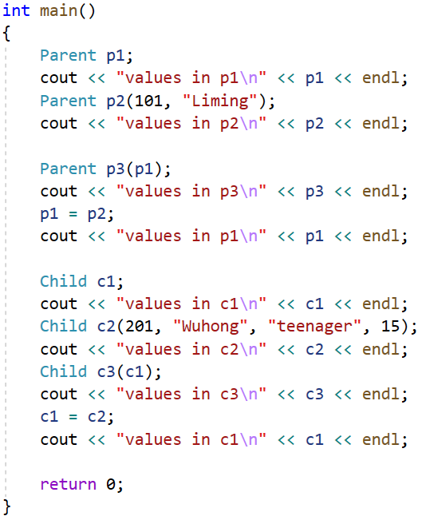
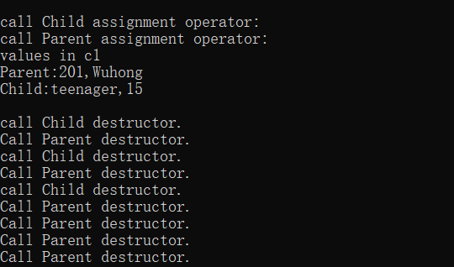
Three child objects
Three parent objects

Slide 17
Exercise:
1. Please point the errors of the following code and explain why to SA.
class Base
{
private:
int x;
protected:
int y;
public:
int z;
void funBase (Base& b)
{
++x;
++y;
++z;
++b.x;
++b.y;
++b.z;
}
};
class Derived:public Base
{
public:
void funDerived (Base& b, Derived& d)
{
++x;
++y;
++z;
++b.x;
++b.y;
++b.z;
++d.x;
++d.y;
++d.z;
}
};
void fun(Base& b, Derived& d)
{
++x;
++y;
++z;
++b.x;
++b.y;
++b.z;
++d.x;
++d.y;
++d.z;
}

Slide 18
Exercise:
2. Run the following program, and explain the result to SA.
int main ()
{
Rectangle rect;
Triangle trgl;
Polygon * ppoly1 = &rect;
Polygon * ppoly2 = &trgl;
ppoly1->set_values (4,5);
ppoly2->set_values (2,5);
cout << rect.area() << endl;
cout << trgl.area() << endl;
cout << ppoly1->area() << endl;
cout << ppoly2->area() << endl;
return 0;
}
#include <iostream>
using namespace std;
class Polygon
{
protected:
int width, height;
public:
void set_values (int a, int b)
{ width=a; height=b; }
int area()
{ return 0;}
};
class Rectangle: public Polygon
{
public:
int area()
{ return width * height; }
};
class Triangle: public Polygon
{
public:
int area()
{ return width*height/2; }
};

Slide 19
Exercise:
3. Run the following program, and explain the result to SA. Is there any problem in the program?
class Rectangle: public Polygon
{
public:
Rectangle(int a,int b) : Polygon(a,b) {}
int area()
{ return width*height; }
};
class Triangle: public Polygon
{
public:
Triangle(int a,int b) : Polygon(a,b) {}
int area()
{ return width*height/2; }
};
// dynamic allocation and polymorphism
#include <iostream>
using namespace std;
class Polygon
{
protected:
int width, height;
public:
Polygon (int a, int b) : width(a), height(b) {}
virtual int area (void) =0;
void printarea()
{ cout << this->area() << '\n'; }
};
int main ()
{
Polygon * ppoly = new Rectangle (4,5);
ppoly->printarea();
ppoly = new Triangle (2,5);
ppoly->printarea();
return 0;
}

