Slide 1
C/C++ Program Design
Lab 13, Composition & Template
廖琪梅，王大兴

Slide 2
Composition and Template
Class Objects as members
Class templates

Slide 3
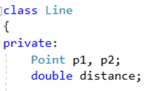
Class Containment(Composition)
Using class members that are themselves objects of another class is referred to as containment or composition or layering.
Containment is typically used to implement has-a relationship, that is, relationship for which the new class has an object of another class.
data in Line class has Point objects

Slide 4
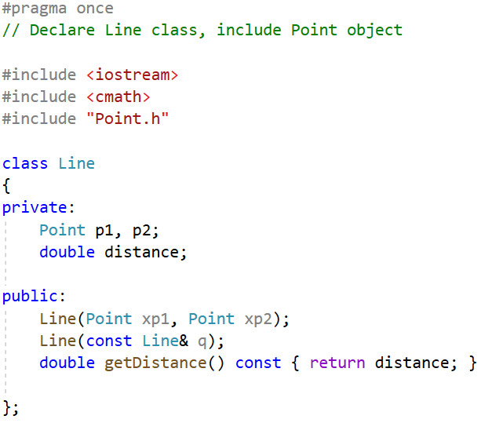
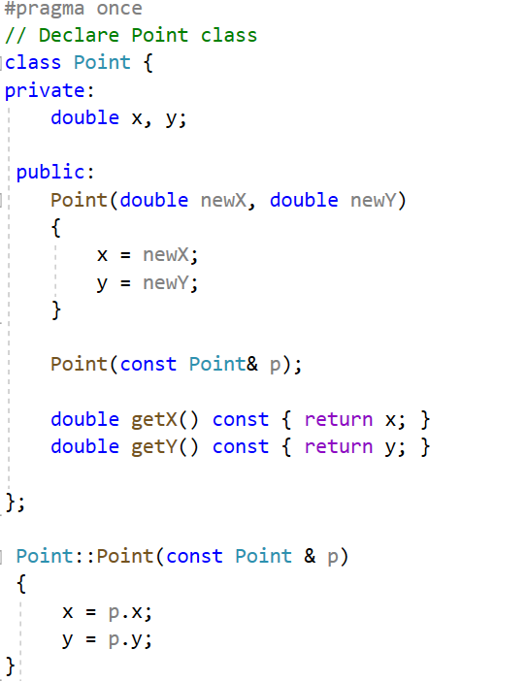
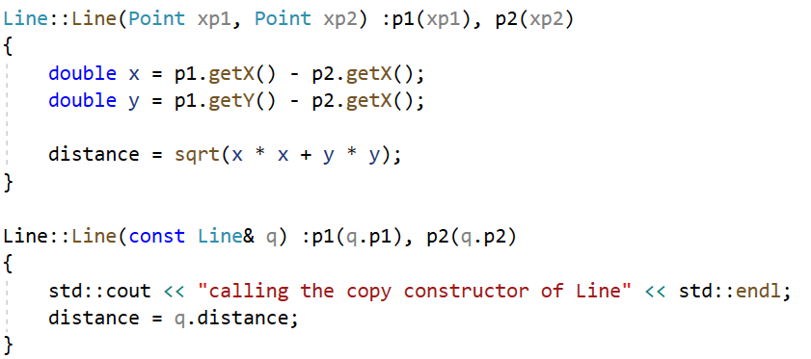
Example:
data in Point class
data in Line class has Point objects
constructor
constructor and
copy constructor
copy constructor
Initialize object first by
initialization list
Initialize object first by initialization list

Slide 5
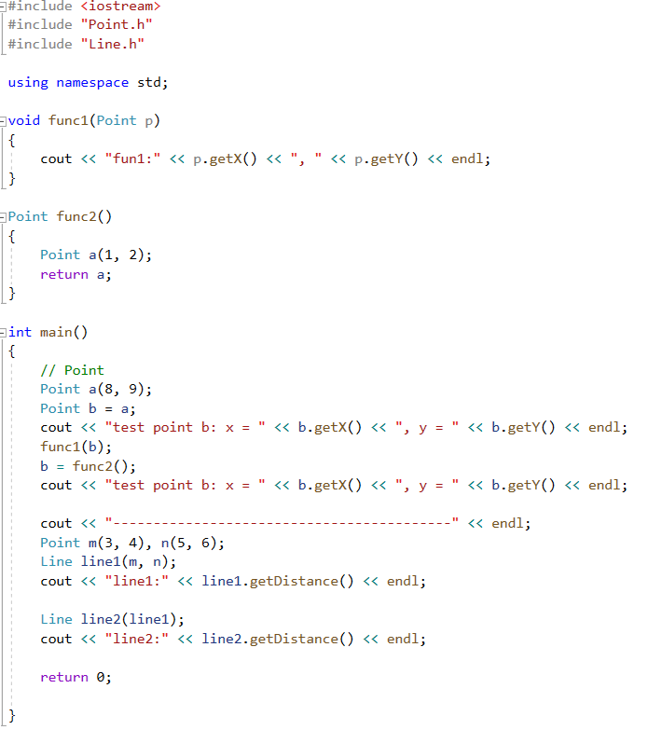
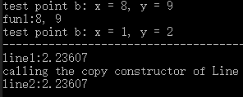
Invoke Point’s constructor
Invoke Point’s copy constructor
Invoke Line’s constructor
Invoke Line’s copy constructor

Slide 6
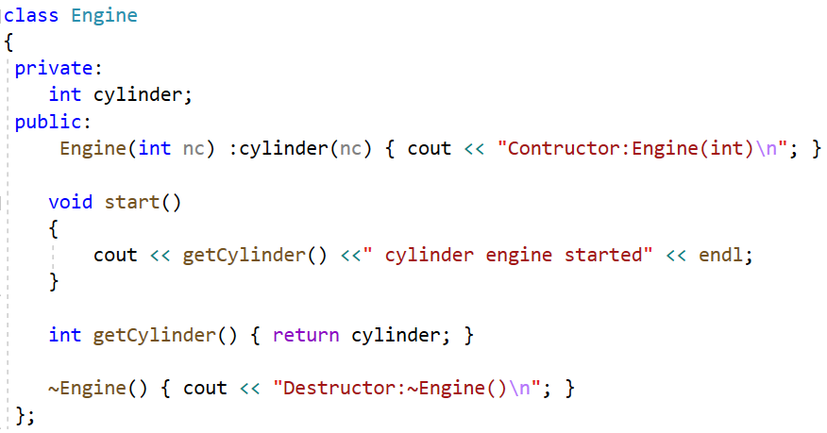
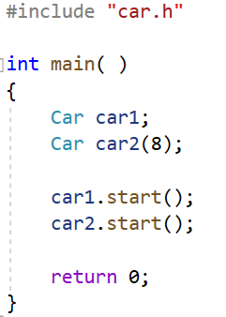
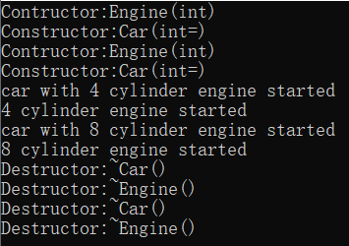
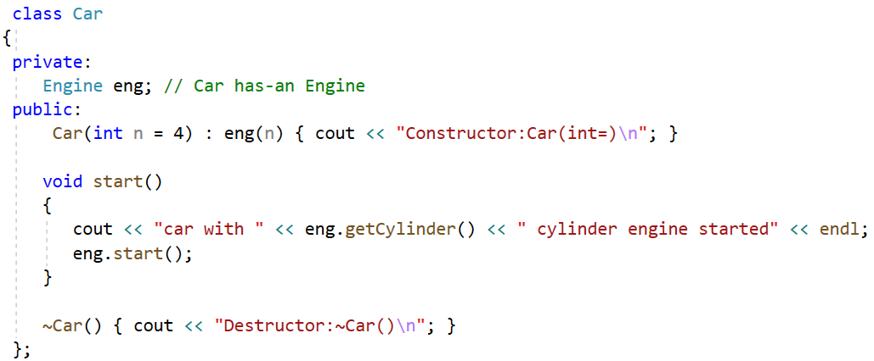
Call the Car’s default constructor
First, constructs the object in Car class
then, constructs the Car object
Define an object of Engine as Car’s attribute
Initialize the object by its own constructor
via initialization list in Car’s constructor
When an object is destructed, the complier first
destructs Car’s object, and then destructs the
composition object in Car class.

Slide 7
Template
The C++ programming language offers a powerful feature known as templates, which enable functions and classes to operate on generic types.
This allows a function or class to be designed to work seamlessly with a diverse range of data types, without the need for tedious and repetitive rewrites for each type.
By leveraging templates, C++ code can be made more concise, modular, and easier to maintain, while also boosting its flexibility and versatility.

Slide 8
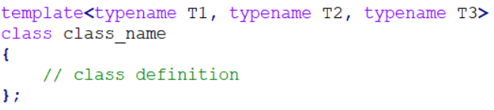
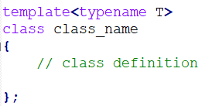
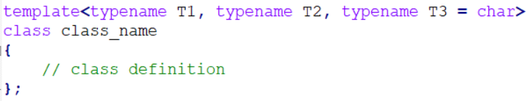
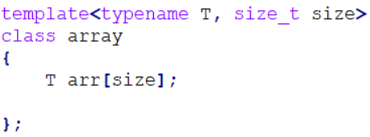
Class Templates
Much like function templates, class templates offer the ability to define a single class that can be utilized with a variety of data types.
or <class T>
multiple parameters
multiple and default parameters
nontype template parameter

Slide 9
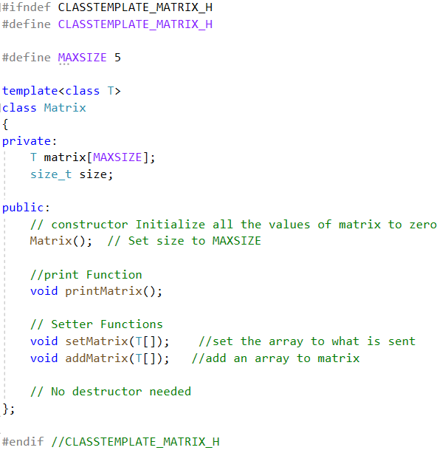
Class Templates
1. Template Definition
data in matrix class

Slide 10
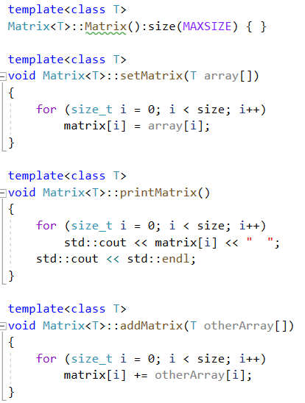
2. Member Function Definition
To refer to the class in a generic way you must include the placeholder in the class name like this:
template <class T>
return_type class_name <T>::
function_name(parameter_list,…)

Slide 11
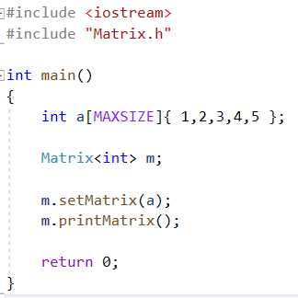
3. Class Instantiation
To make an instance of a class you use this form:
class_name <type> variablename;
For example, to create a Matrix with int you would type:
Matrix<int> m;
Matrix<int> becomes the name of a new class.

Slide 12
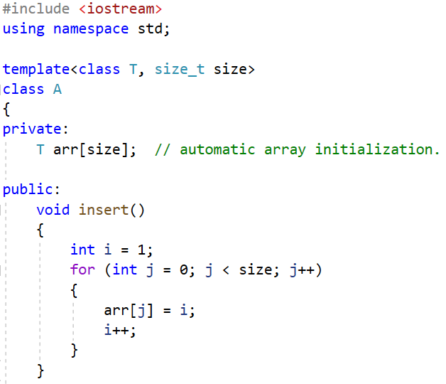
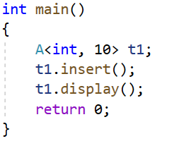
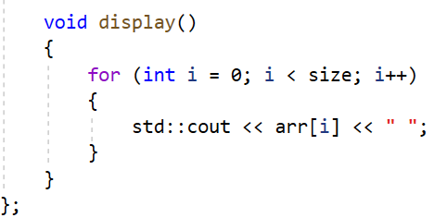
non-type template parameter
Non-type template parameters can be strings,
constant expression and built-in types.

Slide 13
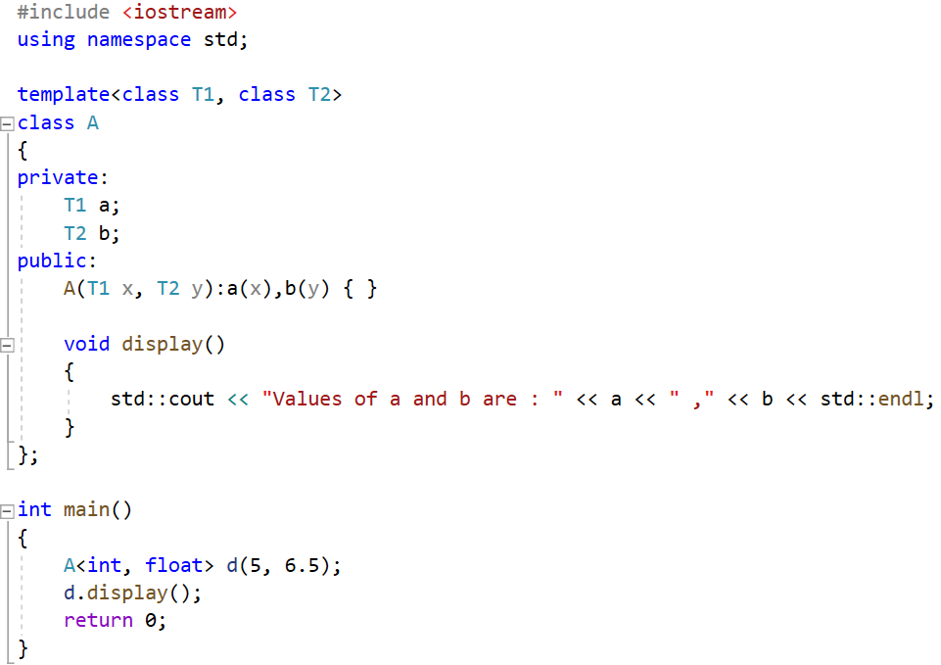
multiple parameters

Slide 14
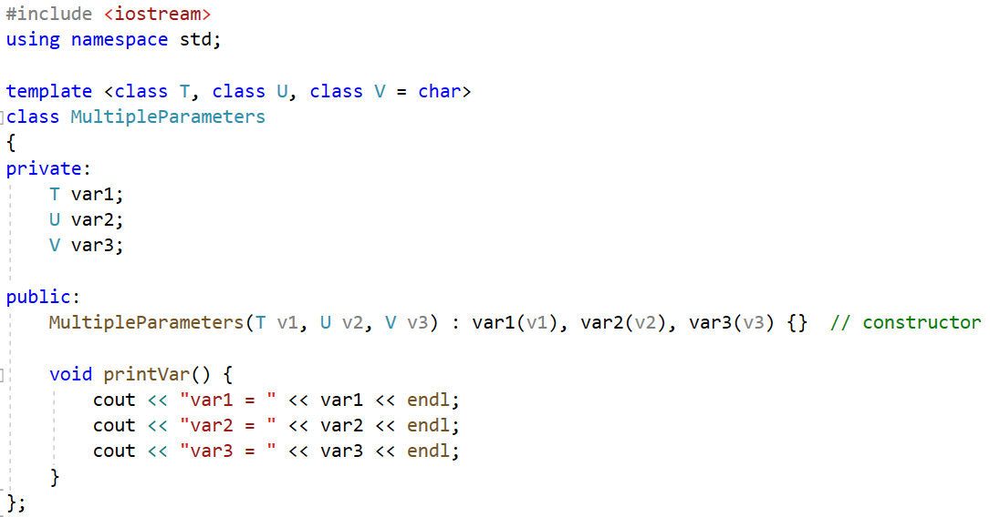
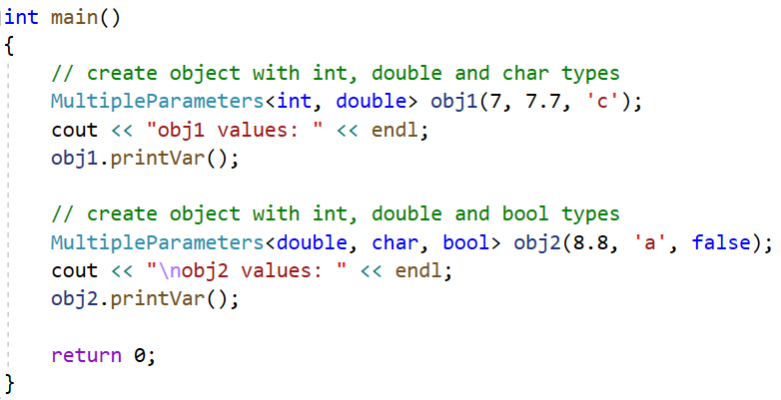
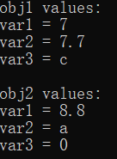
multiple and default parameters

Slide 15
Template specialization
In some cases, it isn't possible or desirable for a template to define exactly the same code for any type. In such cases you can define a specialization of the template for that particular type. When a user instantiates the template with that type, the compiler uses the specialization to generate the class, and for all other types, the compiler chooses the more general template. Specializations in which all parameters are specialized are complete specializations. If only some of the parameters are specialized, it is called a partial specialization.
A template specialization of a class requires a primary class and a type or parameters to specialize. A specialized template class behaves like a new class. There is no inheritance from the primary class. It doesn’t share anything with the primary template class, except the name. Any and all methods and members will have to be implemented.

Slide 16
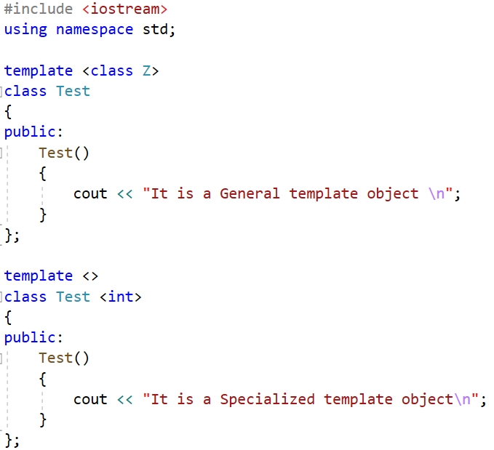
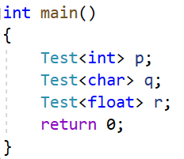

primary class
class specialization

Slide 17
Class templates can be partially specialized, and the resulting class is still a template. Partial specialization allows template code to be partially customized for specific types in situations, such as:
(1) A template has multiple types and only some of them need to be specialized. The result is a template parameterized on the remaining types.
(2) A template has only one type, but a specialization is needed for pointer, reference, pointer to member, or function pointer types. The specialization itself is still a template on the type pointed to or referenced.

Slide 18
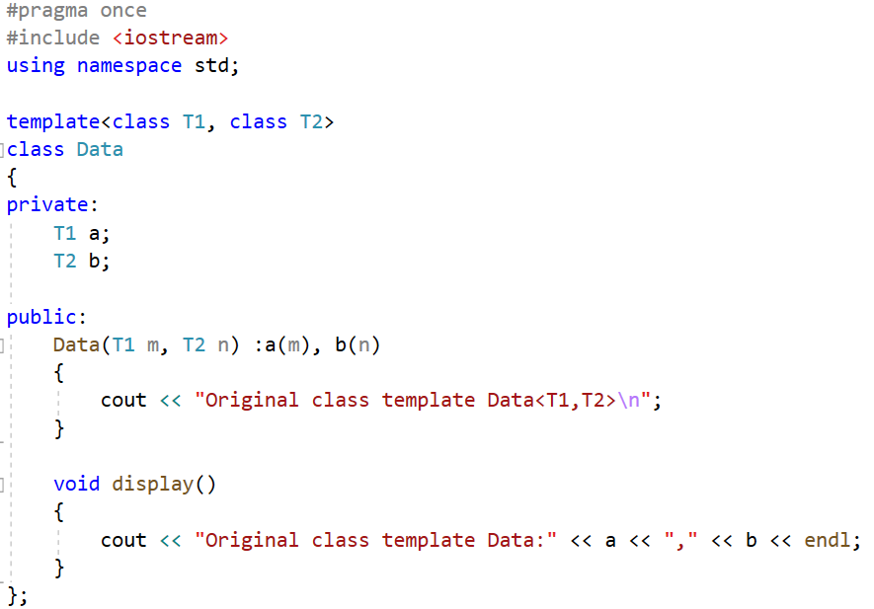
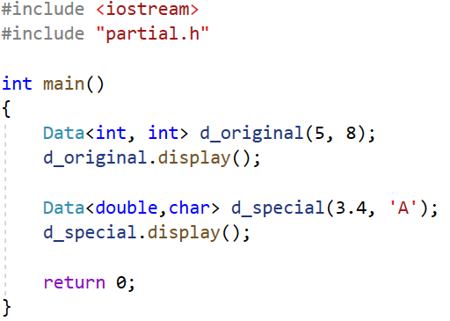
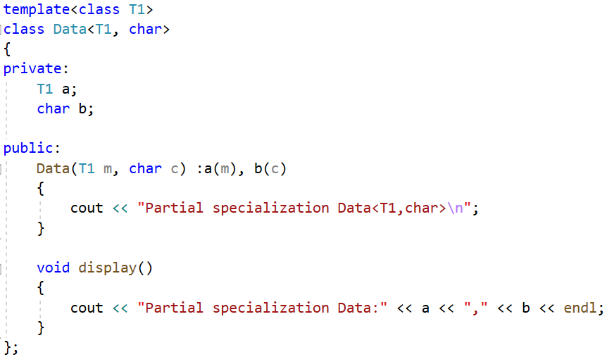

primary class
class partial specialization

Slide 19
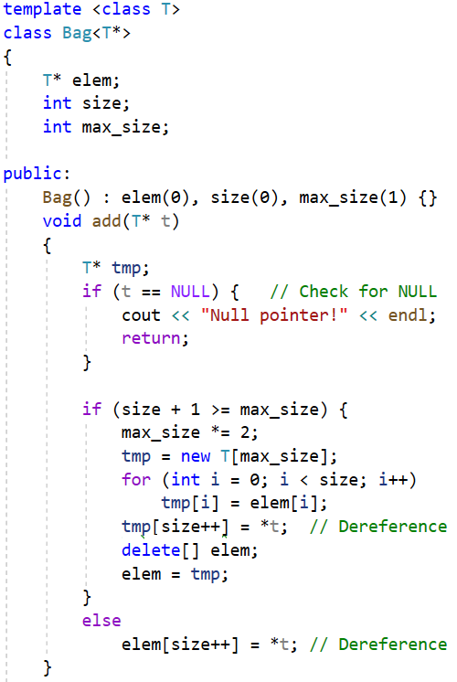
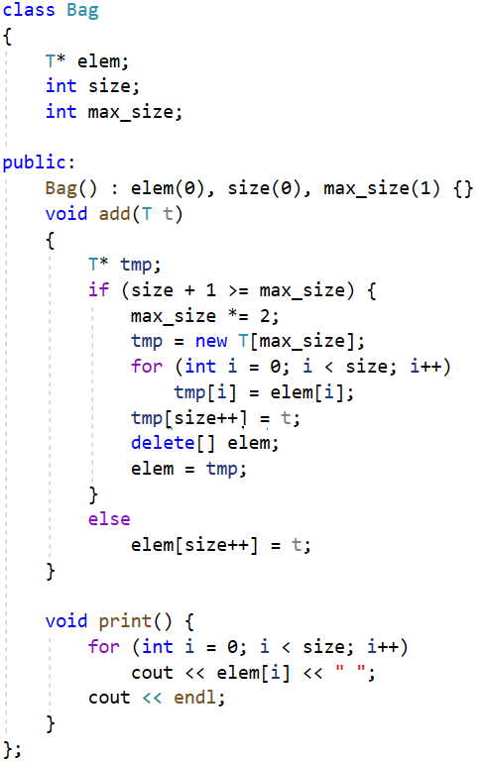
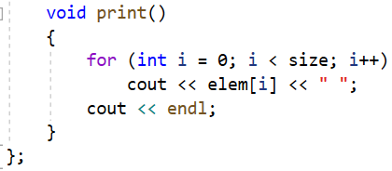
primary class
Original template class
class partial specialization
template partial specialization
for pointer types
The values that are pointed to
are added. If there is no partial specialization, only the pointers themselves are added.

Slide 20
Bringing it All Together
Class templates and their member function templates should be declared in .h/.hpp.

Slide 21
Template or Inheritance
Templates are powerful, but they are not magical. When you design or use a template you should be aware of what operations the data types you will use need to support.
Template should be used to generate a set of classes where the object type does not affect the function behavior of the class.
Inheritance should be used on a set of classes where the object type does affect the function behavior of the class.

Slide 22
Exercise:
1. A template class named Pair is defined as follows. Please implement the overloading operator< which compares the value of the key, if this->key is smaller than that of p.key, return true. Then define a friend function to overload << operator which displays the Pair’s data members. At last, run the program. The output sample is as follows:
#include <iostream>
#include <string>
using namespace std;
template <class T1,class T2>
class Pair
{
public:
T1 key;
T2 value;
Pair(T1 k,T2 v):key(k),value(v) { };
bool operator < (const Pair<T1,T2> & p) const;
};
int main()
{
Pair<string,int> one("Tom",19);
Pair<string,int> two("Alice",20);
if(one < two)
cout << one;
else
cout << two;
return 0;
}
Output:

Slide 23
class Example
{
private:
int size;
double *parray;
double _min;
double _max;
public:
Example(double min, double max);
Example(const double *array, int size);
double& operator[](int index);
bool operator==(const Example&) const;
bool insert(const double*, int);
bool insert(double);
double min() const;
double max() const;
void min(double);
void max(double);
~Example();
};
2. There is a definition of an Example class. Please redefine it with class template. You need not define the member functions.

Slide 24
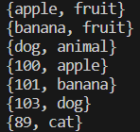
template <class Key, class Value>
class Dictionary {
Key* keys;
Value* values;
int size;
int max_size;
public:
Dictionary(int initial_size) : size(0) {
max_size = 1;
while (initial_size >= max_size)
max_size *= 2;
keys = new Key[max_size];
values = new Value[max_size];
}
void add(Key key, Value value) {
Key* tmpKey;
Value* tmpVal;
if (size + 1 >= max_size) {
max_size *= 2;
tmpKey = new Key [max_size];
tmpVal = new Value [max_size];
for (int i = 0; i < size; i++) {
tmpKey[i] = keys[i];
tmpVal[i] = values[i];
}
tmpKey[size] = key;
tmpVal[size] = value;
delete[] keys;
delete[] values;
keys = tmpKey;
values = tmpVal;
}
else {
keys[size] = key;
values[size] = value;
}
size++;
}
void print() {
for (int i = 0; i < size; i++)
cout << "{" << keys[i] << ", " << values[i] << "}" << endl;
}
~Dictionary()
{
delete[] keys;
delete[] values;
}
};
int main()
{
Dictionary<const char*, const char*> dict(10);
dict.print();
dict.add("apple", "fruit");
dict.add("banana", "fruit");
dict.add("dog", "animal");
dict.print();
Dictionary<int, const char*> dict_specialized(10);
dict_specialized.print();
dict_specialized.add(100, "apple");
dict_specialized.add(101, "banana");
dict_specialized.add(103, "dog");
dict_specialized.add(89, "cat");
dict_specialized.print();
return 0;
}
3. There is a definition of a template class Dictionary. Please write a template partial specialization for Dictionary class whose Key is specified to be int. And then run the program. The output sample is as follows:
Output:

