Slide 1

Postures In Kinesics
reporter：张宇
time：2023.5.16

Slide 2
目
录
Definition
Examples
Significance
The Reason

Slide 3
01
Definition

Slide 4



Denifition
Some people pay little attention to their attention.And some even neglect them completely.
Postures refer to our body positions as a whole.
01
02
To them postures are next to nothing during business communication.
Unfortunately, this shows their ignorance about the nature of postures.
03
04

Slide 5
02
Examples

Slide 6
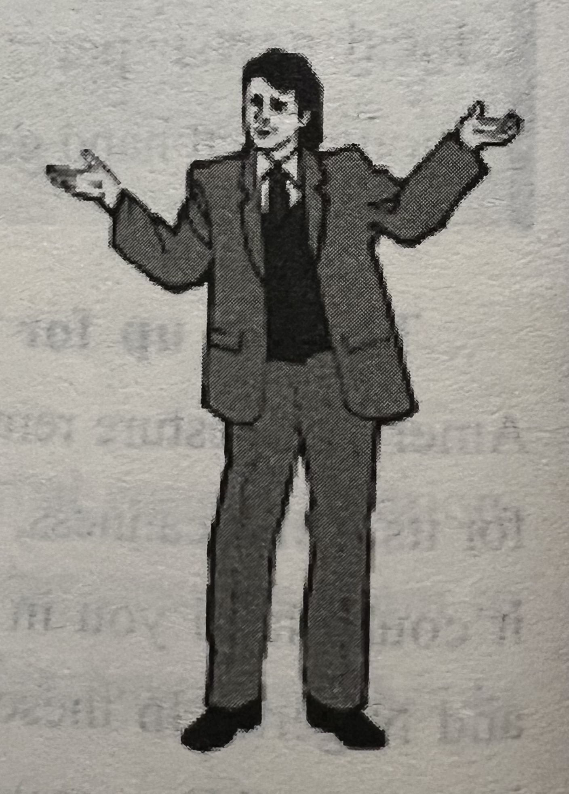
The First Example
With two arms up in the air.
Some Westerners have a habit of showing such a posture in interaction, and sometimes in business negotiation.
It gives people an impression of arrogance. In social activeties, most people dislike talking with this kind of person because this gesture may suggest threat to others.
您的作计划
您的工作计划
您的工作计划
工作划

Slide 7
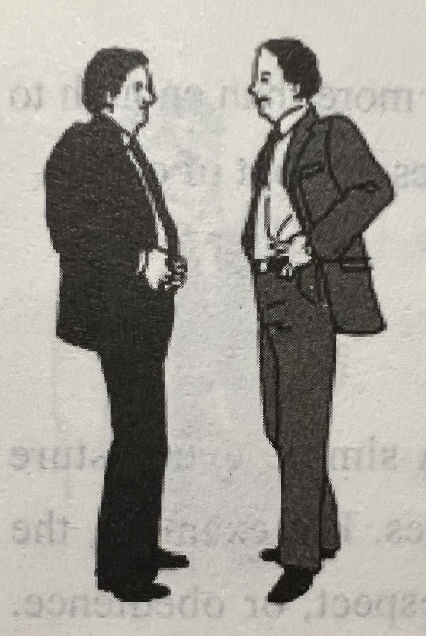
The Second Example
Standing firmly face to face.
This posture can be understood by both Westerners and the Chinese.
If two people stand in such a posture, maybe they’ll start to fight.
Both of the gladiators wish to have strength of confidence before they start to fight.
Such a posture only occurs at the beginning of a fight.

Slide 8
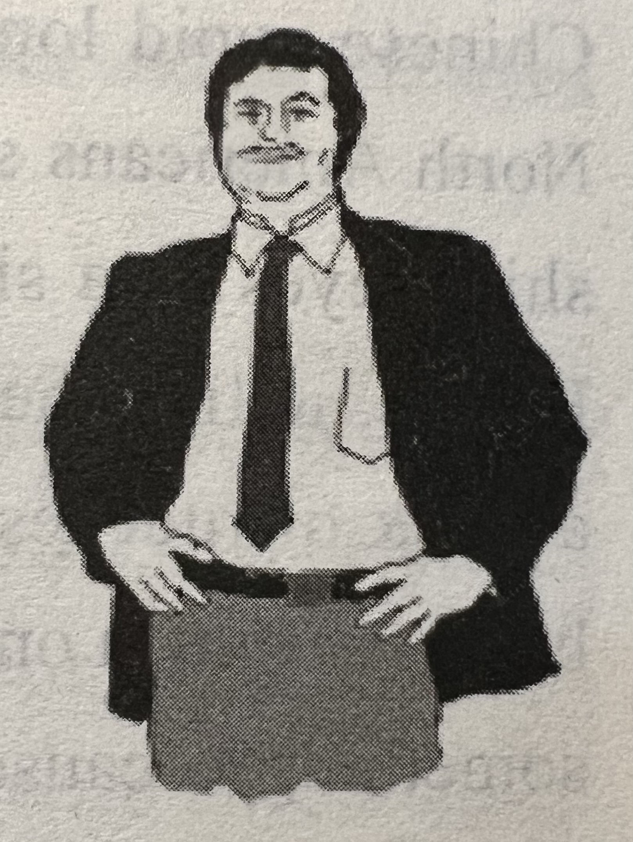
The Third Example
Hands on the waist.
制定您的工作计划
This is a posture indicating direct intrusion into others’affairs.
制定您的工作计划
One lays bare his heart and throat completely to show that he is undaunted.
制定您的工作计划
Most people, both Westerners and the Chinese are not fond of such a posture, as the person who shows such a posture is regarded as aggresive and not considerate enough.

Slide 9
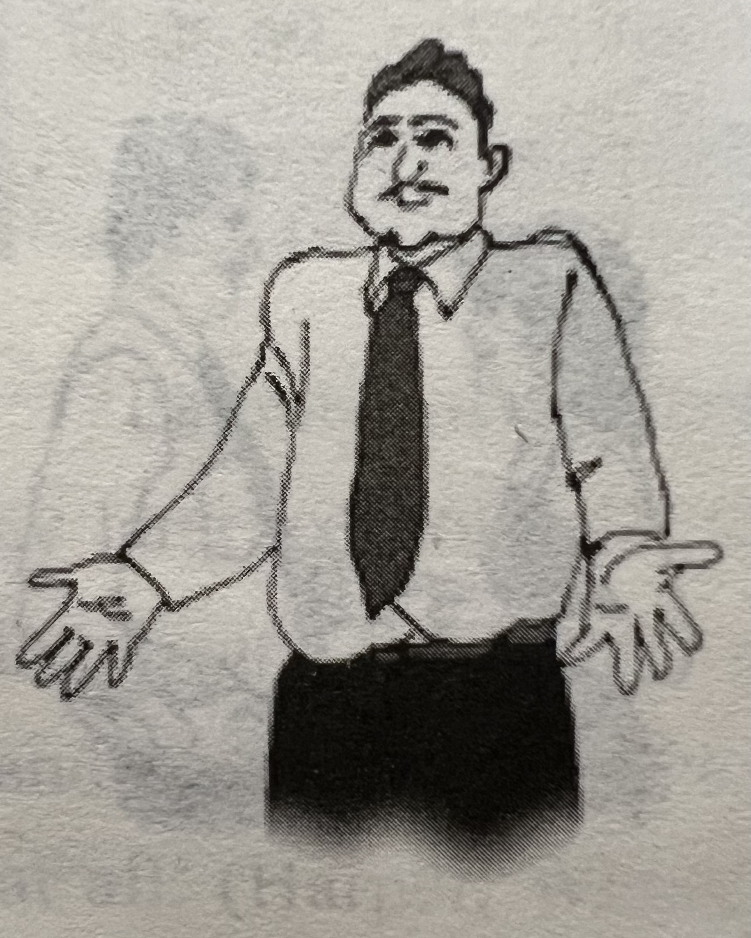
The Fourth Example
Shrugging shoulders.
Shrugging one’s shoulders can express that one is indifferent, powerless or having no secret to conceal.
Americans often shrug their shoulders to show that they are innocent. But Chinese people dislike seeing such a posture in communication.
They are cut down to size if they shrug their shoulders to express their being at a loss to do something, as it is not quite acceptable among the Chinese in communication.

Slide 10
03
Significance

Slide 11
Significance
Postures send different messages to people.
When you stand in an upright position, you impress others as being energetic.
When you are sitting with a hand supporting your chin, you give others the impression that you are eirher deep in thinking or in the blues.
When you lean forward while listening, it will strike the speaker that you are attentive and interested in what he is saying.
But if you look away from time to time while listening, it will be interpreted as being either absent-minded or lacking interest.
In a way we may say that our postures act like a “liberal messenger,”who is ready to send any message out, though most times unconsciously.

Slide 12
04
The Reasons

Slide 13
The Reason
Although not all messages sent by your postures are negative to you, it would be more than enough to damage your image as a businessman if you neglect your postures in front of others.
The reason why posture often goes unnoticed to many people is that it follows one’s natural habits and, therefore, it is subconscious in nature.

Slide 14
Thank You For Listening

