Slide 1
Itti&Koch’s model and LIF

Slide 2
Contents
What did Itti and Koch achieve in the article
What we got till now
Itti & Koch’s LIF: Winner take all network

Slide 3
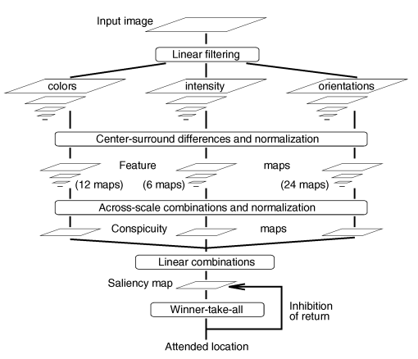
Itti and Koch’s model
The key parts are :
Center-surround differences
Across scale combinations

Slide 4
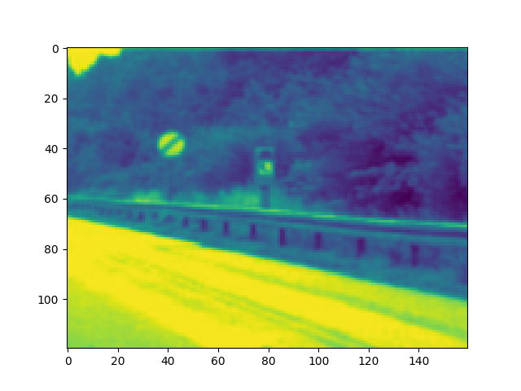
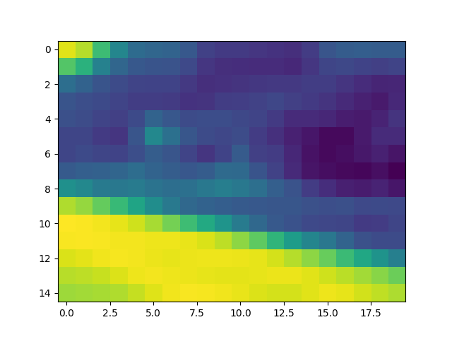
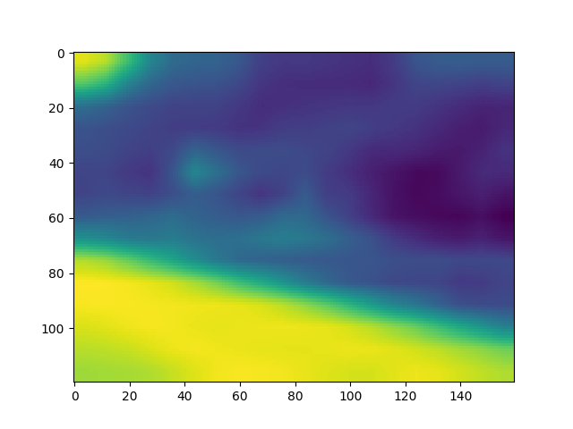
Center-surround differences
Up-sampling
-
High resolution
Low resolution
High resolution

Slide 5
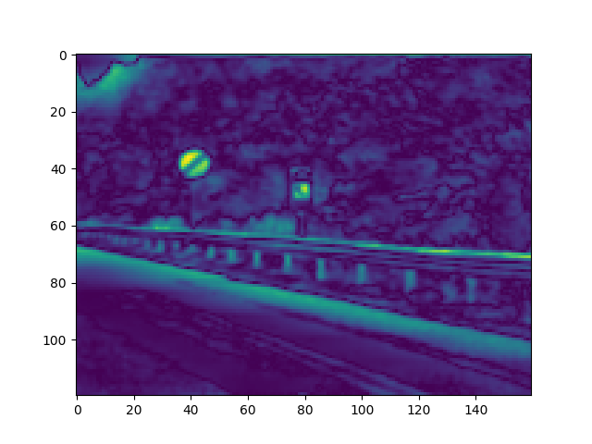
Center-surround differences
Up-sampling
-
High resolution
Low resolution
High resolution

Slide 6
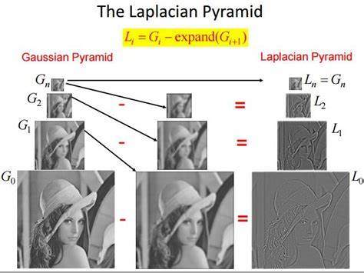

Laplacian Pyrimid
Got G_{c}-expand(G_{c+δ=s})

Slide 7
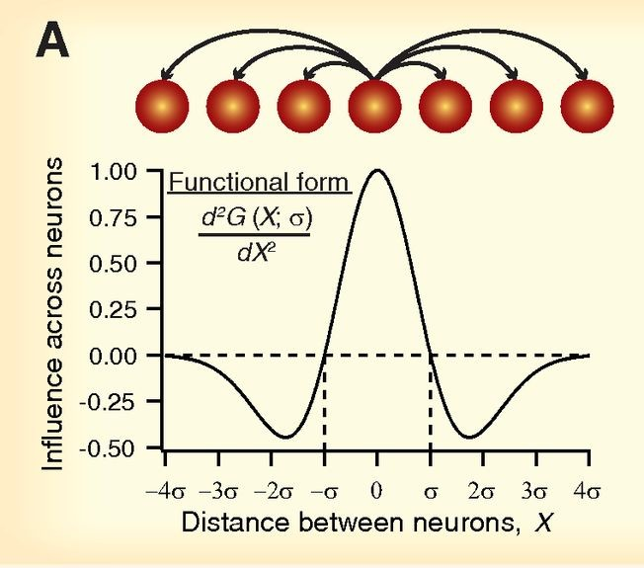
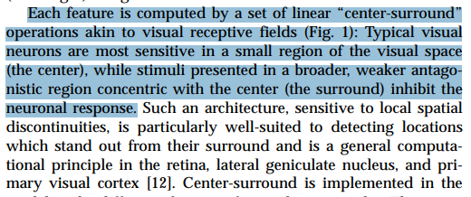
Bio-inspired?

Slide 8
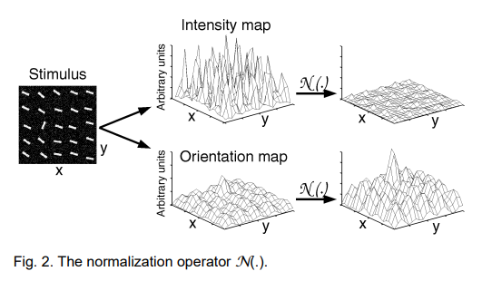
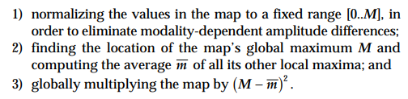
Normalize

Slide 9
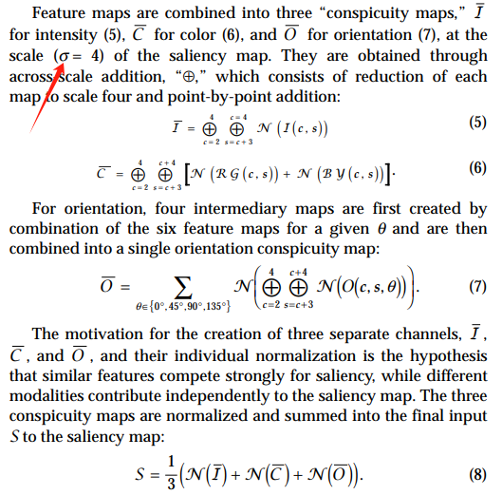
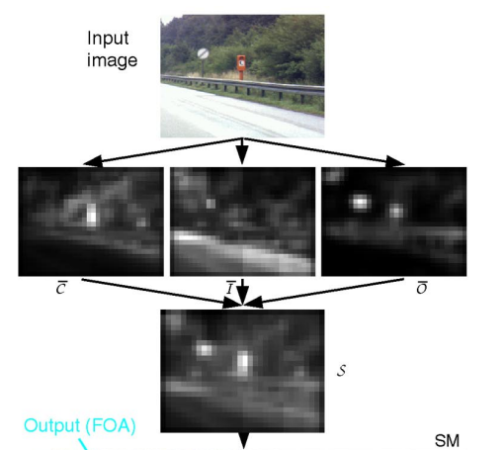
Across scale combinations: down-sampling

Slide 10
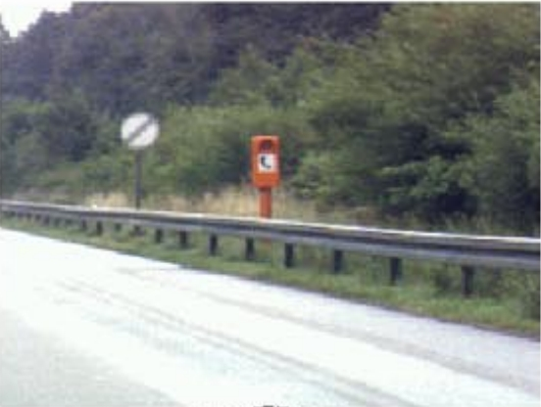
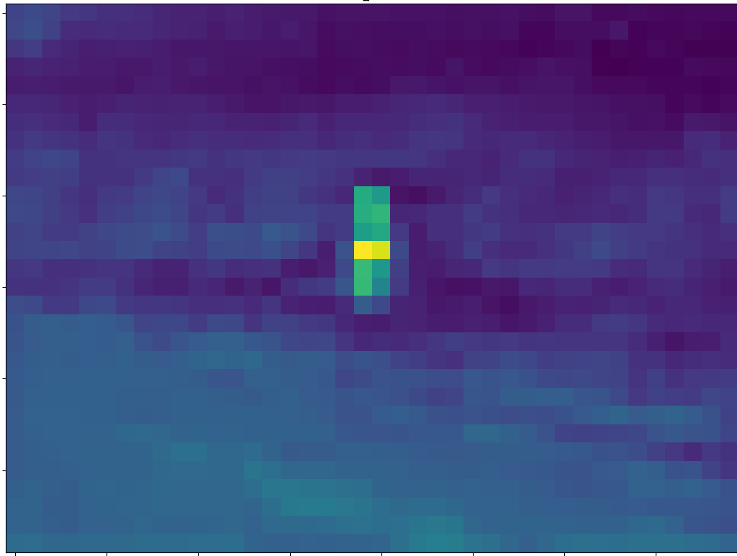
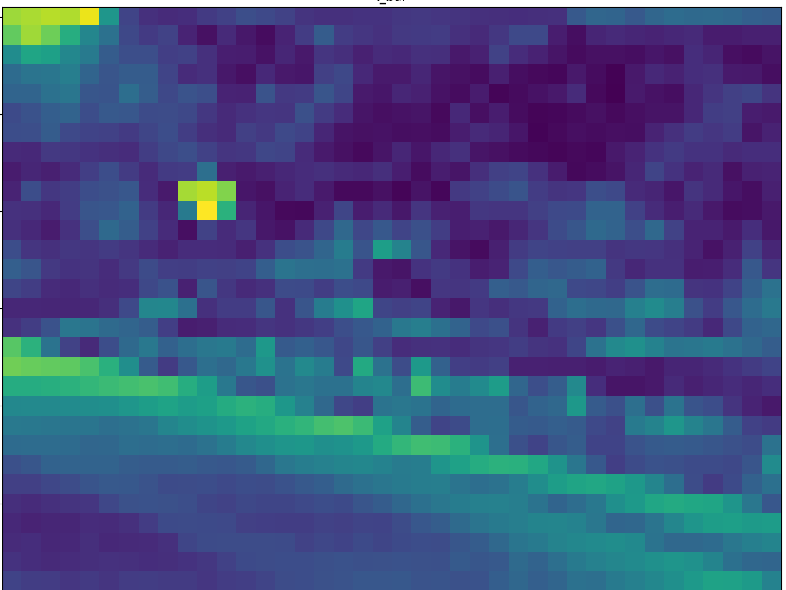
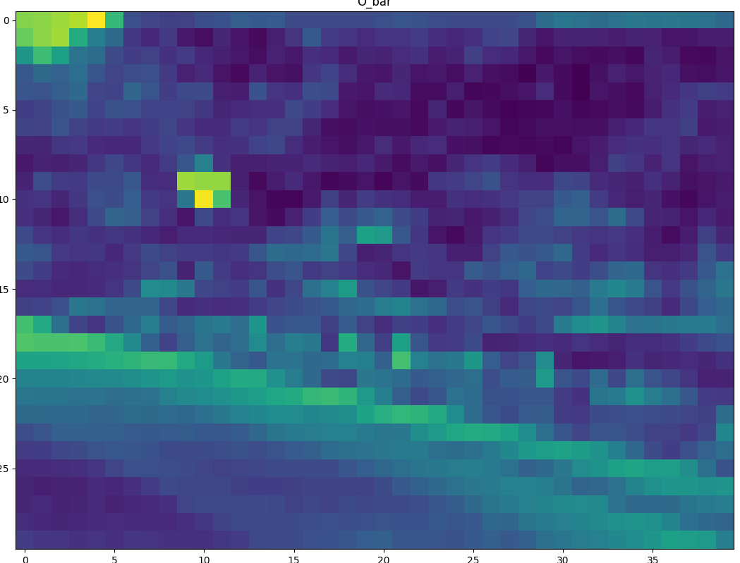
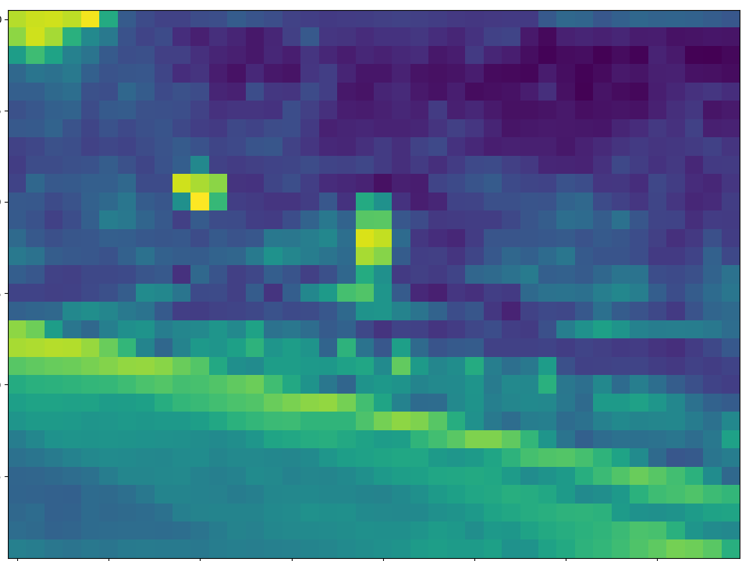
Itti’s result in the article
Our result

Slide 11
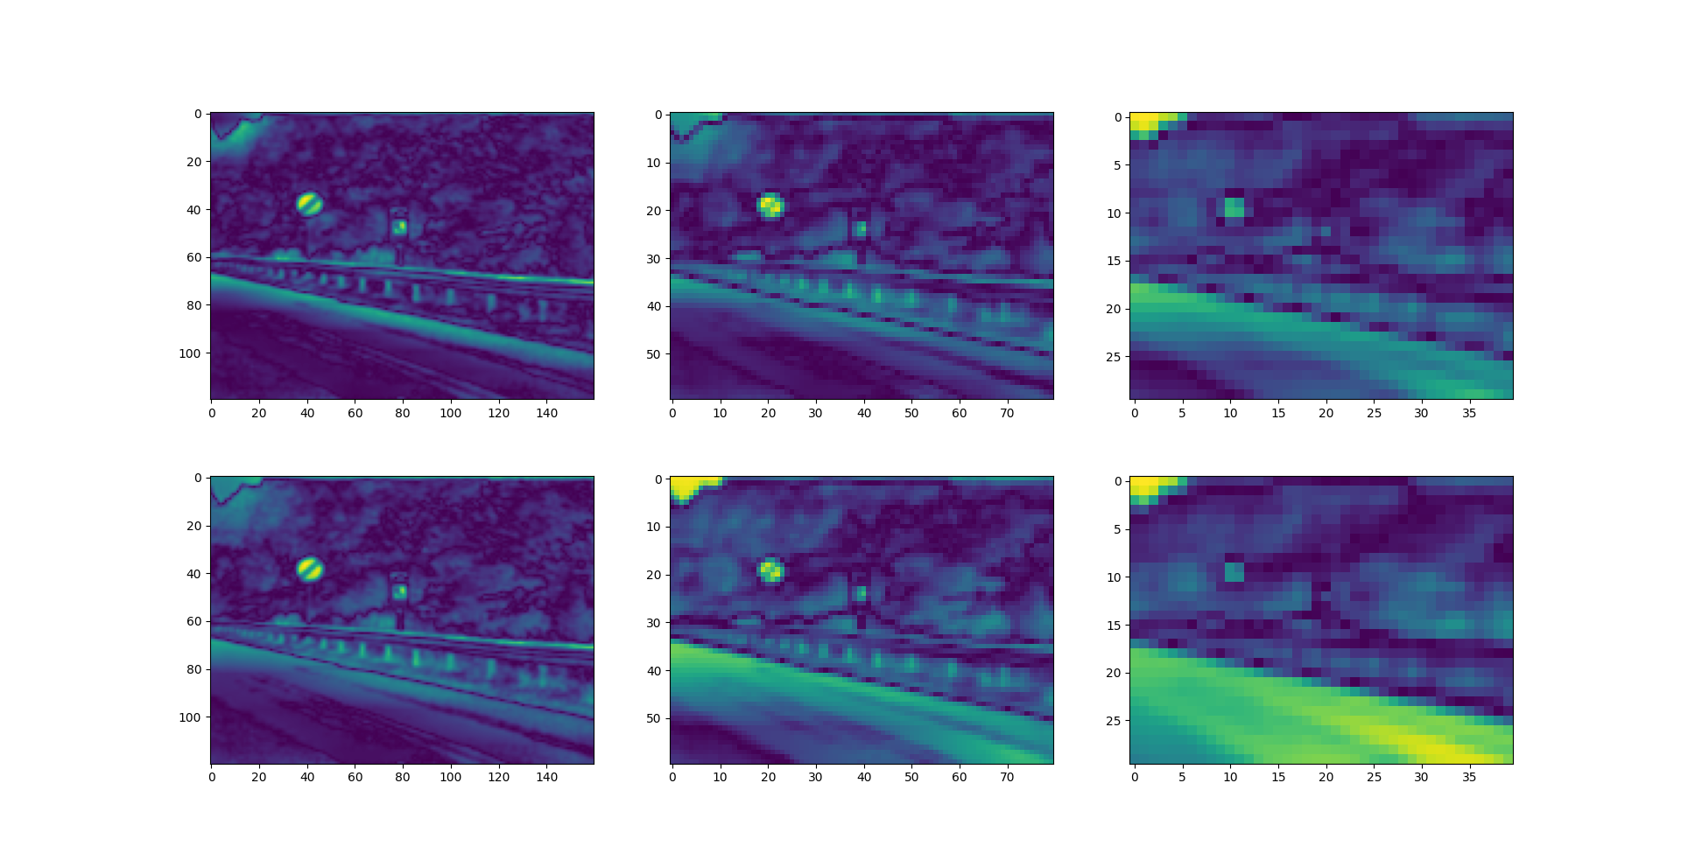
Intensity maps

Slide 12
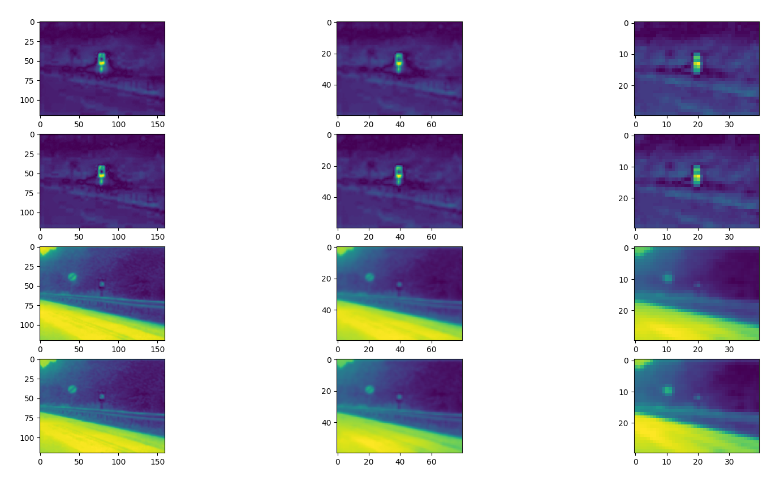
Color maps

Slide 13
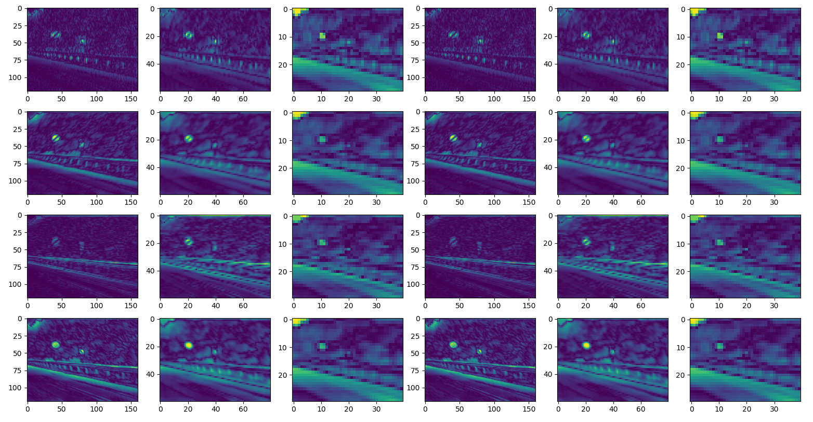
Orientation maps

Slide 14
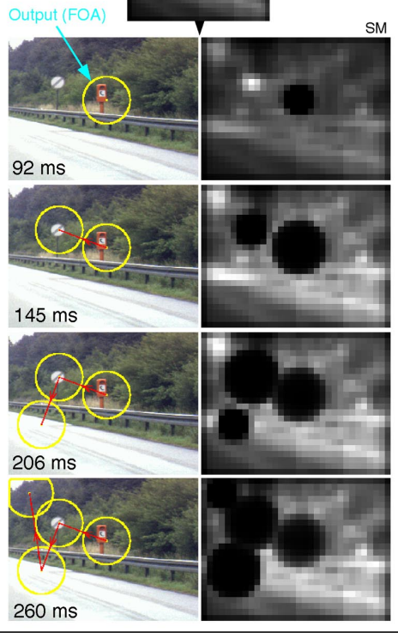
Itti&Koch’s LIF: winner take all
Input
current
2D Winner-Take-All LIF neurons
Saliency Map (SM) at scale(σ) 4

