Slide 1
ACV - HW1 Image Matching

Slide 2
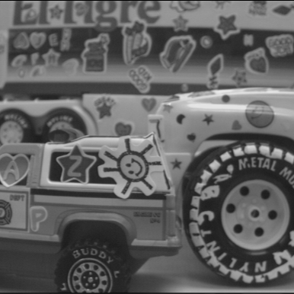
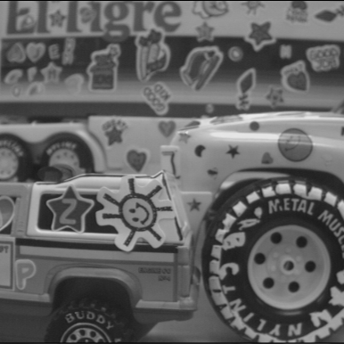
truck a
truck b

Slide 3
truck a
truck b

Slide 4
truck a
truck b
Search range : 50 pixels
Find dx, dy minimize :

Slide 5
truck a
truck b
Search range : 50 pixels
Motion vector
Find dx, dy minimize :

Slide 6
Windows size: 8 x 8

Slide 7
Windows size: 31 x 31

