Slide 1
We need your consent to proceed
This research project is conducted at Ghent University. In this experiment, you will play a simple game. We will need your name in order to give you credit in the Sona, but your name will be immediately deleted after we finish data collection. The data we collect will solely be used for research purposes. Anonymized data from the study will be registered and archived at a trusted public data repository to make them available to other researchers in line with current data sharing practices. You are free to stop the experiment by closing your browser window at any time. Non-participation or withdrawal from the study will not be of any disadvantage to you. If you have any questions, you can contact Zhang Chen at zhang.chen@ugent.be or the lead researcher Frederick Verbruggen at frederick.verbruggen@ugent.be.
By clicking “I agree” (scroll down if you don’t see the button), you affirm that you are at least 18 years of age, which is the minimum age to participate in this study, and that you understand the nature of your participation in this research. If you do not wish to participate, please close this window.

Slide 2
1
2
3
Welcome! In this experiment, you will play two simple games, and then answer some questions. The whole experiment will take around 35 minutes. The progress bar above shows you which task you are currently doing.
IMPORTANT: Do not refresh the page during the experiment. Refreshing the page will restart the experiment from the beginning.
Press J to see the next page.

Slide 3
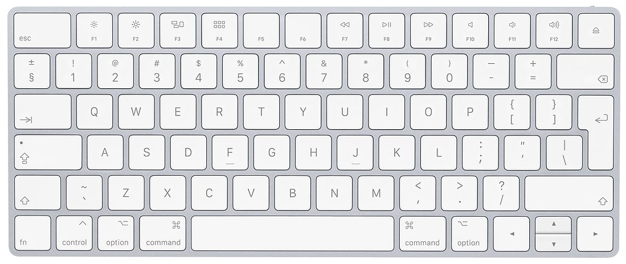
1
2
3
We will now explain the rules of the games. You will use the F, J keys and the space bar to play. Put your left and right index fingers on the F and the J keys and put both thumbs on the space bar.
Press F to see the previous page; press J to see the next page.

Slide 4
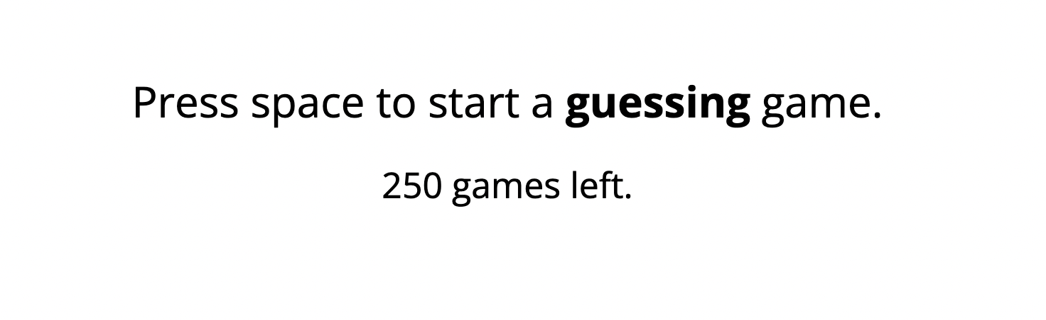
The first task consists of two types of games, the guessing game and the choice game. You will alternate between these two types of games.
Before each game starts, you will see a message telling you which game you are going to play next (see a screen shot below). You need to press the space bar to start a game.
Press F to see the previous page; press J to see the next page.

Slide 5

Rules of the guessing game
In the guessing game, you need to guess the color of a card. Sometimes you will see a card with both blue and yellow (see below) and need to guess the color of the other side of the card. You press F if you think the other side is blue, and J if you think the other side is yellow.
After your guess, the card will be turned. If your guess is correct, you win 40 points; if your guess is incorrect, you lose 40 points.
Press F to see the previous page; press J to see the next page.

Slide 6

Rules of the guessing game
Sometimes you will see a completely blue card or a completely yellow card (see below for a blue card). For these two cards, both sides have the same color. You therefore don’t need to guess. Instead, just press the F key if it is a blue card and press the J key if it is a yellow card.
After you press the correct key, the card will be turned. For these two cards, you will not win or lose any points. However, it is still important that you respond correctly.
Press F to see the previous page; press J to see the next page.

Slide 7
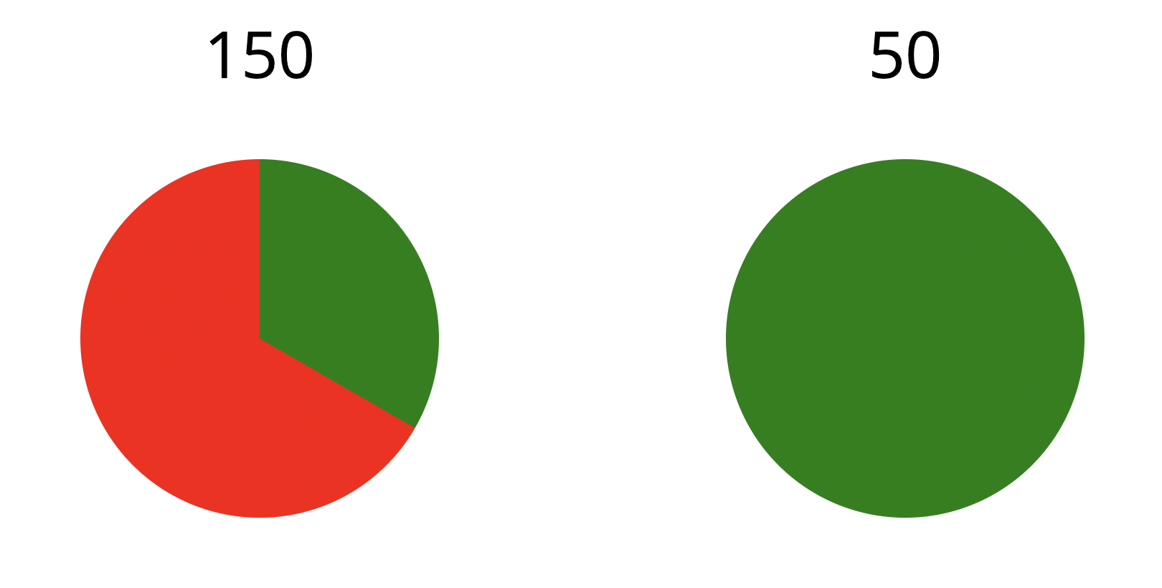
Rules of the choice game
In the choice game, you will see two choice options represented by two pie charts.
One option is a guaranteed number of points. This option is represented by a pie chart that is 100% green (see the example below). If you choose this option, the probability of winning the points is 100%. In the example below, if you pick this option, you will be guaranteed to win 50 points.
Press F to see the previous page; press J to see the next page.

Slide 8
Rules of the choice game
Another option is a gamble option. This option is represented by a pie chart that contains both red and green areas (see the example below). The green area represents the probability that you will win the amount shown above the pie chart; the red area represents the probability that you will get nothing. Thus, the larger the green area, the higher the probability of winning.
In this example, if you pick this option, there is a 33% chance that you will win 150 points, and a 67% chance that you will get nothing (0 points).
Press F to see the previous page; press J to see the next page.

Slide 9
Rules of the choice game
The two options will be shown side by side. Press the F key if you want to choose the left option and press the J key if you want to choose the right option. After your choice, the chosen pie chart will be turned. If the turned side is green, you win the number of points shown above the selected pie chart; if the turned side is red, you will get nothing (0 points).
Press F to see the previous page; press J to see the next page.

Slide 10
You will play 250 games in total (125 guessing games and 125 choice games). At the end of the experiment, we will randomly pick 10 guessing games and 10 choice games. The points that you get on these games will be added up. We plan to recruit around 50 participants for this experiment. The one with the most points will receive a bonus of 10 euro via bank transfer.
We do not include any breaks, so feel free to take short breaks between games, if necessary. Sometimes you may see the ‘Please wait…’ message – this means that the program is processing data and will resume soon. If there is anything unclear, press F to go back to previous pages and read the rules again. If everything is clear now, press J to start playing. Good luck!
IMPORTANT: Do not refresh the page during the experiment. Refreshing the page will restart the experiment from the beginning.

Slide 11
1
2
3
That was the first task. The program has randomly picked 10 guessing games and 10 choice games and recorded the total amount of points you have. We will reveal this at the end of the experiment.
In this second task, you will see 9 questions about your past experiences with gambling. For each question, indicate how often the situation described in the question has occurred to you, by selecting Never, Sometimes, Most of the time or Almost always. You will use the computer mouse or the touchpad to answer these questions.
Press J to continue.

Slide 12
1
2
3
In this last task, you will see 20 statements that describe ways in which people act and think. For each statement, please indicate how much you agree or disagree with the statement, by selecting Agree Strongly, Agree Somewhat, Disagree Somewhat or Disagree Strongly. Be sure to indicate your agreement or disagreement for every statement.
Press J to continue.

