Slide 1
We need your consent to proceed
This research project is conducted at Ghent University. In this experiment, you will play a simple wheel of fortune game. Afterwards you will answer some questions on how you generally think and act. The data we collect will solely be used for research purposes. Anonymized data from the study will be registered and archived at a trusted public data repository to make them available to other researchers in line with current data sharing practices. You are free to stop the experiment by closing your browser window at any time. Non-participation or withdrawal from the study will not be of any disadvantage to you. If you have any questions, you can contact Zhang Chen at zhang.chen@ugent.be.
By clicking “I agree” (scroll down if you don’t see the button), you affirm that you are at least 18 years of age, which is the minimum age to participate in this study, and that you understand the nature of your participation in this research. If you do not wish to participate, please close this window.

Slide 2
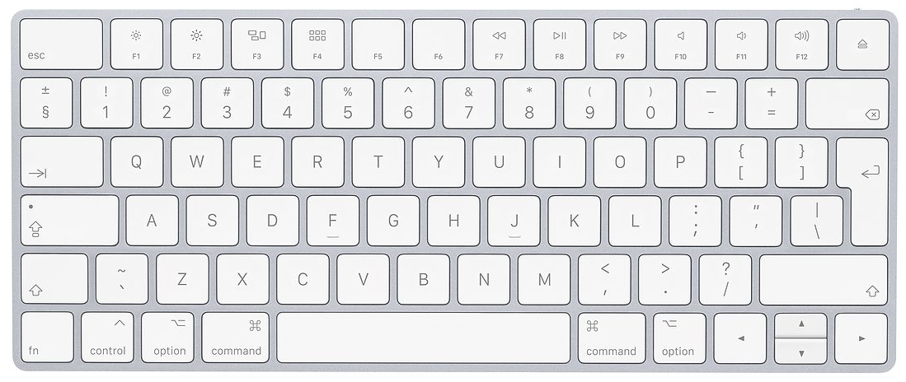
Welcome! In this experiment, you will play a simple wheel of fortune game. Afterwards you will answer some questions on how you generally think and act. The whole experiment will take around 25 minutes.
You will use the F, J keys and the space bar to play. Put your left and right index fingers on the F and the J keys and put both thumbs on the space bar.
Press F to see the previous page; press J to see the next page.

Slide 3
The game consists of 6 blocks. The first two blocks are practice blocks and are quite short (about 1 minute per block). The remaining 4 blocks are experimental blocks and will be somewhat longer (about 5 minutes per block).
We will now explain the rules of the first game, the guessing games.
IMPORTANT: Do not refresh the page during the experiment. Refreshing the page will restart the experiment from the beginning.
Press F to see the previous page; press J to see the next page.

Slide 4
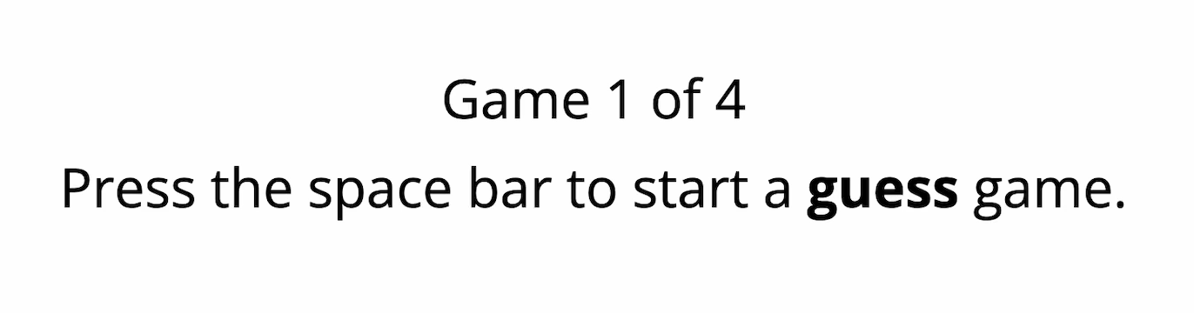
Rules of the guessing game
At the beginning of each guessing game, the program will tell you how many games there are in the current block, and which game you are going to play next (see an example below).
You can press the space bar to start a game.
Press F to see the previous page; press J to see the next page.

Slide 5
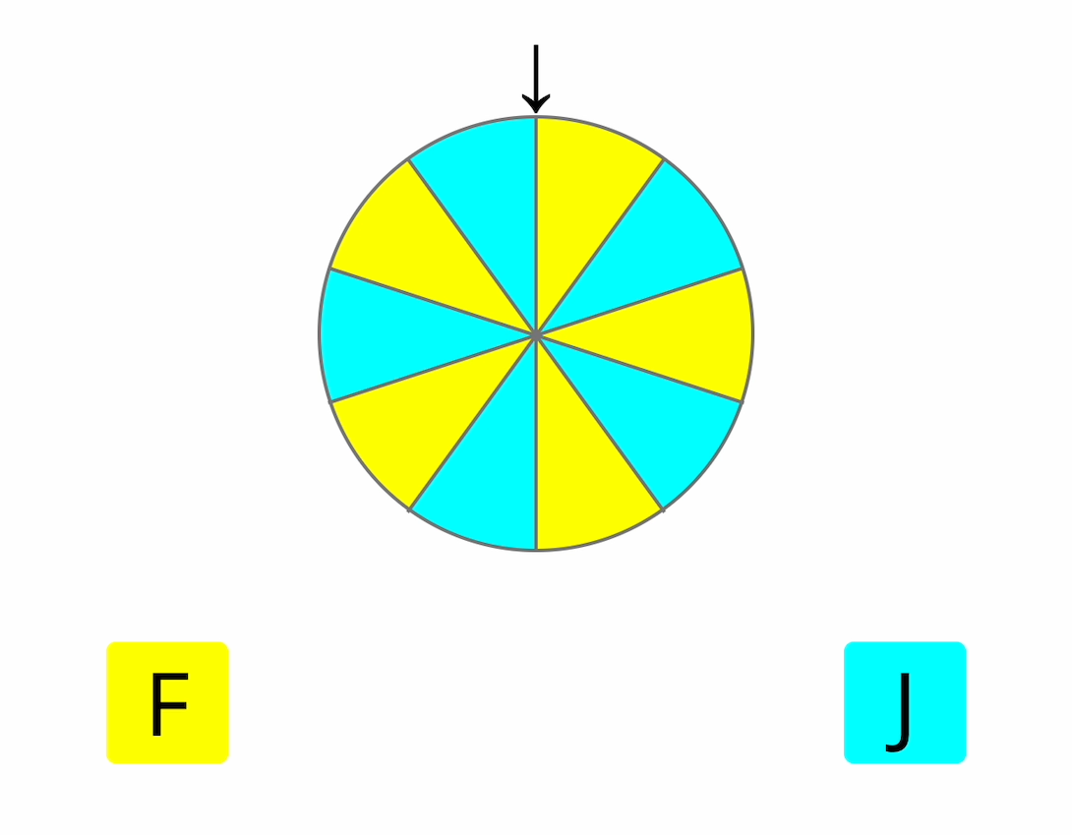
Rules of the guessing game
You will then see a wheel, with both yellow and blue parts (see below). Your task is to guess after spinning the wheel, whether the arrow will point at yellow or blue.
Press F to see the previous page; press J to see the next page.

Slide 6
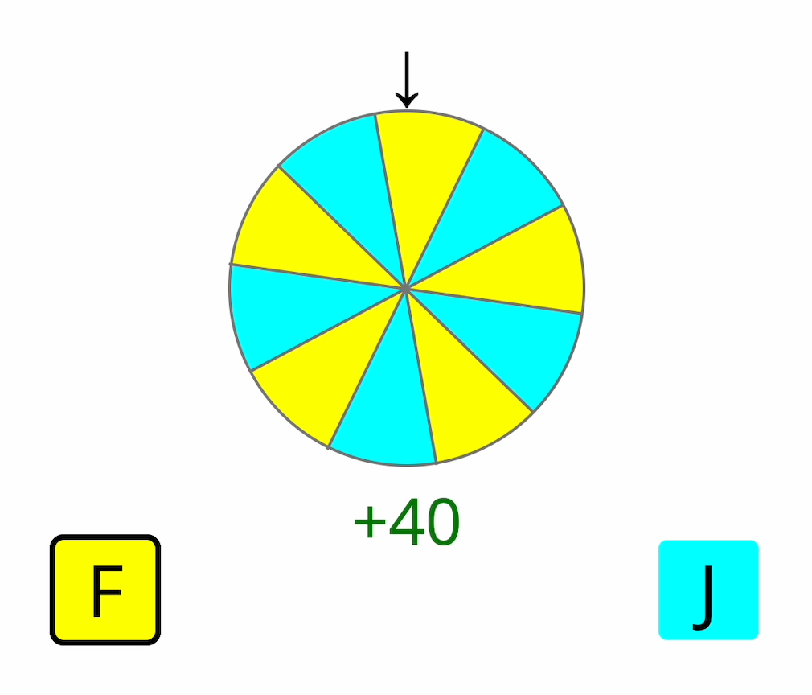
Rules of the guessing game
If you think the arrow will point at yellow, press F; if you think the arrow will point at blue, press J. The program will then spin the wheel. If you guess correctly, you win 40 cents (see an example below); if you guess incorrectly, you lose 40 cents.
Press F to see the previous page; press J to see the next page.

Slide 7
Rules of the guessing game
You will now receive 4 practice trials to get you familiar with the task.
If the rules are not clear to you, press F to read them again.
If everything is clear, press J to start Block 1.
Press F to see the previous page; press J to start Block 1.

Slide 8
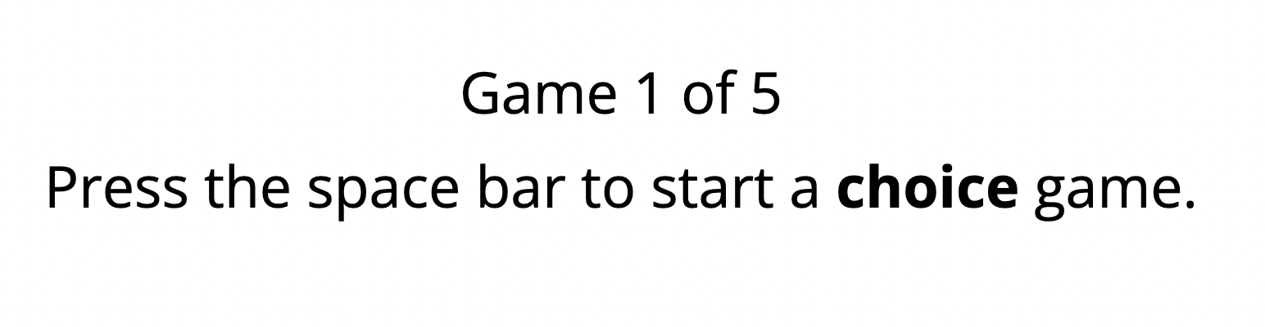
Rules of the choice game
Block 2 contains a different wheel of fortune game, the choice game.
At the beginning of each game, the program will tell you how many games there are in the current block, and which game you are going to play next (see below).
You can press the space bar to start a game.
Press F to see the previous page; press J to see the next page.

Slide 9
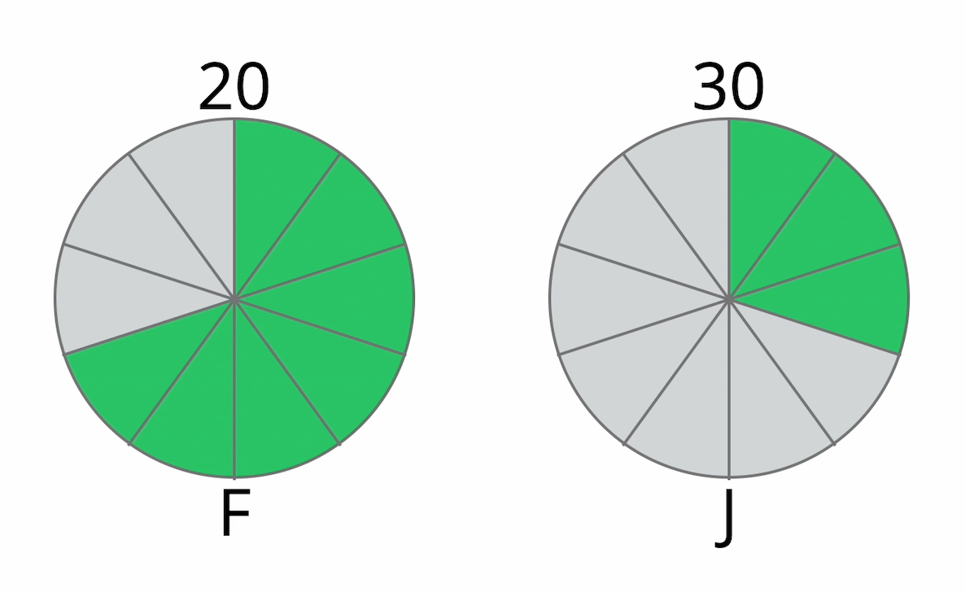
Rules of the choice game
After you start, you will see two wheels on screen (see an example below).
The two wheels will have green and gray parts and have a number on top of them.
Press F to see the previous page; press J to see the next page.

Slide 10
Rules of the choice game
The numbers tell you how many cents you may win for each option.
In the example below, if you choose F, you may win 20 cents; if you choose J, you may win 30 cents.
Numbers show how much money you can win from each option.
Press F to see the previous page; press J to see the next page.

Slide 11
Rules of the choice game
The pie charts tell you the chance of winning. The bigger the green area, the higher the chance of winning.
In the example below, if you choose F, you have a 70% chance of winning 20 cents; if you choose J, you have a 30% chance of winning 30 cents.
Pie charts show the probability of winning for each option.
Press F to see the previous page; press J to see the next page.

Slide 12
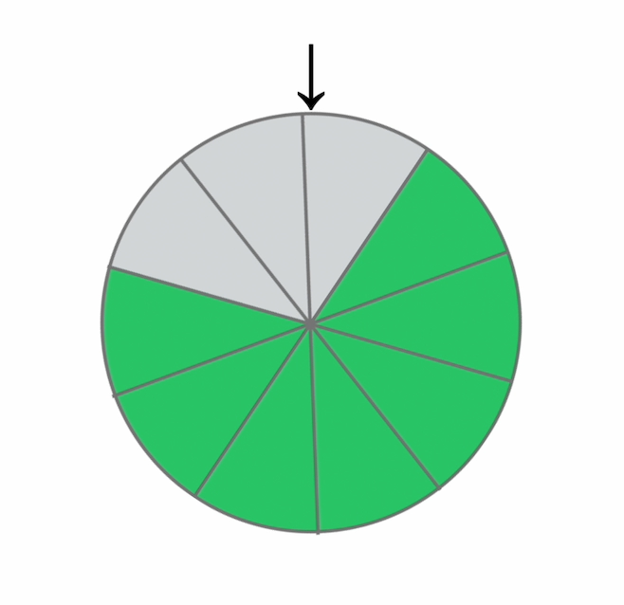
Rules of the choice game
Your task is to choose which wheel you want to play, by pressing F or J. After you have made your choice, the program will spin the chosen wheel.
If the black arrow ends up pointing at green, you win money; if the black arrow points at gray, then you do not win any money (see the example below).
Press F to see the previous page; press J to see the next page.

Slide 13
Rules of the choice game
You will now receive 5 practice trials to get you familiar with the task.
If the rules are not clear to you, press F to read them again.
If everything is clear, press J to start Block 2.
Press F to see the previous page; press J to start Block 2.

Slide 14
Time for the experimental blocks!
You are going to alternate between the guessing game and the choice game. We have included 4 blocks, and each block includes 52 games (5 minutes per block). After finishing each block, you can take a short break if needed.
At the end of the experiment, we will randomly pick 4 guessing games and 4 choice games. The money that you have win or lost on these 8 games will be added up and paid to you as an extra bonus (maximum 1 British pound). If you end up with 0 or a negative number, then you won’t get an extra bonus. Since you don’t know which games will be picked, your best strategy is to treat each game as if it is the only one that counts.
Press J to start the experimental blocks. Good luck!
IMPORTANT: Do not refresh the page during the experiment. Refreshing the page will restart the experiment from the beginning.

Slide 15
In this last part of the experiment, you will see 20 statements that describe ways in which people act and think. For each statement, please indicate how much you agree or disagree with the statement, by selecting Agree Strongly, Agree Somewhat, Disagree somewhat or Disagree Strongly. You will need to use computer mouse or touchpad to do this task. Be sure to indicate your agreement or disagreement for every statement. Press the J key to start.

