Slide 1
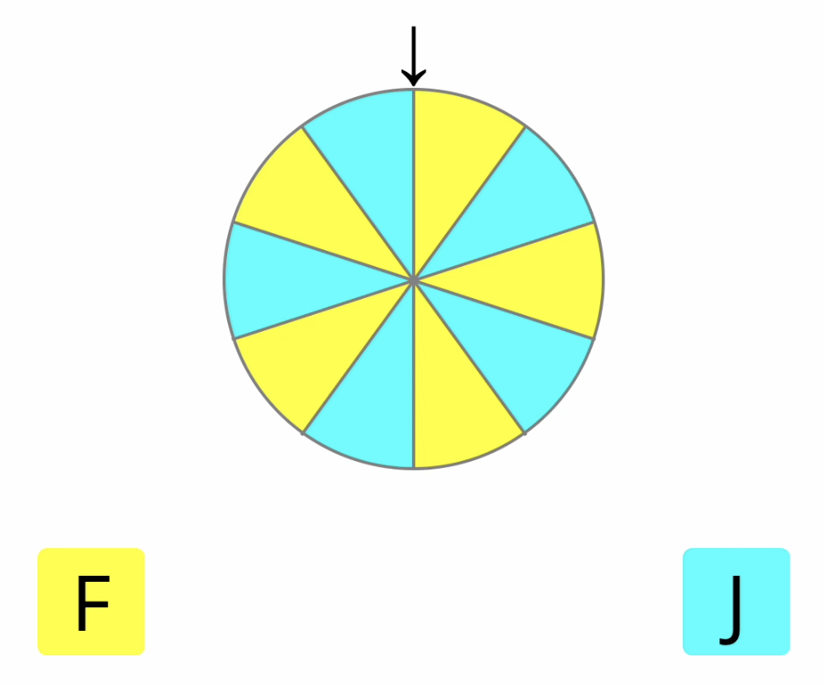
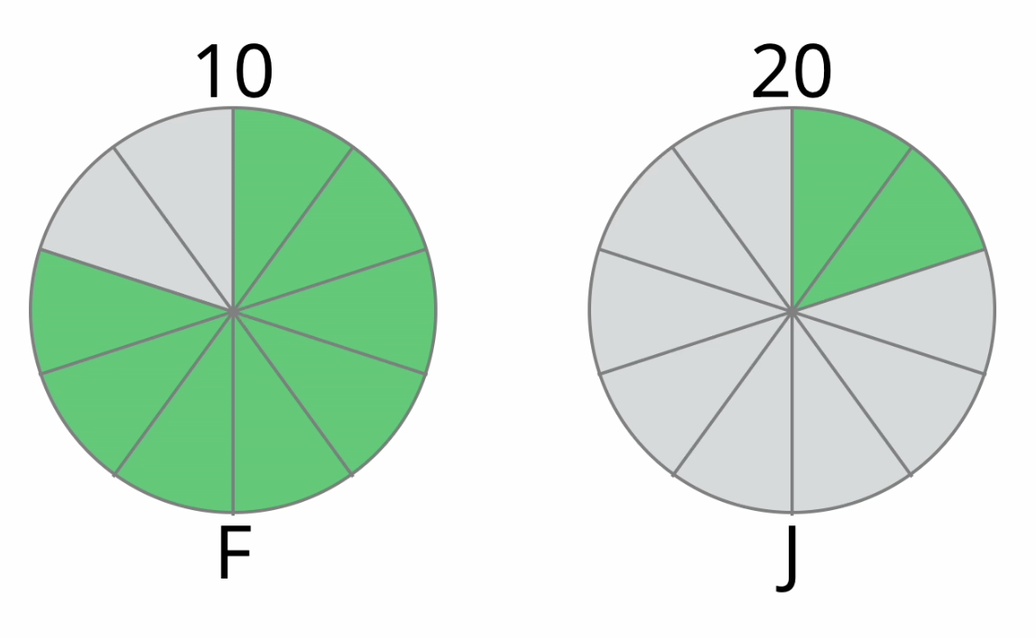
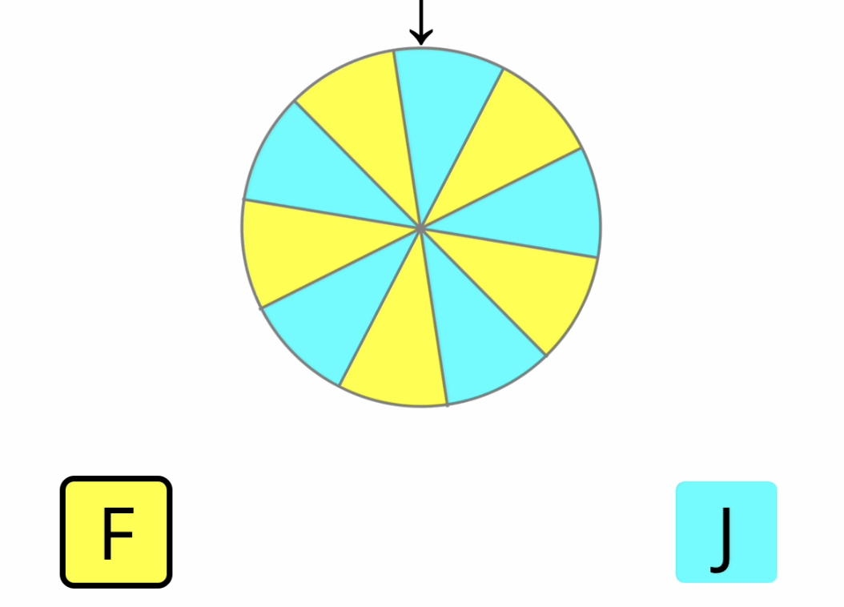
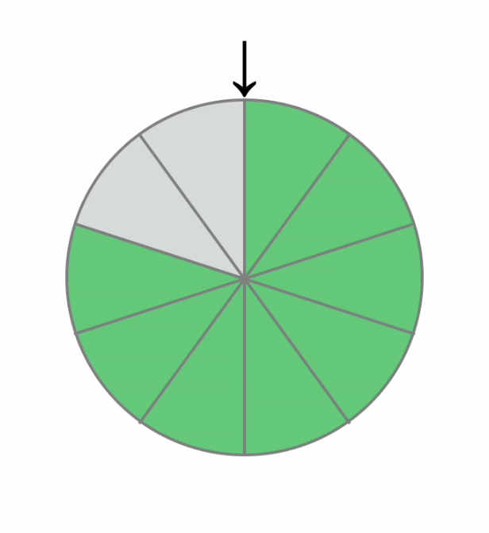

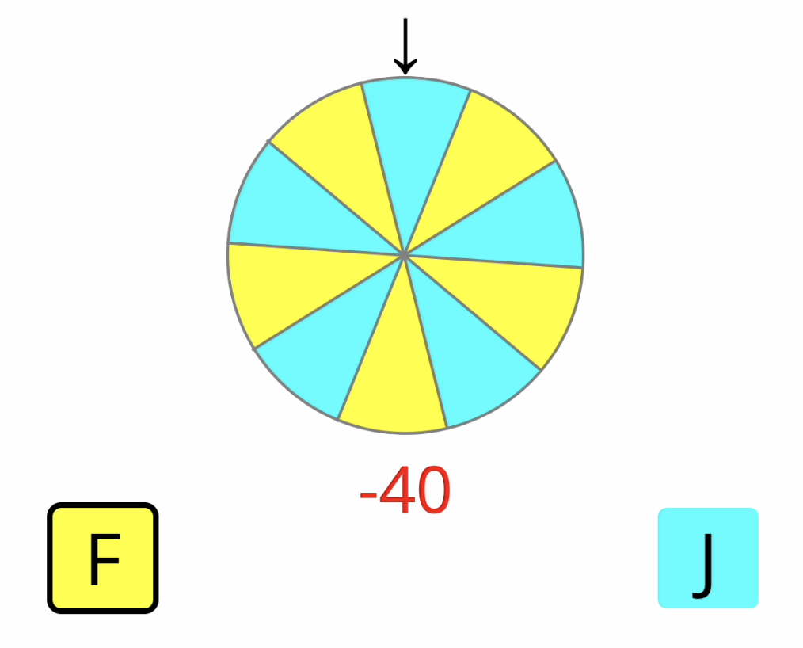
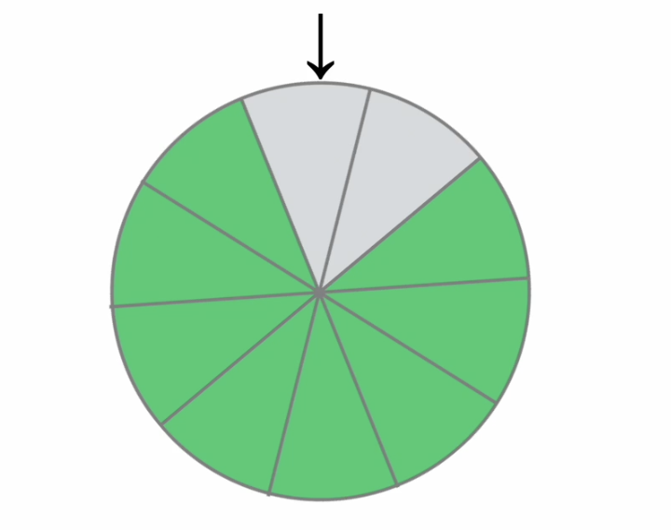
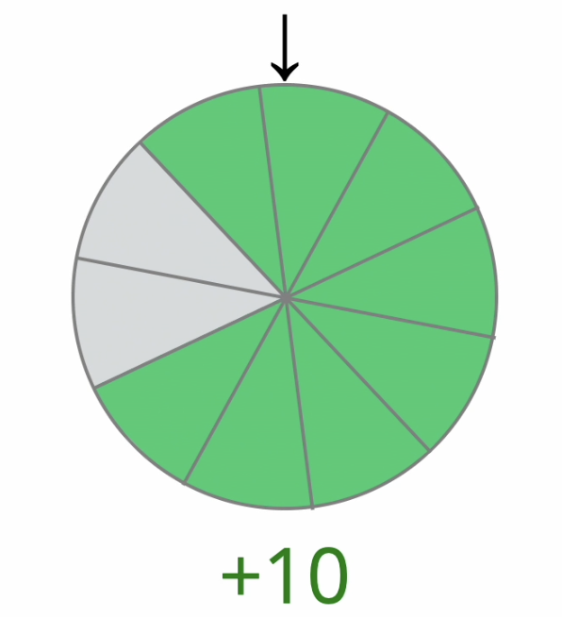
Press the space bar to start a guess game.
Press the space bar to start a choice game.
Self-Paced
Self-Paced
Self-Paced
Self-Paced
1500 ms
500 ms
1000 ms
1500 ms
Loading the game…
0 (300) or 3000 ms
1000 ms

