Slide 1
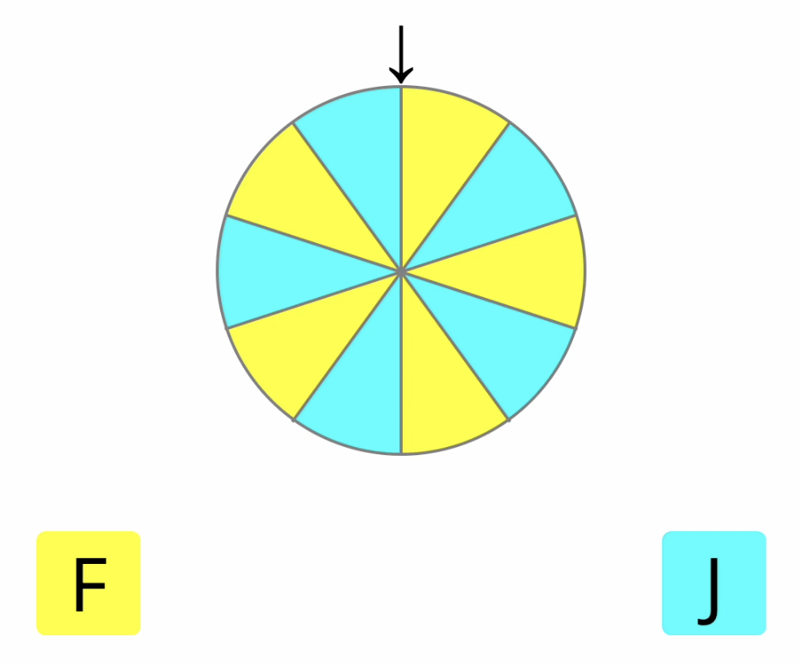
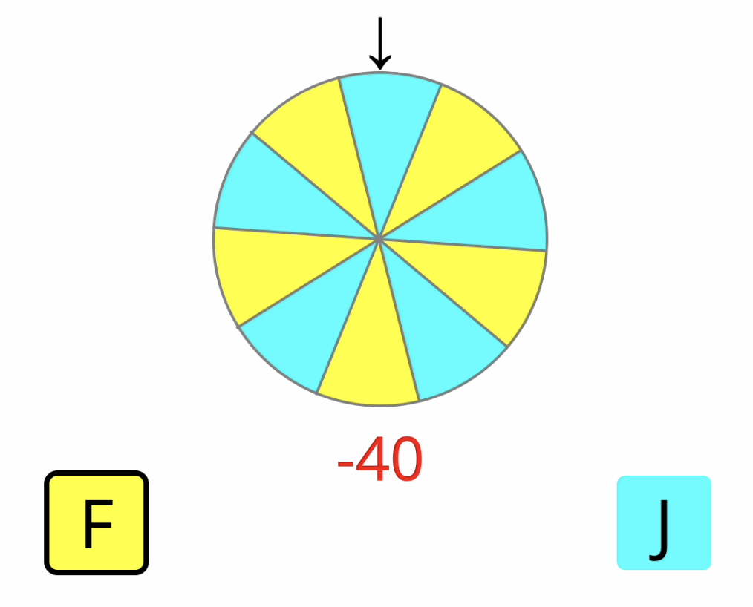
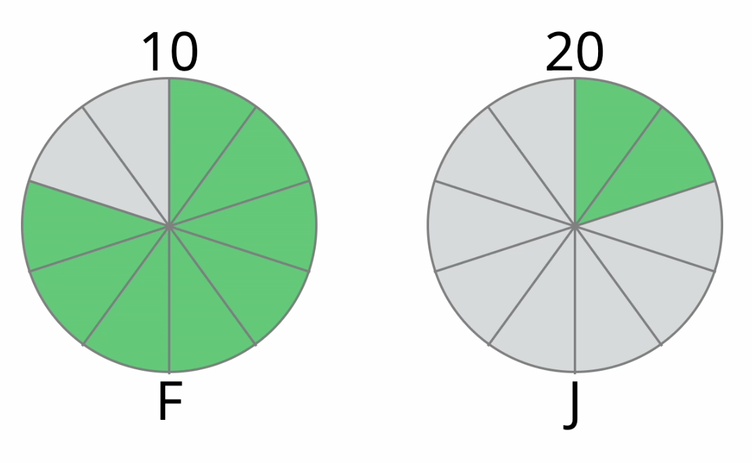
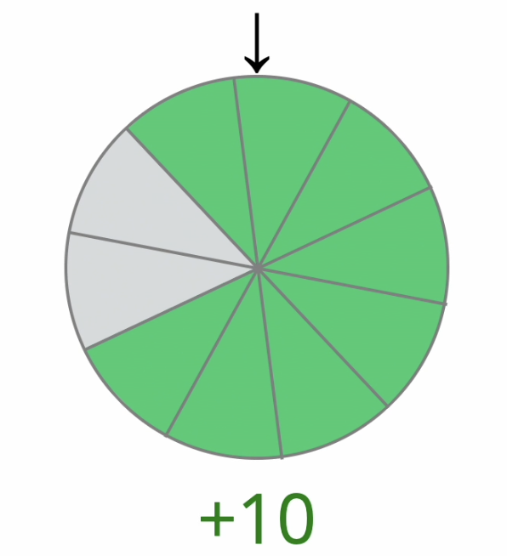
Press the space bar to start a guess game.
Loading the game…
Self-Paced
0 or 3000 ms
Press the space bar to start a choice game.
Self-Paced
Self-Paced
2500 ms
Self-Paced
3000 ms

