Slide 1
We need your consent to proceed
This research project is conducted at Ghent University. In this experiment, you will play some simple games. We need your name to give you credit in Sona, but will immediately delete your name after data collection. These data will solely be used for research purposes. Anonymized data from the study will be registered and archived at a trusted public data repository to make them available to other researchers in line with current data sharing practices. You are free to stop the experiment by closing your browser window at any time. Non-participation or withdrawal from the study will not be of any disadvantage to you. If you have any questions, you can contact Ymke Verduyn at ymke.verduyn@ugent.be or the lead researcher Zhang Chen at zhang.chen@ugent.be.
By clicking “I agree” (scroll down if you don’t see the button), you affirm that you are at least 18 years of age, which is the minimum age to participate in this study, and that you understand the nature of your participation in this research. If you do not wish to participate, please close this window.

Slide 2
Welcome! In this experiment, you will play some simple games, and then answer some questions. The whole experiment will take around 1 hour.
IMPORTANT: Do not refresh the page during the experiment. Refreshing the page will restart the experiment from the beginning.
Press J to see the next page.

Slide 3
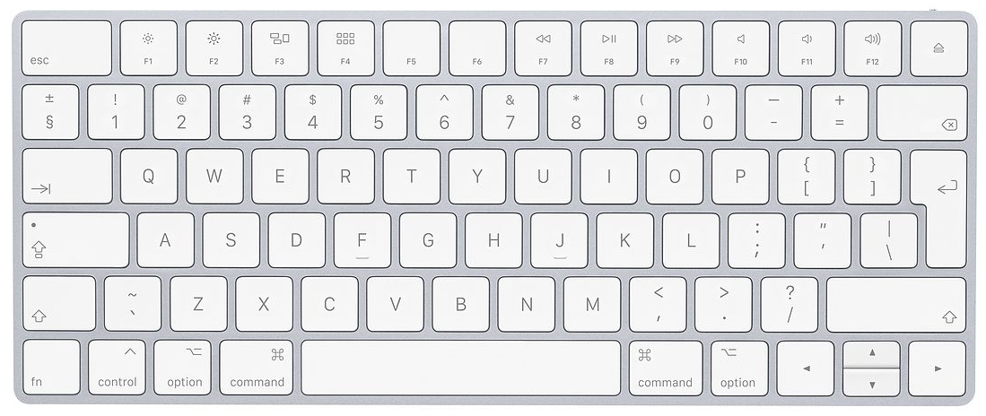
We will now explain the rules of the games. You will use the F, J & K keys and the space bar to play. Put your left and right index fingers on the F and the J keys and put both thumbs on the space bar.
Press F to see the previous page; press J to see the next page.

Slide 4
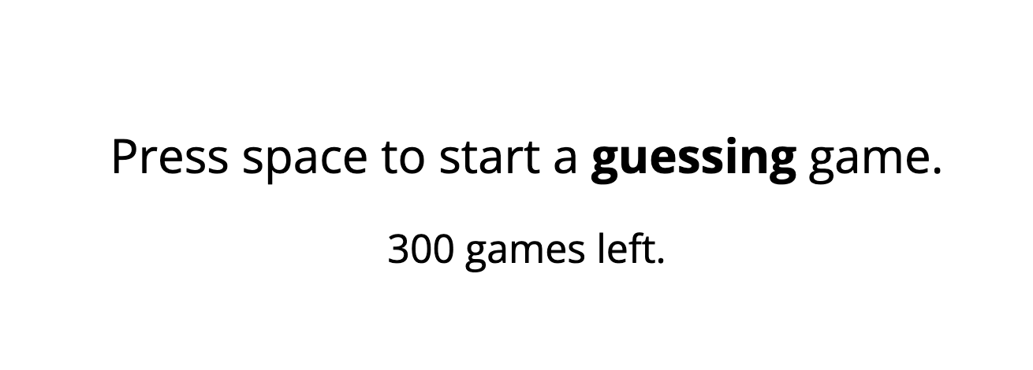
The first task consists of two types of games, the guessing game and the choice game. You will alternate between these two types of games.
Before each game starts, you will see a message telling you which game you are going to play next (see a screen shot below). You need to press the space bar to start.
Press F to see the previous page; press J to see the next page.

Slide 5

Rules of the guessing game
In the guessing game, you need to guess the color of a card. Sometimes you will see a card with both blue and yellow (see below) and need to guess the color of the other side of the card. You press F if you think the other side is blue, and J if you think the other side is yellow.
After your guess, the card will be turned. If your guess is correct, you win 20 cents; if your guess is incorrect, you lose 15 cents.
Press F to see the previous page; press J to see the next page.

Slide 6

Rules of the guessing game
Sometimes you will see a blue or a yellow card (see below for a blue card). For these two cards, both sides are blue or both sides are yellow. You therefore don’t need to guess. Instead, just press the F key if it is a blue card and press the J key if it is a yellow card.
After you press the correct key, the card will be turned. For these two cards, you will not win or lose any cents. However, it is still important that you respond correctly.
Press F to see the previous page; press J to see the next page.

Slide 7
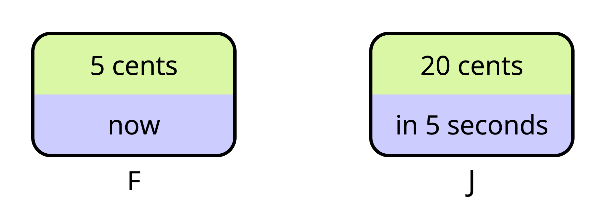
Rules of the choice game
In the choice game, you will see two options (see an example below). One of the two options is an ‘immediate’ option (the left one in the example). If you choose this option, you get a certain amount of money immediately.
The other one is a ‘wait’ option (the right one in the example). It offers a larger amount, but you will need to wait for some time. The option tells you how long you need to wait, and how much money you will get after the wait.
There’s no right or wrong answers. Choose the option that seems better to you at that moment. Press F to choose the left option; press J to choose the right option.
Press F to see the previous page; press J to see the next page.

Slide 8

Rules of the choice game
The money will then appear either immediately (if you choose the ‘immediate’ option) or after some delay (if you choose the ‘wait’ option). You can then press K to collect the money and continue (see an example below).
Press F to see the previous page; press J to see the next page.

Slide 9
The task consists of 6 blocks. Each block will last exactly 8 minutes. Your goal is to try to earn as much money as possible within these 8 minutes. After each block, you will get a chance to take a short break, if necessary.
We will recruit 50 participants. After finishing data collection, we will randomly pick 5 people. One of the 6 blocks will be randomly selected, and the money earned in the selected block (max 10 Euro) will be paid to these five participants, in addition to the 1 study credit.
If there is anything unclear, press F to go back to previous pages and read the rules again. If everything is clear now, press J to start playing. Good luck!
IMPORTANT: Do not refresh the page during the experiment. Refreshing the page will restart the experiment from the beginning.

Slide 10
For each of the next 27 choices, you will see two options: a smaller reward today, or a larger reward in a specified number of days. For each choice, please indicate which reward you would prefer, by using the computer mouse or the touchpad.
Press J to continue.

Slide 11
In this last task, you need to indicate how you felt when you lost or won money in the ‘guessing’ games. You can select the manikin that most accurately represents your feeling, by pressing the corresponding key.
Press J to continue.

Slide 12
This is the end of this experiment. Thank you for your participation !
In this experiment, we are interested in how previous outcomes may influence people’s decisions between smaller immediate rewards and larger delayed rewards (the so-called inter-temporal choices). Previous work has shown that gamblers are in general less patient than non-gamblers. In this experiment, we explore whether experiencing different outcomes (e.g., wins and losses) can already influence people’s momentary level of ‘patience’.
We really appreciate your participation and contribution to this research. If you have any questions, you can contact Ymke Verduyn at ymke.verduyn@ugent.be or the lead researcher Zhang Chen at zhang.chen@ugent.be
You can close this experiment now.

