Slide 1

NumPy Quick Start
Chuye Zhang
2022.4.26

Slide 2

Overview
Understand NumPy
Why NumPy?
Some basic knowledge
Small Practice
Jupyter notebook
Ubuntu tricks
Array operation
Keep Learning

Slide 3
The Zen of Python
Beautiful is better than ugly.
Explicit is better than implicit.
Simple is better than complex.
Complex is better than complicated.
Flat is better than nested.
Sparse is better than dense.
Readability counts.
Special cases aren't special enough to break the rules.
Although practicality beats purity. Errors should never pass silently. Unless explicitly silenced.

Slide 4
The Zen of Python
There should be one-- and preferably only one --obvious way to do it.
Although that way may not be obvious at first unless you're Dutch.
Now is better than never.
Although never is often better than *right* now.
If the implementation is hard to explain, it's a bad idea.
If the implementation is easy to explain, it may be a good idea.
Namespaces are one honking great idea -- let's do more of those!
In the face of ambiguity, refuse the temptation to guess.

Slide 5
Understand NumPy --- Why NumPy?
Effective and efficient (written by C)
Especially when n (array length) is large.
‘ndarray’ is not restricted by GIL (Global Interpreter Lock).
Convenient
Numerical
NumPy = Numerical + Python

Slide 6
Understand NumPy --- Basic knowledge
NumPy’s main object is the homogeneous multidimensional array. It is a table of elements (usually numbers), all of the same type, indexed by a tuple of non-negative integers.
NumPy’s array class is called ‘ndarray’. It is also known by the alias array.
Note that numpy.array is not the same as the Standard Python Library class array.array

Slide 7
Small Practice --- Jupyter notebook
Installation
Please refer to https://www.youtube.com/watch?v=2WL-XTl2QYI
Useful Shortcuts
git@github.com:ZhangChuye/numpy_quick_start.git
Website recommendation
https://towardsdatascience.com/jypyter-notebook-shortcuts-bf0101a98330

Slide 8
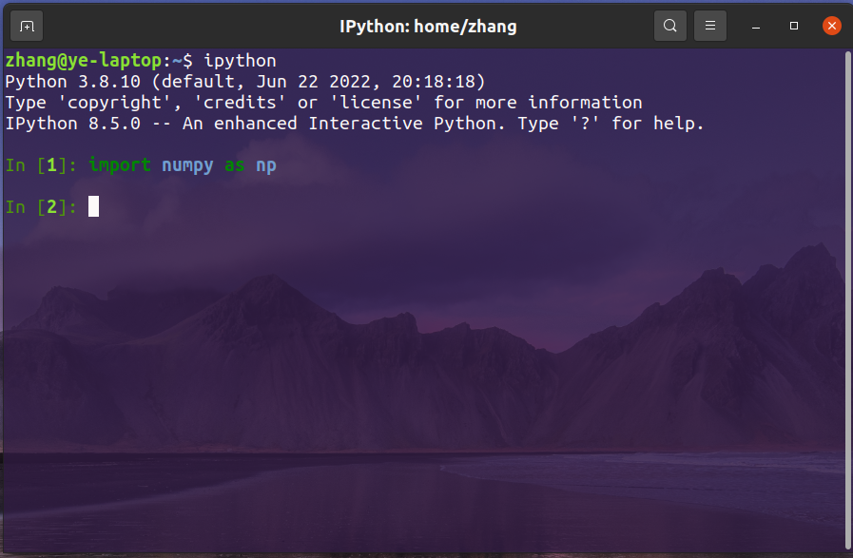
Small Practice --- Ubuntu tricks

Slide 9
Small Practice
Coding with me!

Slide 10
Keep Learning
NumPy Basic: Exercises, Practice, Solution: https://www.w3resource.com/python-exercises/numpy/basic/index.php
Tutorial: https://www.youtube.com/watch?v=AwQRSTCQSJg&list=PLWfX9jo0AdkzNmtJgzXyL_YlWKE2a8idw
CS112 slides
Practice makes perfect

Slide 11
Thanks for Listening

