Slide 1
Dec 4-Final presentation
Everyone will present, each person has 10 minutes for presentation, 5 minutes for question.
1. You can use your own dataset or the gall dataset from this course
2. Outline your research questions
3. Outline the analytical/statistical methods to address your research questions
4. You need use at least three of the statistical methods we learnt from this R course.
5. Describe the statistical model you used, explain why it is the appropriate method to address this question (check if it suits model assumptions, whether it’s the best fitted model).
6. Describe the result of your statistical models.

Slide 2
Dec 4-Final presentation
Evaluation Process: Each presentation will be reviewed by three individuals, with their comments and suggestions compiled in a shared Google Doc. I will provide the evaluation format within a week.
After presenting, participants must respond to all feedback and submit their final data analysis results as either an HTML or PDF file (if knitting is unsuccessful). The final score will be based on how thoroughly the feedback was addressed.

Slide 3
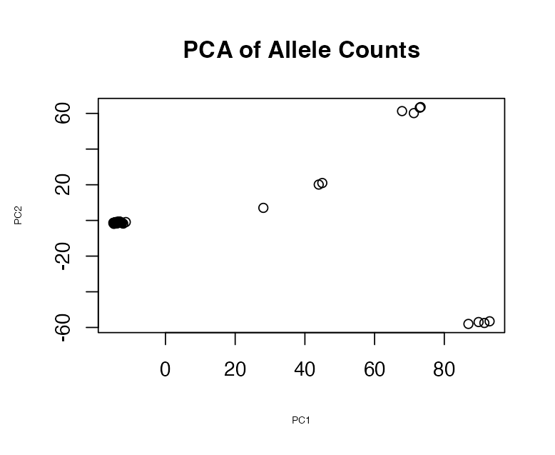
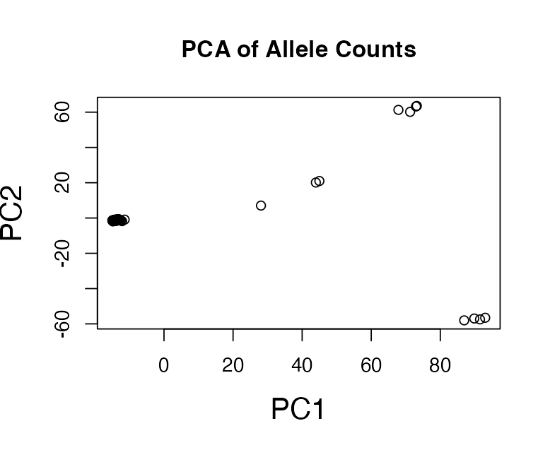
Data visualization principle
Your figure should be interpretable as a stand-alone object
1. Make your legend and axis labels big.

Slide 4
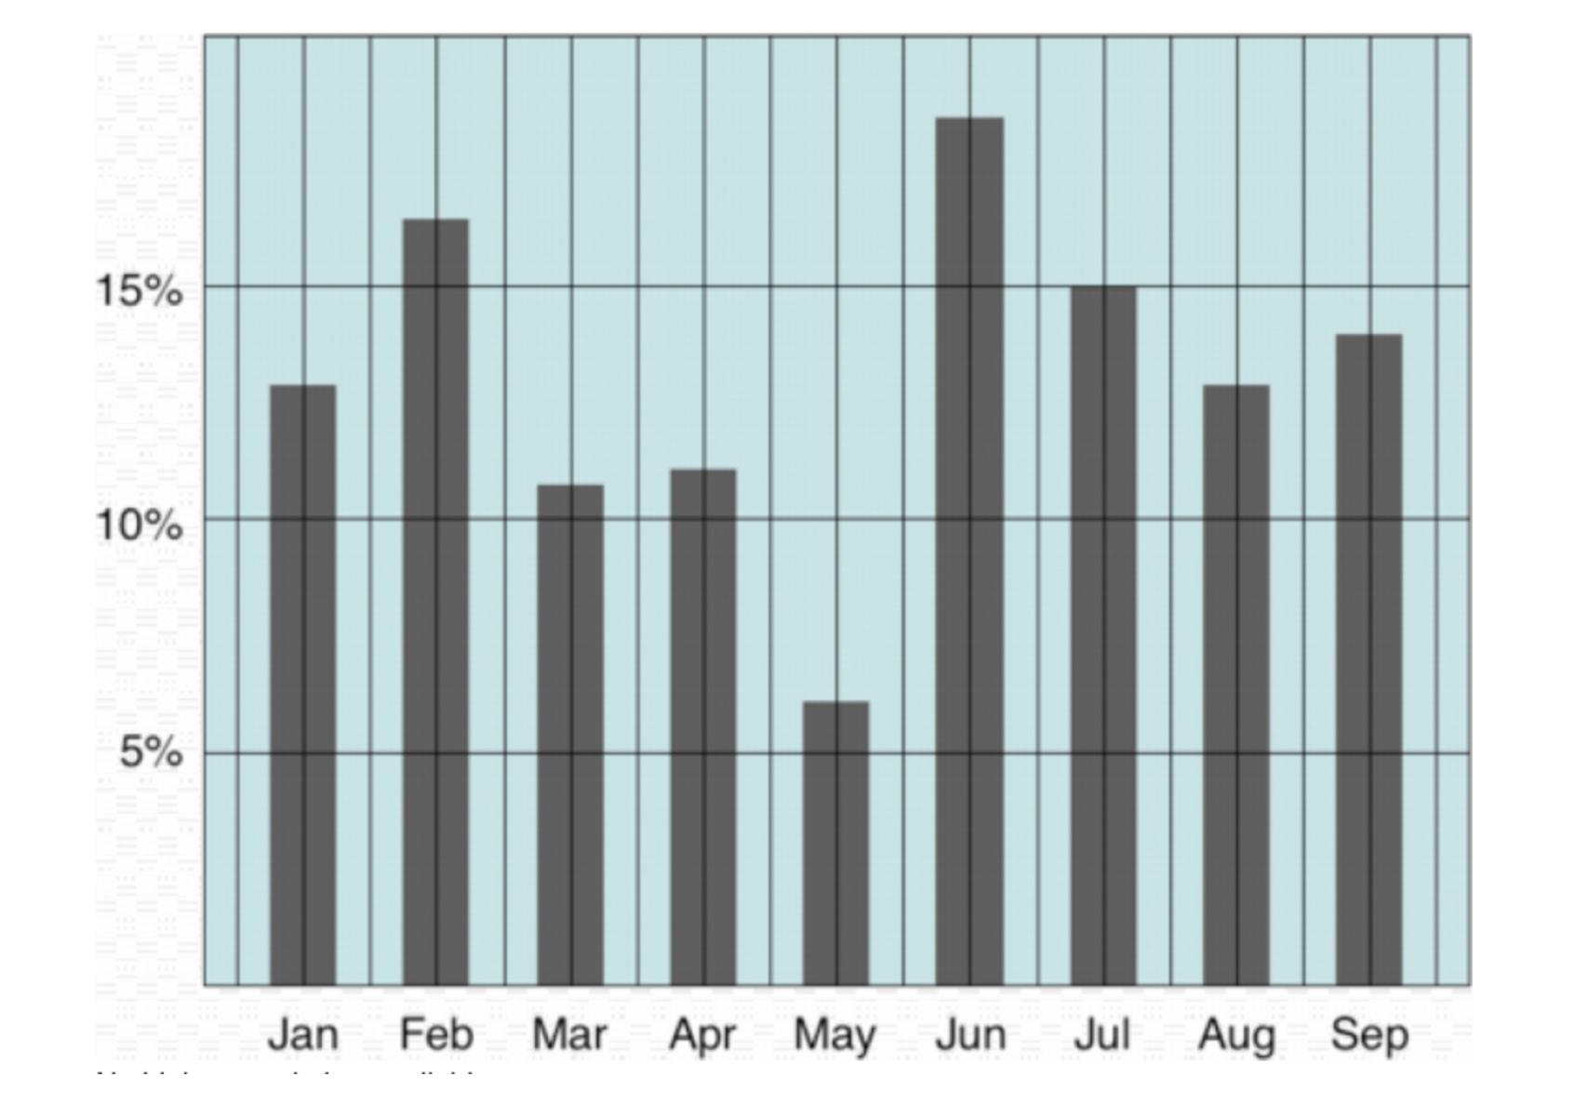
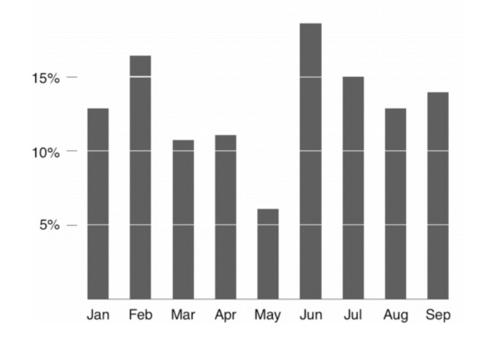
Data visualization and presentation principle
Your figure should be interpretable as a stand-alone object
2. Use contrasting colors for the ink and labels.

Slide 5
Communicating regression results
Describe the goal of the study
Describe and justify analysis
Present the direction, magnitude and uncertainty of results
Notes:
BIG PICTURE HERE

Slide 6
Describing models
Make the goal of the analysis clear
“To assess how light influences plant growth…”

Slide 7
Describing models
Make the goal of the analysis clear
“To assess how light influences plant growth…”

Slide 8
Describing models
Make the goal of the analysis clear
“To assess how light influences plant growth…”
Describe the type of analysis
“…we used a generalized linear model…”

Slide 9
Describing models
Make the goal of the analysis clear
“To assess how light influences plant growth…”
Describe the type of analysis
“…we used a generalized linear model…”

Slide 10
Describing models
Make the goal of the analysis clear
“To assess how light influences plant growth…”
Describe the type of analysis
“…we used a generalized linear model…”
Describe the probability distribution used
“…with a gamma error distribution.”

Slide 11
Describing models
Make the goal of the analysis clear
“To assess how light influences plant growth…”
Describe the type of analysis
“…we used a generalized linear model…”
Describe the probability distribution used
“…with a gamma error distribution.”

Slide 12
Describing models
Make the goal of the analysis clear
“To assess how light influences plant growth…”
Describe the type of analysis
“…we used a generalized linear model…”
Describe the probability distribution used
“…with a gamma error distribution.”
Describe the outcome and predictor variables
“The response variable was dry biomass and predictor variable was canopy openness.”

Slide 13
Describing models
Make the goal of the analysis clear
“To assess how light influences plant growth…”
Describe the type of analysis
“…we used a generalized linear model…”
Describe the probability distribution used
“…with a gamma error distribution.”
Describe the outcome and predictor variables
“The response variable was dry biomass and predictor variable was canopy openness.”

Slide 14
Describing models
Make the goal of the analysis clear
“To assess how light influences plant growth…”
Describe the type of analysis
“…we used a generalized linear model…”
Describe the probability distribution used
“…with a gamma error distribution.”
Describe the outcome and predictor variables
“The response variable was dry biomass and predictor variable was canopy openness.”
Describe any random effects.
“We allowed random intercepts by study site ID.”

Slide 15
Describing models
Make the goal of the analysis clear
“To assess how light influences plant growth…”
Describe the type of analysis
“…we used a generalized linear model…”
Describe the probability distribution used
“…with a gamma error distribution.”
Describe the outcome and predictor variables
“The response variable was dry biomass and predictor variable was canopy openness.”
Describe any random effects.
“We allowed random intercepts by study site ID.”

Slide 16
Describing models
Describe how you implemented the model
“We performed GLMMs using the lme4 package in R (Bates et al. 2015).”
citation(“lme4”)

Slide 17
Describing models
Describe how you implemented the model
“We performed GLMMs using the lme4 package in R (Bates et al. 2015).”
citation(“lme4”)

Slide 18
Describing models
Describe how you implemented the model
“We performed GLMMs using the lme4 package in R (Bates et al. 2015).”
citation(“lme4”)

Slide 19
Describing models
Describe how you implemented the model
“We performed GLMMs using the lme4 package in R (Bates et al. 2015).”
citation(“lme4”)
When in doubt, replicate what others are doing.
Notes:
Effective communication of science is often more formulaic than

Slide 20
Describe results based on the direction, magnitude, and uncertainty of the effects
Direction of effect
Good: “Plant biomass was greater under more open forest canopies.”
Good: “Plant growth was unrelated to light level.”

Slide 21
Describe results based on the direction, magnitude, and uncertainty of the effects
Direction of effect
Good: “Plant biomass was greater under more open forest canopies.”
Good: “Plant growth was unrelated to light level.”

Slide 22
Describe results based on the direction, magnitude, and uncertainty of the effects
Direction of effect
Good: “Plant biomass was greater under more open forest canopies.”
Good: “Plant growth was unrelated to light level.”
Avoid: “Growth was related to light”
Avoid: “Plant biomass was significantly related to canopy openness.”

Slide 23
Describe results based on the direction, magnitude, and uncertainty of the effects
Magnitude of effect
Good: “Plant growth increased with canopy openness (βlight = 1.24 ± 0.12 SE)….”

Slide 24
Describe results based on the direction, magnitude, and uncertainty of the effects
Magnitude of effect
Good: “Plant growth increased with canopy openness (βlight = 1.24 ± 0.12 SE)….”

Slide 25
Describe results based on the direction, magnitude, and uncertainty of the effects
Magnitude of effect
Good: “Plant growth increased with canopy openness (βlight = 1.24 ± 0.12 SE)….”
Better: “…with biomass accumulation 2.5 times higher in high light conditions than in low light conditions.”

Slide 26
Describe results based on the direction, magnitude, and uncertainty of the effects
Magnitude of effect
Good: “Plant growth increased with canopy openness (βlight = 1.24 ± 0.12 SE)….”
Better: “…with biomass accumulation 2.5 times higher in high light conditions than in low light conditions.”
Avoid: “Growth was related to light”
Avoid: “Plant biomass was significantly related to canopy openness.”

Slide 27
Describe results based on the direction, magnitude, and uncertainty of the effects
Uncertainty of effect size
Good: “Plant growth increased with canopy openness (βlight = 1.24 ± 0.12 SE)….”

Slide 28
Describe results based on the direction, magnitude, and uncertainty of the effects
Uncertainty of effect size
Good: “Plant growth increased with canopy openness (βlight = 1.24 ± 0.12 SE)….”
Better: “Plant growth increased with canopy openness (βlight = 1.24; 95% CI 1.01 - 1.37, p = 0.002)….”
Notes:
There are many ways to come up with a confidence interval. confint() is useful for this.

Slide 29
Describe results based on the direction, magnitude, and uncertainty of the effects
Uncertainty of effect size
Good: “Plant growth increased with canopy openness (βlight = 1.24 ± 0.12 SE)….”
Better: “Plant growth increased with canopy openness (βlight = 1.24; 95% CI 1.01 - 1.37, p = 0.002)….”
Avoid: “Growth was related to light (P < 0.05).”

