Slide 1
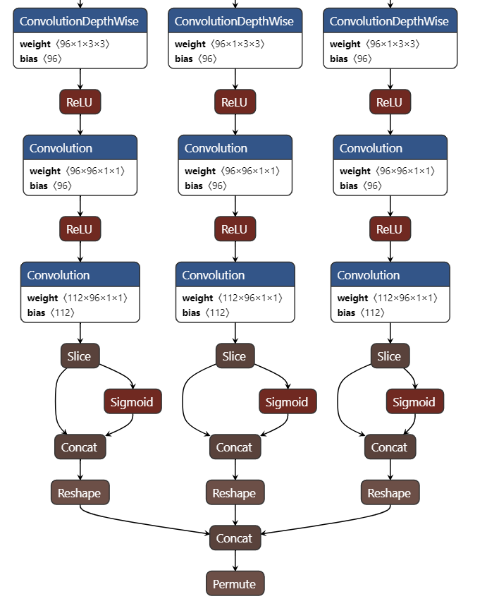
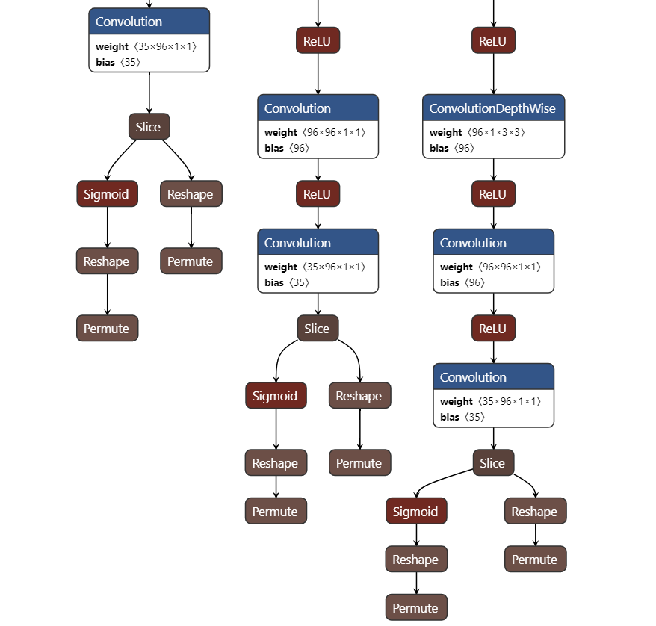
(right) modified head with multiple out branches.
concated head in the original nanodet

Slide 2

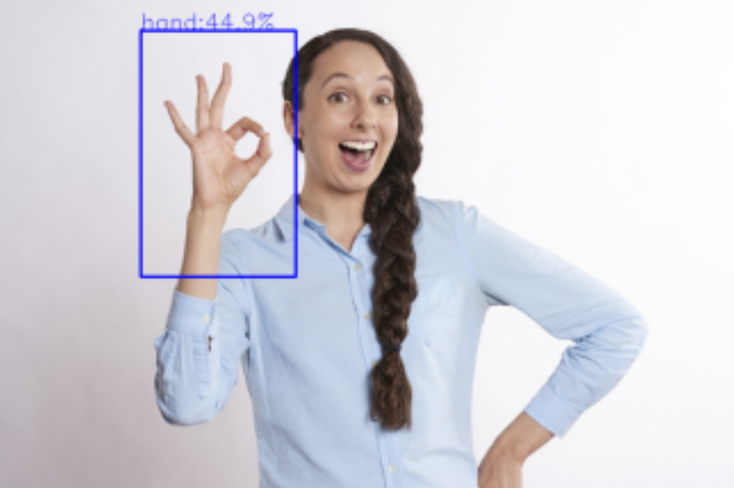

input image/
video stream
hand detection
pose estimation
gesture recognition
interact process
“OK” gesture
OK, I agree with you!

