Slide 1
Musical timbre analysis and synthesis
Master Thesis of Han Zhang
Master of Electrical and Electronic Engineering, Northwestern University
HanZhang2020@u.northwestern.edu
Code: https://github.com/ZhangHanpqqo/timbre_analysis_synthesis

Slide 2
Introduction
Motivation: Timbre is one of the dominant attributes that composers and songwriters would consider for their pieces and songs. Meanwhile, it is the least describable and well-modeled attribute of musical sound. Previous works take efforts to relate timbre to multidimensional spaces or temporal and spectral descriptors by dissimilarity tests and multidimensional scaling([Grey, J. M., 1977][McAdams, S., 1995][Taffeta M., 2012], etc.). However, morphological features of harmonics and their relationship with semantic descriptions remain to be found.
Thesis Description: By analyzing time-variant frequency, magnitude and phase of harmonics derived from the musical timbres of acoustic and electronic instruments and synthesizers, obtain a set of features that are adequate for timbre description and sound synthesis. Principle controlling parameters of timbre can be later determined. It is also possible to map the semantic descriptions that people use on timbre to the scales of these features, and with ML algorithms, characteristics of musical instruments are also attainable. Finally, a new approach of timbal sound design by assigning the parameters and forming the spectrum can be developed.

Slide 3
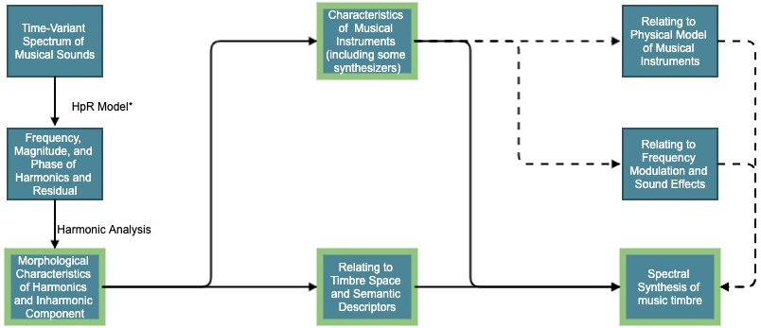
Procedure
Blocks with light green borders are problems to be focused, which are elaborated in the following slide. Blocks connected with dash lines are problems considered to be related but of lower priority.
* HpR Model refers to Harmonics plus Residual Model [Xavier Serra, 1990]

Slide 4
Supposed works
Analyze morphological features: Besides temporal and spectral envelop that are frequently mentioned, other features such as frequency fluctuation, inter-harmonics relationship, characteristics of phase spectrum and distributions of inharmonic components are also considered. With these features, musical sound can be described and fully synthesized. A descriptive result of changing one attribute or multiple attributes jointly is expected.
Find characteristics of musical instruments: Timbres of the same instrument on different pitches have some variations, but perceptually they have some features in common with some others gradually changing along the scale. Instruments of same orchestral family or with similar sonification principle may also share some properties while possessing their distinct features. By looking deeply into the consistency and variation within and between the instruments, an overall characteristics of musical instruments can be expected. This may also relate to physical model of instruments and frequency modulating approach of sound synthesis.
Relate to timbre space and semantic descriptions: Timbre spaces derived from dissimilar tests largely rely on human perception. Semantic descriptions of timbre, such as bright, sharp, or directional, are subjective judgements as well. Investigating the mapping from timbre characteristics to perceptual perspective is also meaningful. Experiments involving human may be introduced in this further step.
Design a spectral sound synthesis model: The final goal of this thesis is set to design a systematic model or approach to generate timbral sounds from spectrum based on the features and their properties found in the previous steps.

Slide 5
References
Grey, J. M. (1977). “Multidimensional perceptual scaling of musical timbres. ” Journal. the Acoustical Society of America, 61, 1270-1277.
McAdams, S., Winsberg, S., Donnadieu, S., De Soete, G., and Krimphoff, J. (1995). “Perceptual scaling of synthesized musical timbres: Common dimensions, specificities, and latent subject classes.” Psychol. Res. 58(3), 177–192.
Taffeta M. Elliott, Liberty S. Hamilton, and Frederic E. Theunissen. (2012). “Acoustic structure of the five perceptual dimensions of timbre in orchestral instrument tones.” Journal. the Acoustical Society of America,133(1), 389-404.
Xavier Serra and Julius Smith, III. (1990). “Spectral Modeling Synthesis: A Sound Analysis/Synthesis System Based on a Deterministic Plus Stochastic Decomposition.” Computer Music Journal. Vol. 14, No. 4. 12-24.

