Slide 1
StudyFlow
Plan work. Observe change. Replan safely.
SIMPLIFYNEXT AGENTIC AI HACKATHON 2026
An adaptive academic execution system that turns assessment deadlines into a schedule students can actually recover.
Notes:
Open with the execution gap: a deadline says when, but not how.
StudyFlow closes that gap and visibly recovers when reality changes.
[Sources]
- AGENTS.md
- docs/ARCHITECTURE.md

Slide 2
The story in four minutes
01 | The execution gap
02 | Plan → Act → Observe → Replan
03 | Live missed + calendar recovery
04 | Safe demo reset
05 | Proof and handoff
06 | Why it matters
Notes:
Keep this slide brief. The live product is the centerpiece.
[Sources]
- docs/demo/VIDEO_SCRIPT.md

Slide 3
One loop, three cooperating capabilities
PLAN
The agent interprets an assessment and decomposes it into named, dependent tasks.
ACT + OBSERVE
The scheduler fits work around hard commitments; task and calendar events update atomic state.
REPLAN
Affected work moves. Completed and unrelated valid placements stay preserved when possible.
Notes:
Point left to right. Emphasize deterministic constraints and canonical shared models.
[Sources]
- docs/DATA_MODELS.md
- docs/ARCHITECTURE.md
- docs/API_CONTRACT.md

Slide 4
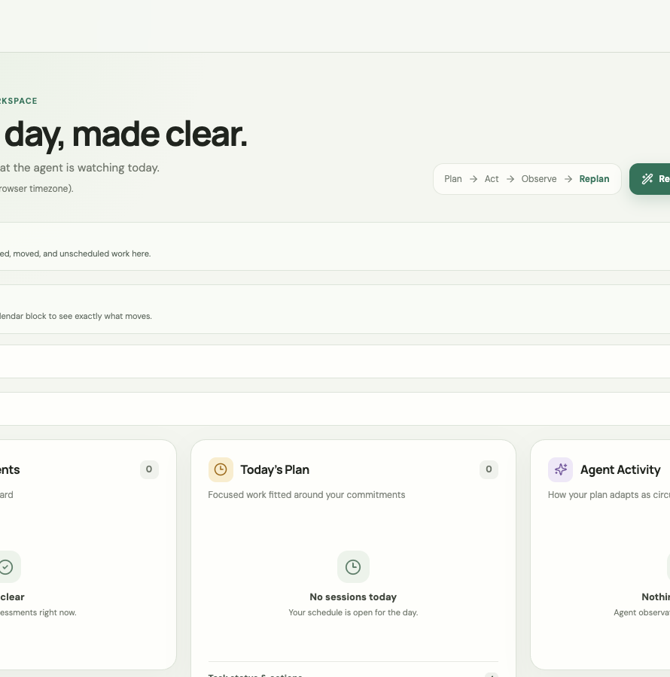
A dashboard built for action
THREE LIVE VIEWS
Upcoming Assessments
Today’s Plan
Agent Activity
USER ACTIONS
Complete / Missed
Add or edit calendar blocks
Add assessment
Generate Plan / Demo Reset
Notes:
Use this as orientation, then switch to the live browser.
All content shown in the product comes from the FastAPI API.
[Sources]
- frontend/src/App.tsx
- frontend/src/api.ts
- docs/API_CONTRACT.md

Slide 5
Replanning is explained as a comparison—not hidden behind “success”
The UI compares the previous and latest canonical schedule using absolute start/end timestamps, task_id, and flexibility. Display timezone is explicit.
MOVED
Before → after, including cross-date changes.
PRESERVED
Completed or unrelated unchanged placements remain visible.
UNSCHEDULED
The exact task, canonical reason, and message are surfaced.
Notes:
In the live demo, mark slides missed and pause on the before/after card.
Call out preserved work and any explicit unscheduled failure.
[Sources]
- frontend/src/App.tsx
- frontend/tests/replan.test.cjs
- docs/DATA_MODELS.md

Slide 6
Deterministic scheduling guardrails
AI interprets.
Constraints decide.
StudyFlow normalizes assessments, tasks, calendar blocks, scheduled tasks, and planning events into shared canonical models. The scheduler validates dependencies, deadlines, hard blocks, durations, and timezone-aware ranges. Replanning preserves valid state whenever possible.
Never overlap hard calendar blocks
Respect task dependencies
Keep completed work stable
Expose partial scheduling failures
Refresh all planning views atomically
Notes:
This is why StudyFlow is more than a generic calendar assistant.
[Sources]
- AGENTS.md
- docs/DATA_MODELS.md
- docs/ARCHITECTURE.md

Slide 7
Live demo: break the plan, watch it recover
1 — RESET + ORIENT
Restore the stable baseline. Show assessments, schedule, task statuses, and agent activity.
2 — MISS + CONFLICT
Mark slides Missed. Add a hard calendar block. Compare moved and preserved work.
3 — ADD + RESET
Create an assessment. Show generated work or unscheduled reason. Reset for the next judge.
0:00–1:00
1:00–2:40
2:40–3:40
Notes:
Follow docs/demo/RUNBOOK.md exactly. Do not improvise IDs or use Swagger.
[Sources]
- docs/demo/RUNBOOK.md
- docs/demo/VIDEO_SCRIPT.md

Slide 8
Calendar changes trigger visible, cross-date recovery
Monday | Tuesday | Wednesday | Thursday | Friday
# | # | # | # | #
# | # | # | # | #
# | # | # | # | #
# | # | # | # | #
Research
preserved
Rehearsal
moved
Slides
missed
Hard event
added
Coding task
preserved
New task
if schedulable
Notes:
The calendar grid is illustrative; the live UI is authoritative.
Stress that cross-date changes remain visible outside Today’s Plan.
[Sources]
- frontend/src/App.tsx
- frontend/tests/replan.test.cjs

Slide 9
Demo-grade reliability, validated on the real stack
Frontend writes use existing contracts, lock duplicate submissions, preserve usable state on failure, and refresh assessments, tasks, calendar, schedule, and planning events after success.
412 BACKEND TESTS
Full pytest suite passed.
8 FRONTEND UNIT TESTS
API parsing and contract behavior passed.
18 BROWSER ACCEPTANCE TESTS
Missed, calendar, reset, assessment, retry, and full rehearsal passed.
PRODUCTION BUILD
All frontend tsconfigs and Vite build passed.
Notes:
These are results from the final Sep 5 validation run, not projections.
[Sources]
- frontend/tests/replan.test.cjs
- frontend/package.json
- final local validation on 2026-09-05

Slide 10
StudyFlow keeps the plan useful
after the plan breaks.
THANK YOU
Plan → Act → Observe → Replan
Visible recovery • explicit failures • demo-safe reset
Ready for final team rehearsal
Notes:
Close on adaptation: the value is not the first schedule; it is safe recovery.
[Sources]
- AGENTS.md
- docs/demo/ABCD_SIGNOFF.md

