Slide 1
StudyFlow
Plan work. Observe change. Replan safely.
SIMPLIFYNEXT AGENTIC AI HACKATHON 2026
An adaptive academic execution system that turns assessment deadlines into a schedule students can actually recover.
Notes:
Open with the execution gap: a deadline says when, but not how.
StudyFlow closes that gap and visibly recovers when reality changes.
[Sources]
- AGENTS.md
- docs/ARCHITECTURE.md

Slide 2
The story in four minutes
01 | The execution gap
02 | Plan → Act → Observe → Replan
03 | Live missed + calendar recovery
04 | Safe demo reset
05 | Proof and handoff
06 | Why it matters
Notes:
Keep this slide brief. The live product is the centerpiece.
[Sources]
- docs/demo/VIDEO_SCRIPT.md

Slide 3
One loop, three cooperating capabilities
PLAN
The agent interprets an assessment and decomposes it into named, dependent tasks.
ACT + OBSERVE
The scheduler fits work around hard commitments; task and calendar events update atomic state.
REPLAN
Affected work is reassessed. Move it when needed; preserve completed and unrelated valid work where possible.
Notes:
The demo uses offline templates. A task event is an explicit student report. Reassessment does not guarantee movement. [Sources]
- docs/SEPT6_AB_HANDOFF.md
- docs/DATA_MODELS.md

Slide 4
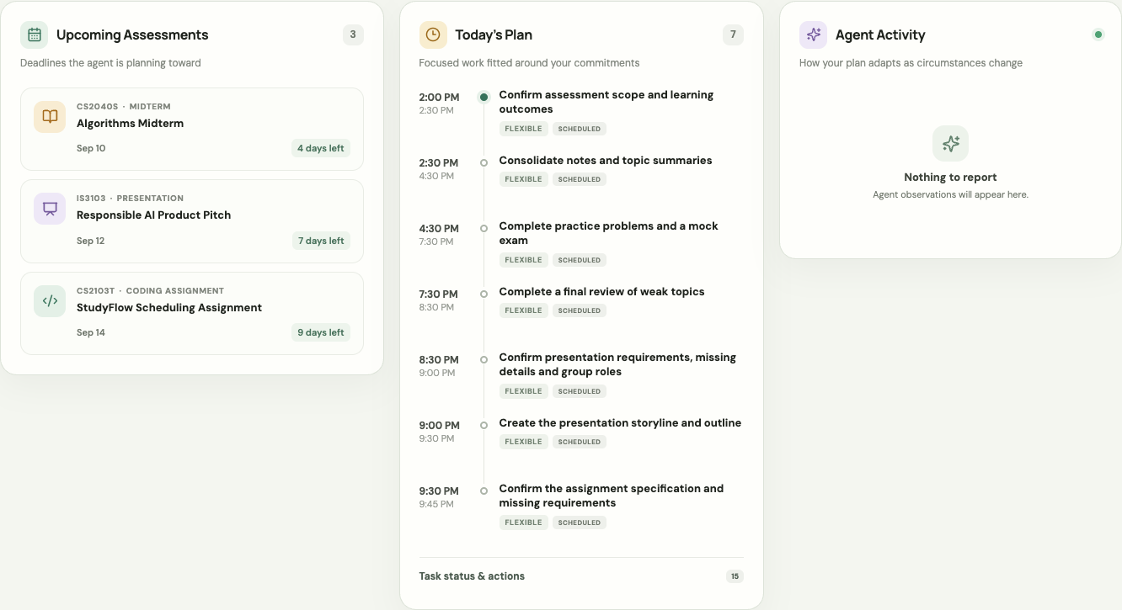
A dashboard built for action
THREE LIVE VIEWS
Upcoming Assessments
Today’s Plan
Agent Activity
USER ACTIONS
Complete / Missed
Add or edit calendar blocks
Add assessment
Generate Plan / Demo Reset
Notes:
Use this as orientation, then switch to the live browser.
All content shown in the product comes from the FastAPI API.
[Sources]
- frontend/src/App.tsx
- frontend/src/api.ts
- docs/API_CONTRACT.md

Slide 5
See what moved, stayed valid, or could not fit
Compare the previous and updated schedule, including full dates and timezone. A successful request may still leave work unscheduled.
MOVED
Before → after, including cross-date changes.
PRESERVED
Completed or unrelated unchanged placements remain visible.
UNSCHEDULED
The exact task, canonical reason, and message are surfaced.
Notes:
Read a real before/after pair and one preserved placement. If there are unscheduled tasks, read the reason. Do not claim rich model reasoning from activity events. [Sources]
- frontend/src/App.tsx
- docs/API_CONTRACT.md

Slide 6
Deterministic scheduling guardrails
Templates or AI interpret.
Constraints decide.
This offline demo uses validated preparation templates. Bedrock is optional. The scheduler checks dependencies, deadlines, hard blocks and durations. Backend changes commit atomically; the dashboard then reads all five collections. Python / FastAPI / Pydantic, with React / TypeScript / Vite.
Never overlap hard calendar blocks
Respect task dependencies
Keep completed work stable
Expose partial scheduling failures
Save changes, then refresh views
Notes:
Python/FastAPI/Pydantic backend and React/TypeScript/Vite frontend. Provider mocks normalize at the boundary. Templates are used offline; no live Bedrock request is claimed. In-memory state, single user, no persistence or real calendar sync. Transactions are atomic in the backend; five GETs are not a multiuser atomic snapshot. [Sources]
- README.md
- docs/ARCHITECTURE.md

Slide 7
Live demo: break the plan, watch it recover
1 — RESET + GENERATE
Reset, then Generate Plan. Show tasks, estimates and prerequisites. Record a completion.
2 — MISS + CONFLICT
Mark materials Missed. Future slots may stay valid. Add an overlapping hard block to show recovery.
3 — ADD + RESET
Create an assessment. Show generated work or unscheduled reason. Reset for the next judge.
0:00–1:10
1:10–2:35
2:35–3:50
Notes:
Follow docs/demo/RUNBOOK.md: Reset, Generate Plan, Complete, Missed. An immediate Missed of future work may preserve every slot. Add a hard block overlapping materials to demonstrate movement. Add an assessment; reset at the end. Do not use fixed historical dates in the live UI. [Sources]
- docs/demo/RUNBOOK.md
- frontend/tests/replan.test.cjs

Slide 8
Verified fallback: recovery after missed materials
Work | Before | After | Outcome | Constraint
Materials | 10:00–11:00 | 13:00–14:00 | Moved | Hard lecture 12:00–13:00
Speaker notes | 13:00–14:30 | 14:00–15:30 | Moved | After materials
Rehearsal | 14:30–15:30 | 16:30–17:30 | Moved | Keep independent 16:00–16:30
Completed + unrelated work | 4 placements | Same 4 slots | Preserved | No lost work
Simulated observation: 6 Sep 2026, 11:30 SGT. Real API replay: 3 moved, 4 preserved, 0 unscheduled.
Notes:
Fallback picture is based on real API responses, not current time. Explicitly say: this is a simulated September 6 observation at 11:30. Completed prerequisites and an unrelated 16:00 session are preserved; the hard lecture stays at noon. Materials, notes and rehearsal move to 13:00, 14:00 and 16:30. No curl or special UI switching is necessary during the presentation: use this slide if the live app fails. [Sources]
- docs/demo/ab-evidence/fallback.json
- docs/demo/ab-evidence/TASKS_AND_MOVES.md

Slide 9
Verified on September 6: ready for human rehearsal
Frontend writes use existing contracts, lock duplicate submissions, preserve usable state on failure, and refresh assessments, tasks, calendar, schedule, and planning events after success.
464 BACKEND TESTS
Full pytest suite passed.
8 FRONTEND UNIT TESTS
API parsing and contract behavior passed.
21 BROWSER ACCEPTANCE TESTS
Includes three complete rehearsals from the default empty startup state.
PRODUCTION BUILD
All frontend tsconfigs and Vite build passed.
Notes:
September 6 verification: 464 backend, 8 frontend unit and 21 browser tests; three default-startup automated rehearsals included. Clean dependency install and production build passed. Automated runs do not count as human spoken rehearsals or recorded videos. [Sources]
- docs/demo/VALIDATION_SEPT6.md
- frontend/tests/replan.test.cjs

Slide 10
StudyFlow keeps the plan useful
after the plan breaks.
THANK YOU
Plan → Act → Observe → Replan
Visible recovery, explicit failures
Ready for human rehearsal
Notes:
Close on adaptation: the value is not the first schedule; it is safe recovery.
[Sources]
- AGENTS.md
- docs/demo/ABCD_SIGNOFF.md

