Slide 1

An Attention-based Feature-rich Model
For Stance Detection In Fake News Challenge
Studenet name:Zhang,He
Student number:20020214
E-mail: k20020214@kcl.ac.uk
Supervisor: Cocarascu, Oana
Notes:
Hello，everyone，my project topic focuses on building an attention-based feature-rich model for stance detection

Slide 2
Part1 : Scope
Notes:
Let me give you a quick introduction about my project scope.

Slide 3
Problem Definition:
Stance Detection:
(StD) represents a well established task in natural language processing and is often described by having two inputs:
(1)a topic of a discussion and (2) a comment made by an author.
Given these two inputs, the aim is to find out whether the author is in favor or against the topic.
Fake News Challenge:
Pomerleau and Rao (2017) organized the first Fake News Challenge2 (FNC-1) in order to foster the development of AI technology to automatically detect fake news. The task is to classify the stance of a single sentence of a news headline towards a specific claim.
Table 1: Distribution Of Classes In Training And Test Set Of FNC
Dataset | Example pairs | Classes
 |  | Unrelated | Discuss | Agree | Disagree
Training | 49972 | 0.73 | 0.17 | 0.07 | 0.016
Test | 25413 | 0.72 | 0.17 | 0.07 | 0.027
Notes:
When it comes to the stance detection, It is a task defined as determining from the text whether the audience is in favor, against or neutral about the target.
As for the fake news challenge, the fake news challenge stage-1 task is documentlevel stance detection, which requires the classification of an entire news article relative to a headline.
According to the distribution of classes in training and test set of fake news challenge corpus shown in table 1, It is an unevenly distributed dataset. the imbalanced distribution of 4 class instances is fully biased towards Unrelated class.

Slide 4
Motivation:
1. The limited use of Attention Mechanism on the aspect of solving Fake News Challenge
Attention-based Neural Networks are widely used on target-specific stance detection
to adress twitter task which is a classification task sharing the similarity with fake news challenge.
2. The importance of handcrafted features for the stance detection performance of Fake news Challenge
Challenge:
The imbalanced distribution of FNC corpus
Notes:
The motivation of my project can be splitted into 2 parts: First, the attention-based network show the effectiveness of predicting the stance for twitter task, but attention mechanism is not widely applied to deal with Fake News Challenge which share the similarity with twitter task. Secondly, Some study has indicated that incorporating handcrafted features contributed a lot to the outstanding stance detection performance.
Also, As i mentioned before, the main challenge for detecting the stance for Fake news challenge is how to alleviate the imbalanced distribution of FNC corpus.

Slide 5
Aims and Objectives:
1.Build an attention-based neural network and combine useful features to handle stance detection on fake news challenge.
2.Explore the effectiveness of selected Attention Mechanism.
3.Quantify the contribution of promising features incorporated.
Notes:
For the project, It is expected that an attention-based neural network can be applied to handle the fake news challenge with the help of promising feature set.
The project also aims at providing the evidence to evaluate the contribution of attention mechanism and useful handcrafted features incorporated.

Slide 6
Contribution:
1. Propose a modified attention-based model: Attention StackLSTM which outperform some state-of-art baseline models designed for solving Fake News Challenge.
2. Demonstrate that the introduced attention mechanism and incorporated features are capable of favoring the classification of minority class.
Notes:
The main contribution of our project is: First, we proposed a modified attention-based model named attention stackLSTM desighed for Fake news challenge and achieve a better prediction result than some state-of-art baseline method. More details about our proposed model performance will be given in the Part 2. Secondly, the experiment analysis demonstrates the effectiveness of introduced attention mechanism and helpful feature representation at the aspect of enhancing the overall stance detection performance with the obvious improvement on evaluation metrics of minority categories.

Slide 7
Part2 : The experiment detail for draw the conclusion

Slide 8
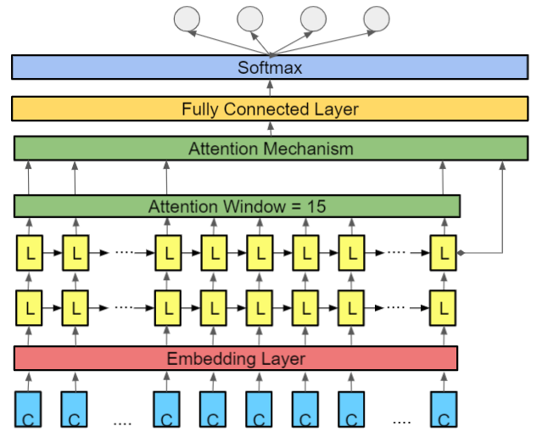
Initial Network Structure: Lstm with Attention
Default Experiment Setting:
epoch num | lr | batch size | num layer | dropout rate | max length | device | weight decay | word embeddings
40 | 0.001 | 128 | 2 | 0.8 | 75 | cuda | 0 | glove.twitter.27B.50d (require grads)
Experiment Results:
Accuracy | FNC score | F1 agree | F1 disagree | F1 discuss | F1 unrelated | Macro F1
0.646165348 | 0.50676966 | 0.196519525 | 0.043087971 | 0.353670162 | 0.78944493 | 0.345680647

Slide 9
Model Selection Process: Choosing word embeddings
Table1: the average performance in validation set based on 5 fold cross validation
baseline
Word embedding | with grad | Accuracy | FNC score | F1 agree | F1 disagree | F1 discuss | F1 unrelated | Macro F1
glove.twitter.27B.100d | True | 0.9396 | 0.9181 | 0.8130 | 0.6484 | 0.9112 | 0.9678 | 0.8336
glove.6B.200d | True | 0.9404 | 0.9199 | 0.8089 | 0.6456 | 0.8895 | 0.9680 | 0.8334
glove.6B.300d | False | 0.9487 | 0.9342 | 0.8118 | 0.6162 | 0.9032 | 0.9772 | 0.8324
glove.6B.300d | True | 0.9391 | 0.9182 | 0.8083 | 0.6440 | 0.9091 | 0.9667 | 0.8321
glove.6B.100d | True | 0.9403 | 0.9180 | 0.8064 | 0.6313 | 0.9090 | 0.9686 | 0.8289
crawl.300d.2M | False | 0.9480 | 0.9318 | 0.8097 | 0.5917 | 0.9032 | 0.9776 | 0.8254
fasttext.en.300d | True | 0.9353 | 0.9070 | 0.7976 | 0.6356 | 0.8988 | 0.9650 | 0.8243
glove.6B.200d | False | 0.9489 | 0.9344 | 0.8101 | 0.5834 | 0.8963 | 0.9781 | 0.8240
crawl.300d.2M | True | 0.9373 | 0.9090 | 0.7957 | 0.6233 | 0.9056 | 0.9663 | 0.8227
glove.twitter.27B.50d | True | 0.9390 | 0.9182 | 0.7988 | 0.6085 | 0.9033 | 0.9684 | 0.8213
GoogleNews.vector300 | True | 0.9327 | 0.9086 | 0.7950 | 0.6273 | 0.8954 | 0.9629 | 0.8202
glove.6B.100d | False | 0.9474 | 0.9323 | 0.7951 | 0.5693 | 0.9078 | 0.9790 | 0.8165
glove.6B.50d | True | 0.9394 | 0.9171 | 0.7988 | 0.5850 | 0.9105 | 0.9689 | 0.8158
fasttext.en.300d | False | 0.9449 | 0.9240 | 0.7998 | 0.5587 | 0.8989 | 0.9762 | 0.8125
wiki_news_300d | True | 0.9292 | 0.8979 | 0.7812 | 0.6077 | 0.8932 | 0.9610 | 0.8098
glove.twitter.27B.100d | False | 0.9417 | 0.9219 | 0.7839 | 0.5302 | 0.8938 | 0.9747 | 0.8010
glove.twitter.27B.50d | False | 0.9392 | 0.9179 | 0.7761 | 0.5304 | 0.9071 | 0.9735 | 0.7968
glove.twitter.27B.25d | True | 0.9305 | 0.9042 | 0.7753 | 0.5515 | 0.8904 | 0.9639 | 0.7963
wiki_news_300d | False | 0.9357 | 0.9146 | 0.7584 | 0.5178 | 0.8996 | 0.9734 | 0.7873
glove.6B.50d | False | 0.9404 | 0.9226 | 0.7756 | 0.4781 | 0.9050 | 0.9770 | 0.7840
glove.twitter.27B.25d | False | 0.9178 | 0.8896 | 0.6848 | 0.4713 | 0.8615 | 0.9667 | 0.7461
Table2: the average performance in test set based on 5 fold cross validation
Word embedding(with grad) | with grad | Accuracy | FNC score | F1 agree | F1 disagree | F1 discuss | F1 unrelated | Macro F1
glove.6B.200d | True | 0.6673 | 0.5148 | 0.2002 | 0.0742 | 0.3757 | 0.8065 | 0.3642
glove.twitter.27B.100d | True | 0.6608 | 0.5107 | 0.1880 | 0.0287 | 0.3730 | 0.7972 | 0.3467
glove.twitter.27B.50d | True | 0.6462 | 0.5068 | 0.19652 | 0.0431 | 0.3537 | 0.7894 | 0.3457
glove.6B.200d | True | 0.6673 | 0.5148 | 0.2002 | 0.0742 | 0.3757 | 0.8065 | 0.3642
glove.twitter.27B.100d | True | 0.6608 | 0.5107 | 0.1880 | 0.0287 | 0.3730 | 0.7972 | 0.3467
glove.twitter.27B.50d | True | 0.6462 | 0.5068 | 0.19652 | 0.0431 | 0.3537 | 0.7894 | 0.3457

Slide 10
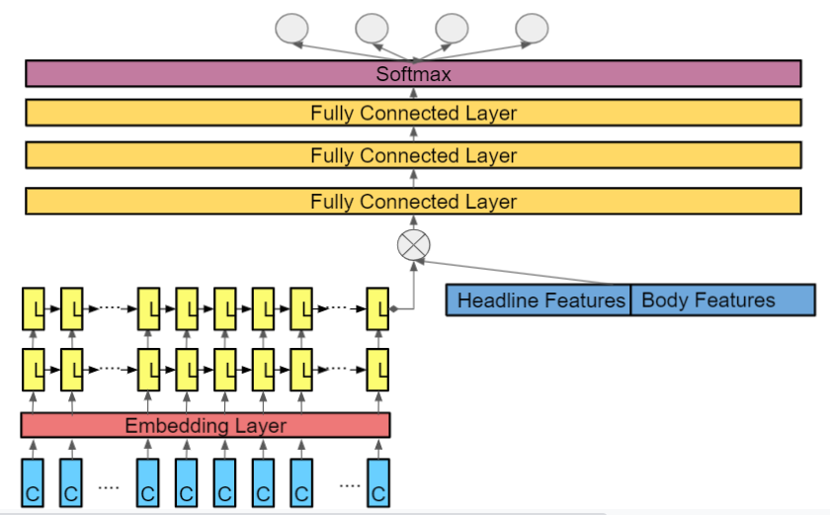
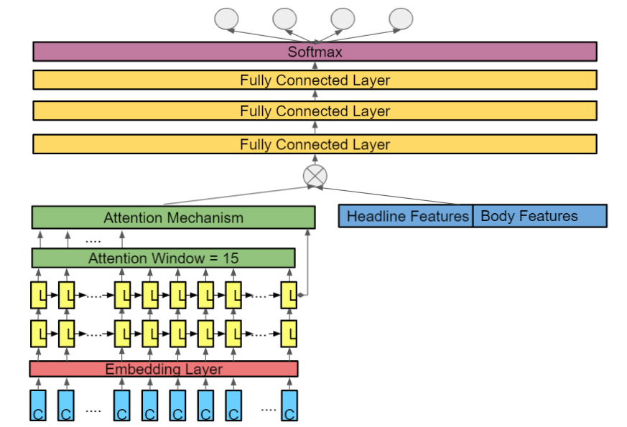
Incorporating useful features:
inspired by the structure of stacklstm
our model structure:
figure1: the structure of stacklstm
figure2: the structure of stack lstm with attention

Slide 11
Improved Model Selection Process: Choosing useful features
Table3: the average performance in validation set based on 5 fold cross validation
features | word_embedding | with grad | Accuracy | FNC_score | F1_agree | F1_disagree | F1_discuss | F1_unrelated | Macro_F1
Baseline and Topic model features | glove.6B.200d | TRUE | 0.9729 | 0.9579 | 0.8627 | 0.6004 | 0.9651 | 0.9943 | 0.8556
Baseline and Topic model features | glove.twitter.27B.100d | TRUE | 0.9731 | 0.9561 | 0.8632 | 0.5856 | 0.9637 | 0.9948 | 0.8518
All | glove.6B.200d | TRUE | 0.9720 | 0.9551 | 0.8606 | 0.5886 | 0.9622 | 0.9940 | 0.8513
4 Baseline features | glove.twitter.27B.100d | TRUE | 0.9626 | 0.9373 | 0.8519 | 0.6186 | 0.9414 | 0.9868 | 0.8495
4 Baseline features | glove.6B.200d | TRUE | 0.9613 | 0.9457 | 0.8524 | 0.6120 | 0.9417 | 0.9852 | 0.8478
All | glove.twitter.27B.100d | TRUE | 0.9721 | 0.9548 | 0.8589 | 0.5627 | 0.9625 | 0.9947 | 0.8447
4 Topic model features | glove.6B.200d | TRUE | 0.9676 | 0.9509 | 0.8467 | 0.5846 | 0.9548 | 0.9916 | 0.8444
4 Topic model features | glove.twitter.27B.100d | TRUE | 0.9663 | 0.9479 | 0.8390 | 0.5669 | 0.9555 | 0.9916 | 0.8383
Baseline and BOW features | glove.6B.200d | TRUE | 0.9610 | 0.9387 | 0.8459 | 0.5654 | 0.9399 | 0.9866 | 0.8344
NO features | glove.6B.200d | TRUE | 0.9396 | 0.9181 | 0.8133 | 0.6484 | 0.9112 | 0.9678 | 0.8336
NO features | glove.twitter.27B.100d | TRUE | 0.9404 | 0.9199 | 0.8089 | 0.6456 | 0.8895 | 0.968 | 0.8334
BOW and Topic model features | glove.6B.200d | TRUE | 0.9655 | 0.9449 | 0.8324 | 0.5213 | 0.9553 | 0.9916 | 0.8252
BOW and Topic model features | glove.twitter.27B.100d | TRUE | 0.9677 | 0.9488 | 0.8448 | 0.5011 | 0.9581 | 0.9921 | 0.8240
Baseline and BOW features | glove.twitter.27B.100d | TRUE | 0.9547 | 0.9291 | 0.8182 | 0.5563 | 0.9251 | 0.9856 | 0.8213
1 BOW feature | glove.6B.200d | TRUE | 0.9002 | 0.8573 | 0.6954 | 0.4936 | 0.8458 | 0.9432 | 0.7445
1 BOW feature | glove.twitter.27B.100d | TRUE | 0.8986 | 0.8468 | 0.6839 | 0.5123 | 0.8396 | 0.9419 | 0.7444
Table4: the average performance in test set based on 5 fold cross validation
Features | Word embedding | with grad | Accuracy | FNC score | F1 agree | F1 disagree | F1 discuss | F1 unrelated | Macro F1
Baseline and Topic model features | glove.6B.200d | True | 0.8801 | 0.7893 | 0.4903 | 0.1635 | 0.7355 | 0.9714 | 0.5902
Baseline and Topic model features | glove.twitter.27B.100d | True | 0.8865 | 0.7988 | 0.4688 | 0.0976 | 0.7659 | 0.9707 | 0.5865
All | glove.6B.200d | True | 0.8875 | 0.8125 | 0.5069 | 0.068 | 0.7634 | 0.9733 | 0.5781
Baseline and Topic model features | glove.6B.200d | True | 0.6673 | 0.5148 | 0.2002 | 0.0742 | 0.3757 | 0.8065 | 0.3642
Baseline and Topic model features | glove.twitter.27B.100d | True | 0.6608 | 0.5107 | 0.1880 | 0.0287 | 0.3730 | 0.7972 | 0.3467

Slide 12
Improved Model Selection Process: Using Bidirectional Lstm
Table5: the average performance in validation set based on 5 fold cross validation
features | bidirectional | word embedding (with grad) | with grad | Accuracy | FNC score | F1 agree | F1 disagree | F1 discuss | F1 unrelated | Macro F1
4 Baseline features 4 Topic model features | TRUE | glove.6B.200d | TRUE | 0.9799 | 0.9680 | 0.9084 | 0.7708 | 0.9693 | 0.9943 | 0.9107
4 Baseline features 4 Topic model features | TRUE | glove.twitter. 27B.100d | TRUE | 0.9755 | 0.9628 | 0.8914 | 0.7241 | 0.9603 | 0.9936 | 0.8924
All | TRUE | glove.6B.200d | TRUE | 0.9729 | 0.9590 | 0.8703 | 0.6337 | 0.9616 | 0.9938 | 0.8648
4 Baseline features 4 Topic model features | FALSE | glove.6B.200d | TRUE | 0.9739 | 0.9580 | 0.8680 | 0.6000 | 0.9663 | 0.9948 | 0.8573
All | FALSE | glove.6B.200d | TRUE | 0.9721 | 0.9546 | 0.8644 | 0.5844 | 0.9629 | 0.9940 | 0.8514
4 Baseline features 4 Topic model features | FALSE | glove.twitter. 27B.100d | TRUE | 0.9728 | 0.9563 | 0.8675 | 0.5663 | 0.9643 | 0.9943 | 0.8481
All | FALSE | glove.twitter.27B.100d | TRUE | 0.9721 | 0.9560 | 0.8598 | 0.5669 | 0.9624 | 0.9946 | 0.8459
All | TRUE | glove.twitter.27B.100d | TRUE | 0.9565 | 0.9262 | 0.7737 | 0.5187 | 0.9348 | 0.9916 | 0.8047

Slide 13
Improved Model Selection Process: Different layer numbers
Table5: the average performance in validation set based on 5 fold cross validation
5 dense layer | Bilstm layer number | Accuracy | FNC score | F1 agree | F1 disagree | F1 discuss | F1 unrelated | Macro F1
 | 1 | 0.9704 | 0.9504 | 0.8641 | 0.6432 | 0.9519 | 0.9931 | 0.8631
 | 2 | 0.9771 | 0.9648 | 0.8955 | 0.6996 | 0.9679 | 0.9939 | 0.8892
 | 3 | 0.9742 | 0.9573 | 0.8864 | 0.6008 | 0.9638 | 0.9929 | 0.8610
 | 4 | 0.9753 | 0.9631 | 0.8894 | 0.6705 | 0.9640 | 0.9935 | 0.8794
4 dense layer | Bilstm layer number | Accuracy | FNC score | F1 agree | F1 disagree | F1 discuss | F1 unrelated | Macro F1
 | 1 | 0.9749 | 0.9597 | 0.8826 | 0.7048 | 0.9604 | 0.9941 | 0.8855
 | 2 | 0.9778 | 0.9669 | 0.8979 | 0.7441 | 0.9671 | 0.9941 | 0.9008
 | 3 | 0.9813 | 0.9700 | 0.9184 | 0.7888 | 0.9701 | 0.9949 | 0.9181
 | 4 | 0.9785 | 0.9672 | 0.9023 | 0.7409 | 0.9668 | 0.9944 | 0.9011
3 dense layer | Bilstm layer number | Accuracy | FNC score | F1 agree | F1 disagree | F1 discuss | F1 unrelated | Macro F1
 | 1 | 0.9746 | 0.9578 | 0.8854 | 0.6666 | 0.9606 | 0.9938 | 0.8766
 | 2 | 0.9814 | 0.9706 | 0.9154 | 0.7791 | 0.9718 | 0.9950 | 0.9153
 | 3 | 0.9792 | 0.9656 | 0.9115 | 0.7782 | 0.9656 | 0.9938 | 0.9122
 | 4 | 0.9760 | 0.9658 | 0.8929 | 0.7207 | 0.9628 | 0.9937 | 0.8925

Slide 14
Improved Model Selection Process: Choosing the hyperparameters
Table6: The average performance in validation set based on 5 fold cross validation
epoch num | lr | dropout rate | Accuracy | FNC score | F1 agree | F1 disagree | F1 discuss | F1 unrelated | Macro F1
40 | 0.0005 | 0.2 | 0.9786 | 0.9674 | 0.9007 | 0.7565 | 0.9668 | 0.9944 | 0.9046
40 | 0.0005 | 0.4 | 0.9776 | 0.9666 | 0.8965 | 0.7608 | 0.9632 | 0.9943 | 0.9037
40 | 0.0005 | 0.6 | 0.9797 | 0.9679 | 0.9081 | 0.7909 | 0.9660 | 0.9945 | 0.9149
40 | 0.0005 | 0.8 | 0.9803 | 0.9695 | 0.9175 | 0.8086 | 0.9652 | 0.9942 | 0.9214
40 | 0.00075 | 0.2 | 0.9776 | 0.9643 | 0.8981 | 0.7675 | 0.9630 | 0.9939 | 0.9056
40 | 0.00075 | 0.4 | 0.9792 | 0.9666 | 0.9026 | 0.7747 | 0.9646 | 0.9949 | 0.9091
40 | 0.00075 | 0.6 | 0.9795 | 0.9704 | 0.9102 | 0.7893 | 0.9646 | 0.9944 | 0.9146
40 | 0.00075 | 0.8 | 0.9814 | 0.9712 | 0.9163 | 0.7916 | 0.9701 | 0.9950 | 0.9183
40 | 0.001 | 0.2 | 0.9784 | 0.9663 | 0.9027 | 0.7658 | 0.9648 | 0.9942 | 0.9069
40 | 0.001 | 0.4 | 0.9797 | 0.9684 | 0.9092 | 0.7901 | 0.9660 | 0.9945 | 0.9149
40 | 0.001 | 0.6 | 0.9795 | 0.9679 | 0.9082 | 0.7444 | 0.9677 | 0.9945 | 0.9037
40 | 0.001 | 0.8 | 0.9770 | 0.9644 | 0.9009 | 0.7320 | 0.9653 | 0.9930 | 0.8978
40 | 0.0015 | 0.2 | 0.9782 | 0.9660 | 0.8995 | 0.7648 | 0.9655 | 0.9941 | 0.9060
40 | 0.0015 | 0.4 | 0.9760 | 0.9608 | 0.8945 | 0.7003 | 0.9617 | 0.9937 | 0.8875
40 | 0.0015 | 0.6 | 0.9754 | 0.9607 | 0.8831 | 0.6748 | 0.9643 | 0.9940 | 0.8791
40 | 0.0015 | 0.8 | 0.9789 | 0.9657 | 0.9040 | 0.7518 | 0.9684 | 0.9944 | 0.9047
40 | 0.002 | 0.2 | 0.9743 | 0.9573 | 0.8763 | 0.6454 | 0.9617 | 0.9941 | 0.8694
40 | 0.002 | 0.4 | 0.9754 | 0.9604 | 0.8900 | 0.6649 | 0.9624 | 0.9941 | 0.8779
40 | 0.002 | 0.6 | 0.9756 | 0.9614 | 0.8839 | 0.6647 | 0.9653 | 0.9943 | 0.8771
40 | 0.002 | 0.8 | 0.9720 | 0.9564 | 0.8653 | 0.6043 | 0.9569 | 0.9948 | 0.8553

Slide 15
Improved Model Training Process
Applying 5 fold cross validation to train 5 models based on the following features using the performance in validation set to choose the parameter voting to get the results
Table7: The hyperparameters choosing based on 5 fold cross validation
Hyperparameter/Variable name
epoch number | 40
learning rate | 0.0005
batch size | 128
layer number | 3
dropout rate | 0.8
weight decay | 0
incorporated features | Baseline and Topic model features
bidirectional | TRUE
word embedding | glove.6B.200d

Slide 16
Improved Model Training Process
Table 8: Testing result based on 5 fold cross validation
Model | FNC score | Agree F1 | Disagree F1 | Discuss F1 | Unrelated F1 | Macro F1 | Confusion matrix | Agree AUC | Disagree AUC | Discuss AUC | Unrelated AUC | Macro AUC
1 | 0.7830 | 0.5152 | 0.2414 | 0.6981 | 0.9759 | 0.6076 | [[ 1065 207 458 173] [ 190 176 143 188] [ 949 348 2752 415] [ 27 30 67 18225]] | 0.9000 | 0.8456 | 0.8876 | 0.9904 | 0.9060
2 | 0.7976 | 0.5061 | 0.2290 | 0.7333 | 0.9753 | 0.6109 | [[ 995 130 604 174] [ 208 131 186 172] [ 772 179 3101 412] [ 54 7 103 18185]] | 0.8926 | 0.7272 | 0.9071 | 0.9729 | 0.8750
3 | 0.8078 | 0.4788 | 0.2744 | 0.7493 | 0.9771 | 0.6199 | [[ 842 218 708 135] [ 146 190 208 153] [ 609 220 3328 307] [ 17 60 175 18097]] | 0.8920 | 0.8042 | 0.9298 | 0.9867 | 0.9032
4 | 0.8075 | 0.4618 | 0.2515 | 0.7574 | 0.9790 | 0.6124 | [[ 788 189 796 130] [ 172 164 211 150] [ 513 218 3382 351] [ 37 36 78 18198]] | 0.9107 | 0.8421 | 0.9419 | 0.9867 | 0.9204
5 | 0.8069 | 0.5105 | 0.2290 | 0.7574 | 0.9759 | 0.6182 | [[ 959 173 607 164] [ 190 135 176 196] [ 673 153 3269 369] [ 32 21 116 18180]] | 0.8845 | 0.7580 | 0.9181 | 0.9853 | 0.8865

Slide 17
Improved Model Evaluation Process
Table 10: The evaluation metrics compared with state of art baseline model
Baseline Models | F1 score | F1 agree | F1 disagree | F1 discuss | F1 unrelated | FNC
TalosComb | 58.2 | 53.9 | 3.5 | 76 | 99.4 | 82
UCLMR | 58.3 | 47.9 | 11.4 | 74.7 | 98.9 | 81.7
Athene | 60.4 | 48.7 | 15.1 | 78 | 99.6 | 82
stackLSTM | 60.9 | 50.1 | 18 | 75.7 | 99.5 | 82.1
featMLP | 61.6 | 50.3 | 27.2 | 72.43 | 96.54 | 78.59
Proposed Model | F1 score | F1 agree | F1 disagree | F1 discuss | F1 unrelated | FNC
stackLSTM with attention | 62.51 | 52.33 | 24.49 | 75.44 | 97.79 | 80.97
Superior Models | F1 score | F1 agree | F1 disagree | F1 discuss | F1 unrelated | FNC
BERT | 72.82 | 64.7 | 47.84 | 80.07 | 98.68 | 86.16
XLNet | 76.06 | 68.61 | 54.85 | 82.1 | 98.65 | 87.9
RoBERTa | 78.12 | 70.71 | 58.06 | 84.57 | 99.16 | 89.17
CNN-LSTM + PCA | 97.8 | 86 | 76 | 88 | 99 | ----

Slide 18
Attention StackLSTM Evaluation On Partial FNC Dataset
Table 11: the evaluation metrics on test sets for 5 attention stacklstm models obtained through 5 fold cross-validation
Model | Accuracy | Agree F1 | Disagree F1 | Macro F1 | Confusion matrix | Agree AUC | Disagree AUC | Macro AUC
1 | 0.6911 | 0.7996 | 0.3269 | 0.5633 | [[1602 301] [ 502 195]] | 0.6500 | 0.6496 | 0.6503
2 | 0.685 | 0.7961 | 0.3077 | 0.5519 | [[1599 304] [ 515 182]] | 0.6140 | 0.6195 | 0.6173
3 | 0.6658 | 0.7756 | 0.3451 | 0.5604 | [[1502 401] [ 468 229]] | 0.6092 | 0.6126 | 0.6114
4 | 0.6758 | 0.7891 | 0.2993 | 0.5442 | [[1577 326] [ 517 180]] | 0.5985 | 0.6003 | 0.5999
5 | 0.6862 | 0.7976 | 0.3014 | 0.5495 | [[1608 295] [ 521 176]] | 0.5938 | 0.5936 | 0.5942
Table 12: the evaluation metric on test sets after applying designed voting scheme
for 5 attention stacklstm models obtained through 5 cross-validation
Accuracy | Agree F1 | Disagree F1 | Macro F1 | Confusion matrix
0.6912 | 0.8015 | 0.3048 | 0.5531 | [[1621 282] [ 521 176]]

Slide 19
Attention LSTM Evaluation ON Partial FNC Dataset
Table 13: the evaluation metrics on test sets for 5 attention lstm models obtained through 5 fold cross-validation
Model | Accuracy | Agree F1 | Disagree F1 | Macro F1 | Confusion matrix | Agree AUC | Disagree AUC | Macro AUC
1 | 0.7292 | 0.8328 | 0.2889 | 0.5608 | [[1753 150] [ 554 143]] | 0.6489 | 0.6486 | 0.6492
2 | 0.7123 | 0.8194 | 0.2930 | 0.5562 | [[1697 206] [ 542 155]] | 0.6149 | 0.6139 | 0.6149
3 | 0.7219 | 0.8265 | 0.3001 | 0.5633 | [[1722 181] [ 542 155]] | 0.6513 | 0.6586 | 0.6554
4 | 0.6985 | 0.8088 | 0.2873 | 0.5480 | [[1658 245] [ 539 158]] | 0.6292 | 0.6387 | 0.6344
5 | 0.7104 | 0.8148 | 0.3366 | 0.5757 | [[1656 247] [ 506 191]] | 0.6274 | 0.6270 | 0.6276
Table 14: the evaluation metric on test sets after applying designed voting scheme
for 5 attention lstm models obtained through 5 fold cross-validation
Accuracy | Agree F1 | Disagree F1 | Macro F1 | Confusion matrix
0.7004 | 0.8106 | 0.2833 | 0.5470 | [[1667 236] [ 543 154]]

Slide 20
StackLstm Evaluation On Partial Dataset
Table 15: the evaluation metrics on test sets for 5 stacklstm models obtained through 5 fold cross-validation
Model | Accuracy | Agree F1 | Disagree F1 | Macro F1 | Confusion matrix | Agree AUC | Disagree AUC | Macro AUC
1 | 0.665 | 0.7763 | 0.3336 | 0.5549 | [[1511 392] [ 479 218]] | 0.6273 | 0.6289 | 0.6286
2 | 0.6900 | 0.8000 | 0.3099 | 0.5550 | [[1613 290] [ 516 181]] | 0.6192 | 0.6303 | 0.6252
3 | 0.6942 | 0.8047 | 0.2958 | 0.5503 | [[1638 265] [ 530 167]] | 0.5957 | 0.5964 | 0.5965
4 | 0.7026 | 0.8142 | 0.2560 | 0.5351 | [[1694 209] [ 564 133]] | 0.6242 | 0.6228 | 0.6240
5 | 0.6950 | 0.8065 | 0.2797 | 0.5431 | [[1653 250] [ 543 154]] | 0.6011 | 0.6047 | 0.6034
Table 16: the evaluation metric on test sets after applying designed voting scheme
for 5 stacklstm models obtained through 5 fold cross-validation
Accuracy | Agree F1 | Disagree F1 | Macro F1 | Confusion matrix
0.7015 | 0.8133 | 0.2567 | 0.5350 | [[1690 213] [ 563 134]]

Slide 21
Attention Mechanism Analysis and Incorporated Feature Contribution
The evaluation metrics for 3 models on partial FNC test dataset
Model | Accuracy | Agree F1 | Disagree F1 | Macro F1 | Confusion matrix
Attention StackLSTM | 0.6912 | 0.8015 | 0.3048 | 0.5531 | [[1621 282] [ 521 176]]
Attention LSTM | 0.7004 | 0.8106 | 0.2833 | 0.5470 | [[1667 236] [ 543 154]]
StackLSTM | 0.7015 | 0.8133 | 0.2567 | 0.5350 | [[1690 213] [ 563 134]]

