Slide 1
Cell Proximity Influence on other Cell Intensity
By Tony Zhang
Find code here.

Slide 2
Background
Goal: find evidence that a cell’s intensity is influenced by neighboring cells.
Questions:
If neighboring cells’ intensities are higher, will the cell also have a higher intensity.
If neighboring cells’ intensities are changing greatly, will the cell also have a greater change in intensity?
Intensity is the expression of the BRN-2 transcription factor.
All intensity figures were normalized by dry mass.

Slide 3
Quantifying Influence of Cells
How can I quantify how much a cell is influencing another cell?
Attempted methods:
Binary distance band
Inverse distance band
Mean distance to k-nearest neighbor

Slide 4

Gaussian Distance Band
As cells get further away, their influence on a cell decreases.
Used equation: $e^{−\frac{{(distance)}^{2}}{2σ^{2}}}$
5 different sigmas (50, 100, 150, 200, 250)
Larger sigma, slower rate of decline.

Slide 5
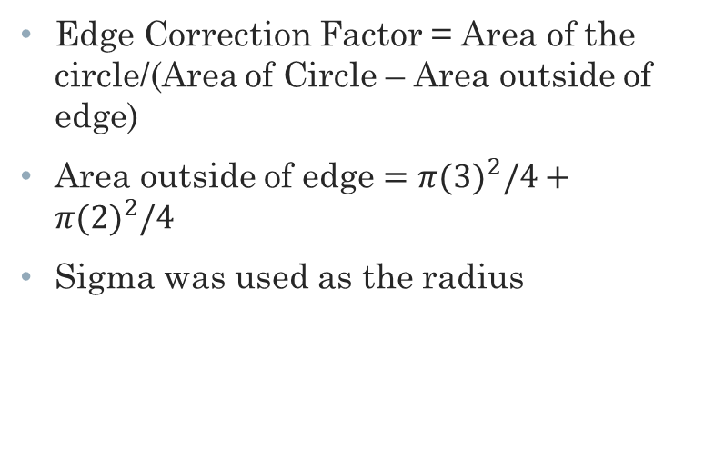
Edge Correction
Edge Correction Factor = Area of the circle/(Area of Circle – Area outside of edge)
Area outside of edge $=π({3)}^{2}/4+$ $π({2)}^{2}/4$
Sigma was used as the radius
6
3
2

Slide 6
Intensity Weighted Crowding
Each cell would calculate influence of every other cell.
This influence score would be multiplied by that neighboring cell.
All scores would be summed for a crowding score.
The higher a crowding score is the greater number of cells with high intensities are surrounding it.

Slide 7
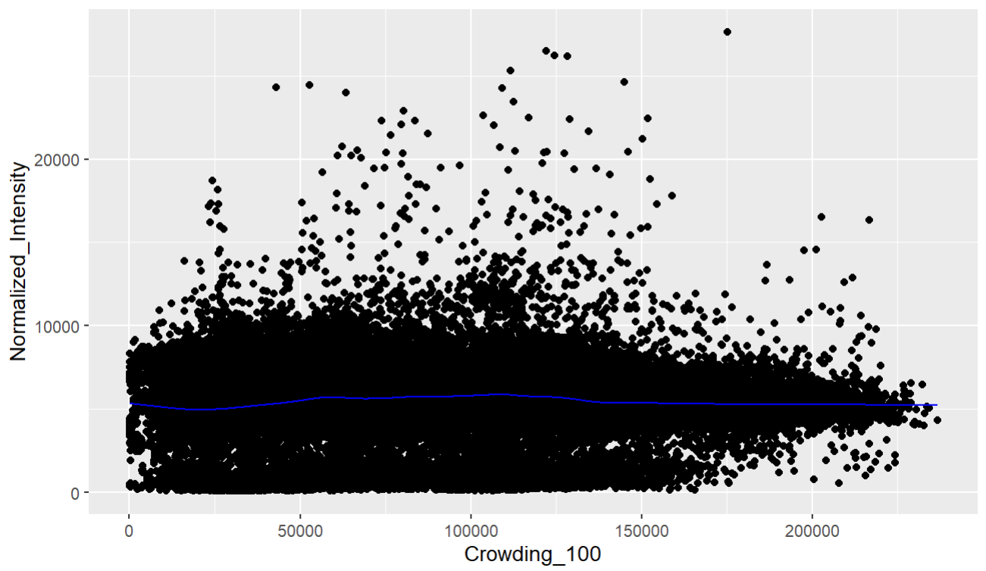
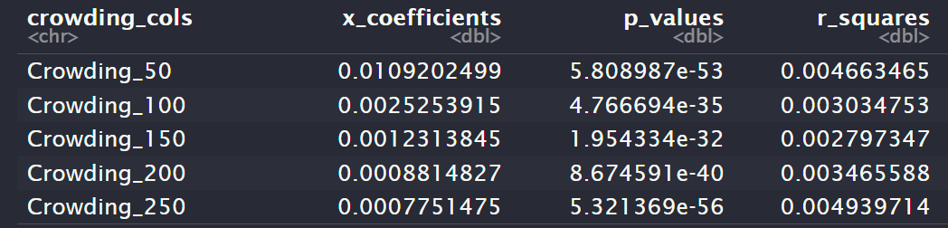
Crowding Score vs. Normalized Intensity
Appears that as the amount of higher intensity cells surround a cell, the higher a cell’s intensity will be.

Slide 8
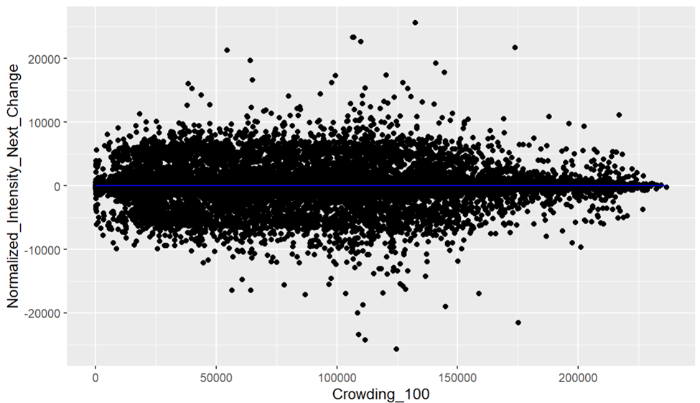
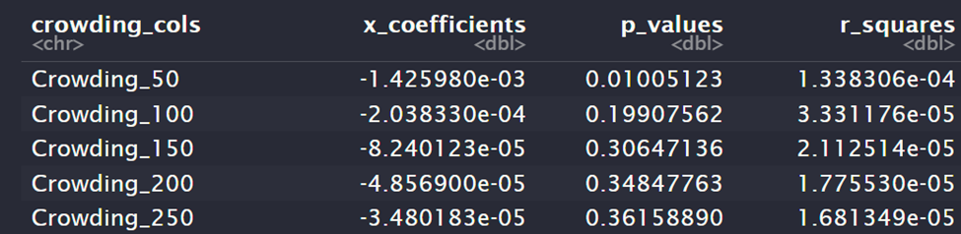
Crowding Score vs. Normalized Intensity Next Change
Relatively high p-values not anything too noteworthy.

Slide 9
Intensity Next Change Weighted Crowding
Next approach was to multiply influence score by how much the neighboring cell changed in intensity in their next time step.

Slide 10
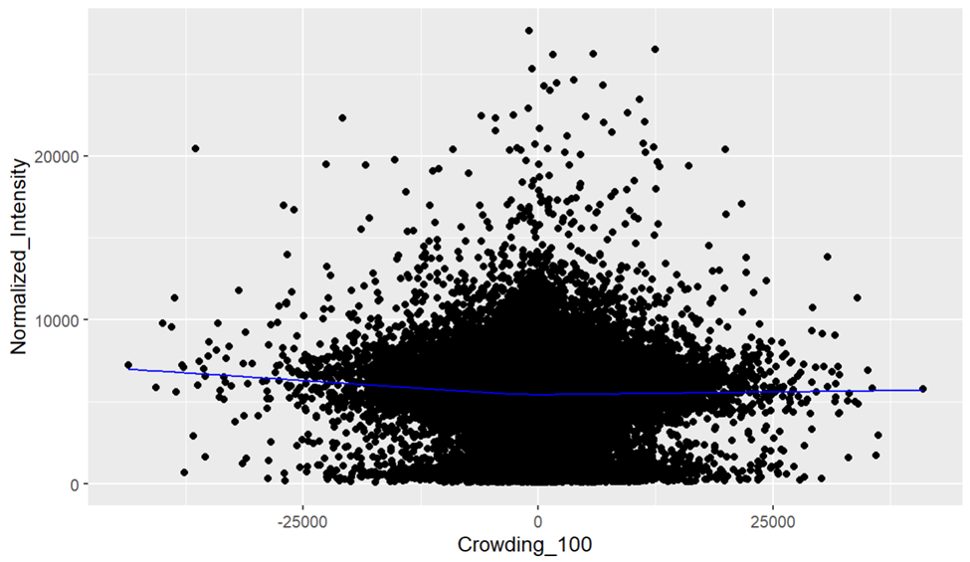
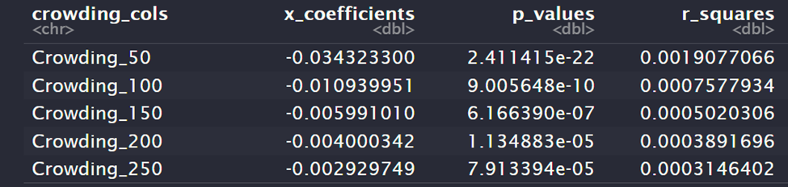
Crowding Score vs. Normalized Intensity
Has a v-shape
Appears that cells with neighbors greatly changing in intensity will have a greater intensity.
Linear-regression indicates the relationship is stronger for intensity decreases.

Slide 11
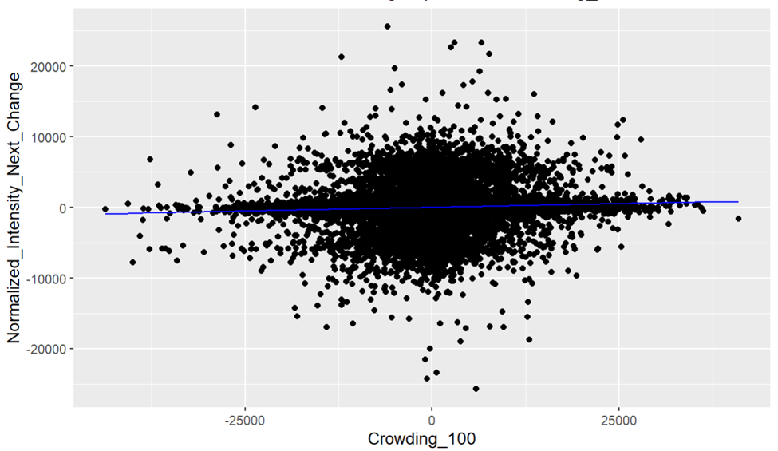
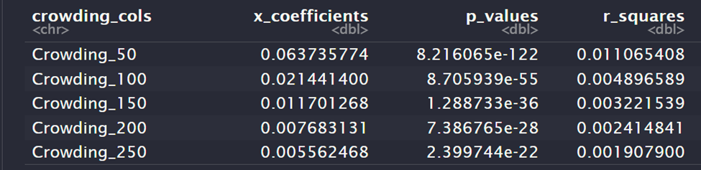
Crowding Score vs. Normalized Intensity Next Change
Appears that cell’s change in intensity follows closely with neighbors’ changes.

Slide 12
Intensity Previous Change Weighted Crowding
Final approach was to multiple influence score by how much neighboring cell’s intensity changed in the previous time step.

Slide 13
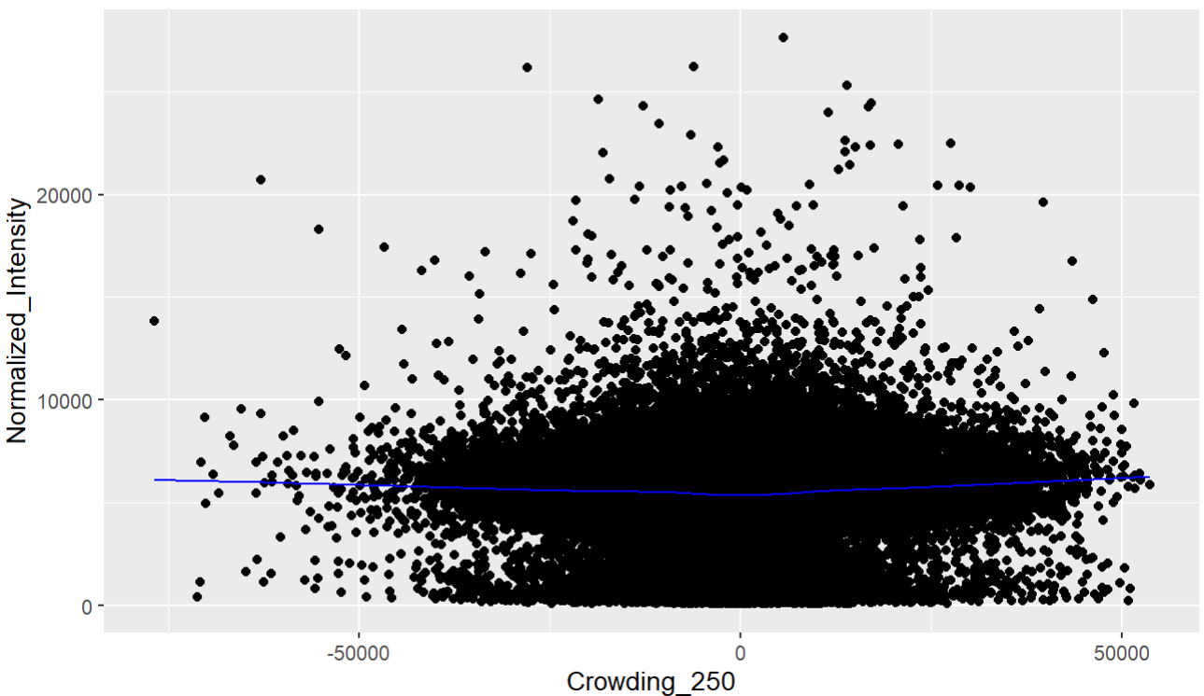
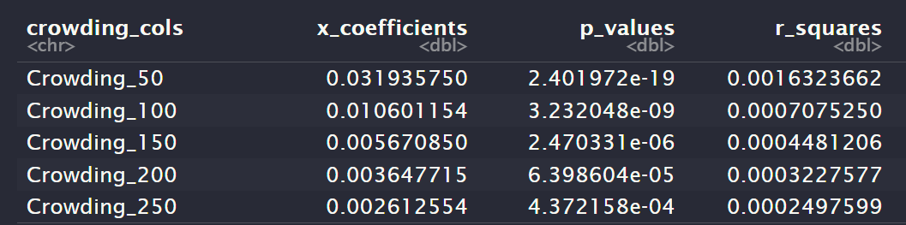
Crowding Score vs. Normalized Intensity
Has a v-shape
Appears that cells with neighbors greatly changing in intensity will have a greater intensity.
Linear-regression indicates the relationship is stronger for intensity increases.
Opposite of Next Change Weighted

Slide 14
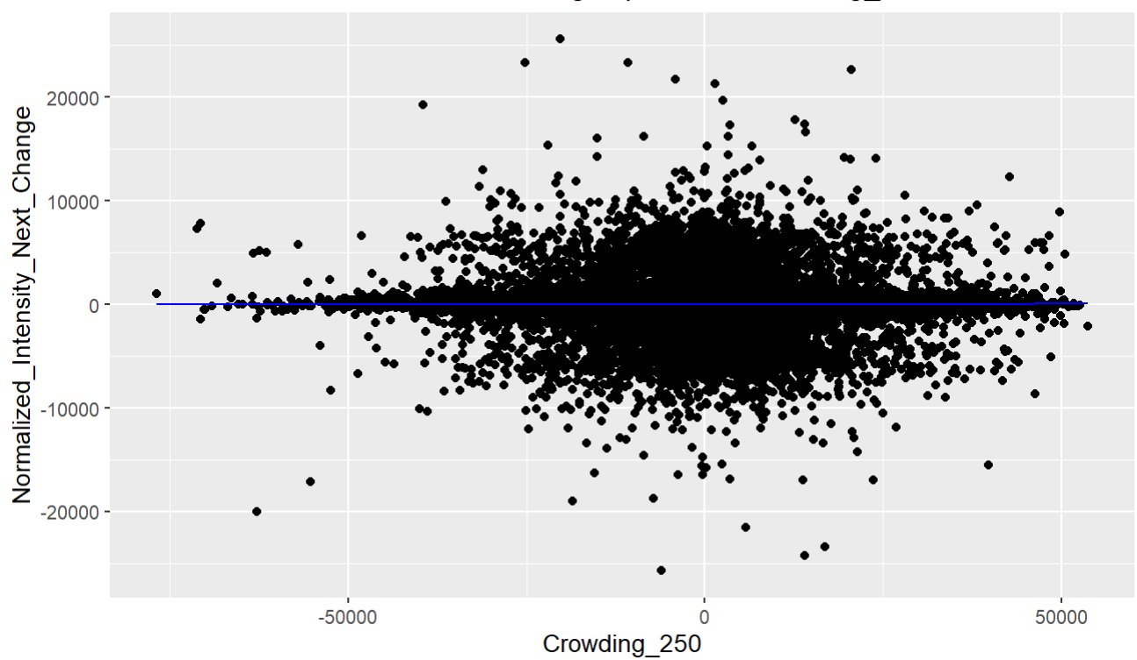
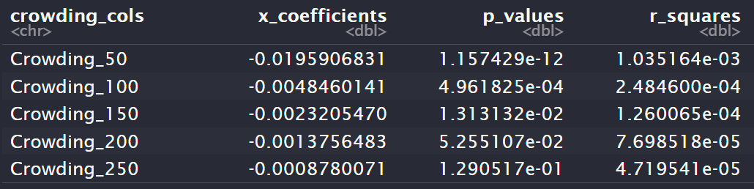
Crowding Score vs. Normalized Intensity Next Change
Appears that cell’s change in intensity is opposite of neighbors’ overall previous change.

Slide 15
Is it communication?
Based on the graphs presented it is difficult to tell if cells are truly communicating or it there is something else causing this behavior.
Cells could just be acting similar because they come from the same parent and stay close together.

Slide 16
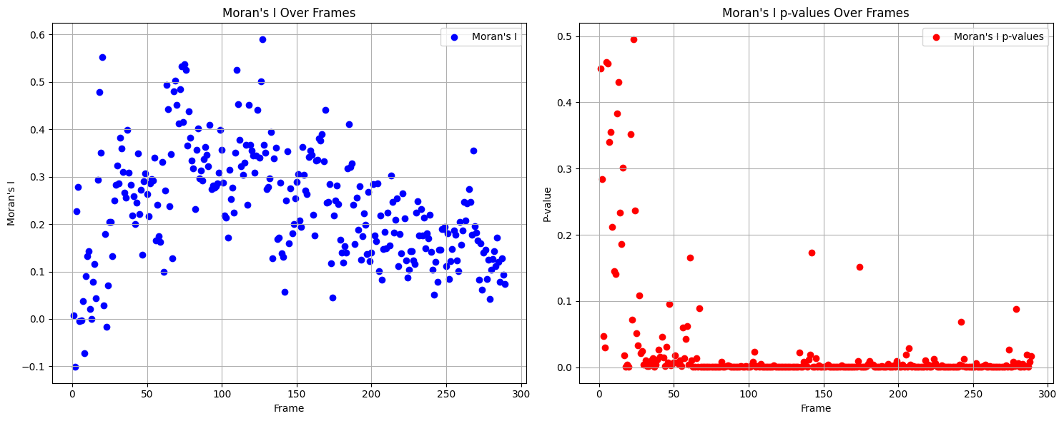
Spatial Autocorrelation (Moran’s I)
I-value has a range from -1 to 1.
A negative score indicates the value tends to be dispersed.
A positive score indicates that the value tends to be clustered.
A value closer to 0 indicates the values are randomly dispersed.

Slide 17
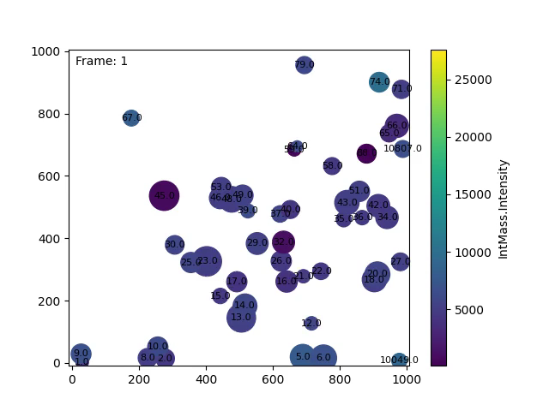

Slide 18
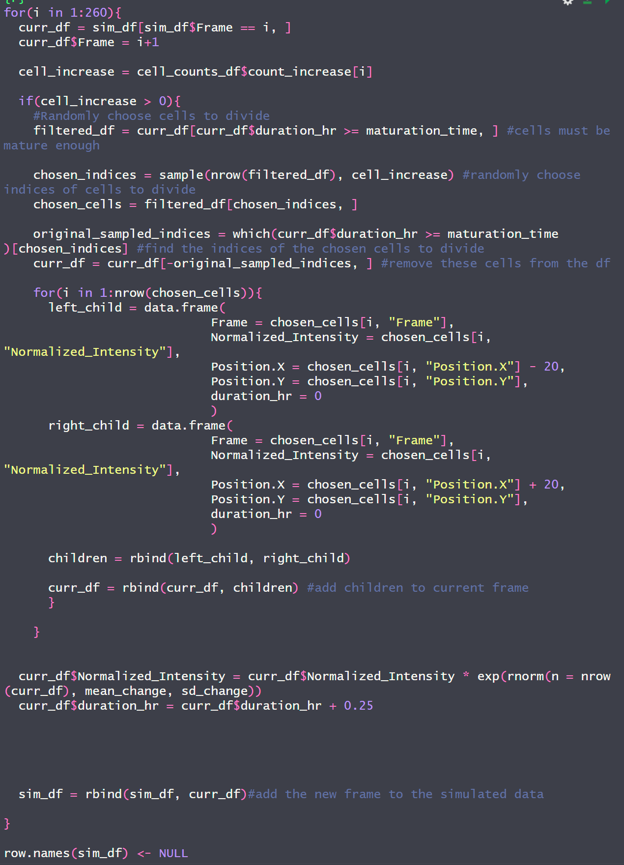
Simulation
Attempt to replicate behaviors of cells in a simulation.
Make behavior to simulate potential hypothesis that cells are not communicating but rather because cells come from the same parent.

Slide 19
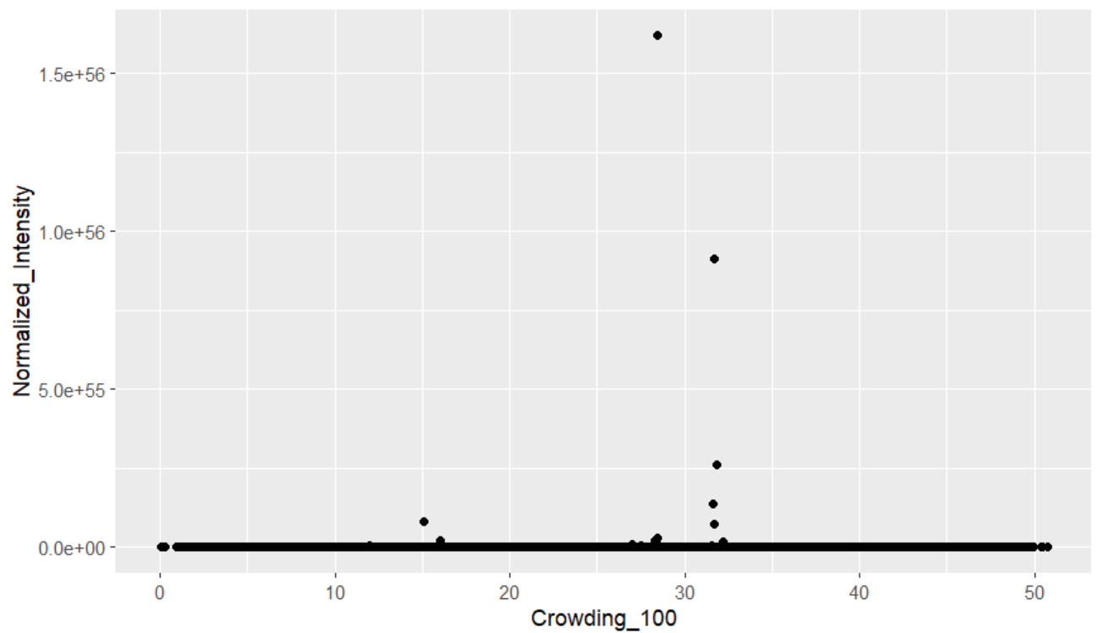
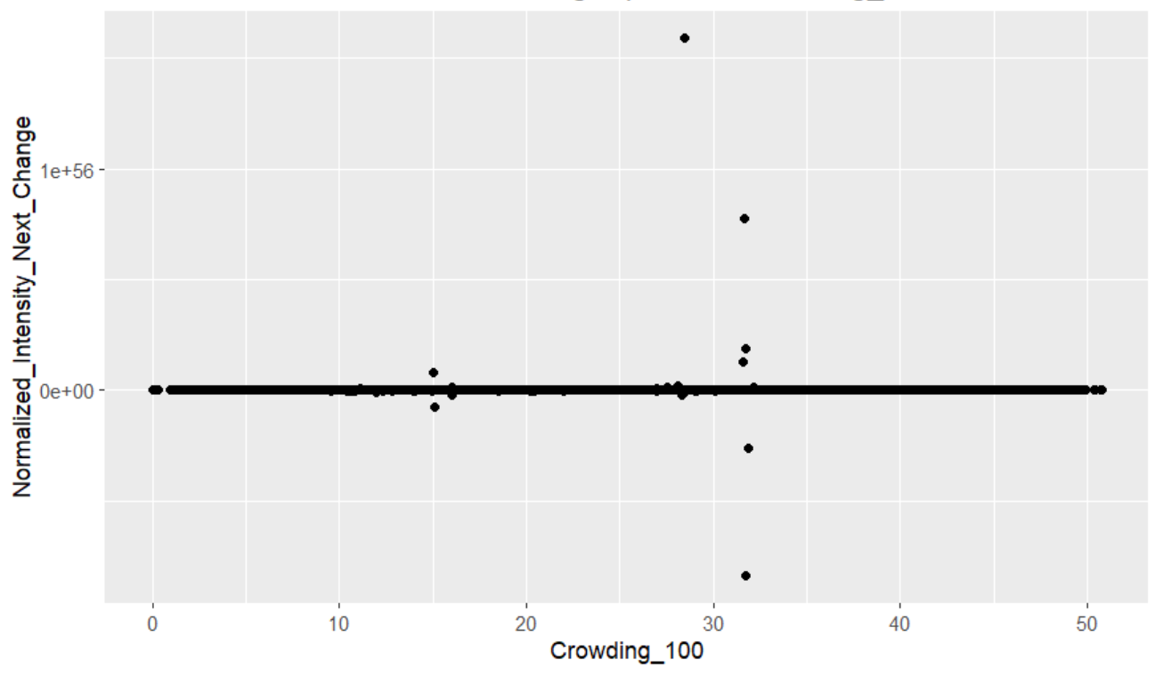
Didn’t work

Slide 20
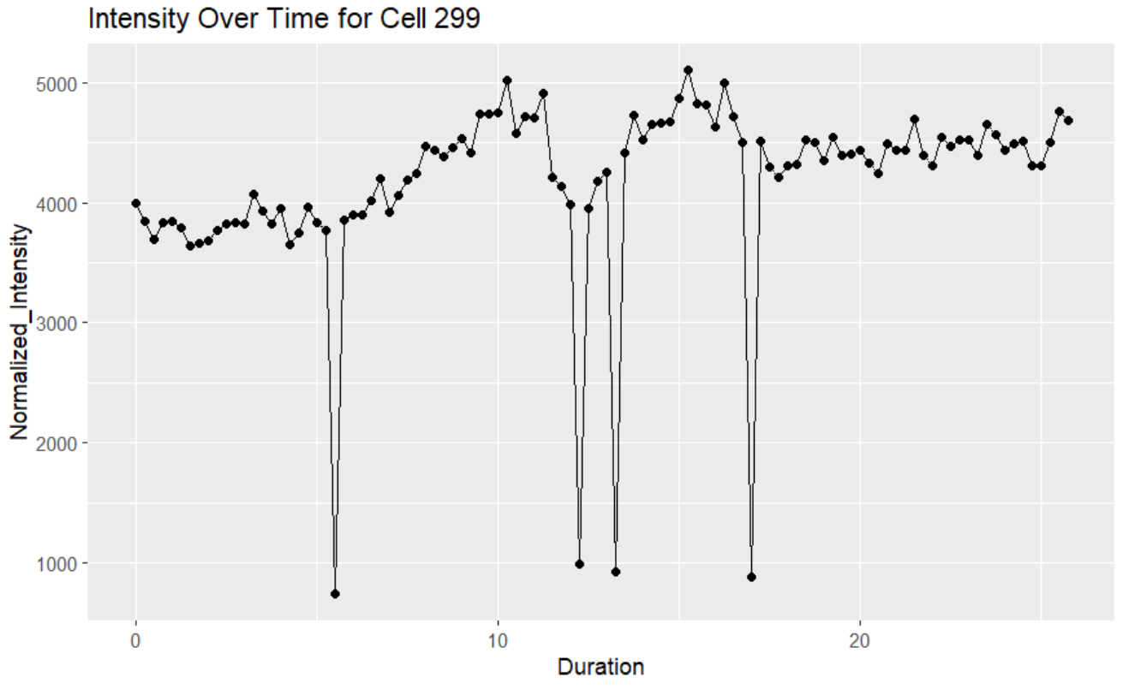
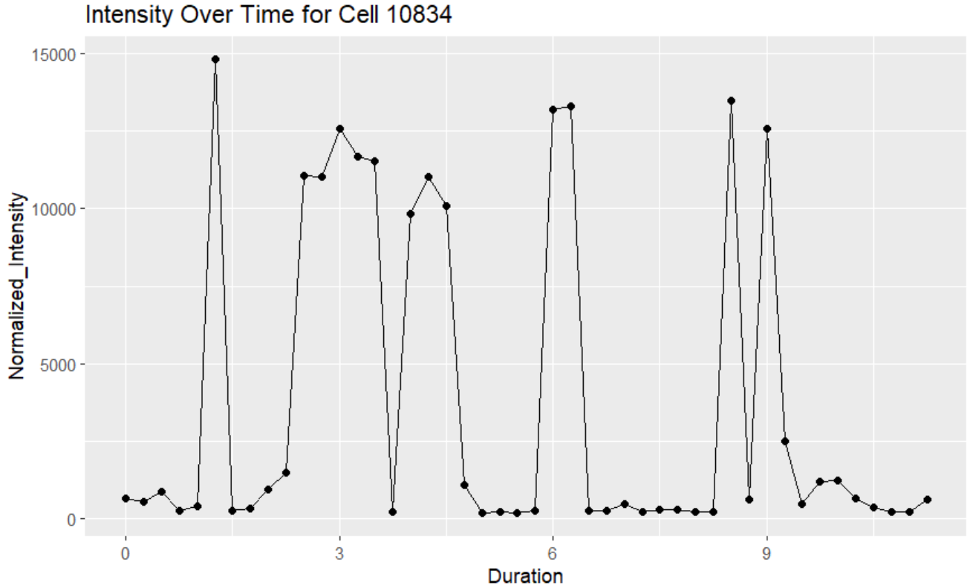
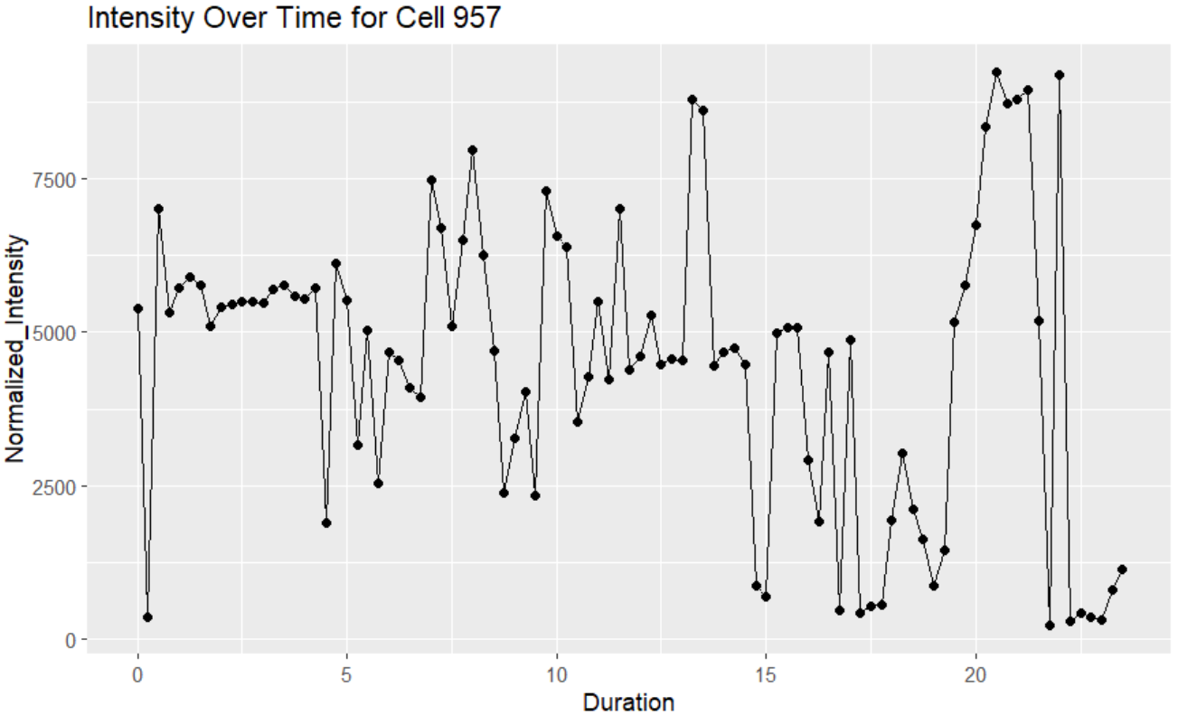
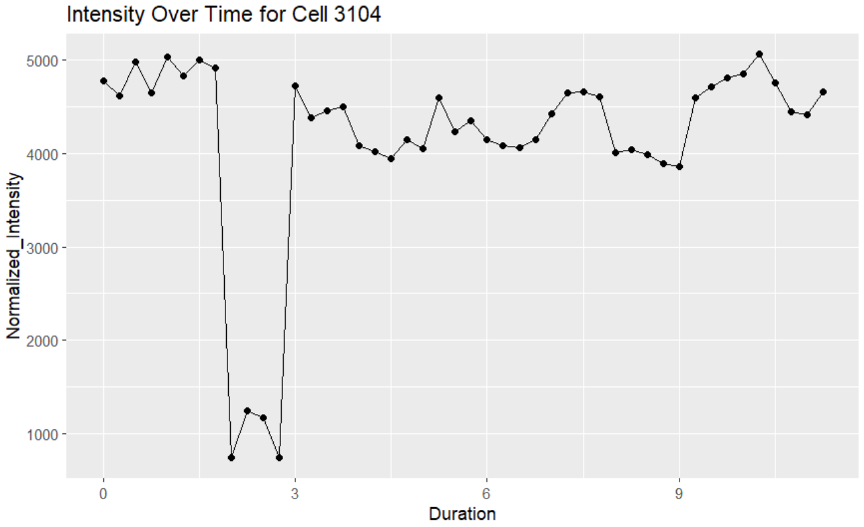
Simulating Intensity Changes is hard ☹

Slide 21
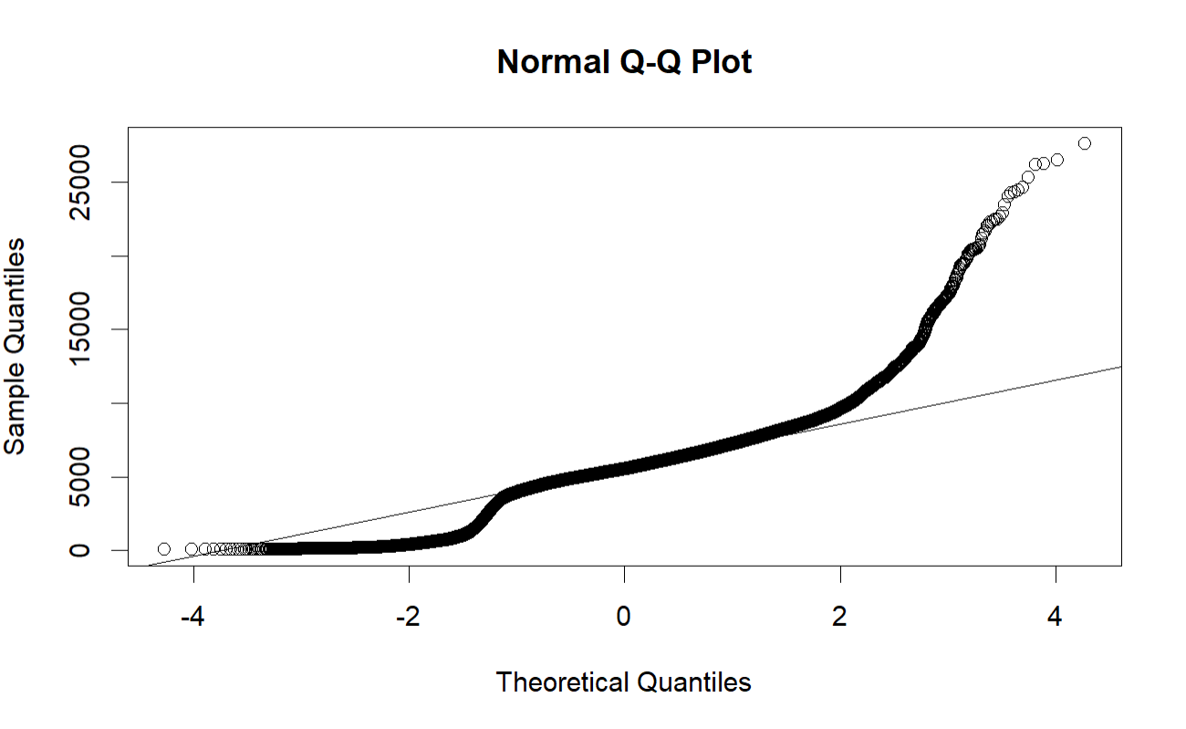
Attempted to sample from normal distribution
Many datasets follow the normal distribution.
These cell intensities don’t.
Tried it anyways.

Slide 22

Future Steps
Improve simulation to better replicate actual cell intensities.

