Slide 1
PARALLEL COMPUTING · IMAGE PIPELINE
ParallelPix
One image pipeline. Three execution paths. Sequential · OpenMP · CUDA
Notes:
Suggested time: 0:30
Opening: ParallelPix is not just an image-processing utility. It is a verifiable parallel-computing experiment platform. Three backends execute the same pixel semantics, allowing us to compare correctness, compute time, and end-to-end gains.
[Sources]
- D:\Programming\MS3\ParallelPix\docs\design\项目需求文档.md
- D:\Programming\MS3\ParallelPix\docs\tech\技术架构文档.md
[/Sources]

Slide 2
The real question is where computation pays off
Batch product-image standardization
Center crop, bilinear resize, brightness adjustment, and watermark blending repeat across millions of pixels.
Every output is 1024×1024, while input dimensions and content vary.
Repeatable
Every image runs through the same processing pipeline.
Independent
Images and output pixels have almost no cross-dependencies.
Measurable
Scale, threads, batches, and transfers define the experiment matrix.
2
Notes:
Suggested time: 1:00
Frame the research question first: the value of a single CPU core, multiple CPU cores, or a GPU is not fixed. It depends on batch size, task granularity, and the cost of moving data between host and device.
[Sources]
- D:\Programming\MS3\ParallelPix\docs\design\项目需求文档.md
[/Sources]

Slide 3
One pipeline isolates performance differences to the backend
01 · INGEST
02 · COMPUTE
03 · EVIDENCE
Stable input
Scan → sort → decode Skip corrupt files; contiguous BGR
Fixed pixel semantics
Center crop → bilinear resize Brightness → watermark
Validation & reporting
PNG round-trip validation Statistics → atomic CSV → dashboard
3
Notes:
Suggested time: 1:15
Stress fairness: OpenCV handles only image I/O. The three backends preserve identical core pixel semantics, so measured differences come from execution strategy rather than different algorithms.
[Sources]
- D:\Programming\MS3\ParallelPix\docs\design\M3图片数据IO设计.md
- D:\Programming\MS3\ParallelPix\docs\design\M4公共处理模型与Sequential设计.md
- D:\Programming\MS3\ParallelPix\docs\design\M7验证与Benchmark设计.md
[/Sources]

Slide 4
One controller, three replaceable compute backends
M1 + M2 + M3
Dashboard / CLI / Controller Input, planning, logs, and exit codes
IBackendExecutor
M4 Sequential M5 OpenMP M6 CUDA
M7 Benchmark
Validation gate, layered timing, statistics 27-column CSV feeds M1
CONTROL
BACKENDS
EVIDENCE
4
Notes:
Suggested time: 1:30
The architectural idea is dependency inversion. The controller depends only on a common backend interface. Each backend reports availability and returns a common execution result. CUDA phase timing and effective batch size remain optional extensions.
[Sources]
- D:\Programming\MS3\ParallelPix\include\parallelpix\benchmark\backend.hpp
- D:\Programming\MS3\ParallelPix\src\pipeline\benchmark_pipeline.cpp
- D:\Programming\MS3\ParallelPix\docs\tech\技术架构文档.md
[/Sources]

Slide 5
Lock down semantics before measuring speed
Sequential is the semantic oracle
Identical crop, sampling, rounding, brightness, and alpha-blend rules.
Performance metrics become meaningful only after validation passes.
OpenMP
CUDA
Exact pixel match
Maximum error = 0
No floating-point reduction
Per-channel error ≤ 1
Structural errors reported separately
Failed runs publish no speedup
5
Notes:
Suggested time: 1:20
Make the rule explicit: fast but incorrect is invalid. OpenMP preserves operation order and performs no floating-point reduction, so it must match exactly. CUDA allows an error of at most one per channel. Failed validations remain recorded, but speedup and efficiency are left blank.
[Sources]
- D:\Programming\MS3\ParallelPix\docs\design\M4公共处理模型与Sequential设计.md
- D:\Programming\MS3\ParallelPix\docs\design\M7验证与Benchmark设计.md
- D:\Programming\MS3\ParallelPix\src\benchmark\runner\experiment.cpp
[/Sources]

Slide 6
Deep dive 1: OpenMP performance depends on granularity
Image level · dynamic(1)
image_count ≥ threads Balances unequal image workloads
Row level · static
Small batches split output rows Keeps cores busy when images are few
No nested parallelism
Choose one granularity per run Avoid oversubscription
Deterministic writes
Preallocated output; threads write separate images or rows, with no pixel locks
6
Notes:
Suggested time: 2:00
Show the two actual directives: image-level work uses #pragma omp parallel for schedule(dynamic,1), while row-level work uses schedule(static). Dynamic scheduling handles unequal image workloads but adds scheduling cost; static scheduling suits uniform output rows. The key is selecting one granularity from batch size and thread count, not nesting both levels.
[Sources]
- D:\Programming\MS3\ParallelPix\src\openmp\scheduling\scheduling.cpp
- D:\Programming\MS3\ParallelPix\src\openmp\processor\processor.cpp
- D:\Programming\MS3\ParallelPix\src\openmp\processor\process_image.cpp
[/Sources]

Slide 7
5.34× on 8 threads: efficiency loss is evidence
6 real product images · compute 679.50 → 127.16 ms · pixel error = 0
5.34×
66.8%
Measured speedup
Parallel efficiency E=S/N
7
Notes:
Suggested time: 1:35
Read the gap between the measured and ideal lines. With eight threads, S=5.343 and E=S/8=0.668. An Amdahl-style estimate places the effective serial fraction plus parallel overhead at about 7.1%. OpenMP with one thread reaches only 0.922×, confirming that parallel-region and scheduling costs are real. The sample contains only six images, so this efficiency must not be generalized to large workloads.
[Sources]
- D:\Programming\MS3\ParallelPix\docs\test\M5 OpenMP后端测试.md
- D:\Programming\MS3\ParallelPix\results\benchmark.csv
[/Sources]

Slide 8
Deep dive 2: CUDA fusion reduces global-memory traffic
One thread, one output pixel
A 16×16 block covers the output plane with grid.x/y; grid.z selects the image.
Each thread completes three-channel bilinear sampling, brightness, and watermark blending.
DATA
Packed variable-size BGR + descriptors
KERNEL
Fused resize + brightness + watermark
TIMING
Single stream: H2D → kernel → D2H
RESILIENCE
On OOM, halve the batch and retry once
8
Notes:
Suggested time: 2:00
GPU value is not just a larger thread count. A fused kernel avoids repeatedly writing intermediate resize, brightness, and watermark images to global memory. Contiguous packing reduces fragmentation and repeated copies; a single stream is an intentional, interpretable baseline. OOM fallback discards the failed attempt, halves the batch, and retries from the beginning once.
[Sources]
- D:\Programming\MS3\ParallelPix\src\cuda\kernels\process_batch.cu
- D:\Programming\MS3\ParallelPix\src\cuda\processor\batch_executor.cpp
- D:\Programming\MS3\ParallelPix\src\cuda\processor\processor.cpp
[/Sources]

Slide 9
The GPU kernel is only part of compute time
RTX 5070 Ti Laptop · 8 images · batch 8
compute = 26.71 ms; H2D + kernel + D2H = 15.78 ms. The remaining 10.93 ms comes from host packing, reconstruction, and invocation overhead.
14.63×
41%
vs. same-run Sequential
Host + other share of compute
9
Notes:
Suggested time: 1:30
Do not compare the 7.44 ms kernel time directly with CPU wall-clock time. The valid comparison uses the full compute value of 26.71 ms. CUDA event phases still sum to less than compute; the roughly 41% gap shows that host preparation and object reconstruction matter. These CUDA figures are historical measurements from the target GPU, while the current workspace build is CPU-only.
[Sources]
- D:\Programming\MS3\ParallelPix\docs\test\M6 CUDA后端测试.md
[/Sources]

Slide 10
Deep dive 3: Fair benchmarking is a system feature
Same inputs, semantics, build, and timing boundaries; validate before computing speedup.
compute_ms: backend computation; CPU uses steady_clock, while CUDA events only split device phases.
end_to_end_ms: scan, decode, compute, and encode; validation and CSV writing are excluded.
Release build
2 warmups
≥ 5 measured repeats
median + min/max/stddev
Valid same-size Sequential baseline
10
Notes:
Suggested time: 1:45
Keep the three timing domains separate: compute, end-to-end, and CUDA event phases. The reported result uses the median while retaining min, max, and standard deviation. Speedup may reference only a validated Sequential record from the same run and image count. The dashboard remains entirely outside the timed region.
[Sources]
- D:\Programming\MS3\ParallelPix\src\benchmark\runner\experiment.cpp
- D:\Programming\MS3\ParallelPix\docs\design\M7验证与Benchmark设计.md
- D:\Programming\MS3\ParallelPix\docs\tech\技术架构文档.md
[/Sources]

Slide 11
The system accelerates; a unified ranking needs one experiment
Evidence status
The M1–M7 functional chain is substantially complete.
Final conclusions still require one machine, one dataset, and one Release run.
Established
Still required
M5: 15/15 CLI configurations passed
OpenMP pixel error = 0
M6: 10/10 on GPU + 0 sanitizer errors
Unified M5 + M6 + M7 build regression
10/50/100 or 1,000-image matrix
All three backends in the same run
11
Notes:
Suggested time: 1:20
State the limitation proactively: OpenMP and CUDA performance results come from different runs and workload sizes, so they cannot be combined into a claim such as 'CUDA is X times faster than OpenMP.' Each backend has demonstrated acceleration, but the final three-way conclusion requires a unified experiment.
[Sources]
- D:\Programming\MS3\ParallelPix\docs\plan\开发计划.md
- D:\Programming\MS3\ParallelPix\docs\test\M5 OpenMP后端测试.md
- D:\Programming\MS3\ParallelPix\docs\test\M6 CUDA后端测试.md
- D:\Programming\MS3\ParallelPix\docs\test\M7验证与Benchmark测试.md
[/Sources]

Slide 12
Why not distributed? New variables outweigh current value
Data capacity
Current data and computation fit within one machine and one GPU.
Data movement
Cross-node PNG transfer, serialization, and networking change the end-to-end model.
System complexity
Scheduling, fault tolerance, and storage consistency become new research questions.
Trigger condition
Use it when data exceeds one machine or throughput must scale across nodes.
12
Notes:
Suggested time: 1:10
This is a technical trade-off, not a missing feature. Images could be partitioned across nodes, but networking, serialization, distributed storage, and fault tolerance introduce new variables. Sequential, OpenMP, and CUDA already answer the central question of where computation should happen on one machine.
[Sources]
- D:\Programming\MS3\ParallelPix\项目要求.md
- D:\Programming\MS3\ParallelPix\docs\tech\技术架构文档.md
[/Sources]

Slide 13
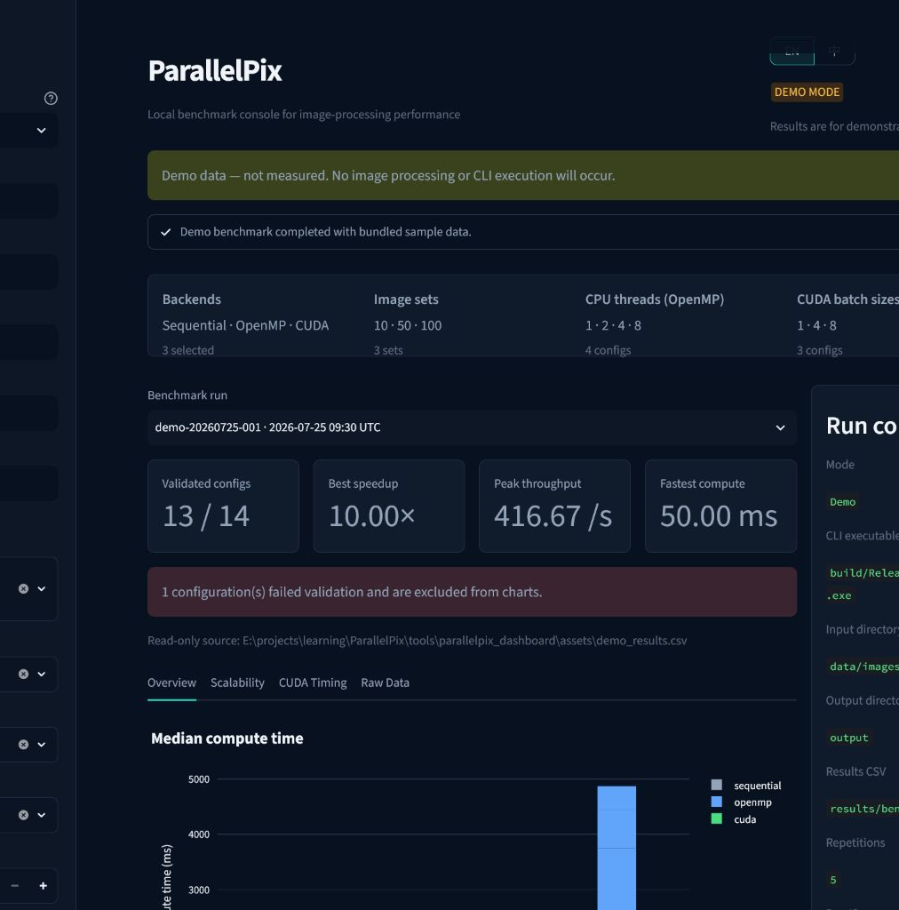
Live demo: close the experiment loop
M1 is the local experiment console
Local CLI mode invokes the real C++ executable; Demo mode reads sample data only. Run a small Sequential + OpenMP matrix, then inspect validation, speedup, and compute vs. end-to-end charts.
13
Notes:
Suggested time: 2:20
Demonstrate the complete loop rather than a static screenshot. In Local CLI mode, select the current CPU-only executable, choose Sequential + OpenMP, 2/4/6 images, and 1/2/4/8 threads. After execution, show the new run_id, validation_passed, speedup, and the difference between compute and end-to-end. If the environment is unstable, switch to Demo mode and clearly state that its values are not measured on the current machine.
[Sources]
- D:\Programming\MS3\ParallelPix\tools\parallelpix_dashboard\page.py
- D:\Programming\MS3\ParallelPix\tools\parallelpix_dashboard\runners.py
- D:\Programming\MS3\ParallelPix\tools\parallelpix_dashboard\views.py
- D:\Programming\MS3\ParallelPix\docs\test\screenshots\m1-implementation-en-demo-final-1440x1024.png
[/Sources]

Slide 14
SUMMARY
Correctness, speedup, and overhead belong together
OpenMP: granularity
CUDA: data movement
M8: unified validation
Notes:
Suggested time: 0:45
Close on the contribution: ParallelPix is not defined by one maximum speedup number. It places correctness, acceleration, overhead, and applicability boundaries in one reproducible experiment. M8 Hybrid is a hypothesis for the next stage, not a promise of higher performance, because the CPU and GPU may compete for memory bandwidth and I/O.
[Sources]
- D:\Programming\MS3\ParallelPix\docs\design\M8 CPU-GPU混合后端设计.md
- D:\Programming\MS3\ParallelPix\docs\plan\开发计划.md
[/Sources]

