Slide 1
Graph Paper Style Thesis
Infographics
Infographics
Here is where this template begins

Slide 2
Graph paper style thesis infographics
10%
30%
Mars
Jupiter
Despite being red, Mars is a cold place
Jupiter is the biggest planet of them all
20%
40%
Neptune
Venus
Neptune is very far away from the Sun
Venus has a beautiful name, but it’s very hot

Slide 3
Graph paper style thesis infographics
01
02
03
Mercury | Venus is the second planet from the Sun | Jupiter is the biggest planet of them all | Saturn is a gas giant and has many rings
Mercury is the closest planet to the Sun and the smallest of them all
Mars | Neptune is very far away from the Sun | Earth is the planet where we all live | Pluto is now considered a dwarf planet
Despite being red, Mars is actually a very cold place

Slide 4
Graph paper style thesis infographics
 | Mon | Tue | Wed | Thu | Fri
9:00h | Data collect
10:00h |  |  |  | Data study
11:00h | Comparison
12:00h |  |  | Comparison
13:00h |  |  |  |  | Comparison
14:00h |  | Results collect

Slide 5
Graph paper style thesis infographics
Author | Year | Title | Institution | Place
Jane Doe | 2XXX | Mercury Is Small | University of Mercury | Mercury
Helena Harris | 2XXX | Neptune Is Far From Us | University of Neptune | Neptune
Danny Thomson | 2XXX | Venus Is A Hot Place | University of Venus | Venus
Timmy Jimmy | 2XXX | Jupiter Is A Big Planet | University of Jupiter | Jupiter
John Morris | 2XXX | Mars Is Very Cold | University of Mars | Mars

Slide 6
Graph paper style thesis infographics
Phase 01
Phase 02
Phase 03
Mercury is the smallest planet
Despite being red, Mars is very cold
Neptune is very far away from us
Saturn is the ringed planet
Jupiter is the biggest planet
The Moon is Earth’s satellite
Venus has a beautiful name
Earth is the planet where we all live
Pluto is a dwarf planet. It’s small

Slide 7
Graph paper style thesis infographics
Hypothesis 01
Ceres is in an asteroid belt
Jupiter is the biggest planet
Mercury is the closest planet to the Sun
Hypothesis 02
Pluto is now a dwarf planet
Saturn is the ringed planet
Mars is made of basalt and it’s a red planet
Hypothesis 02
Mercury is the smallest planet
Venus has a beautiful name
Saturn is composed of hydrogen and helium

Slide 8
Graph paper style thesis infographics
10%
Mercury
Mars
Mercury is the closest planet to the Sun and the smallest of them all
Despite being red, Mars is a cold place
Neptune is far away from us
90%
Saturn is the ringed planet
Jupiter is the biggest planet
Venus
Venus has extremely high temperatures

Slide 9
Graph paper style thesis infographics
Mercury
Venus
Mercury is the smallest planet
01
04
Venus has a beautiful name
Objectives
Saturn
Mercury is the closest planet to the Sun and the smallest of them all
Earth
Saturn is the ringed planet
02
05
Earth is the planet with life
Mars
Neptune
Despite being red, Mars is cold
03
06
Neptune is far away from us

Slide 10
Graph paper style thesis infographics
Methodology 01 |  | Methodology 02 |  | Methodology 03
Mercury is the closest planet to the Sun and the smallest |  | Earth is the third planet from the Sun and harbors life |  | Despite being red, Mars is actually a cold place
Methods | Mars is cold | Methods | Ceres is small | Methods | Saturn has rings
 | Venus is hot |  | Neptune is far |  | Jupiter is big

Slide 11
Graph paper style thesis infographics
5%
15%
20%
25%
40%
Mercury
Mars
Jupiter
Saturn
Neptune
Mercury is the closest planet to the Sun
Despite being red, Mars is a cold place
Jupiter is the biggest planet of them all
Saturn was named after a Roman god
Neptune is very far away from the Sun

Slide 12
Graph paper style thesis infographics
20%
40%
40%
Mars
Venus
Saturn
Despite being red, Mars is a cold place
Venus has extremely high temperatures
Saturn was named after a Roman god
Data collection

Slide 13
Graph paper style thesis infographics
Mercury
Mars
Mercury is the closest planet to the Sun
Despite being red, Mars is actually a cold place
Saturn
Earth
Saturn is composed of hydrogen and helium
Earth is the third planet from the Sun

Slide 14
Graph paper style thesis infographics
Data collect
Despite being red, Mars is a cold place
Results
Venus has a beautiful name and is the second planet from the Sun. It’s terribly hot, even hotter than Mercury, and its atmosphere is poisonous
Comparison
Venus has extremely temperatures
Experimentation
Neptune is very far away from us

Slide 15
Graph paper style thesis infographics
 | Week 1 | Week 2 | Week 3 | Week 4
Task 1
Task 2
Task 3
Task 4
Task 5
Not started
In progress
Completed

Slide 16
Graph paper style thesis infographics
Month, 2XXX
Mon | Tue | Wed | Thu | Fri | Sat | Sun
 |  |  | 1 | 2 | 3 | 4
5 | 6 | 7 | 8 | 9 | 10 | 11
12 | 13 | 14 | 15 | 16 | 17 | 18
19 | 20 | 21 | 22 | 23 | 24 | 25
26 | 27 | 28 | 29 | 30 | 31
Data collect
Deadline: Fri 2nd
Planning
Deadline: Sat 10th
Write article
Deadline: Thu 22nd
Results show
Deadline: Sat 31st

Slide 17
Graph paper style thesis infographics
Day, Month, 2XXX
Timetable | Tasks |  | Check
9:00h-11:00h | Task name | Mars is a cold planet | Yes
11:00h-12:30h | Task name | Venus has high temperatures | No
12:30h-13:00h | Task name | Jupiter is the biggest planet | Yes
16:00h-18:00h | Task name | Neptune is far away from us | Yes
18:00h-20:00h | Task name | Earth is the planet with life | No

Slide 18
Graph paper style thesis infographics
01
03
05
02
04
Mercury
Venus
Earth
Mercury is the smallest planet
Venus has a beautiful name
Earth is the planet we live on
Mars
Jupiter
Mars is a very cold planet
Jupiter is the biggest planet

Slide 19
Graph paper style thesis infographics
Hypothesis
Jupiter is the fourth-brightest object in the night sky. It was named after a Roman god
Results 01
Results 02
Results 03
Despite being red, Mars is a cold place
Jupiter is the biggest planet of them all
Earth is the third planet from the Sun

Slide 20
Graph paper style thesis infographics
Hypothesis
Results
Mars
01
Venus is hot and is the second planet from the Sun
Jupiter is very big and was named after a Roman god
Despite being red, Mars is actually a cold place. It's full of iron oxide dust, which gives the planet its reddish cast
Hypothesis
Results
02
Earth is the only planet known to harbor life
Saturn is a gas giant and has several rings

Slide 21
Graph paper style thesis infographics
Problem 01
Problem 02
Despite being red, Mars is actually a cold place
Venus is hot and is the second planet from the Sun
Hypothesis 01
Hypothesis 02
Earth is the only planet known to harbor life
Saturn is a gas giant and has several rings
Methodology 01
Methodology 02
Jupiter is the biggest planet of them all
Mercury is the smallest planet of them all

Slide 22
Graph paper style thesis infographics
Mars is actually a cold place
Venus has a beautiful name
Jupiter is the biggest planet
Mars
Venus
Jupiter
01
02
03
05
04
Neptune
Saturn
Neptune is far away from us
Saturn is the ringed planet

Slide 23
Graph paper style thesis infographics
Theoretical framework 1
Theoretical framework 2
Mercury is the closest planet to the Sun and the smallest one in the Solar System
Earth is the third planet from the Sun and where we all live on
Venus is the second planet from the Sun
Despite being red, Mars is actually a cold place
Jupiter is the biggest planet of them all

Slide 24
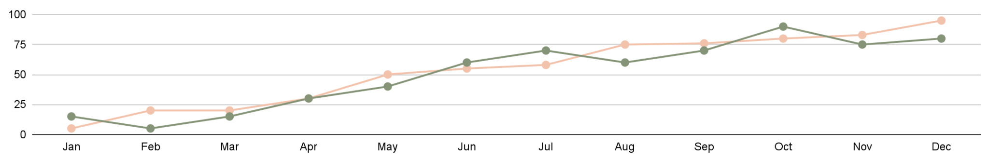
Graph paper style thesis infographics
5% to 95%
15% to 80%
Results analysis progress
Data collect progress
Mercury is the closest planet to the Sun and the smallest one in the Solar System
Venus has a beautiful name and is the second planet from the Sun
Follow the link in the graph to modify its data and then paste the new one here. For more info, click here

Slide 25
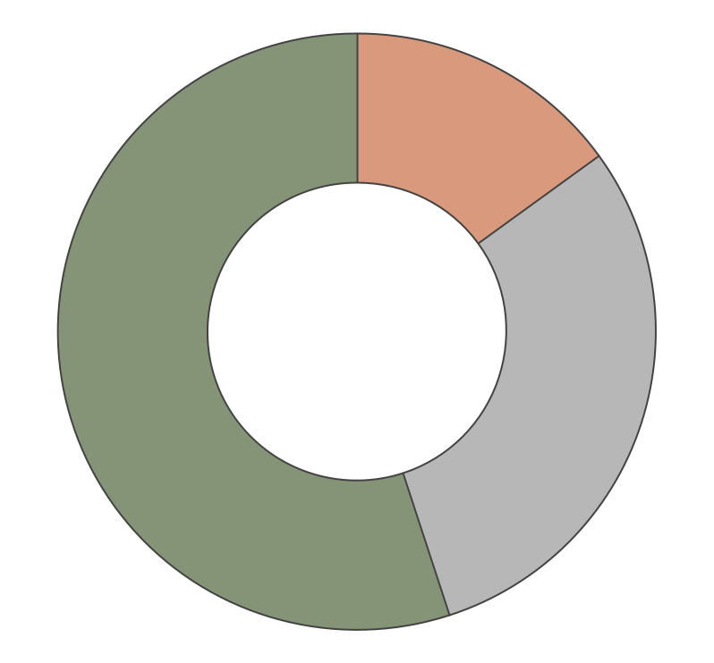
Graph paper style thesis infographics
15%
Mars
Despite being red, Mars is a cold place
30%
Jupiter
Jupiter is the biggest planet
55%
Saturn
Saturn was named after a Roman god
Follow the link in the graph to modify its data and then paste the new one here. For more info, click here

Slide 26
Graph paper style thesis infographics
Positive results
Negative results
Mercury is the closest planet to the Sun
Despite being red, Mars is actually a cold place
Positive results
Negative results
Saturn was named after a Roman god
Earth is the only planet known to harbor life
Positive results
Negative results
Neptune is the farthest planet from the Sun
Venus has a beautiful name and high temperatures

Slide 27
Graph paper style thesis infographics
 | Hypothesis 01
 | Results 1 | Results 2
Mercury | Mars is very cold | Mercury is a small place
Mars | Neptune is far from us | The Moon is a satellite
Conclusions
Venus has a beautiful name and is the second planet from the Sun
 | Hypothesis 02
 | Results 1 | Results 2
Venus | Venus is very hot | Jupiter is very big
Earth | Pluto is very small | Saturn is a gas giant
Conclusions
Saturn is a gas giant and has rings. It's composed mostly of hydrogen and helium

Slide 28
Graph paper style thesis infographics
Estimated project budget
Amount | Resources | Price (unit) | Total
3 | Product name | $15 | $45
1 | Product name | $30 | $30
4 | Product name | $3.50 | $14
2 | Product name | $20 | $40
6 | Product name | $8.50 | $51
 |  |  | $180

Slide 29
Graph paper style thesis infographics
Problem
Mercury is the closest planet to the Sun
Hypothesis
Venus is the second planet from the Sun
Confirmation
Refutation
Jupiter is the biggest planet of them all
Despite being red, Mars is actually a cold place
Contrast
Earth is the only planet known to harbor life

Slide 30
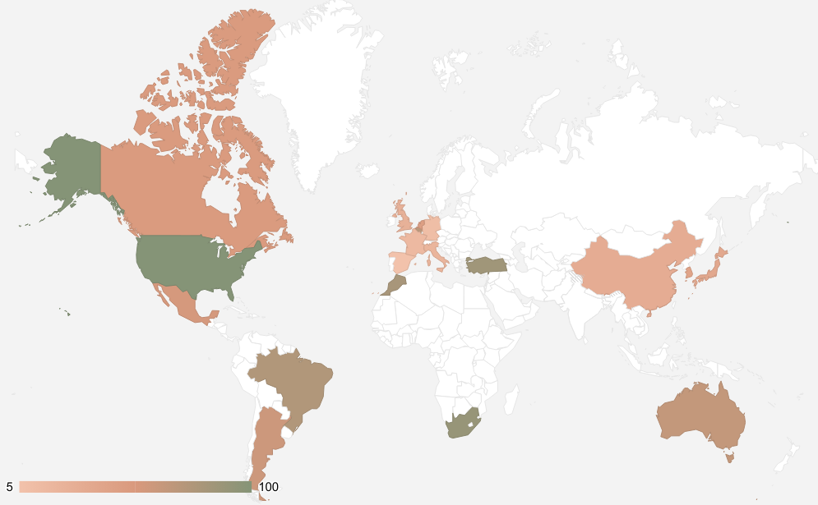
Graph paper style thesis infographics
Earth
Earth is the third planet from the Sun and the only one that harbors life
Venus
Venus has a beautiful name and is the second planet from the Sun
Follow the link in the graph to modify its data and then paste the new one here. For more info, click here

Slide 31
Graph paper style thesis infographics
Author | Title | Important quotes | Pages
John Doe | Mars is cold | “Despite being red, Mars is actually a cold place. It's full of iron oxide dust” | 125-126
 |  | “Earth is the third planet from the Sun and the only one that harbors life” | 241
Jenna Harris | Mercury is small | “Jupiter is a gas giant and the biggest planet in the Solar System” | 15-16
 |  | “Saturn is a gas giant and has several rings. It's composed mostly of hydrogen and helium” | 36-37

