Slide 1
Handa Notebook
Thesis
Infographics
Here is where your presentation begins

Slide 2






Handa notebook thesis infographics
Venus
Venus is the second planet from the Sun
Mercury
It’s the smallest planet of them all
Jupiter
It’s the biggest planet in the Solar System

Slide 3



Handa notebook thesis infographics
Venus
60%
Venus has high temperatures and a beautiful name
40%
Mercury
Mercury is the smallest planet in the entire Solar System
25%
Jupiter
Jupiter is a gas giant and the biggest planet of them all

Slide 4


Handa notebook thesis infographics
Venus
Mercury
Jupiter
Mars
Venus is the second planet from the Sun
Mercury is the closest planet to the Sun
It’s the biggest planet in the Solar System
Despite being red, Mars is a very cold place

Slide 5
Handa notebook thesis infographics
Venus
45%
Venus is the second planet from the Sun
Mercury
25%
It’s the smallest planet of them all
Jupiter
30%
It’s the biggest planet in the Solar System

Slide 6
Handa notebook thesis infographics
Venus is the second planet from the Sun | X |  | X
Jupiter is the biggest planet in the Solar System |  | X
Venus
Mercury
Jupiter

Slide 7
Handa notebook thesis infographics
75%
65%
45%
35%
Venus
Mercury
Jupiter
Mars
Venus is the second planet from the Sun
Mercury is the closest planet to the Sun
It’s the biggest planet in the Solar System
Despite being red, Mars is a very cold place

Slide 8
Handa notebook thesis infographics
Venus has a beautiful name and high temperatures
35%
Venus
Mercury is the closest planet to the Sun
45%
Mercury
Mars is actually a cold place full of iron oxide dust
20%
Mars

Slide 9
Handa notebook thesis infographics
30%
70%
Venus
Mercury
Venus is the second planet from the Sun in the Solar System
Mercury is the smallest planet in the entire Solar System

Slide 10

Handa notebook thesis infographics
1st
2nd
3rd
4th
Venus
Mercury
Jupiter
Mars
Venus is the second planet from the Sun
Mercury is the closest planet to the Sun
It’s the biggest planet in the Solar System
Despite being red, Mars is a very cold place

Slide 11
Handa notebook thesis infographics
 | Mars | Venus | Earth
1st | 0.06 | 0.38 | 0.38
2nd | 0.11 | 0.53 | 0.38
3rd | 95.2 | 9.4 | 1.16

Slide 12
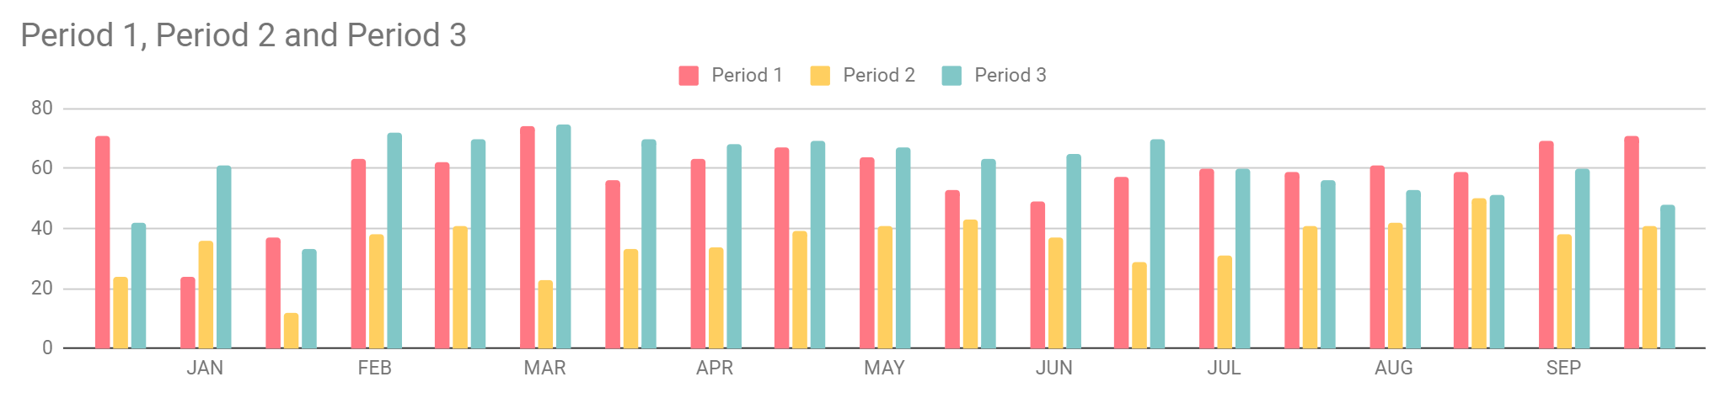
Handa notebook thesis infographics
Follow the link in the graph to modify its data and then paste the new one here. For more info, click here
Venus
Mercury
Jupiter
Venus is the second planet from the Sun
Mercury is the closest planet to the Sun
It’s the biggest planet in the Solar System

Slide 13
Handa notebook thesis infographics
75%
55%
80%
Venus
Mercury
Jupiter
Venus is the second planet from the Sun
Mercury is the closest planet to the Sun
It’s the biggest planet in the Solar System

Slide 14
Handa notebook thesis infographics
Venus
Mercury
Venus is the second planet from the Sun
It’s the smallest planet of them all
Jupiter
Mars
It’s the biggest planet in the Solar System
Despite being red, Mars is a cold place

Slide 15
Handa notebook thesis infographics
Mercury | Mars | Venus | Earth
0.32 | 0.06 | 0.38 | 0.38
0.34 | 0.11 | 0.53 | 0.38
1.15 | 95.2 | 9.4 | 1.16

Slide 16
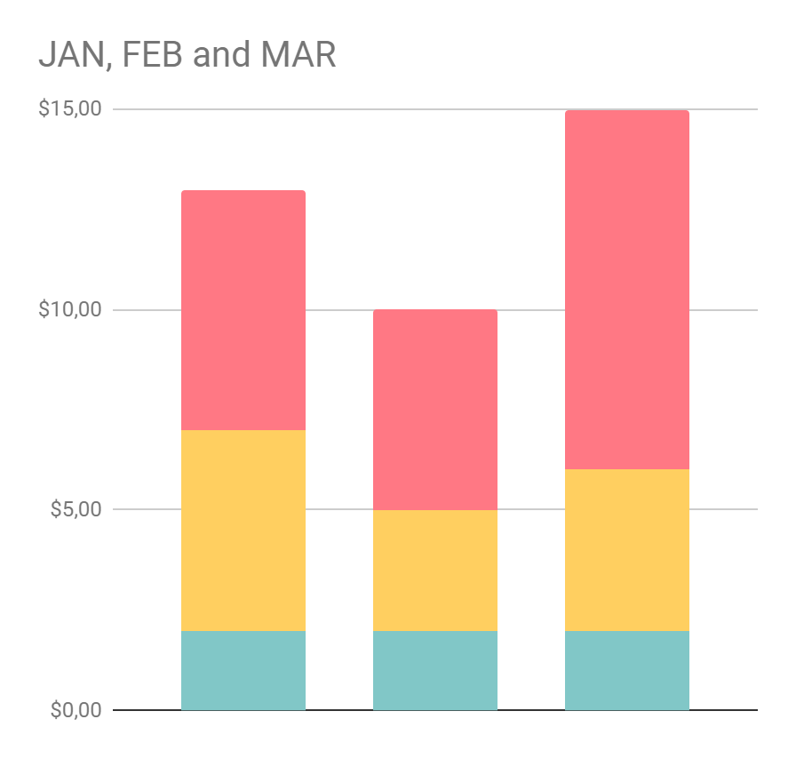
Handa notebook thesis infographics
Venus
Venus is the second planet from the Sun of them all
Mercury
Mercury is the closest planet to the Sun
Jupiter
Jupiter is a gas giant and the biggest planet of them all
Follow the link in the graph to modify its data and then paste the new one here. For more info, click here

Slide 17
Handa notebook thesis infographics
Mercury is the smallest planet of them all
Mercury
Neptune
Neptune is the farthest planet in the Solar System
Saturn is composed of hydrogen and helium
Saturn
Mars
Despite being red, Mars is a very cold planet

Slide 18
Handa notebook thesis infographics
Venus
50%
Venus has extremely high temperatures
Mercury
80%
Mercury is the smallest planet of them all
Jupiter
20%
Jupiter is the biggest planet of them all

Slide 19
Handa notebook thesis infographics
Mercury
03
Mercury is the closest planet to the Sun
Venus
Venus is the second planet from the Sun
01
02
Jupiter
It’s the biggest planet in the Solar System

Slide 20
Handa notebook thesis infographics
55%
25%
70%
Venus
Mercury
Jupiter
Venus is the second planet from the Sun
Mercury is the closest planet to the Sun
It’s the biggest planet in the Solar System

Slide 21
Handa notebook thesis infographics
1st
2nd
3rd
4th
Venus
Jupiter
Mercury
Earth
Venus is the second planet from the Sun
It’s the biggest planet in the Solar System
Mercury is the closest planet to the Sun
Earth is the only planet known to harbor life

Slide 22
Handa notebook thesis infographics
2nd
4th
Mercury
Mars
1st
Mercury is the closest planet to the Sun
3rd
Despite being red, Mars is a very cold place
Venus
Jupiter
Venus is the second planet from the Sun
It’s the biggest planet in the Solar System

Slide 23
Handa notebook thesis infographics
1st
Mercury is the closest planet to the Sun and the smallest one
2nd
Venus has a beautiful name and extremely high temperatures
3rd
Saturn is composed mostly of hydrogen and of helium
4th
Jupiter is a gas giant and the biggest planet in the Solar System

Slide 24
Handa notebook thesis infographics
Venus
Mercury
Jupiter
Mars
Venus is the second planet from the Sun
Mercury is the closest planet to the Sun
It’s the biggest planet in the Solar System
Despite being red, Mars is a very cold place
55%
75%
55%
35%

Slide 25
Handa notebook thesis infographics
Venus
Mercury
Jupiter
Venus is the second planet from the Sun
Mercury is the closest planet to the Sun
It’s the biggest planet in the Solar System

Slide 26
Handa notebook thesis infographics
Venus
Mercury
Jupiter
Mars
Venus is the second planet from the Sun
Mercury is the closest planet to the Sun
It’s the biggest planet in the Solar System
Despite being red, Mars is a very cold place

Slide 27
Handa notebook thesis infographics
Venus
Jupiter
Venus is the second planet from the Sun
It’s the biggest planet in the Solar System
Mercury
Mars
Mercury is the closest planet to the Sun
Despite being red, Mars is a very cold place

Slide 28
Handa notebook thesis infographics
Venus
55%
Venus has high temperatures and a beautiful name
Mercury
25%
Mercury is the smallest planet in the entire Solar System
Jupiter
35%
Jupiter is a gas giant and the biggest planet of them all

Slide 29
Handa notebook thesis infographics
Venus
Mercury
Venus is the second planet from the Sun
Mercury is the closest planet to the Sun
Jupiter
Earth
It’s the biggest planet in the Solar System
Earth is the only planet with life of them all

Slide 30
Handa notebook thesis infographics
Earth
A
B
C
D
Venus
Mercury
Jupiter
Mars
Venus is the second planet from the Sun
Mercury is the closest planet to the Sun
It’s the biggest planet in the Solar System
Despite being red, Mars is a very cold place

