Slide 1
World Geography Bundle for Middle School Infographics
Here is where this template begins

Slide 2
World geography bundle for middle school
Definitions
Country
Ocean
Desert
Border
Jupiter is the biggest planet in the Solar System
Mercury is the smallest planet in the Solar System
Venus is the second planet from the Sun
Saturn is a gas giant and has several rings

Slide 3
World geography bundle for middle school
Americas
Europe
Jupiter is the biggest planet in the Solar System
Venus is the second planet from the Sun
Africa
Oceania
Mercury is the closest planet to the Sun
Pluto is considered a dwarf planet

Slide 4
World geography bundle for middle school
01
02
03
Oceans
Forests
Cities
Jupiter is the biggest planet in the Solar System
Mercury is the closest planet to the Sun
Venus is the second planet from the Sun
50%
30%
20%

Slide 5
World geography bundle for middle school
Mercury is the closest planet to the Sun and the smallest one
Venus has a beautiful name, but also very high temperatures
vs
Geography
Geology
Jupiter is a gas giant and the biggest planet in the Solar System
Earth is the only planet that harbors life in the Solar System

Slide 6
World geography bundle for middle school
Name the capital cities of these countries
Spain | Madrid
Germany | Berlin
Uganda | XXX
Mexico | XXX
Chile | XXX

Slide 7
World geography bundle for middle school
Neptune
Neptune is the farthest planet from the Sun
Americas
Jupiter
Jupiter is the biggest planet of them all
Geography
Mercury
Mercury is the closest planet to the Sun
Europe
Venus
Venus is the second planet from the Sun

Slide 8
World geography bundle for middle school
Continent | Population | Area
Asia | 3,261,050,390 | 31,033,131 km²
Africa | 1,340,598,147 | 29,648,481 km²
Europe | 747,636,026 | 22,134,900 km²

Slide 9
World geography bundle for middle school
World population
Asia
Jupiter is the biggest planet in the Solar System
59%
Africa
Mercury is the closest planet to the Sun
18%
Europe
Neptune is the farthest planet from the Sun
9%

Slide 10
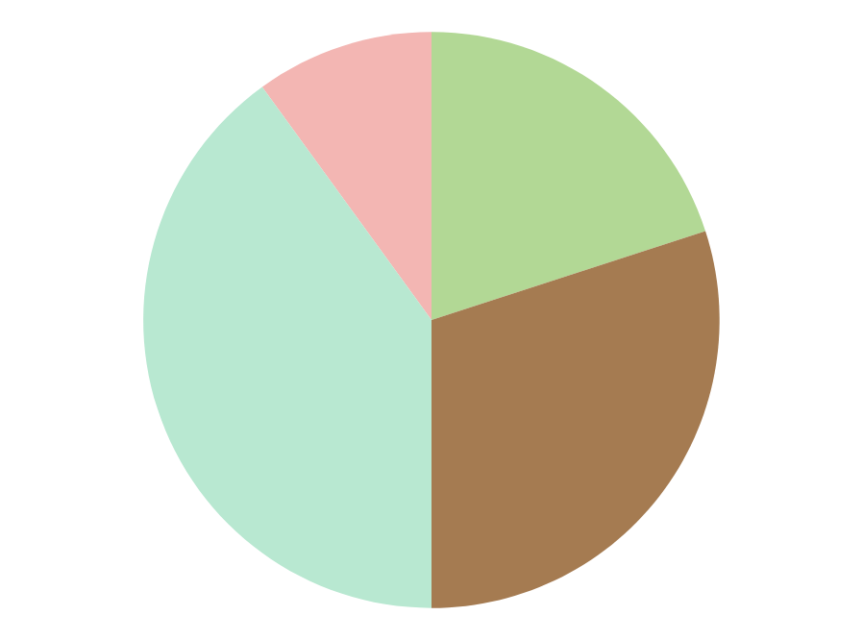
World geography bundle for middle school
Americas
Europe
Jupiter is the biggest planet in the Solar System
10%
20%
Venus is the second planet from the Sun
Africa
Oceania
Mercury is the closest planet to the Sun
40%
30%
Pluto is considered a dwarf planet
Follow the link in the graph to modify its data and then paste the new one here. For more info, click here

Slide 11
World geography bundle for middle school
Geography
01
02
03
Location
Place
Region
Jupiter is the biggest planet of them all
Mercury is the closest planet to the Sun
Saturn is a gas giant and has several rings
Despite being red, Mars is a cold place
Pluto is considered a dwarf planet
Earth is the third planet from the Sun

Slide 12
World geography bundle for middle school
 | Morocco | China | USA
Area | 9,904,607 | 1,439,323,776 | 9,093,510
Population | 111,890 km² | 9,388,211 km² | 37,742,154 km²
Notes | Mercury is quite a small planet | Despite being red, Mars is cold | Venus has a beautiful name

Slide 13
World geography bundle for middle school
01
Cultural
Jupiter is the biggest planet in the Solar System
World geography
02
Economic
Mercury is the closest planet to the Sun
03
Historical
Neptune is the farthest planet from the Sun

Slide 14
World geography bundle for middle school
60%
40%
vs
Europe
Africa
Jupiter is the biggest planet of them all
Mercury is the closest planet to the Sun
Pluto is considered a dwarf planet
Earth is the third planet from the Sun

Slide 15
World geography bundle for middle school
Americas
 | Individualism
 | Extroversion
 | Fear death
 | Money driven
Asia
 | Collectivism
 | Introversion
 | Face death
 | Community driven

Slide 16
World geography bundle for middle school
01
Jupiter
Jupiter is the biggest planet in the Solar System
02
Mercury
Mercury is the closest planet to the Sun

Slide 17
World geography bundle for middle school
01
02
03
Jupiter
Mercury
Venus
Jupiter is an enormous planet
Mercury is quite a small planet
Venus has a beautiful name

Slide 18
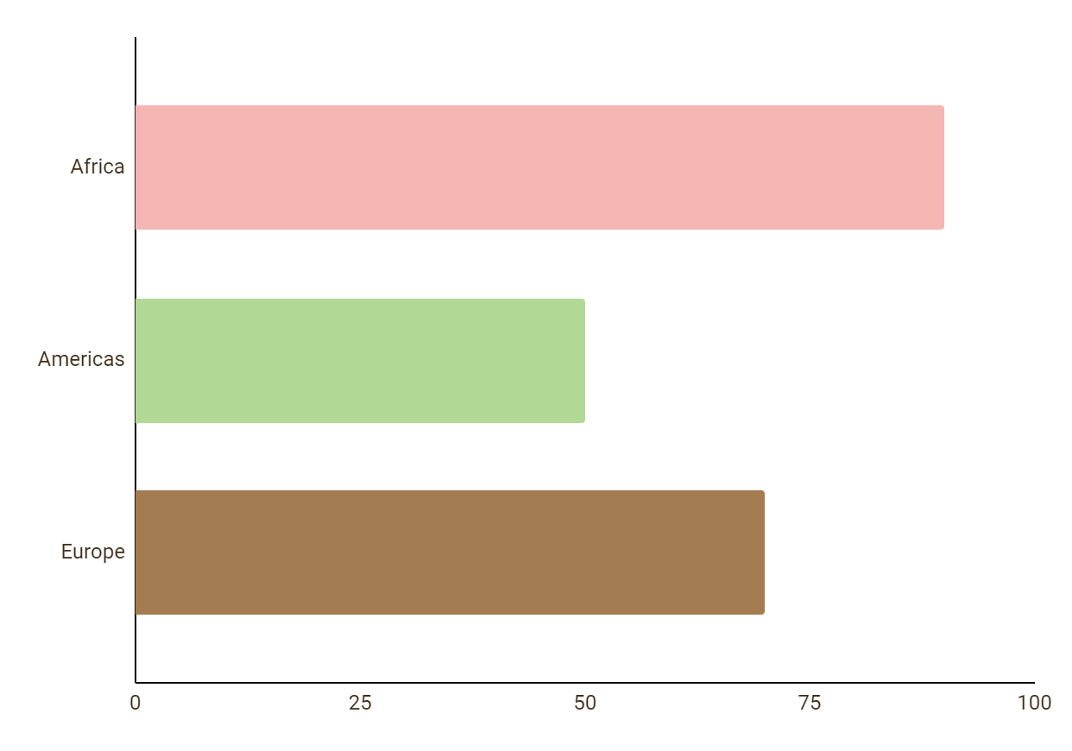
World geography bundle for middle school
Africa
90%
Jupiter is big
Americas
50%
Mercury is small
Europe
70%
Saturn has rings
Follow the link in the graph to modify its data and then paste the new one here. For more info, click here

Slide 19
World geography bundle for middle school
Geography | Asia | Americas | Europe
History | Jupiter is the biggest planet of them all | Neptune is the farthest planet from the Sun | The Sun is the star at the center of the Solar System
Tradition | Mercury is the closest planet to the Sun | Despite being red, Mars is actually a very cold place | Earth is the third planet from the Sun and has life
Language | Venus is the second planet from the Sun | Uranus is the seventh planet from the Sun | The Moon is a natural satellite of the Earth

Slide 20
World geography bundle for middle school
2xxx
Despite being red, Mars is a cold place
2xxx
Mercury is the smallest planet of them all
2xxx
Saturn is composed of hydrogen and helium

Slide 21
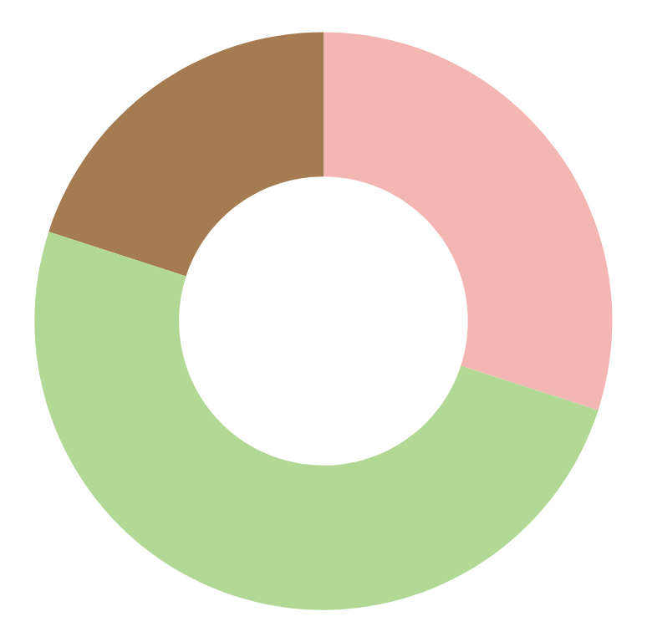
World geography bundle for middle school
30%
Customs
Jupiter is an enormous planet
50%
Food
Mercury is quite a small planet
20%
Culture
Neptune is very far away from us
Follow the link in the graph to modify its data and then paste the new one here. For more info, click here

Slide 22
World geography bundle for middle school
80%
30%
Mercury
Mars
Mercury is a bit larger than the Moon
Despite being red, Mars is a cold place
50%
70%
Venus
Neptune
Venus is the second planet from the Sun
Neptune the farthest planet from the Sun

Slide 23
World geography bundle for middle school
50%
20%
30%
Europe
Americas
Africa
Mercury is the closest planet to the Sun
Jupiter is the biggest planet in the Solar System
Despite being red, Mars is actually a very cold place

Slide 24
World geography bundle for middle school
Lunch time in different countries
Spain | UK | Germany | Cameroon
14:00 | 12:00 | 13:00 | 11:00
Saturn is a gas giant and has rings | Mercury is quite a small planet | Jupiter is an enormous planet | Venus is the second planet from the Sun

Slide 25
World geography bundle for middle school
Africa
Vs
Oceania
1
Jupiter is the biggest planet of them all
Saturn is a gas giant and has several rings
4
2
Venus is the second planet from the Sun
Earth is the planet that harbors life
5
3
Mercury is quite a small planet
Despite being red, Mars is cold
6

Slide 26
World geography bundle for middle school
Jupiter is a gas giant
Mercury is a small planet
Venus has a beautiful name
Earth harbors life
Mars is a cold place
Pluto is a dwarf planet
Ceres is in the asteroid belt
Neptune is far away from us
The Moon is our satellite
The Sun is a bright star
North America
South America
Americas

Slide 27
World geography bundle for middle school
Cultural differences
Europe | Africa
Introvert people | Extrovert people
Punctuality | Relaxed way of living
Work first | Family first
Stress | Happiness

Slide 28
World geography bundle for middle school
Oceans
Rivers
Mercury is quite a small planet
Despite being red, Mars is cold
Physical
Political
Cities
Countries
Jupiter is an enormous planet
Saturn is a gas giant and has rings

Slide 29
World geography bundle for middle school
Asia
Europe
Mercury
Jupiter
Mercury is quite a small planet
Differences
Jupiter is an enormous planet
Mars
Saturn
Despite being red, Mars is cold
Saturn is a gas giant and has rings

Slide 30
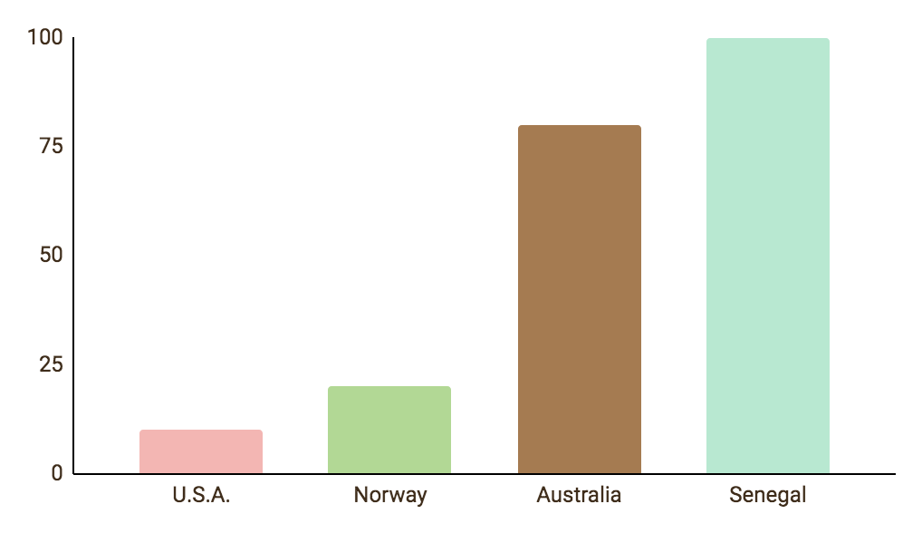
World geography bundle for middle school
External debt
Mercury is the closest planet to the Sun and the smallest in the Solar System. This planet's name has nothing to do with the liquid metal, since Mercury was named after the Roman messenger god
10%
20%
80%
100%
Follow the link in the graph to modify its data and then paste the new one here. For more info, click here

Slide 31
World geography bundle for middle school
1
3
Politics
Culture
Mercury is quite a small planet
2
Jupiter is an enormous planet
4
Religion
Food
Despite being red, Mars is cold
Saturn is a gas giant and has rings

