Slide 1
Big Data in Healthcare and Privacy Issues
Issa Karadsheh

Slide 2
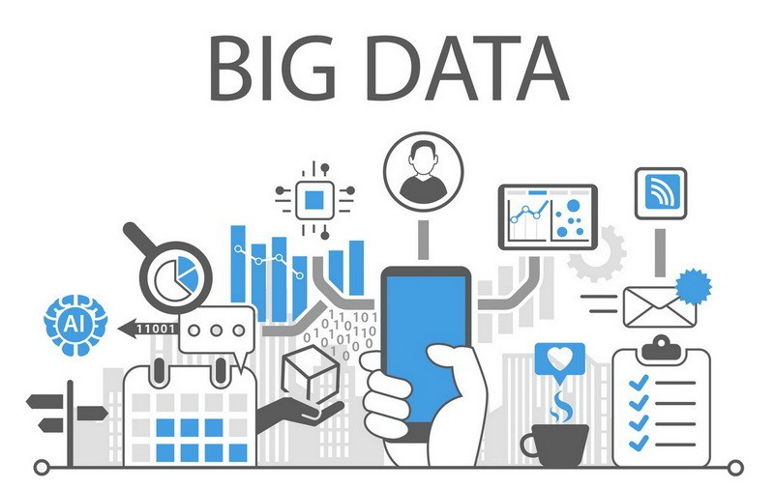
What is Big Data?
A massive amount of information on a given topic.
Big data includes information that is generated, stored, and analyzed on a massive scale.
Data that is so large, fast, and complex that it is impossible to process under traditional methods.

Slide 3

Big Data in Healthcare
Big data includes:
Patient Medical Records
Hospital Records
Medical Exam Results
Information Collected by Healthcare Testing Machines
Biomedical research on public health also provides a large portion of the big data that, if properly managed and analyzed, can serve as meaningful information for patients, doctors, administrators, and researchers alike.

Slide 4
The importance of Big Data in Healthcare
It can make more informed decisions about treatment and services.
Identify the warning signs of a serious illness before it arises.
Administrators can use key performance indicators and data analytics to make a number of funding and resource allocation decisions.
Big data amassed in health records and Google maps have been used to make critical health maps that highlight underserved locations.

Slide 5
The importance of Big Data in Healthcare
Administrators and providers can use such information to determine where to deploy mobile health clinics and other resources.
Hospitals and other large care facilities can use big data to capture a comprehensive picture of patient experience.
Big data holds the promise of consolidating patient data, allowing for rapid and accurate communication between patients and providers that draws from a patient’s entire health history.

Slide 6

Staffing
It can help with patient predictions for improved staffing.
Shift managers face how many people that they can staff at any given time period.
Putting too many workers runs the risk of having unnecessary labor costs adding up. Too few workers can lead to poor customer outcomes, which can be fatal for patients in that industry.

Slide 7
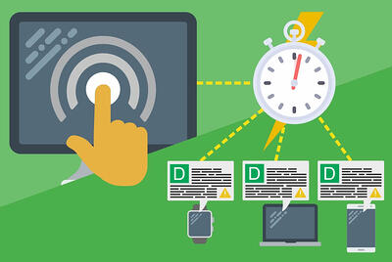
REal-Time Alerting
Clinical Decision Support (CDS) software analyzes medical data on the spot, providing health practitioners with advice as they make prescriptive decisions.
Wearables will collect patients’ health data continuously and send this data to the cloud.
Additionally, this information will be accessed to the database on the state of health of the general public, which will allow doctors to compare this data in a socio-economic context and modify the delivery strategies accordingly.

Slide 8

Health Records
Every patient has their own digital record that include demographics, medical history, allergies, laboratory test results, etc.
Records are shared through secure information systems and are available for providers from both private and public sectors.
Every record is comprised of one modifiable file.

Slide 9

What is Privacy?
Privacy is often defined as having the ability to protect sensitivity information about personally identifiable health care information.
It focuses on the use of governance of individual’s personal data like making policies and establishing authorization requirements to ensure that patients’ personal information is being collected, shared, and utilized in right ways.

Slide 10

Invasion of Privacy
An incident reported in Forbes magazine mentioned that Target corporation sent baby care coupons to a teenage girl unknown to her parents.
This incident impels analytics and developers to consider privacy in big data.
It raised an alarm over patient privacy.

Slide 11

Obstruction of Privacy Through Breaches
With the rise of personized marketing, many people fear that their privacy to be in a state of decline.
Usually, a huge portion of big data consists of predictions being made regardless of patient details.
These details can be extremely personal, and if a small chance of information falls into the wrong hands, an individual would lose trust in the organization.

Slide 12

It Becomes Near-Possible to Achieve Anonymity
Anonymity on the internet is considered a superpower.
Data files being anonymized becomes impossible as organizations use big data analytics.
There is a high possibility that patients have their identification factors shown as big data insights are based on a wide variety of raw data sets.
If a data file is anonymized, several security teams combine these valued files with others, to make the process of identifying an individual quite easy.

Slide 13
Data Masking Met With Failure in a Big Data-Driven Setting
Data masking is the process through which real data is hidden by other less important characters or data sets.
Its primary function is the protection of confidential data from ending up in the wrong hands.
If not used properly, it could lead to compromising security.
Organizations tend to ignore the risks associated with big data

Slide 14
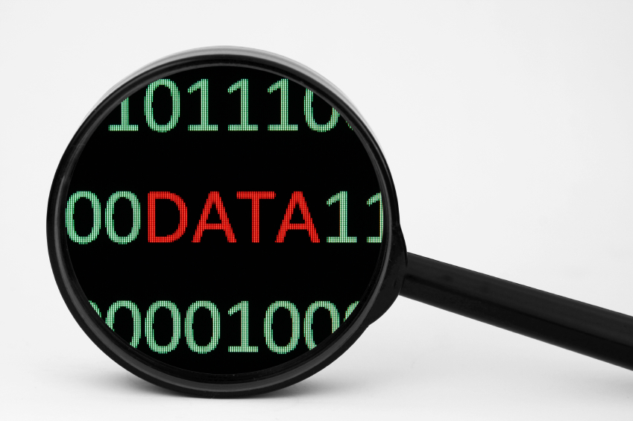
Big Data Analysis Isn’t Completely Accurate
Even though big data is powerful, it is critically flawed.
Inaccurate big data analysis is rooted primarily in
Flawed algorithms
Incorrect data models
Misplaced data about individuals
Poorly done big data diagnosis can lead to direct harm towards patients such as false misdiagnosis or denial of essential services.

Slide 15

Copyrights and Patents Are Rendered Irrelevant
Obtaining patents becomes extremely challenging.
It takes an excruciatingly long amount of time to verify the uniqueness of the patent.
Big data makes the manipulation of data highly possible, which also sends the royalties associated with the invention of something original, breaking apart.

Slide 16
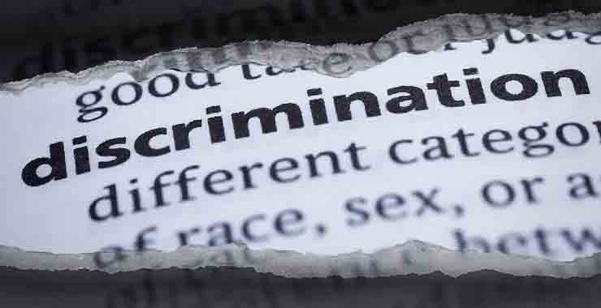
Discrimination Issues
Discrimination exists in almost all sectors and industries.
Companies can now find out the race of an individual and leverage their piece of information against them.

Slide 17
Protection strategies
Define and manage data governance policies to clarify what data is critical.
Automated, centralized big data privacy tools that integrate with native big data tools to streamline and facilitate the process of managing data access.
Discover, classify, and understand a wide range of sensitive data across all big data platforms at massive scale to develop and implement intelligent big data management policies.

Slide 18
Safeguards

Slide 19
Questions

