Slide 1
Business Analytics and Data Mining
Survival Analysis 生存分析
Zach Zhizhong Zhou
12/10/2016

Slide 2
What is survival analysis?
Statistical methods for analyzing longitudinal data on the occurrence of events.
Events may include death, injury, onset of illness, recovery from illness (binary variables) or transition above or below the clinical threshold of a meaningful continuous variable (e.g. CD4 counts).
Accommodates data from randomized clinical trial or cohort study design.

Slide 3
Randomized Clinical Trial (RCT)
Disease
Intervention
Random assignment
Disease-free
Target population
Disease-free, at-risk cohort
Disease
Control
Disease-free
TIME

Slide 4
Randomized Clinical Trial (RCT)
Cured
Treatment
Random assignment
Not cured
Target population
Patient population
Cured
Control
Not cured
TIME

Slide 5
Randomized Clinical Trial (RCT)
Dead
Treatment
Random assignment
Alive
Target population
Patient population
Dead
Control
Alive
TIME

Slide 6
Cohort study (prospective/retrospective)
Disease
Exposed
Disease-free
Target population
Disease-free cohort
Disease
Unexposed
Disease-free
TIME

Slide 7
Why use survival analysis?
1. Why not compare mean time-to-event between your groups using a t-test or linear regression?
-- ignores censoring
2. Why not compare proportion of events in your groups using risk/odds ratios or logistic regression?
--ignores time

Slide 8
Survival Analysis: Terms
Time-to-event: The time from entry into a study until a subject has a particular outcome
Censoring: Subjects are said to be censored if they are lost to follow up or drop out of the study, or if the study ends before they die or have an outcome of interest. They are counted as alive or disease-free for the time they were enrolled in the study.

Slide 9
Probability density function: f(t)
The probability of the failure time occurring at exactly time t (out of the whole range of possible t’s).

Slide 10
Survival function: 1-F(t)
F(t) is the CDF of f(t), and is “more interesting” than f(t).
Example: If t=100 years, S(t=100) = probability of surviving beyond 100 years.
The goal of survival analysis is to estimate and compare survival experiences of different groups.
Survival experience is described by the cumulative survival function:

Slide 11
Hazard function
Derivation (Bayes’ rule):
In words: the probability that if you survive to t, you will succumb to the event in the next instant.

Slide 12
Hazard vs. density
This is subtle, but the idea is:
When you are born, you have a certain probability of dying at any age; that’s the probability density (think: marginal probability)
Example: a woman born today has, say, a 1% chance of dying at 80 years.
However, as you survive for awhile, your probabilities keep changing (think: conditional probability)
Example, a woman who is 79 today has, say, a 5% chance of dying at 80 years.

Slide 13
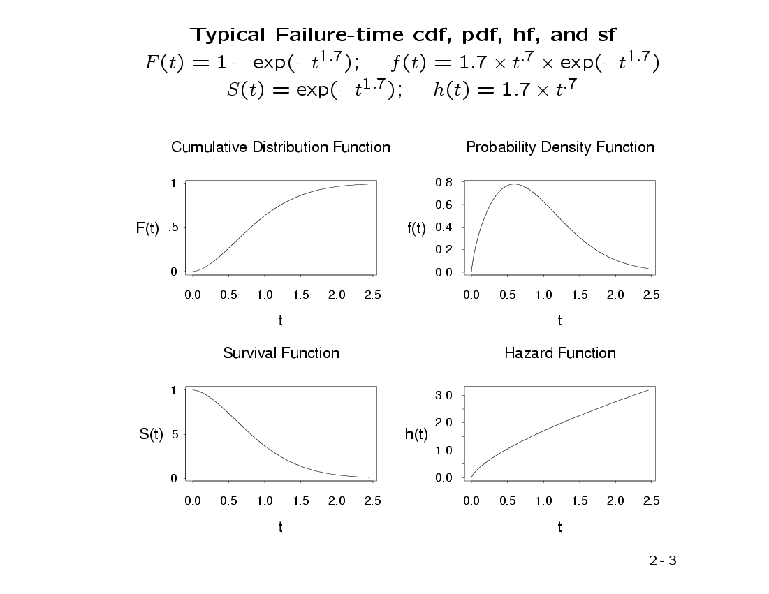
A possible set of probability density, failure, survival, and hazard functions.
f(t)=density function
F(t)=cumulative failure
S(t)=cumulative survival
h(t)=hazard function

Slide 14
Examples: common functions to describe survival
Exponential (hazard is constant over time, simplest!)
Weibull (hazard function is increasing or decreasing over time)

Slide 15
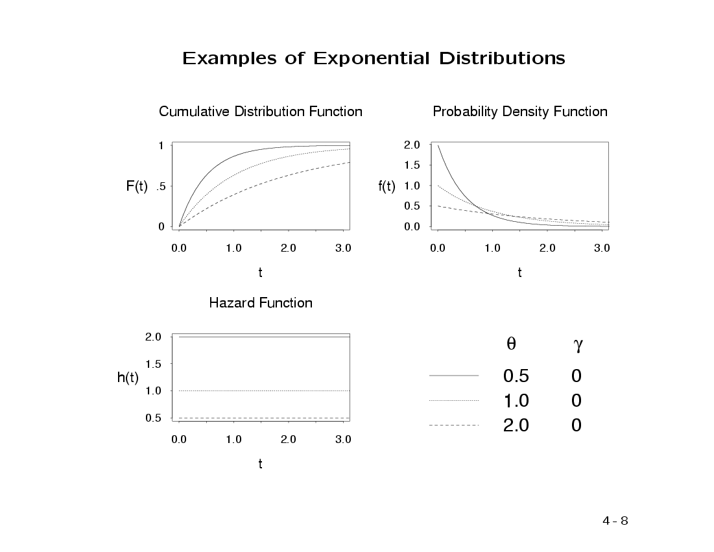
f(t), F(t), S(t), and h(t) for different exponential distributions:
λ

Slide 16
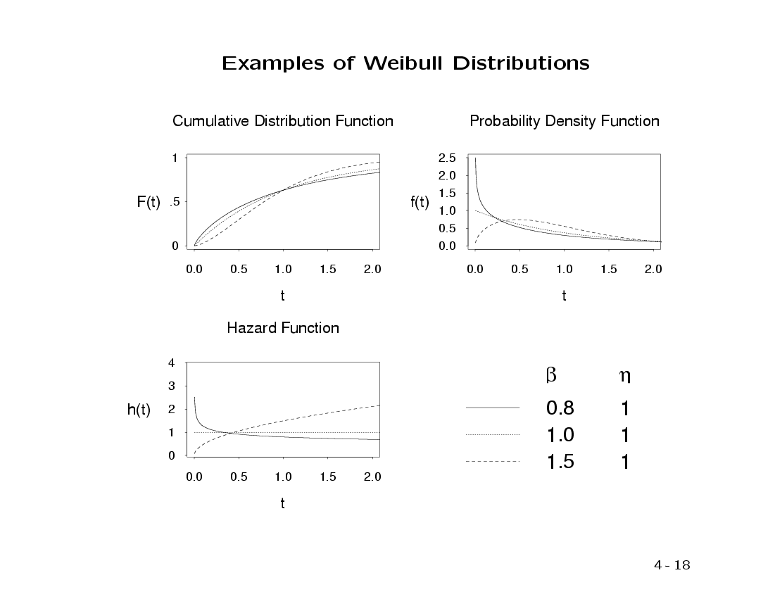
f(t), F(t), S(t), and h(t) for different Weibull distributions:
Parameters of the Weibull distribution

Slide 17
Exponential
Constant hazard function:
Exponential density function:
Survival function:

Slide 18
Relating these functions (a little calculus just for fun…):
Notes:
If you know one, you can derive all the others.
We saw special case of 2 and 3 with exponential waiting times.

Slide 19
Introduction to Kaplan-Meier
Non-parametric estimate of the survival function:
Simply, the empirical probability of surviving past certain times in the sample (taking into account censoring).

Slide 20
Introduction to Kaplan-Meier
Non-parametric estimate of the survival function.
Commonly used to describe survivorship of study population/s.
Commonly used to compare two study populations.
Intuitive graphical presentation.

Slide 21
Kaplan-Meier Estimate of Survival Function
Case with no censoring during the study (notes give rules when some individuals leave for other reasons during study)
Identify the observed failure times: t₍₁₎<···<t_{(k)}
Number of individuals at risk before t_{(i)} ≡ n_{i}
Number of individuals with failure time t_{(i)} ≡ d_{i}
Estimated hazard function at t_{(i)}:
Estimated Survival Function at time t
(when no censoring)

Slide 22
Survival Data (right-censored)
Subject A
Subject B
Subject C
Subject D
Subject E
X
1. subject E dies at 4 months
Beginning of study
End of study
→ Time in months →

Slide 23
Corresponding Kaplan-Meier Curve
100%
Probability of surviving to 4 months is 100% = 5/5
Fraction surviving this death = 4/5
Subject E dies at 4 months
→ Time in months →

Slide 24
Survival Data
Subject A
2. subject A drops out after 6 months
Subject B
Subject C
3. subject C dies at 7 months
X
Subject D
Subject E
X
1. subject E dies at 4 months
Beginning of study
End of study
→ Time in months →

Slide 25
Corresponding Kaplan-Meier Curve
100%
Fraction surviving this death = 2/3
subject C dies at 7 months
→ Time in months →

Slide 26
Survival Data
Subject A
2. subject A drops out after 6 months
Subject B
4. Subjects B and D survive for the whole year-long study period
Subject C
3. subject C dies at 7 months
X
Subject D
Subject E
X
1. subject E dies at 4 months
Beginning of study
End of study
→ Time in months →

Slide 27
Corresponding Kaplan-Meier Curve
100%
∴Product limit estimate of survival =
P(surviving interval 1/at-risk up to failure 1) *
P(surviving interval 2/at-risk up to failure 2)
= 4/5 * 2/3= .5333
Rule from probability theory:
P(A&B)=P(A)*P(B) if A and B independent
In survival analysis: intervals are defined by failures (2 intervals leading to failures here).
P(surviving intervals 1 and 2)=P(surviving interval 1)*P(surviving interval 2)
→ Time in months →

Slide 28
The product limit estimate
The probability of surviving in the entire year, taking into account censoring
= (4/5) (2/3) = 53%
NOTE: > 40% (2/5) because the one drop-out survived at least a portion of the year.
AND <60% (3/5) because we don’t know if the one drop-out would have survived until the end of the year.

Slide 29
Example 1: time-to-conception for subfertile women
“Failure” here is a good thing.
38 women (in 1982) were treated for infertility with laparoscopy and hydrotubation.
All women were followed for up to 2-years to describe time-to-conception.
The event is conception, and women "survived" until they conceived.

Slide 30
Raw data: Time (months) to conception or censoring in 38 sub-fertile women after laparoscopy and hydrotubation (1982 study)
Conceived (event)
Did not conceive (censored)
1
2
1
3
1
4
1
7
1
7
1
8
2
8
2
9
2
9
2
9
2
11
3
24
3
24
3
4
4
4
6
6
9
9
9
10
13
16
Data from: Luthra P, Bland JM, Stanton SL. Incidence of pregnancy after laparoscopy and hydrotubation. BMJ 1982; 284: 1013-1014

Slide 31
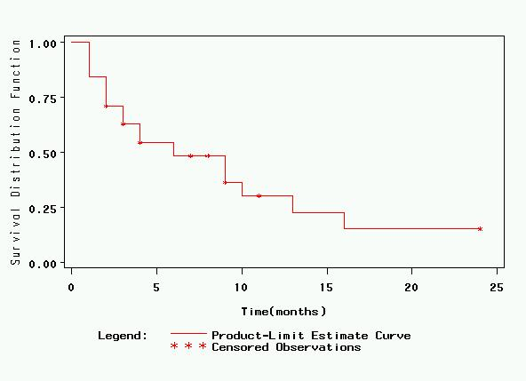
Corresponding Kaplan-Meier Curve
S(t) is estimated at 9 event times.
(step-wise function)

Slide 32
Raw data: Time (months) to conception or censoring in 38 sub-fertile women after laparoscopy and hydrotubation (1982 study)
Conceived (event)
Did not conceive (censored)
1
2
1
3
1
4
1
7
1
7
1
8
2
8
2
9
2
9
2
9
2
11
3
24
3
24
3
4
4
4
6
6
9
9
9
10
13
16
Data from: Luthra P, Bland JM, Stanton SL. Incidence of pregnancy after laparoscopy and hydrotubation. BMJ 1982; 284: 1013-1014

Slide 33
Raw data: Time (months) to conception or censoring in 38 sub-fertile women after laparoscopy and hydrotubation (1982 study)
Conceived (event)
Did not conceive (censored)
1
2
1
3
1
4
1
7
1
7
1
8
2
8
2
9
2
9
2
9
2
11
3
24
3
24
3
4
4
4
6
6
9
9
9
10
13
16
Data from: Luthra P, Bland JM, Stanton SL. Incidence of pregnancy after laparoscopy and hydrotubation. BMJ 1982; 284: 1013-1014

Slide 34
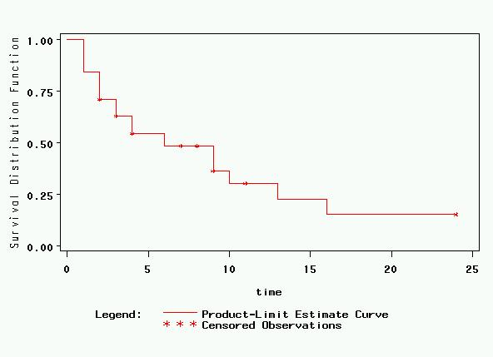
Corresponding Kaplan-Meier Curve
6 women conceived in 1st month (1st menstrual cycle). Therefore, 32/38 “survived” pregnancy-free past 1 month.

Slide 35
Corresponding Kaplan-Meier Curve
S(t=1) = 32/38 = 84.2%
S(t) represents estimated survival probability: P(T>t)
Here P(T>1).

Slide 36
Important detail of how the data were coded: Censoring at t=2 indicates survival PAST the 2nd cycle (i.e., we know the woman “survived” her 2nd cycle pregnancy-free). Thus, for calculating KM estimator at 2 months, this person should still be included in the risk set. Think of it as 2+ months, e.g., 2.1 months.
Raw data: Time (months) to conception or censoring in 38 sub-fertile women after laparoscopy and hydrotubation (1982 study)
Conceived (event)
Did not conceive (censored)
1
2.1
1
3
1
4
1
7
1
7
1
8
2
8
2
9
2
9
2
9
2
11
3
24
3
24
3
4
4
4
6
6
9
9
9
10
13
16
Data from: Luthra P, Bland JM, Stanton SL. Incidence of pregnancy after laparoscopy and hydrotubation. BMJ 1982; 284: 1013-1014

Slide 37
Corresponding Kaplan-Meier Curve

Slide 38
Corresponding Kaplan-Meier Curve
5 women conceive in 2nd month.
The risk set at event time 2 included 32 women.
Therefore, 27/32=84.4% “survived” event time 2 pregnancy-free.
S(t=2) = ( 84.2%)*(84.4%)=71.1%

Slide 39
Raw data: Time (months) to conception or censoring in 38 sub-fertile women after laparoscopy and hydrotubation (1982 study)
Conceived (event)
Did not conceive (censored)
1
2.1
1
3.1
1
4
1
7
1
7
1
8
2
8
2
9
2
9
2
9
2
11
3
24
3
24
3
4
4
4
Risk set at 3 months includes 26 women
6
6
9
9
9
10
13
16
Data from: Luthra P, Bland JM, Stanton SL. Incidence of pregnancy after laparoscopy and hydrotubation. BMJ 1982; 284: 1013-1014

Slide 40
Corresponding Kaplan-Meier Curve

Slide 41
Corresponding Kaplan-Meier Curve
3 women conceive in the 3rd month.
The risk set at event time 3 included 26 women.
23/26=88.5% “survived” event time 3 pregnancy-free.
S(t=3) = ( 84.2%)*(84.4%)*(88.5%)=62.8%

Slide 42
Raw data: Time (months) to conception or censoring in 38 sub-fertile women after laparoscopy and hydrotubation (1982 study)
Conceived (event)
Did not conceive (censored)
1
2
1
3.1
1
4
1
7
1
7
1
8
2
8
2
9
2
9
2
9
2
11
3
24
3
24
3
4
4
4
Risk set at 4 months includes 22 women
6
6
9
9
9
10
13
16
Data from: Luthra P, Bland JM, Stanton SL. Incidence of pregnancy after laparoscopy and hydrotubation. BMJ 1982; 284: 1013-1014

Slide 43
Corresponding Kaplan-Meier Curve

Slide 44
Corresponding Kaplan-Meier Curve
3 women conceive in the 4th month, and 1 was censored between months 3 and 4.
The risk set at event time 4 included 22 women.
19/22=86.4% “survived” event time 4 pregnancy-free.
S(t=4) = ( 84.2%)*(84.4%)*(88.5%)*(86.4%)=54.2%

Slide 45
Raw data: Time (months) to conception or censoring in 38 sub-fertile women after laparoscopy and hydrotubation (1982 study)
Conceived (event)
Did not conceive (censored)
1
2
1
3
1
4.1
1
7
1
7
1
8
2
8
2
9
2
9
2
9
2
11
3
24
3
24
3
4
4
4
Risk set at 6 months includes 18 women
6
6
9
9
9
10
13
16
Data from: Luthra P, Bland JM, Stanton SL. Incidence of pregnancy after laparoscopy and hydrotubation. BMJ 1982; 284: 1013-1014

Slide 46
Corresponding Kaplan-Meier Curve

Slide 47
Corresponding Kaplan-Meier Curve
2 women conceive in the 6th month of the study, and one was censored between months 4 and 6.
The risk set at event time 5 included 18 women.
16/18=88.8% “survived” event time 5 pregnancy-free.
S(t=6) = (54.2%)*(88.8%)=42.9%

Slide 48
Skipping ahead to the 9th and final event time (months=16)…
S(t=13) ≈ 22%
(“eyeball” approximation)

Slide 49
Raw data: Time (months) to conception or censoring in 38 sub-fertile women after laparoscopy and hydrotubation (1982 study)
Conceived (event)
Did not conceive (censored)
1
2
1
3
1
4
1
7
1
7
1
8
2
8
2
9
2
9
2
9
2
11
3
24
2 remaining at 16 months (9th event time)
3
24
3
4
4
4
6
6
9
9
9
10
13
16
Data from: Luthra P, Bland JM, Stanton SL. Incidence of pregnancy after laparoscopy and hydrotubation. BMJ 1982; 284: 1013-1014

Slide 50
Skipping ahead to the 9th and final event time (months=16)…
S(t=16) =( 22%)*(2/3)=15%
Tail here just represents that the final 2 women did not conceive (cannot make many inferences from the end of a KM curve)!

Slide 51
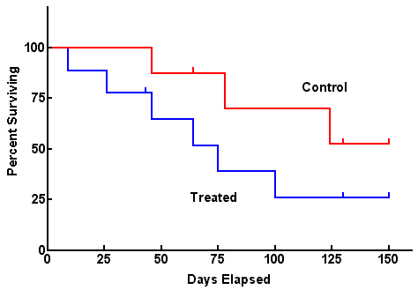
Comparing 2 groups
Use log-rank test to test the null hypothesis of no difference between survival functions of the two groups

Slide 52
Caveats
Survival estimates can be unreliable toward the end of a study when there are small numbers of subjects at risk of having an event.

Slide 53
Limitations of Kaplan-Meier
Mainly descriptive
Doesn’t control for covariates
Requires categorical predictors
Can’t accommodate predictor variables that change over time

Slide 54
Log-Rank Test to Compare 2 Survival Functions
Goal: Test whether two groups (treatments) differ wrt population survival functions. Notation:
t_{(i)} ≡ Time of the i^{th} failure time (across groups)
d_{1i} ≡ Number of failures for trt 1 at time t_{(i)}
d_{2i} ≡ Number of failures for trt 2 at time t_{(i)}
n_{1i} ≡ Number at risk prior for trt 1 prior to time t_{(i)}
n_{2i} ≡ Number at risk prior for trt 2 prior to time t_{(i)}
Computations:

Slide 55
Log-Rank Test to Compare 2 Survival Functions
H₀: Two Survival Functions are Identical
H_{A}: Two Survival Functions Differ
Some software packages conduct this identically as a chi-square test, with test statistic (T_{MH})² which is distributed c₁² under H₀

Slide 56
Introduction to Cox Regression
Semi-parametric
Cox models the effect of predictors and covariates on the hazard rate but leaves the baseline hazard rate unspecified.
Also called proportional hazards regression. Does NOT assume knowledge of absolute risk. Estimates relative rather than absolute risk.
Multivariate regression technique where time-to-event (taking into account censoring) is the dependent variable.
Estimates adjusted hazard ratios.
A hazard ratio is a ratio of rates (hazard rates)

Slide 57
History
“Regression Models and Life-Tables” by D.R. Cox, published in 1972, is one of the most frequently cited journal articles in statistics and medicine
Introduced “maximum partial likelihood”

Slide 58
Introduction to Cox Regression
Distinction between hazard/rate ratio and odds ratio/risk ratio:
Hazard ratio: ratio of rates
Odds/risk ratio: ratio of proportions
All are measures of relative risk!
By taking into account time, you are taking into account more information than just binary yes/no.
Gain power/precision.
Logistic regression aims to estimate the odds ratio; Cox regression aims to estimate the hazard ratio

Slide 59
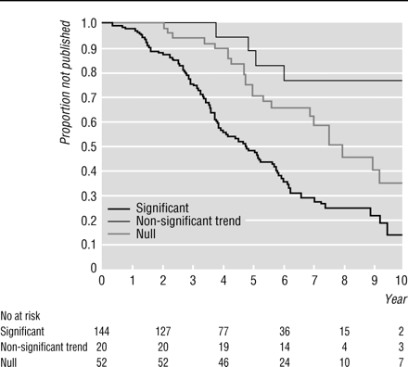
Example 1: Study of publication bias
By Kaplan-Meier methods
From: Publication bias: evidence of delayed publication in a cohort study of clinical research projects BMJ 1997;315:640-645 (13 September)

Slide 60
Univariate Cox regression
Table 4 Risk factors for time to publication using univariate Cox regression analysis
Characteristic
# not published
# published
Hazard ratio (95% CI)
Null
29
23
1.00
Non-significant trend
16
4
0.39 (0.13 to 1.12)
Significant
47
99
2.32 (1.47 to 3.66)
From: Publication bias: evidence of delayed publication in a cohort study of clinical research projects BMJ 1997;315:640-645 (13 September)
Interpretation: Significant results have a 2-fold higher incidence of publication compared to null results.

Slide 61
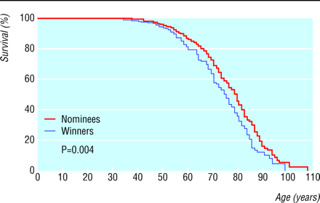
Example 2: Study of mortality in academy award winners for screenwriting
Kaplan-Meier methods
From: Longevity of screenwriters who win an academy award: longitudinal study BMJ 2001;323:1491-1496 ( 22-29 December )

Slide 62
Table 2. Death rates for screenwriters who have won an academy award.* Values are percentages (95% confidence intervals) and are adjusted for the factor indicated
Relative increase in death rate for winners
Basic analysis
37 (10 to 70)
HR=1.37; interpretation: 37% higher incidence of death for winners compared with nominees
Adjusted analysis
Demographic:
Year of birth
32 (6 to 64)
Sex
36 (10 to 69)
Documented education
39 (12 to 73)
All three factors
33 (7 to 65)
Professional:
Film genre
37 (10 to 70)
HR=1.35; interpretation: 35% higher incidence of death for winners compared with nominees even after adjusting for potential confounders
Total films
39 (12 to 73)
Total four star films
40 (13 to 75)
Total nominations
43 (14 to 79)
Age at first film
36 (9 to 68)
Age at first nomination
32 (6 to 64)
All six factors
40 (11 to 76)
All nine factors
35 (7 to 70)

Slide 63
Characteristics of Cox Regression
Can accommodate both discrete and continuous measures of event times
Easy to incorporate time-dependent covariates—covariates that may change in value over the course of the observation period

Slide 64
Characteristics of Cox Regression
Cox models the effect of covariates on the hazard rate but leaves the baseline hazard rate unspecified.
Does NOT assume knowledge of absolute risk.
Estimates relative rather than absolute risk.

Slide 65
Assumptions of Cox Regression
Proportional hazards assumption: the hazard for any individual is a fixed proportion of the hazard for any other individual
Multiplicative risk

Slide 66
The Hazard function
In words: the probability that if you survive to t, you will succumb to the event in the next instant.

Slide 67
The model: Cox regression
Components:
A baseline hazard function that is left unspecified but must be positive (=the hazard when all covariates are 0)
A linear function of a set of k fixed covariates that is exponentiated. (=the relative risk)
Can take on any form

Slide 68
The Model
The point is to compare the hazard rates of individuals who have different covariates. Hence, called Proportional hazards:
Hazard for person i (eg a smoker)
Hazard ratio
Hazard for person j (eg a non-smoker)
Hazard functions should be strictly parallel!
Produces covariate-adjusted hazard ratios!

Slide 69
The model: binary predictor
This is the hazard ratio for smoking adjusted for age.

Slide 70
The model: continuous predictor
This is the hazard ratio for a 10-year increase in age, adjusted for smoking.
Exponentiating a continuous predictor gives you the hazard ratio for a 1-unit increase in the predictor.

