Slide 1
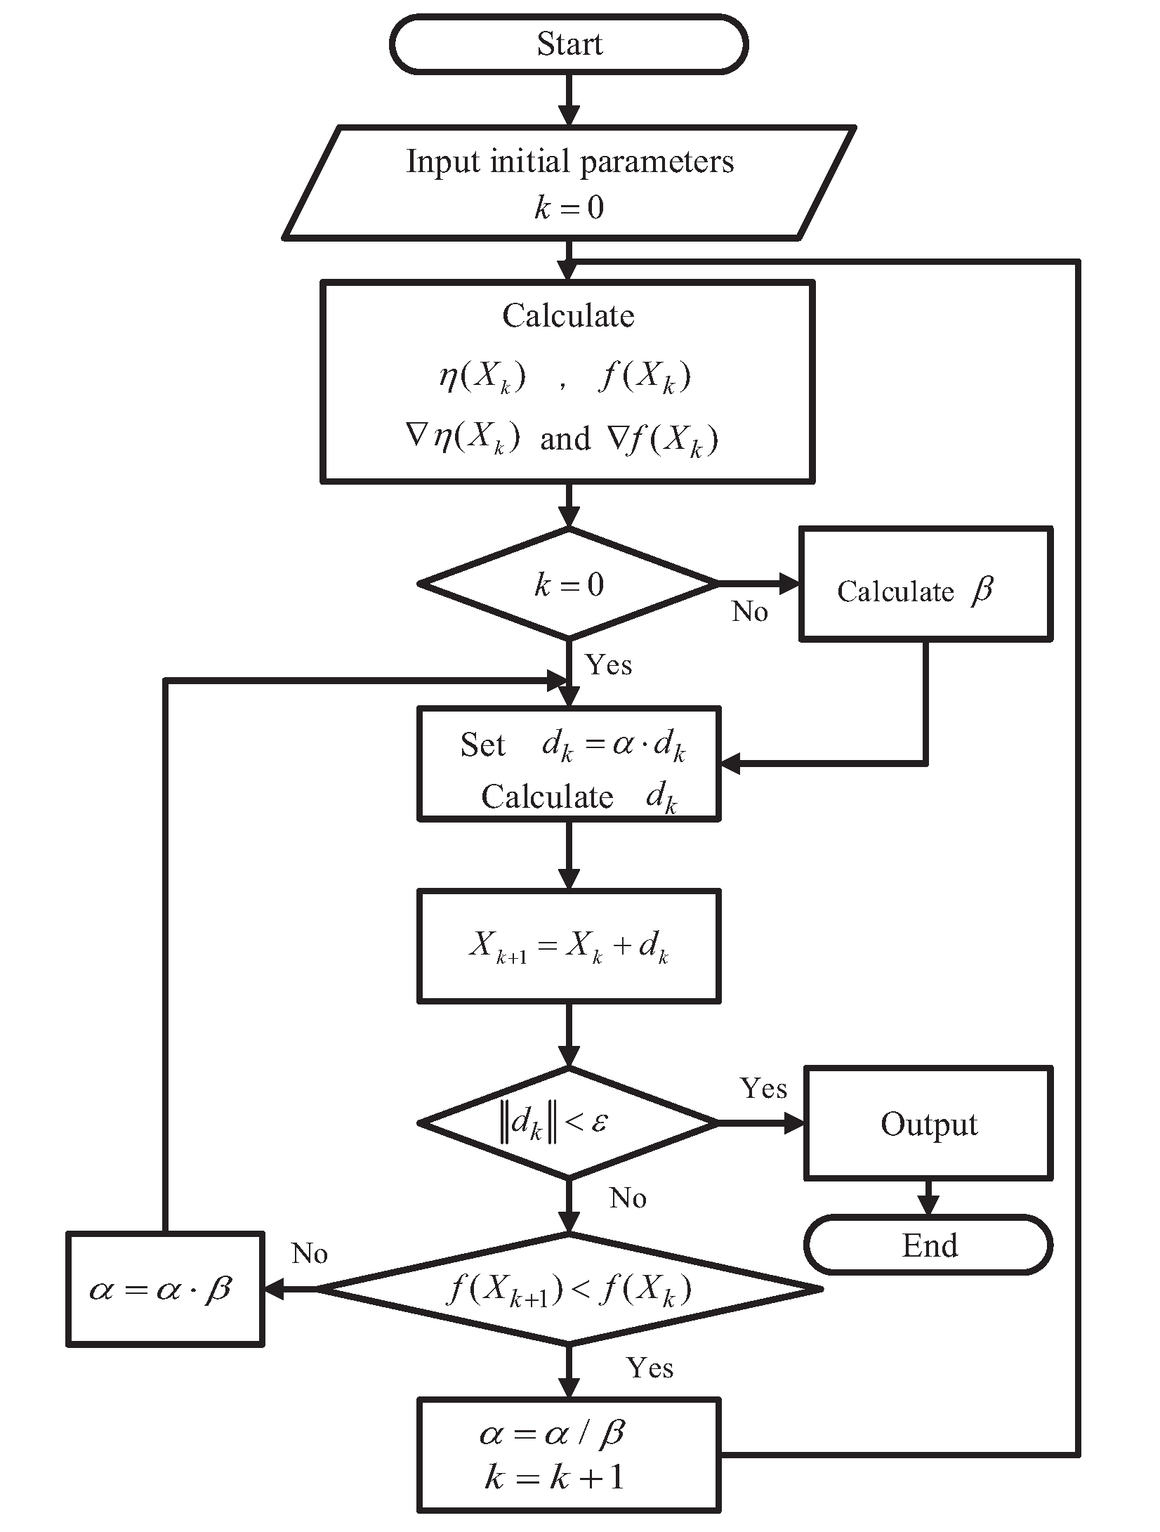
Form-finding of Tensegrity Structures Utilizing a Nonlinear Fletcher-Reeves Conjugate Gradient Method
Liming Zhao and Keping Liu and Zhongbo Sun
Department of Control Engineering, Changchun University of Technology, China
Chunxu Li and Long Jin
Center for Robotics and Neural Systems, University of Plymouth, UK
School of Information Science and Engineering, Lanzhou University, China
A conjugate gradient form-finding algorithm is developed for form-finding of tensegrity systems.
The form-finding problems are transformed into unconstrained optimization problems.
The initial conditions have been utilized to explore the configuration details.

