Slide 1
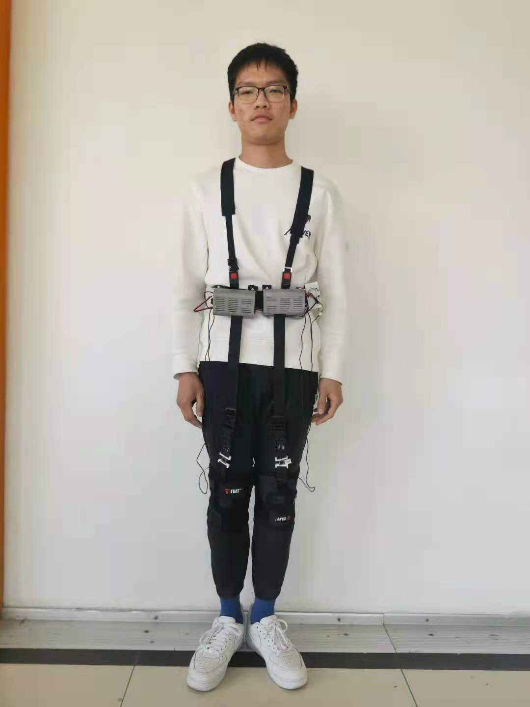
A Human-Computer Interaction Scheme of Lower-Limb Power-Assist Flexible Robot
Detian Zeng, Lei Sun, Xin Chen, Yunfei Li, Mu Zhu, Xinxiang Gong
Tianjin University of Technology
A human mechanical and electrical system.
Improving the walking state of the senior citizen.
Understanding the movement of the subjects according to the hip joint angle.
Playing an important role in rehabilitation training, maintaining and restoring the ability of the elderly.
A figure here
For figure caption (optional), use arial narrow 20pt font

