Slide 1
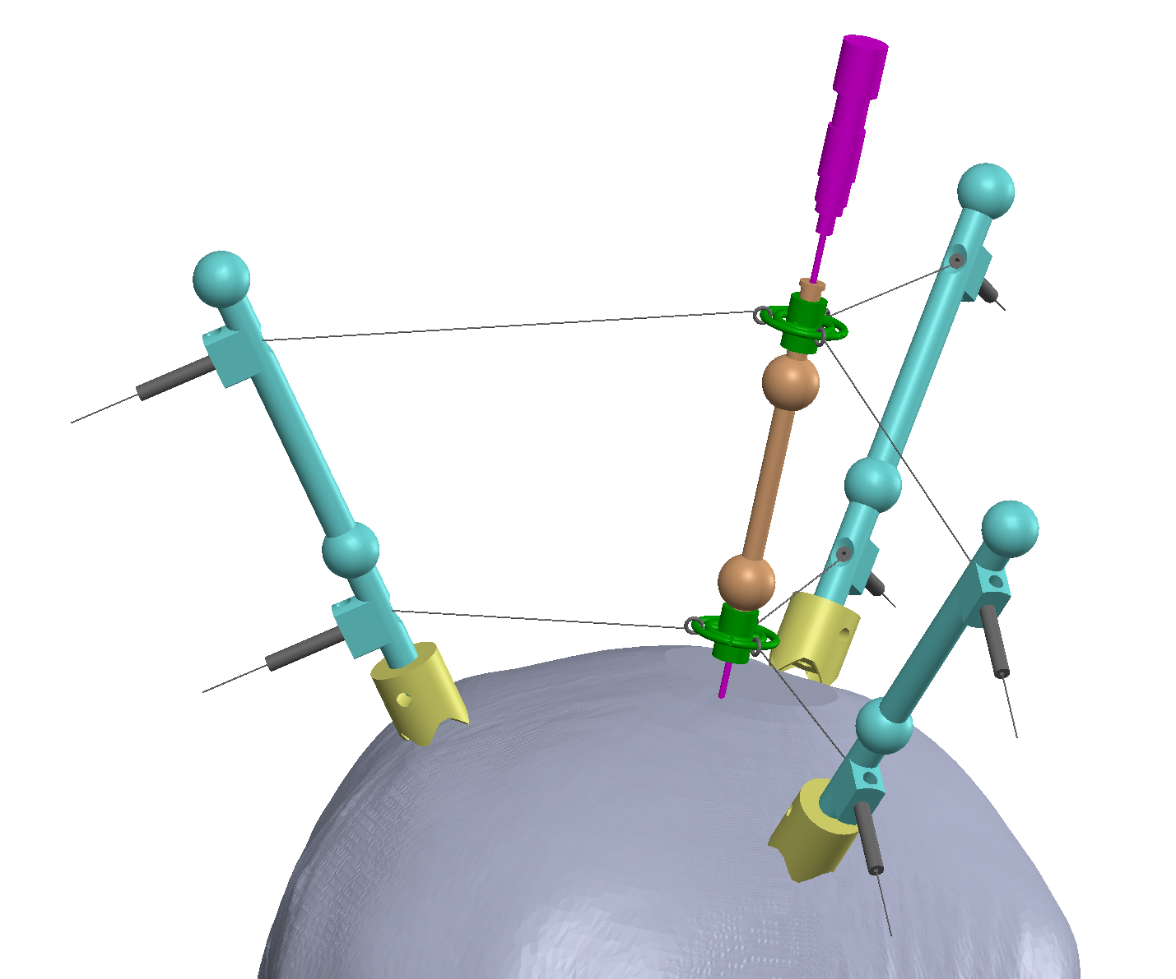
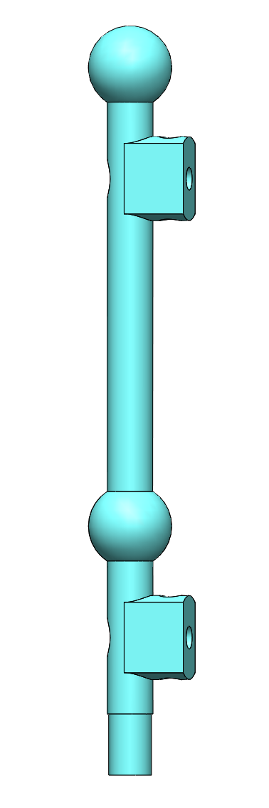
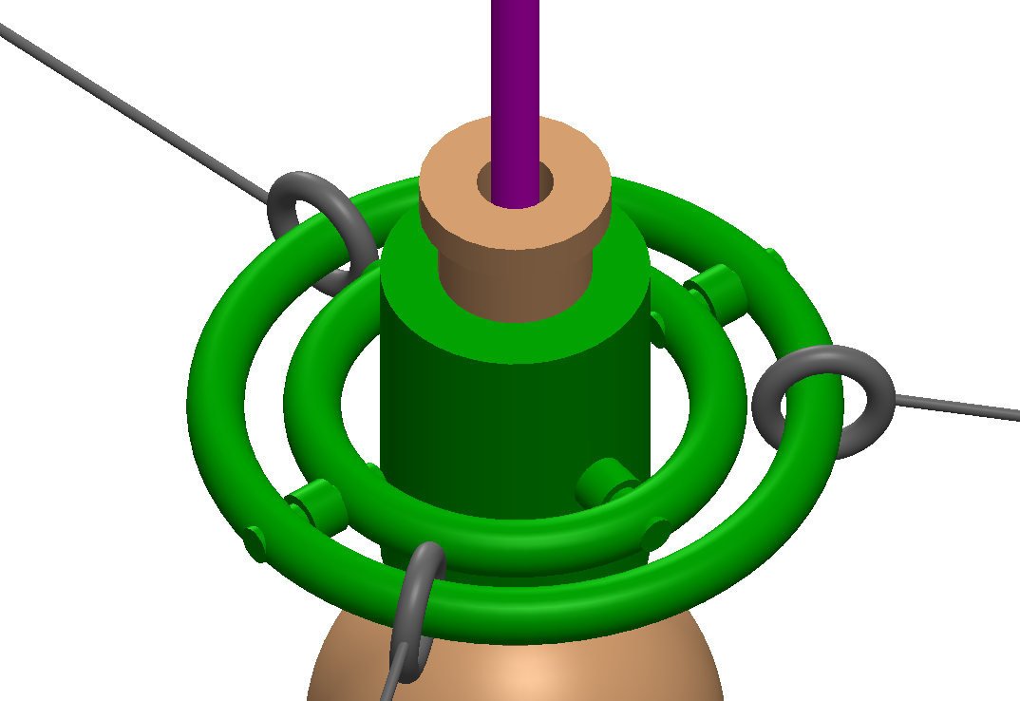
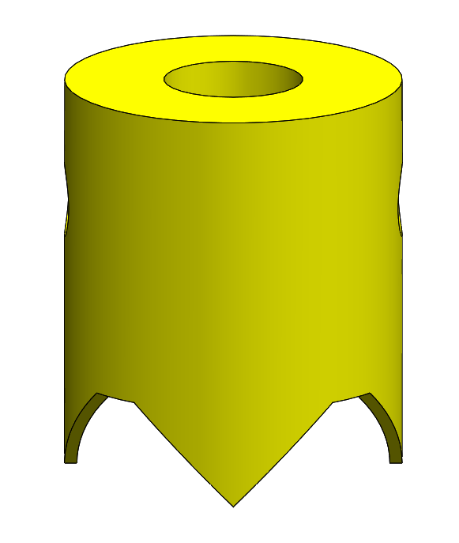
Reconfigurable Cable-Driven Parallel Robot with Adjustable Workspace Towards Positioning in Neurosurgery: A Preliminary Design
Changsheng Li, Jingchen Huang, Mengya Su, Diao Wu, Peng Xu, Yushan Xie, Fansheng Meng, Hao Wen, Huanyu Tian and Xingguang Duan
School of Mechatronical Engineering, Beijing Institute of Technology, China
A cable-driven parallel robot is proposed for positioning in neurosurgery.
The robot is reconfigurable and lightweight, which is suitable for being mounted on the skull
The workspace is adjustable according to the surgical requirements
Surgical
tool
Universal
joint
Guiding
tube
Positioning ball
Cable
Flexible tube
Support
foot
Rod

