Slide 1
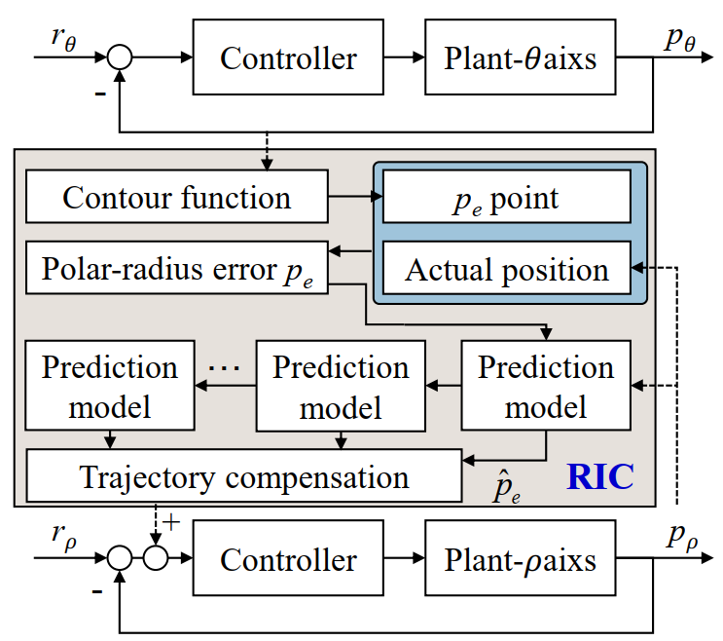
Precision RIC Contouring Control Method for Polar Coordinate Motion Systems
Ze Wang, Ran Zhou, Chuxiong Hu and Yu Zhu
Department of Mechanical Engineering, Tsinghua University, China
RIC contouring control method has been proposed for two-axis motion systems.
Contouring performance has been redefined by polar radius error to facilitate algorithm implementation.
Comparative experiments with different error definition and control modes have been carried out.
Block diagram of the proposed RIC scheme

