Slide 1
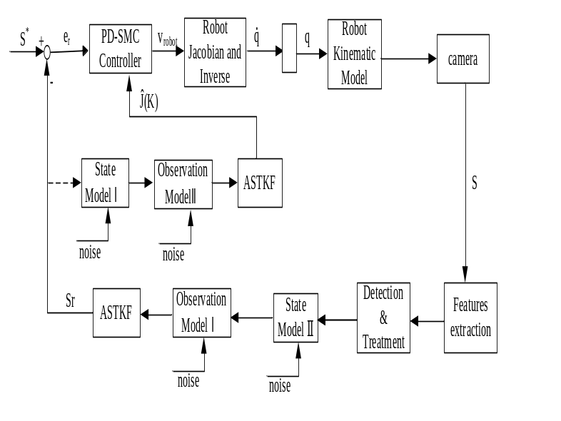
Uncalibrated Image-Based Visual Servoing Control based on Image Occlusion using Dual Adaptive Strong Tracking Kalman Filter
Xiaolin Ren and Hongwen Li
Changchun Institute of Optics,
Fine Mechanics and Physics, Chinese Academy of Sciences, China
The scenarios of image features being lost or occluded with image features
Dual adaptive strong tracking Kalman filter Scheme
Image occlusion analysis

