Slide 1
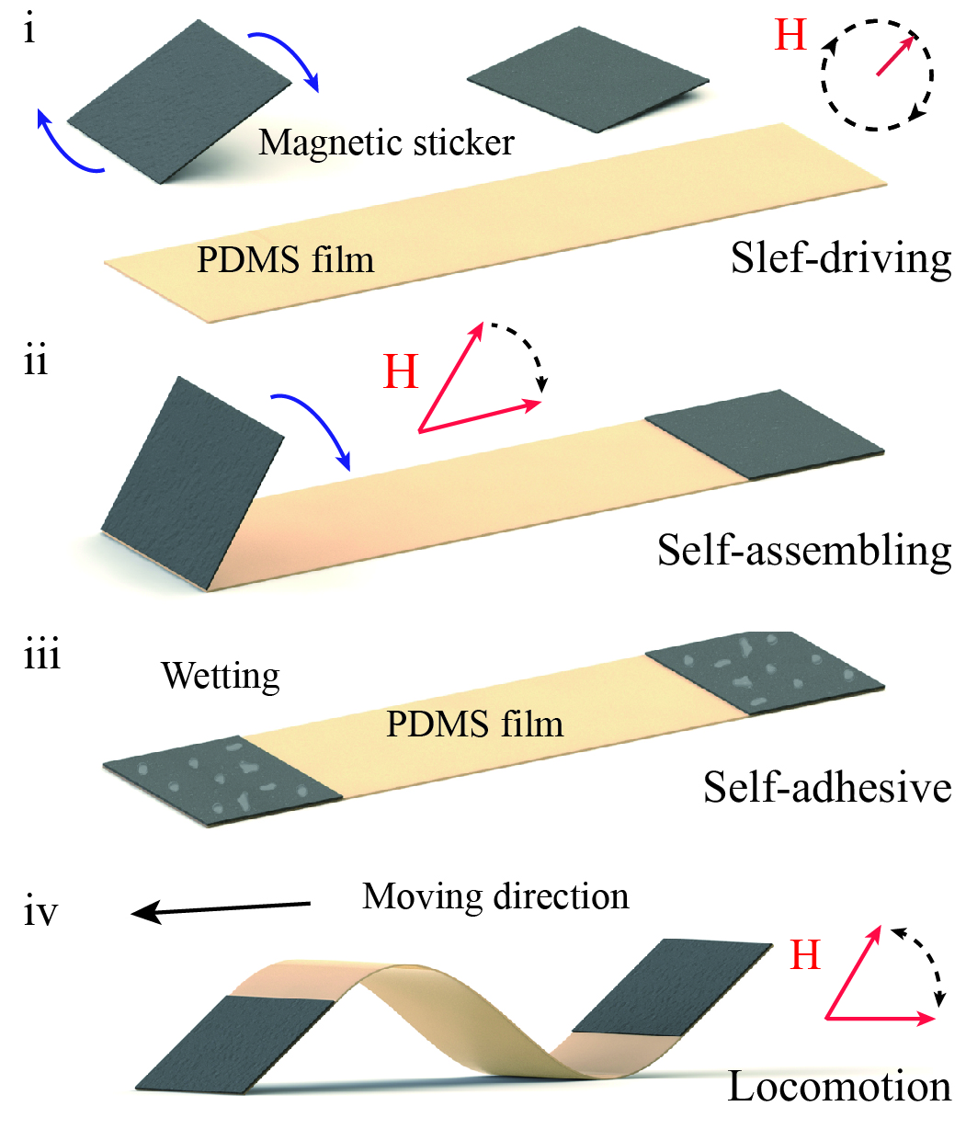
Magnetic sticker with water-triggered adhesiveness for object manipulation
Xiong Yang and Yajing Shen
Biomedical engineering, City University of Hong Kong, China
Magnetic sticker with directional magnetization and water-triggered adhesiveness.
Manipulate object, especially the targets with small size and flexible material.
The thin thickness makes it more suitable for the tasks in limited space.
They can also cooperate with other stickers to achieve a more complex and precise manipulation task.

