Slide 1
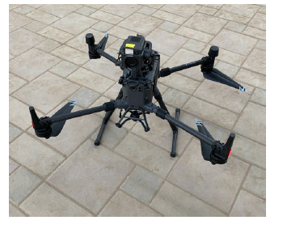
The Navigation and Control Study of UAV for Cross-domain Bridge Collaboration Detection
Yuchen Yan, Yizhai Zhang, Panfeng Huang
School of Astronautics, Northwestern Polytechnical University, China
Porposed a path planning method and UAV control method.
Designed the UAV control system to track and control the planned path.
Establish the kinematics and dynamics model of the UAV.
Design a four-channel PID controller to realize the trajectory and attitude control of the four-rotor UAV.

