Slide 1
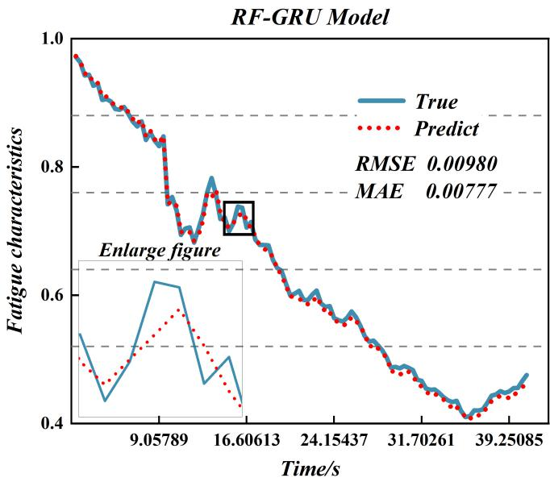
Prediction Method of Lower Limb Muscle Fatigue Based on Combining Random Forest and Gated Recurrent Unit Neural Network
Xin Shi, Shuyuan Xu, Pengjie Qin, Gaojie He, and Zhengli Leng
College of Automation, Chongqing University, China
Muscle fatigue reduces the stability of human-computer interaction
Random forest algorithm improves the lag phenomenon of GRU prediction
Compared with RNN、LSTM、GRU and BPNN, the algorithm has higher prediction accuracy and generalization
The prediction effect of the proposed algorithm

