Slide 1
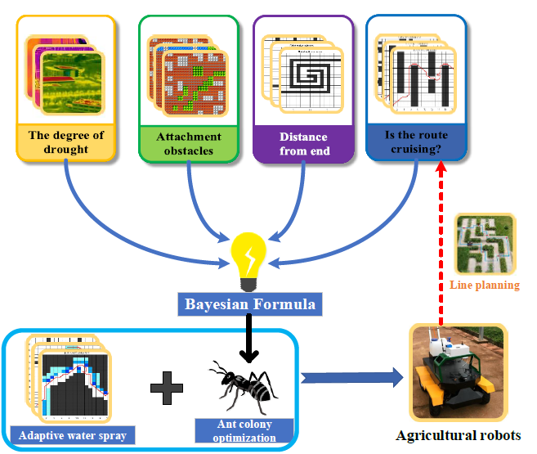
Design and Implementation of A Novel Internet of Things Irrigation System With A Precision Irrigation Robot
Minghan Chen, Yilong Sun, Boyi Liu, Bingjie Yan
The RobAI-Lab, Hainan university, China
Xiulai Li, Kai Lu, Tenglong Ren, Bin Ma, Yangyang Tian
Hainan Hairui Zhong Chuang Technol Co Ltd, China; Hainan Vocational College of Political Science and Law , China; The College of Intelligence and Computing, Tianjin University , China; State Grid Henan Electric Power Company Research Institute, China
This paper designs and implements the IoT irrigation system based on an intelligent path planning algorithm and designs and manufactures the agricultural irrigation robot combining the Internet of Things. The system transmits humidity information to the server through the soil humidity sensor, and performs path planning through an improved path planning algorithm.

