Slide 1
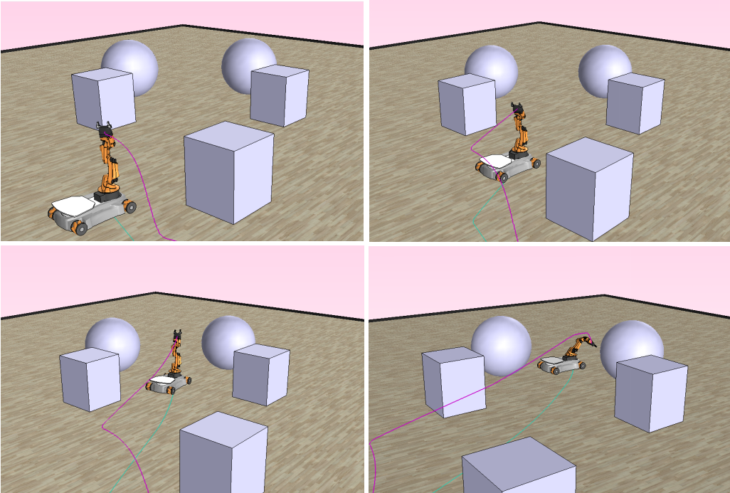
RRT-GoalBias and Path Smoothing Based Motion
Planning of Mobile Manipulators with Obstacle Avoidance
Jun Shao
School of Mechanical Engineering, Zhejiang University, China
Jianfeng Liao and Wei Song and Jason Gu and Shiqiang Zhu
Zhejiang Lab, China
Hao Xiong and Zheng Chen
Ocean College, Zhejiang University, China
The motion planning based on the RRT-GoalBias algorithm and path smoothing is proposed.
The kinematics model of mobile manipulator, constraints of configuration and obstacle avoidance are given.
The RRT-GoalBias algorithm is applied and modified to generate an initial path.
A novel post-processing algorithm is proposed to smooth and optimize the initial path.

