Slide 1
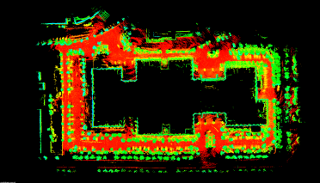
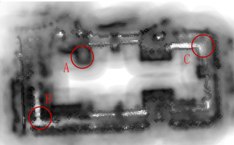
A Localizability Estimation Method for Mobile Robots Based on 3D Point Cloud Feature
Ying Liu and Jingchuan Wang
the Department of Automation, the Institute of Medical Robotics, Shanghai Jiao Tong University, China
Yi Huang
Kingyoung Intelligent Technology CO., LTD., Nanjing
Firstly, we propose a real-time point cloud clustering algorithm with multiple constraints based on depth map.
Localizability is set to be equal to the strength of the constraints associated with 3D point cloud.
Based on the method of using information matrix theory, this paper integrates the Fisher’s information matrix and point cloud features to estimate localizability.

