Slide 1
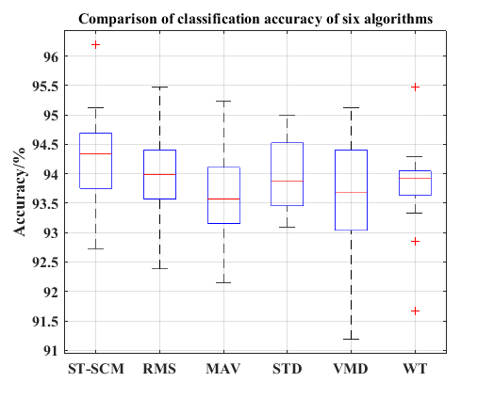
A new sEMG signal feature extraction method based on S transform
Xin Shi, Maqiang Zhai, Pengjie Qin, Keqi Yu, and Wenbo Zhou College of Automation, Chongqing University, China
sEMG signal can reflect the state of human movement.
The combination of SVD and concentration measurement can reduce the dimensionality of S transformation's result.
Compared with RMS、MAV、STD 、VMD and WT, the algorithm has higher prediction accuracy.
The prediction effect of the proposed algorithm (ST-SCM)

