Slide 1
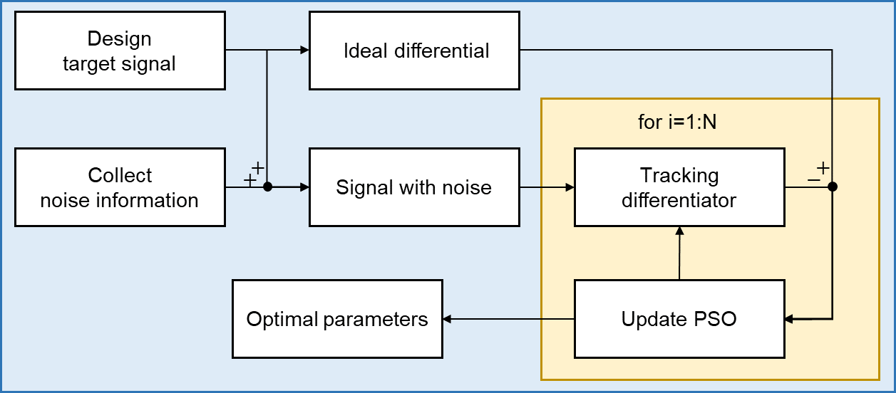
Design of Optimal Tracking Differentiator Based on Particle Swarm Optimization
Yang Gao and Dapeng Tian
Key Laboratory of Airborne Optical Imaging and Measurement, Changchun Institute of Optics, Fine Mechanics and Physics, CAS, China
University of Chinese Academy of Sciences, China
An optimal parameter design method for tracking differentiators.
It is proved that the function of filter and error is convex.
An off-line parameter design method based on PSO.
The workflow of the optimal tracking differentiator design based on PSO.

