Slide 1
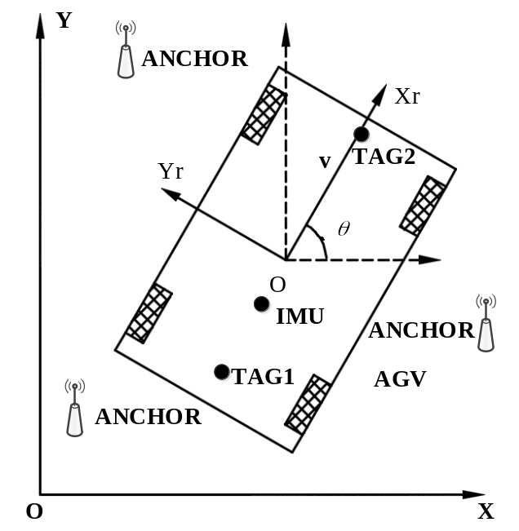
Research of AGV Positioning and Navigation System Based on UWB
Changsheng Ai , Lei Zheng , Dunyang Geng , Zhengguang Qi
School of Mechanical Engineering, University of Jinan, China
A navigation method combining UWB and inertial measurement unit (IMU) is proposed.
The time-based wireless positioning principle is
used to obtain the UWB positioning data.
The Kalman filter algorithm is used to fuse the
UWB measurement data and IMU calculation
data.
The experimental results show that the error of
UWB is less than 75mm in the static condition.

