Slide 1
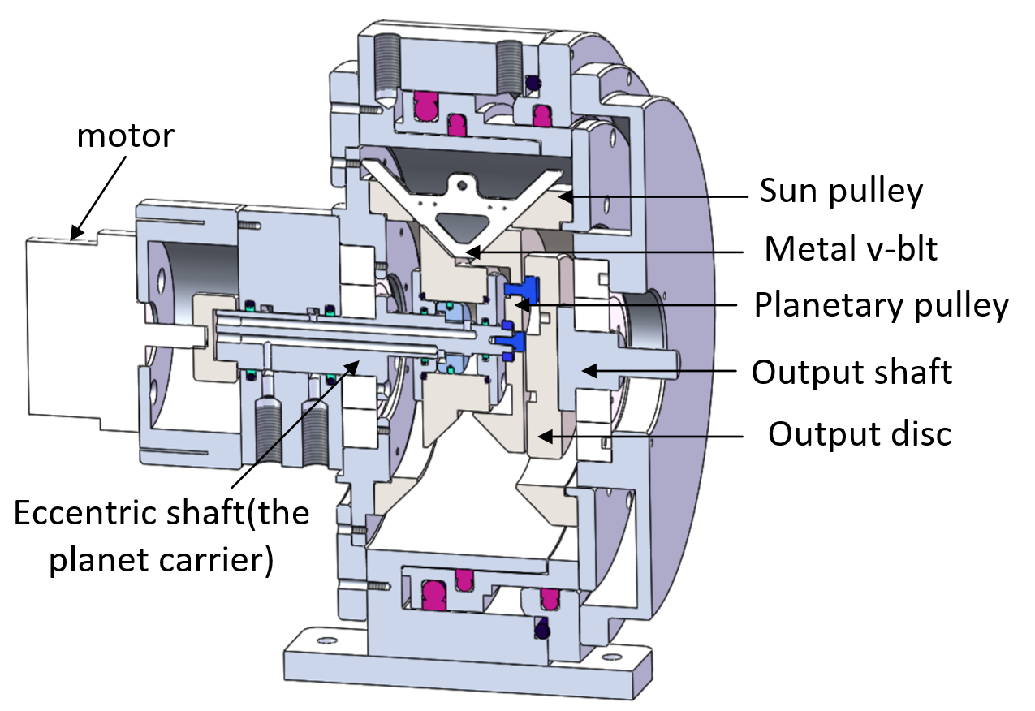
Design, Modeling and Estimation of an Innovative Continuously Transmission
Zhipeng Liu and Shouqi Chen
Department of Precision Machinery and Precision Instrumentation, University of Science and Technology of China, Hefei, China
Linsen Xu
Institute of Advanced Manufacturing Technology, Hefei Institutes of Physical Science, Chinese Academy of Sciences, Hefei, China
An innovative continuously variable transmission for robots.
This simple and effective structure can effectively reduce manufacturing costs and improve motor efficiency .
Continuous geometric model of the metal v-belt
and analyzes the kinematics and dynamics of a single metal segment.
The factors affecting the stability of the v-belt transmission ratio are analyzed .
3D model of the innovative CVT

