Slide 1
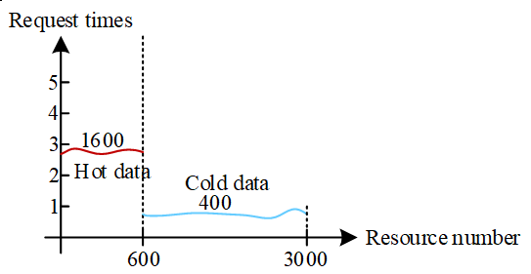
High-Speed Proxy Cache Management Strategy Based on Comprehensive Resident Value and Generation
Chunmei Huang, Min Xiang, Yuzhou Jiang and Zhong Xia
School of Automation, Chongqing University of Posts and Telecommunications, Chongqing
This paper proposes an efficient proxy cache management strategy named HPCMSCRVG.
The strategy based on generational garbage collection mechanism.
The strategy based on the 80/20 rule.
The strategy can significantly reduce backbone network traffic consumption and proxy cache response delay.
Client request distribution

