Slide 1
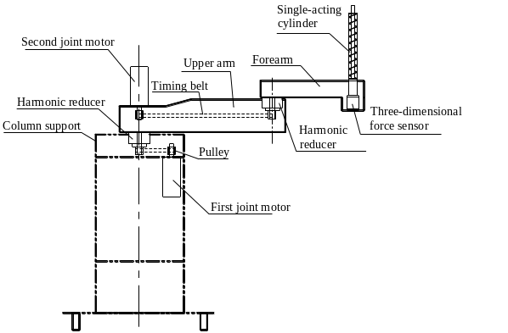
A new structure of end-effector traction upper limb rehabilitation robot
Liaoyuan Li Jianhai Han Xiangpan Li Bingjing Guo Pengpeng Xia
School of Mechanical and Electrical Engineering, HAUST, China
Ganqin Du
Department of Neurology ，First Affiliated Hospital of HAUST, China.
2 horizontal rotary joints and 1 vertical prismatic joint.
Realize rehabilitation training in three-dimensional space with compact structure.
Realize passive and active rehabilitation training.
With passive and active compliance and safety.
The overall structure diagram of the robot

