Slide 1
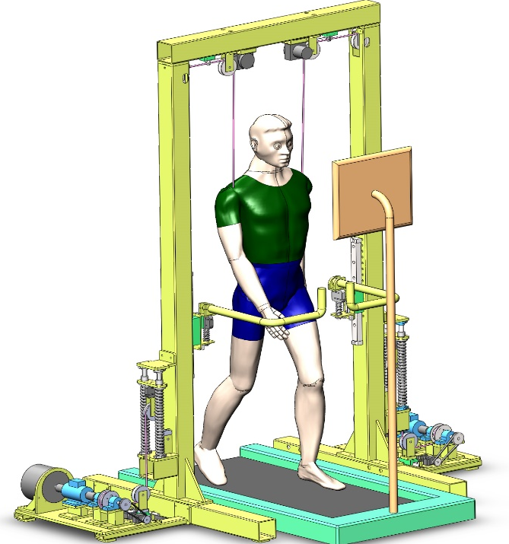
Design and Position Servo Control of an Active Body-Weight Support Training System
Chao Wei¹, Tao Qin¹*, Xin Meng¹, Jinxing Qiu¹, Qilong Meng¹ and Bo Li ^{1,2}
1.Mechanical Engineering, Hubei University of Arts and Sciences, China
2.Xiangyang Institute of Advanced Manufacturing Engineering , Huazhong University of Science and Technology, China
An active BWSTS with double-shoulder suspension based on cable-driven was designed for rehabilitation training
The mathematical model of the system drive unit was established by using mechanism analysis method
The position servo control strategy with disturbance feedforward compensation was proposed to improve the system loading accuracy
The system simulation model was built to prove the effectiveness of the position servo control strategy

