Slide 1
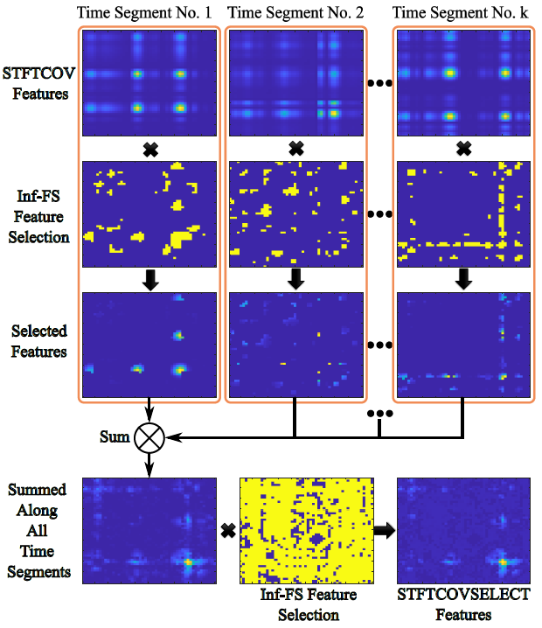
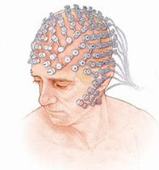
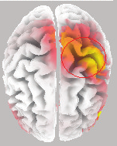
Short-Time Fourier Transform Covariance and Selection, A Feature Extraction Method for Binary Motor Imagery Classification
Yue Ma, Liangsheng Zheng, Zhengkun Yi, Yang Xiao, Can Wang, and Xinyu Wu
Shenzhen Institute of Advanced Technology, Chinese Academy
of Sciences, China.
A feature extraction method STFT covariance that integrates spatial-time-frequency domain information is proposed.
The novel feature selection method, the infinite feature selection, is introduced in the proposed method to improve the stability and effectiveness.
Good classification average accuracy and stability of 83.8%±14 are obtained in the BCI Competition IV DataSet IIb.
MI-Feature Extraction

