Slide 1
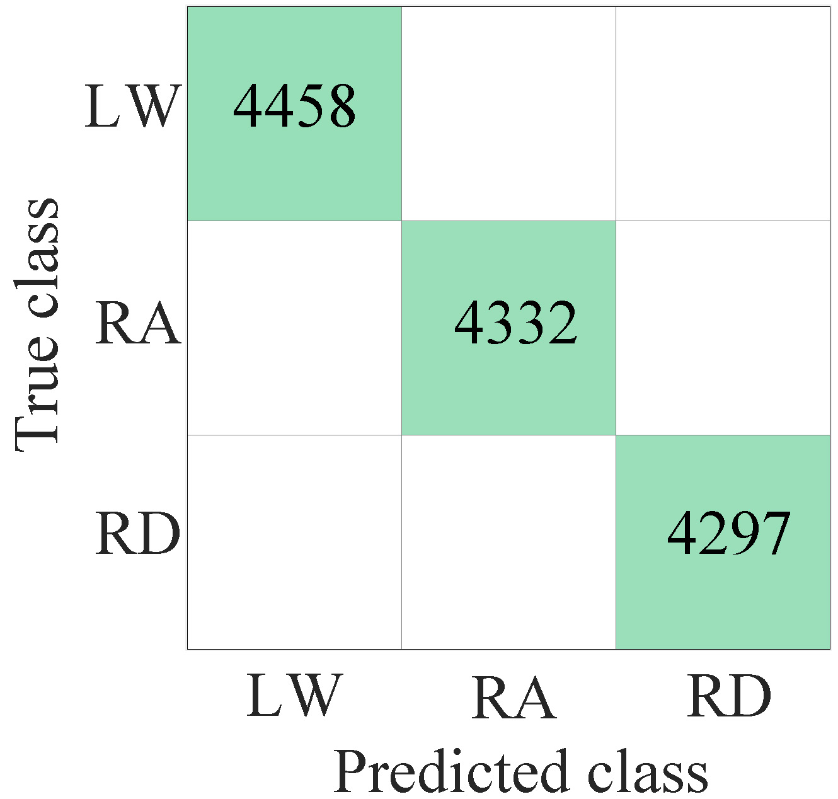
Recognition and Gait Cycle Prediction Using IMU
Zhuo Wang, Yu Zhang, Jiangpeng Ni,
Xinyu Wu, Yida Liu, Xin Ye and Chunjie Chen*
Shenzhen Institute of Advanced Technology, Chinese Academy of Sciences
Terrain recognition based on intersection angle only quickly recognizes the terrain when walking stably, and its robustness is limited.
Terrain recognition based on SVM is achieved to 100% after introducing the Gaussian kernel function.
Wiener one step prediction is applied in predicting the GC, the error from which is less than 4.35%.
Terrain recognition based on SVM

