Slide 1
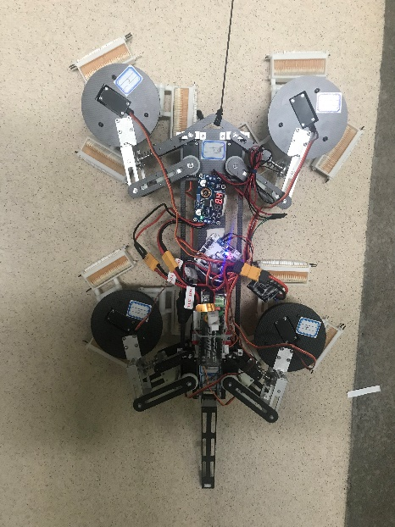
Design of a Quadruped Wall-Climbing Robot (WCR) with a Three-Row Opposed Gripping Mechanism
Shengchang Fang, Chao Xie, Xuan Wu, and Xiaojie Wang
Institute of Intelligent Machines, Hefei Institutes of Physical Science, Chinese Academy of Sciences, Hefei
A quadruped climbing robot with a three-row opposed gripping mechanism is designed.
The degree of freedom of the robot is demonstrated and adopting the trotting gait as the climbing mode.
The feasibility of the mechanical structure and gait scheme is verified.
The prototype of the robot is made and a preliminary experiment is carried out.
The robot can attach to the wall with four feet equipped with three-row opposed grippers

